Slide 1
State Ed Update

Slide 2
State Ed Update

Slide 3
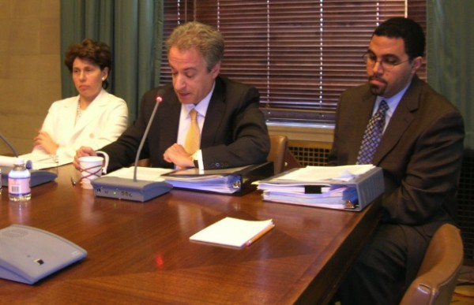
New Commissioner

Slide 4
APPR
Draft + Governor intervention = regulations approved
Changed from draft
Use of state assessment
2/3 of the other 60%
Timetable acceleration

Slide 5
APPR
Annual Evaluation
100 point scale
Highly Effective
Effective
Developing
Ineffective

Slide 6
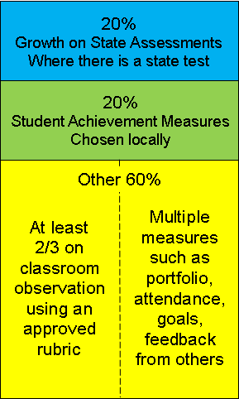
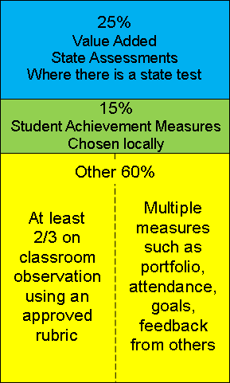
APPR: Teachers
When Value-Added is implemented

Slide 7
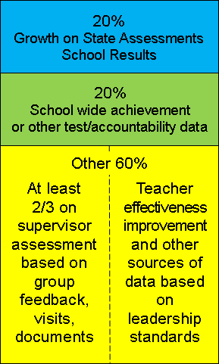
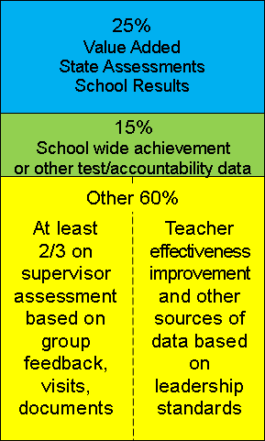
APPR: Principals
When Value-Added is implemented

Slide 8
APPR: Rating
 | Student Growth 20% | Achievement 20% | Other 60% | Composite
Ineffective | 0-2 | 0-2 | Ranges determined locally | 0-64
Developing | 3-11 | 3-11 |  | 65-74
Effective | 12-17 | 12-17 |  | 75-90
Highly Effective | 18-20 | 18-20 |  | 91-100

Slide 9
APPR: Training
Required training
Lead-evaluator certified to evaluate
All evaluators trained to observe and/or evaluate
Ongoing training and monitoring

Slide 10
APPR: Plan
Describe process
Describe tools
Describe reporting
Describe support
Describe training
Describe timing
Describe appeals
Posted to web by 9.1.11

Slide 11
APPR: When & Who
Phase-In
Math & ELA 4-8 2011-2012
Everyone else 2012-2013
Sooner if possible
Unless specifically addressed by a labor agreement signed prior to July 1, 2010

Slide 12
Graduation Requirements
More CTE Integration?
Revised Regents exam requirements?

Slide 13
Accountability
Graduation Rate reporting
% with Advance Designation
% with enhanced ELA/Math Assessment

Slide 14
Assessment
9-11 ELA and math in RFP
Is there enough money?
6-8 Science with RTTT $
Can’t score own students
Regents going to scaled score and 1,2,3,4
No more: LOTE, January

Slide 15
DASA
Dignity for All Students Act
July 1, 2012
Tack Force formed and meeting
Regulations will come

Slide 16
ASCD Collection:
2010 Supplement
… and the ISTE collection!

