Slide 1
Teacher and Principal Evaluation
The Next Chapter of Annual Professional Performance Review (APPR)
as described in the April 15th Draft Regulations

Slide 2
Teachers

Slide 3
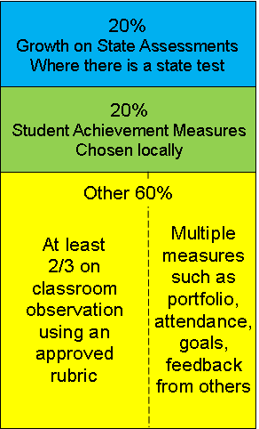
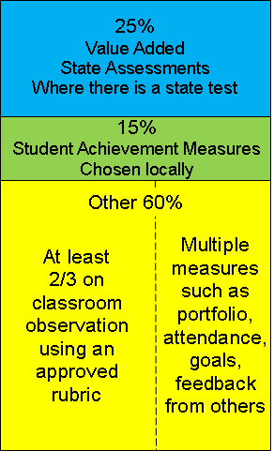
Classroom teachers
When Value-Added is implemented

Slide 4
Growth on State Assessments
ELA/Math 4-8
2011-2012 and Beyond
Student Growth (eventually to include subgroups)
1 Teacher of record (for now)

Slide 5
Growth on State Assessments
Other Teachers
2012-2013 and Beyond
Sooner if possible
As assessments become available
K-3 Progress Monitoring

Slide 6
Growth on State Assessments
If No State Test(s)?
State approved 3rd party assessments
Rigorous (verified?)District or BOCES-developed
Agreed to in goal setting

Slide 7
Student Achievement Measures
Locally Selected
Same across all classrooms
State assessments can be used
Choose from approved 3rd party assessments

Slide 8
Student Achievement Measures
Locally Selected
Same across all classrooms
Rigorous (verified?)District or BOCES-developed
Can be group measures
Agreed to in goal setting

Slide 9
The Other 60 Points
Required
Multiple measures
≥ 2/3 based on observation (menu of approved tools)
Principal or trained other
All standards every year

Slide 10
The Other 60 Points
Optional
Structure review of teacher artifacts and/or portfolio
Feedback from others using survey tools
Goals and reflection (≤5pts)

Slide 11
Scoring and Rating
 | Student Growth 20% | Achievement 20% | Other 60% | Composite
Ineffective | 0-2 | 0-2 | Ranges determined locally | 0-64
Developing | 3-11 | 3-11 |  | 65-74
Effective | 12-17 | 12-17 |  | 75-90
Highly Effective | 18-20 | 18-20 |  | 91-100

Slide 12
Principals

Slide 13
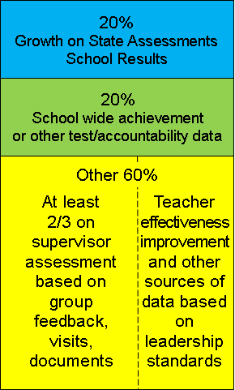
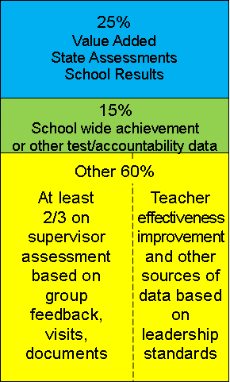
Principals
When Value-Added is implemented

Slide 14
Growth on State Assessments
Elem/Middle
Result of student growth
Added to as measures become available
Other measures being used for teachers in the school

Slide 15
Growth on State Assessments
High School
Result of student growth
Added to as available
Progress to graduation
Other measures being used for teachers in the school

Slide 16
Student Achievement Measures
Elem/Middle
District-wide achievement measures
Achievement on state tests
Growth or achievement for subgroups

Slide 17
Student Achievement Measures
High School
Regents participation rates
College ready rates
Graduation rates
Credit accumulation
Dropout rates
PSAT, SAT, AP, IB, etc.

Slide 18
The Other 60 Points
Required
Multiple measures
≥ 2/3 based on broad assessment of actions
Include at least two:
Feedback from constituencies
School visits
Review of documents

Slide 19
The Other 60 Points
Required
Locally-selected measure of teacher effectiveness contribution, such as:
High performer retention
Granted v. denied tenure
Teacher satisfaction w/ feedback
Evaluation quality

Slide 20
The Other 60 Points
Required
All standards at least once per year

Slide 21
The Other 60 Points
Optional
Teacher and/or student attendance
School goals
Goals and reflection (≤5pts)

Slide 22
Scoring and Rating
 | Student Growth 20% | Achievement 20% | Other 60% | Composite
Ineffective | 0-2 | 0-2 | Ranges determined locally | 0-64
Developing | 3-11 | 3-11 |  | 65-74
Effective | 12-17 | 12-17 |  | 75-90
Highly Effective | 18-20 | 18-20 |  | 91-100

Slide 23
Improvement Plans

Slide 24
Improvement Plans
Developing or ineffective (teachers and principals)
Developed through negotiations
Within 10 days after report date for new school year

Slide 25
Appeals Process

Slide 26
Appeals Process
Challenge the “substance” of the review
Challenge adherence to standards and methodologies
Challenge adherence to regulations and negotiated procedures

Slide 27
The APPR Plan Requirements

Slide 28
Plan Requirements
Process for data linkage and verification
Process for data (subscores and scores)submission
Assessment security measures

Slide 29
Plan Requirements
Local achievement measures and scoring methodology
Teacher 60% rubric
Principal 60% rubric

Slide 30
Plan Requirements
How APPR process will be used for PD for teachers and principals
How principals and teachers will receive timely feedback

Slide 31
Plan Requirements
Improvement Plan process
Evaluator training process
Evaluator reliability over time (recertification)
Appeals process

Slide 32
Help with Your Plan
Template to be developed
Archived at site

Slide 33
When and Who?

Slide 34
When and Who?
Phase-In
Math and ELA 4-8 2011-2012
Everyone else 2012-2013
Everyone else sooner if possible
Unless specifically addressed by a labor agreement signed prior to July 1, 2010

Slide 35
From §3012-c
Nothing in this section shall be construed to abrogate any conflicting provisions of any collective bargaining agreement in effect on July 1, 2010 during the term of such agreement and until the entry into a successor collective bargaining agreement, provided that notwithstanding any other provision of law to the contrary, upon expiration of such term and the entry into a successor collective bargaining agreement the provisions of this section shall apply. However, this section further provides that "nothing in this section or in any rule or regulation promulgated hereunder shall in any way, alter, impair or diminish the rights of a local collective bargaining representative to negotiate evaluation procedures in accordance with article 14 of the Civil Service Law with the school district or board of cooperative educational services".

Slide 36
From §3012-c
The New York State Court of Appeals has held that “[w]here [a collective bargaining agreement] is silent respecting the matter in dispute, unilateral action by a public employer changing terms and conditions of employment violates the statutory duty to bargain and constitutes an improper practice” (Roma, et al. v. Ruffo, et al., 92 NY2d 489 [1998]). At that point, the district and the union have a duty to bargain these issues. However, to the extent that the collective bargaining agreement is silent on issues that are not considered terms and conditions or employment or evaluation procedures (i.e., evaluation criteria or the standards of evaluation) in Education Law §3012-c, it appears the district is obligated to comply with those portions. You should consult with your school attorney to determine what aspects of the new law your district must comply with in light of the Taylor Law.

