Slide 1
Social Emotional Learning
“You First” Approach
OCM BOCES Special Education Directors Roundtable
10/10/19

Slide 2
Welcoming Activity
Greeting Frenzy
Time: 2 minutes
Goal: Greet as many people in the room as possible
Process: Introduce yourself, greet everyone in the room by name and make some sort or brief physical contact such as a handshake, high five, fist or elbow bump.
Notes:
You have 2 minutes, and within that time your job is to introduce yourself, greet everybody in the room, by name, and make some brief physical contact. It could be a handshake, high five, fist or elbow bump; there may even be some huggers in the room...” (Groups of 12 or less, one minute; larger groups, two minutes; huge groups, three minutes: “…greet as many people in the room as possible…”) Set the timer and use an agreed-upon attention signal to bring the room to full quiet before

Slide 3
Adult SEL CASEL Website and Resources
https://schoolguide.casel.org/focus-area-2/overview/

Slide 4
What is Social Emotional Learning
Notes:
Common understanding
View video and ask participants to share with an elbow partner what stood out to them.

Slide 5
What is Social Emotional Learning
Social and emotional learning (SEL) is the process through which children and adults understand and manage emotions, set and achieve positive goals, feel and show empathy for others, establish and maintain positive relationships, and make responsible decisions.
https://casel.org/what-is-sel/
Notes:
Read slide stress the importance of both student and adult

Slide 6
NYSED Goals
1. Develop self-awareness and self-management skills essential to success in school and in life.
2. Use social awareness and interpersonal skills to establish and maintain positive relationships.
3. Demonstrate ethical decision-making skills and responsible behaviors in personal, school, and community contexts.

Slide 7
Why SEL?Activity Materials
What do the Statistics say?
Count off by groups of 6
Find your corresponding group number
As a group share your individual statistics and then develop a summary based on all of the information you heard
Share your summary with the large group

Slide 8
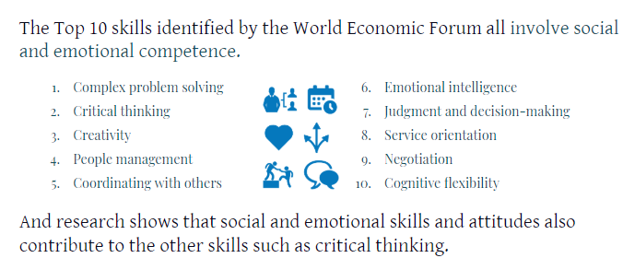
Why SEL? College & Career Readiness
92%
Of surveyed executives say skills such as problem-solving and communicating clearly are equally or more important than technical skills
Source: Future of Jobs Report, World Economic Forum

Slide 9
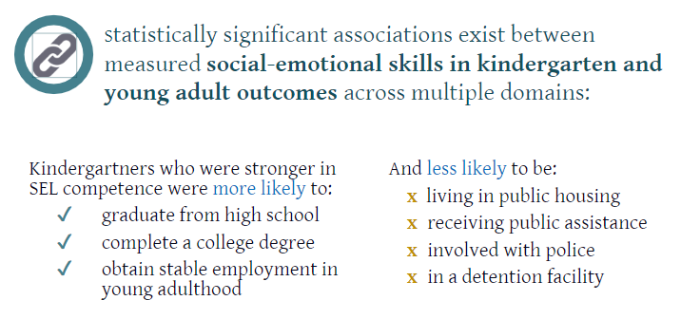
Why SEL? College & Career Readiness
Source: Damon E. Jones, Mark Greenberg, and Max Crowley. Early Social-Emotional Functioning and Public Health: The Relationship Between Kindergarten Social Competence and Future Wellness. American Journal of Public Health: November 2015, Vol. 105, No. 11, pp. 2283-2290.

Slide 10
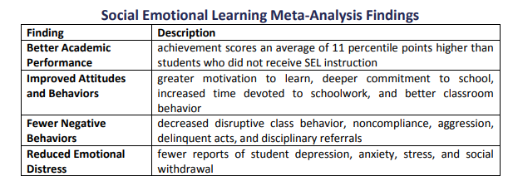
Why SEL? Achievement & Behavior
Notes:
This slide shows the longitudinal impact of SEL programming. This 2017 meta-analysis included the 82 studies that showed longitudinal effects, and the results show that the gains are LASTING. SEL programming isn’t just a shot in the arm that benefits in the short term. There are long lasting benefits that go beyond school outcomes.

Slide 11
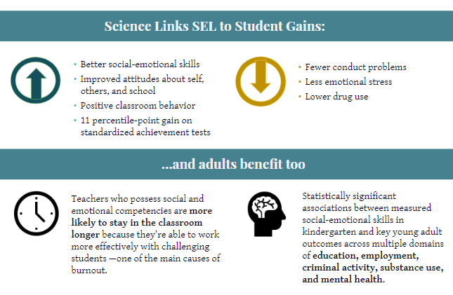
Why SEL?

Slide 12
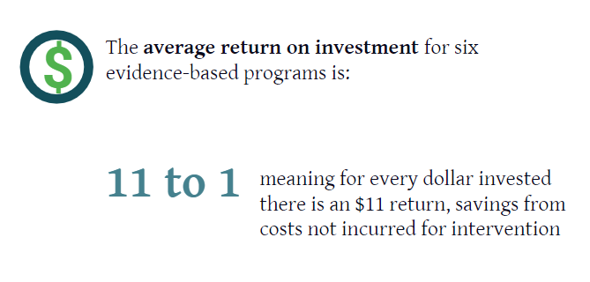
Why SEL? Financial
Source: Belfield, C., Bowden, B., Klapp, A., Levin, H., Shand, R., & Zander, S. (2015). The Economic Value of Social and Emotional Learning. New York: Center for Benefit-Cost Studies in Education.

Slide 13
Why SEL?
The overwhelming majority of administrators (96%), teachers (93%) and parents (81%) believe that social and emotional learning is just as important as academic learning.
Source: 2018 Social and Emotional Learning report, 2018

Slide 14
Why Adult SEL?
Successful SEL implementation depends on how well staff work together to facilitate SEL instruction, foster a positive school community, and model social and emotional competence. This calls on schools to focus on adults’ professional growth as educators as well as their own social and emotional learning (Jones et al., 2018).
Your school’s implementation plan will likely call on many adults—from teachers to lunchroom staff to out-of-school time partners—to take an active role in promoting social and emotional learning. You may find that staff need to engage with new programming or curricula, take on different responsibilities, or fine-tune their professional practices to serve the goals of your plan. At the same time, teaching is one of the most stressful occupations in the U.S. (Gallup, 2014). Stress affects teachers’ health and well-being, job satisfaction, job turnover, and student outcomes (Greenberg et al., 2016).
Notes:
For these reasons, it’s critically important that schoolwide SEL implementation intentionally nurtures a work environment in which staff feel supported, empowered, able to collaborate effectively and build relational trust, and also able to develop their social and emotional skills.

Slide 15
Why Reflect on our own SEL Competencies?
If we don’t take stock in our own competencies, we aren’t going to be able to teach them to kids….
We also aren’t going to be able to model for kids how to build upon and develop those competencies….

Slide 16
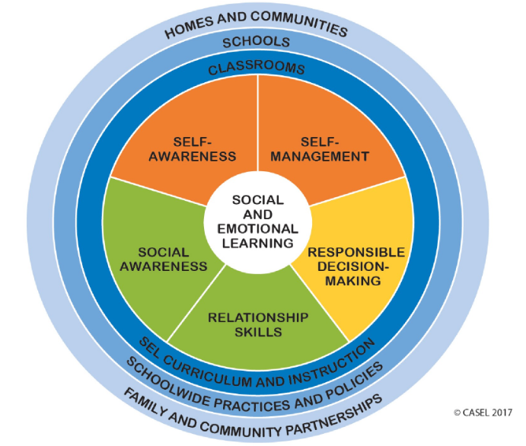

Slide 17
Self-Awareness

Slide 18
Self-Awareness
Encompasses
Identifying emotions
Accurate self-perception
Recognizing strengths
Self-confidence
Self-efficacy
Reflection: Take a moment to reflect
*Individually identify one area in which you may want to build upon.

Slide 19
Self-Awareness Activity Activity Materials
Identifying our Strengths and Acknowledging them
Choose statements you’d like to respond to:
This is what I want my family and friends to remember me
I want my coworker to say this about me
I am most confident about
This makes me wonderfully unique
This is my greatest strength
I am most proud of (Can’t say kids)
Take four sticky notes
Write your responses and post them on the corresponding poster around the room

Slide 20
Self-Awareness Application
At your tables,
Identify all of the ways in this building that we help each other build this competency.
Identify all of the ways that you wish we helped each other build this competency.
Identify one thing you personally commit to doing to help build this competency among staff
Notes:
Option 1-Table discussion
Option 2-Have table groups make a T-chart. On the left side ask them to answer the 1st prompt. On the right side ask them to answer the 2nd. One they have finished ask the table group to post their chart. When all charts are posted ask the group to do a gallery walk. When they return to their seats ask them to reflect on one thing they are each going to personally commit to to help build this competency among staff.

Slide 21
Self-Management

Slide 22
Self-Management
Encompasses:
Impulse control
Stress management
Self-discipline
Self-motivation
Goal-setting
Organizational skills
Reflection: Take a moment to reflect
*Individually identify one area in which you may want to build upon.

Slide 23
Self-Management Common Mistakes
1. Not using “to-do” lists.
2. Multitasking
3. Not taking breaks
4. Thriving on “busy”
5. Saying “yes” much more often than no
6. Failing to manage distractions
7. Not setting personal goals
8. Not prioritizing
9. Forgetting your “why”
10. Neglecting self-care
Notes:
Read through this list. Can anyone relate with 1 to 3 of these items? 4 to 6? More than 6?!

Slide 24
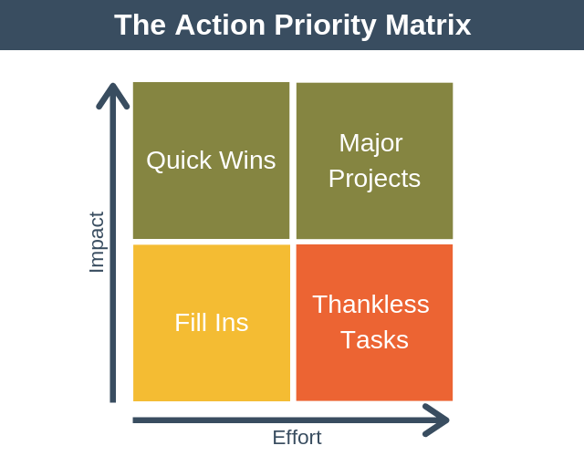
Self-Management Activity
Make a list of everything you have on your plate. One item per sticky note.
Assign each item a score for effort and a score for impact.
High Effort or, Low Effort
High Impact or Low Impact
Categorize each item on your list into one of the boxes on the Priority Matrix.
Quick Win-Low effort, High Impact
Major Project-High Effort, High Impact
Fill-in-Low Effort, Low Impact
Thankless Task- High Effort, Low Impact
Give Quick wins the highest priority
Spend your remaining time on Major Projects
If you have remaining time, do your Fill-Ins
Eliminate Thankless Tasks!

Slide 25
Self-Management Application
At your tables,
Identify all of the ways in this building that we help each other build this competency.
Identify all of the ways that you wish we helped each other build this competency.
Identify one thing you personally commit to doing to help build this competency among staff.
Notes:
Option 1-Table discussion
Option 2-Have table groups make a T-chart. On the left side ask them to answer the 1st prompt. On the right side ask them to answer the 2nd. One they have finished ask the table group to post their chart. When all charts are posted ask the group to do a gallery walk. When they return to their seats ask them to reflect on one thing they are each going to personally commit to to help build this competency among staff.

Slide 26
Relationship Skills

Slide 27
Relationship Skills
Encompass:
Communication
Social engagement
Relationship-building
Teamwork
Reflection: take a moment to reflect
*Individually identify one area in which you may want to build upon.

Slide 28
Relationship Skills Activity-Activity Materials
Commonalities
Count off by groups of 3
In your group identify 3 things that you have in common
Share with the larger group
Join another group of 3. In your now group of 6 identify 3 things you have in common that weren’t previously mentioned
Continue the process until you are one large group!

Slide 29
Relationship Skills Application
At your tables,
Identify all of the ways in this building that we help each other build this competency.
Identify all of the ways that you wish we helped each other build this competency.
Identify one thing you personally commit to doing to help build this competency among staff.
Notes:
Option 1-Table discussion
Option 2-Have table groups make a T-chart. On the left side ask them to answer the 1st prompt. On the right side ask them to answer the 2nd. One they have finished ask the table group to post their chart. When all charts are posted ask the group to do a gallery walk. When they return to their seats ask them to reflect on one thing they are each going to personally commit to to help build this competency among staff.

Slide 30
Social Awareness

Slide 31
Social Awareness
Encompasses:
Perspective-taking
Empathy
Appreciating diversity
Respect for others
Reflection: Reflect on this competency
*Individually identify one area in which you may want to build upon.

Slide 32
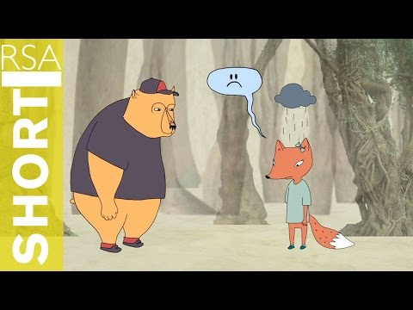
Social Awareness Activity
Empathy is feeling with people.
It is a sacred space. When someone is in a deep hole, it is climbing down with them.
Empathy is a vulnerable choice because you have to connect to something painful within yourself.
*Rarely can a response make something better, what makes something better is a connection.

Slide 33
Social Awareness Application
At your tables,
Identify all of the ways in this building that we help each other build this competency.
Identify all of the ways that you wish we helped each other build this competency.
Identify one thing you personally commit to doing to help build this competency among staff.
Notes:
Option 1-Table discussion
Option 2-Have table groups make a T-chart. On the left side ask them to answer the 1st prompt. On the right side ask them to answer the 2nd. One they have finished ask the table group to post their chart. When all charts are posted ask the group to do a gallery walk. When they return to their seats ask them to reflect on one thing they are each going to personally commit to to help build this competency among staff.

Slide 34
Responsible Decision Making

Slide 35
Responsible Decision Making
Encompasses:
Identifying problems
Analyzing situations
Solving problems
Evaluating
Reflecting
Ethical responsibility
Reflection: reflect on this competency
*Individually identify one area you commit to helping yourself build upon in this competency.

Slide 36
Responsible Decision-Making ActivityActivity Materials
What you value in life has a major impact on how you make decisions.
Take a moment of “I” time to complete the Life Satisfaction Chart.
Are your responses in line with what you value in life?
Turn to a partner and share one way you will balance your chart with what you value in life.

Slide 37
Responsible Decision-Making Application
At your tables,
Identify all of the ways in this building that we help each other build this competency.
Identify all of the ways that you wish we helped each other build this competency.
Identify one thing you personally commit to doing to help build this competency among staff.
Notes:
Option 1-Table discussion
Option 2-Have table groups make a T-chart. On the left side ask them to answer the 1st prompt. On the right side ask them to answer the 2nd. One they have finished ask the table group to post their chart. When all charts are posted ask the group to do a gallery walk. When they return to their seats ask them to reflect on one thing they are each going to personally commit to to help build this competency among staff.

Slide 38
Reflection and Action

Slide 39
Reflection and Action
Take 5 minutes to review all of your responses. Those marked often could be indicators of strength, marked rarely could be indicators of challenge.
Individual Reflection
Which strengths made you most proud?
How do these strengths affect your interactions with students?
How might enhancing your area(s) of challenge benefit your interactions with students?
Notes:
Individual Reflection with Optional Shareout

Slide 40
One Word
Take one minute of “I” and decide on a word that best reflects your experiences today.
Share your word round robin style.

