Slide 1
Restorative Practices Overview
Randi Downs &
Dan Hesler
dhesler@ocmboces.org
rdowns@ocmboces.org
Notes:
Randi

Slide 2
Restorative Practice
An emerging field of study that enables people to restore and build community in an increasingly disconnected world. (www.iirp.org)
Notes:
Randi

Slide 3
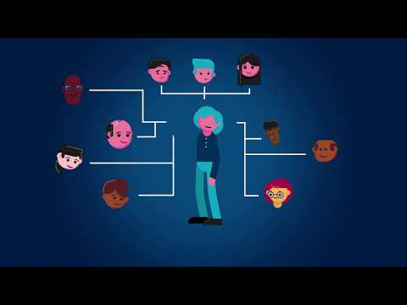
Notes:
Randi

Slide 4
History
Notes:
Randi
Restorative practices has its roots in restorative justice, a way of looking at criminal justice that emphasizes repairing the harm done to people and relationships rather than only punishing offenders (Zehr, 1990). ... It was originally envisioned as a family empowerment process, not as restorative justice.

Slide 5
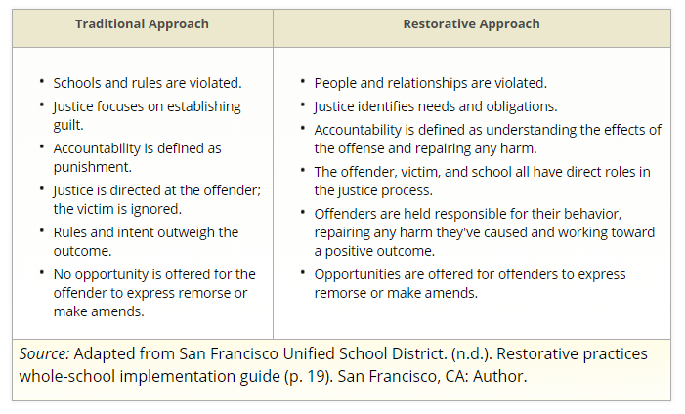
Notes:
Randi

Slide 6
Notes:
Dan

Slide 7
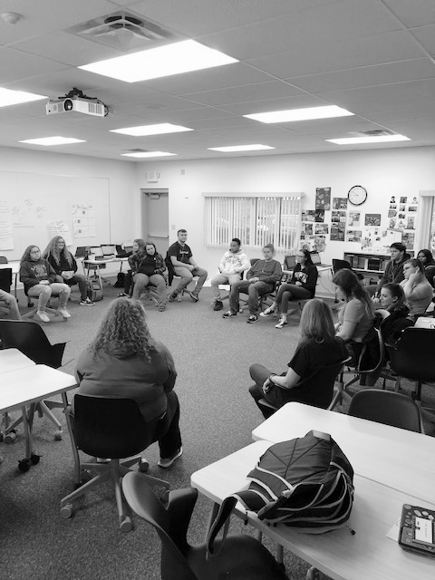
Restorative Practice identifies both proactive (building relationships and developing community) and reactive (repairing harm and restoring relationships) approaches (Davey, 2007).
Notes:
Dan

Slide 8
Restorative Practices
Fundamental Hypothesis/Social Discipline Window
Fair Process
Psychology of Affect
Restorative Practices Continuum
Notes:
Dan

Slide 9
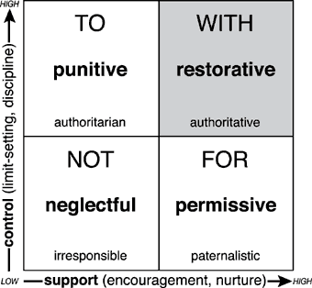
Social Discipline Window
Notes:
Dan

Slide 10
Fair Process
Engagement
Explanation
Expectation Clarity
Notes:
Dan

Slide 11
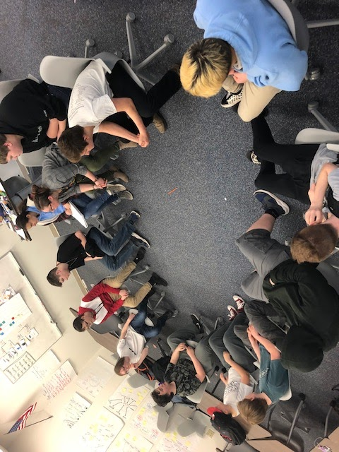
Restorative Practices Continuum
80% Proactive
Notes:
Dan

Slide 12
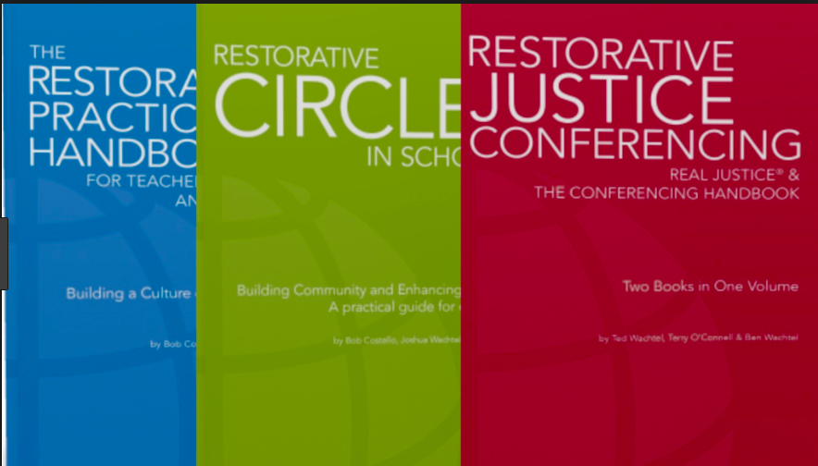
Trainings and Resources
https://www.iirp.edu
Introduction to Restorative Practices and Using Circles Effectively- Days 1 & 2
Facilitating Restorative Conferences- Days 3 & 4
Notes:
Randi

Slide 13
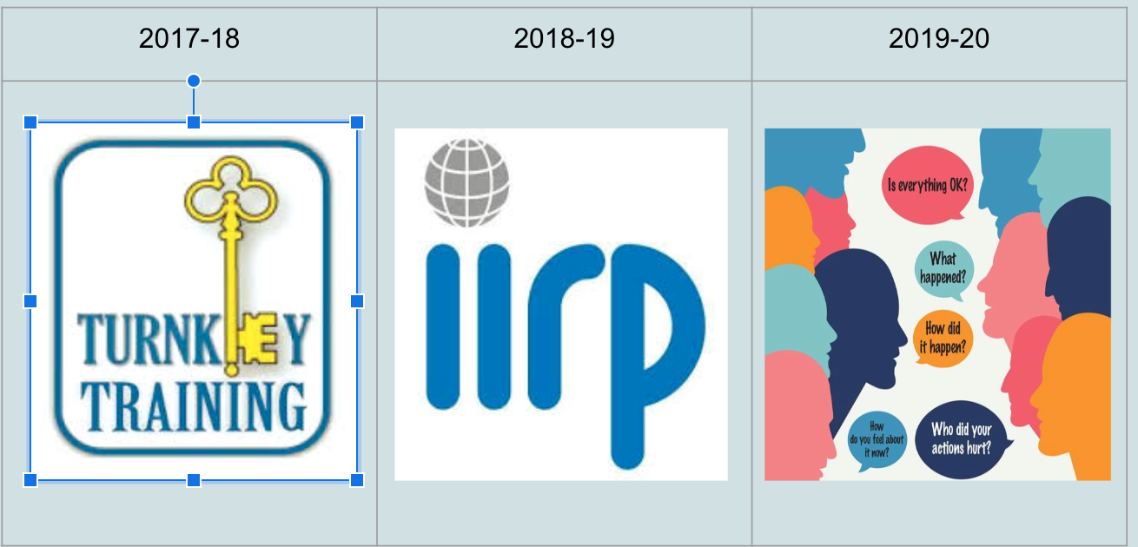
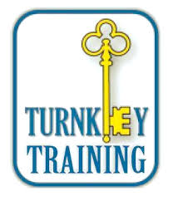
OCM BOCES
Notes:
Randi

Slide 14
Notes:
Randi/Dan
https://admin.sli.do/event/jsabdnxn/questions

Slide 15
Notes:
Randi/Dan

