Slide 1
NYSAA
Ryan Oyer, OCM BOCES, royer@ocmboces.org
Pam Culbertson, CNYRIC, pculbertson@cnyric.org
October 10, 2019

Slide 2
Training
Test Administration Trainers
Alison LaRocca- Alarocca@ocmboces.org
Ryan Oyer- royer@ocmboces.org
Testing Dates
New Teacher Training(New to NYSAA)- January 17th 8:30-3:00 Main Campus
Veteran Teacher Training-January 23rd 8:30-3:00 LGI Room @ Thompson Road
Prior to Training
Teachers MUST be added as users in Educator Portal
Rosters Assigned to Teachers

Slide 3
NYSAA News
Technology Update
Kite Client needs to be removed and reinstalled
Student Learning Profiles
Describes student skills as they relate to each essential element
Became available in Educator Portal September 25th

Slide 4
Student Learning Profiles

Slide 5
NYSAA Data
Enrollment
Grade Level 13 (K-6 Elementary) or 14 (7-12 Secondary) - Ungraded
Program Service Code 0220, Eligible for Alternate Assessment
Type of Disability
Birth Date – Match with Age Ranges for Testing on NYSAA

Slide 6
NYSAA Due Dates
NYSED One-Time Pull – Thursday, November 7, 2019
KITE System Automatically Populated
Students identified as NYSAA-eligible for loading of final enrollment file to Educator Portal Program Service Code 0220, Eligible for Alternate Assessment – November 18, 2019

Slide 7
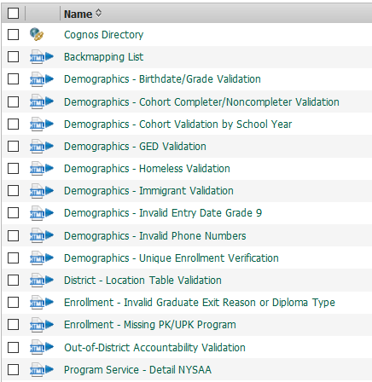
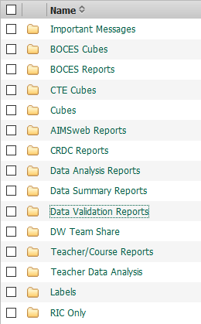
Cognos Level 1

Slide 8
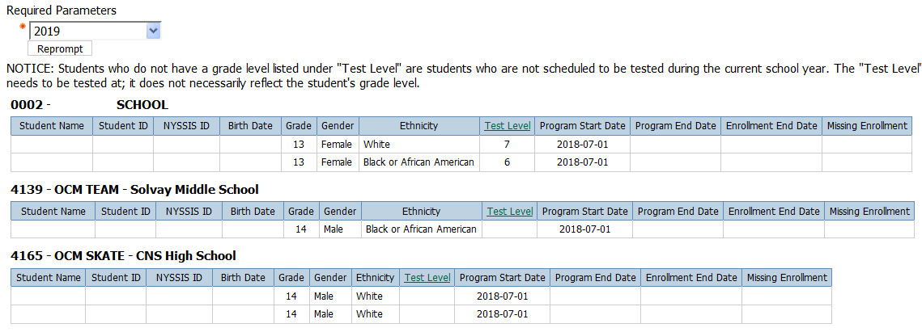
Cognos Level 1
Sec

Slide 9
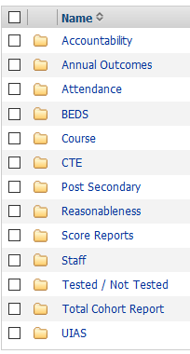
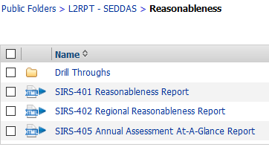
Cognos Level 2

Slide 10
Cognos Level 2

Slide 11
Access
Cognos Level 1
RIC – District Administration Approval
Cognos Level 2
NYSED Portal - Superintendent

Slide 12
NYSAA Musts
Identify who is responsible for Technology Implementation(downloading new software)
Identify who is responsible for roster management
Double Check NYSAA Administration Grade Level against Student’s Birthdate

Slide 13
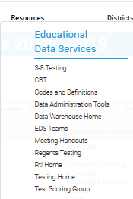
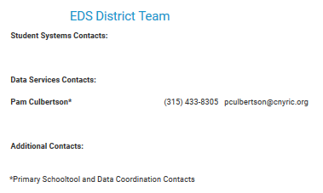
CNYRIC District Data Coordinator Contacts
www.cnyric.org
Select district
“Data Services Contacts” section

Slide 14
Questions

