Slide 1
Functional Behavior Assessments/
Behavior Intervention
Plans
December 2019

Slide 2
Staff Trainings:
Through CETAS
Trainings
Support in evaluation and writing formal BIPs based on FBA evaluation
Support with data sheets and monitoring
Checks and balances regarding state regulations
Internal BOCES:
SW are trained on a regular basis by the psychologist regarding FBA data and Progress Monitoring
BIP reviews are done as needed with changes/ addendums documented
Annual summaries reviewed at annual CSE mtgs

Slide 3
FBA Must Haves: BIP Must Haves:
 | Obtain parental consent
 | Contact student’s home district to request parental consent for completion of an FBA/BIP. District will ask if the parent has been notified District may ask for a written justification for an FBA Follow-up with district monthly to monitor status of consent
 | Identify the behavior in concrete terms (observable, measurable, concrete language)
 | Behavior should be identified as a team (staff members working with student)
 | Identify contextual factors that contribute to the behavior
 | Collect data and gather information
 | Identify sequence of events that reliably predict the behavior (Antecedent Events, Setting Events, Maintaining Consequences)
 | Direct observation of student – Collect Baseline Data. Observe student for at least 10-20 minutes across settings over at least three occasions or until data is stable. Data should address frequency, duration, latency, intensity.
 | Complete interviews with teacher, parent and student (if appropriate)
 | Complete motivation / behavior checklists
 | Review student records (academic, behavior, assessments, medical)
 | Generate hypotheses statements
 | Global Hypothesis: “(Student) is a young person who enjoys…. And is interested or successful in …. Student might benefit from….”
 | Specific Hypothesis: “When (describe context), this student (describe behavior) to (get / avoid consequences). This pattern is more likely to occur when…
 | Build a “Competing Behavior Pathway” to identify possible elements of a behavioral intervention plan
 | Includes setting event, triggering antecedent, desired / problem / replacement behaviors and maintaining consequences
 | Replacement behavior should ultimately lead to desired behavior
 | Replacement behavior and problem behavior must have the same function
 | Replacement behavior must be easier or more motivating for the student
 | Determine need for development of a Behavior Intervention Plan
 | Review following guidelines to determine next steps: The CSE or CPSE shall consider the development of a BIP, as such term is defined in 200.1(mmm) for a student with a disability when: (i) the student exhibits persistent behaviors that impede his or her learning or that of others, despite consistently implemented general school-wide or classroom-wide interventions; (ii) the student’s behavior places the student or others at risk of harm or injury; (iii) the CSE or CPSE is considering more restrictive programs or placements as a result of the student’s behavior. Section 201.3 If the manifestation team makes the determination that the behavior was a manifestation of the student’s disability – conduct and implement and /or modify the BIP.
 | A Behavioral Intervention Plan must include:
 | Baseline measure of problem behavior, including frequency, duration, intensity and / or latency of targeted behaviors. Baseline measure must include data taken across activities, settings, people and times of day. Baseline will be used as a standard to evaluate intervention effectiveness.
 | Expected behavioral changes (general outcome, long and short-term goals, maintenance & generalization)
 | What methods will be used to measure and monitor progress toward goals (How will progress be recorded, at what frequency and by whom?)
 | What form will data be collected, displayed and shared in?
 | Create decision rules / criteria to determine if the BIP should be maintained, faded, modified or discontinued
 | Determine individual responsible for monitoring progress and integrity of implementation
 | Intervention Strategies
 | Strategies to alter antecedent events and prevent the occurrence of behaviors
 | Strategies to teach individual alternative and adaptive behaviors to the student
 | Provision of consequences for targeted inappropriate behavior(s)
 | Provision of alternative, acceptable behaviors
 | Procedural steps for crisis intervention
 | BIP must include the individual(s) responsible for each step
 | Schedule to measure effectiveness of the interventions
 | Must include frequency, duration and intensity of targeted behaviors at scheduled intervals
 | Progress Monitoring
 | Implementation must include regular progress monitoring of frequency, duration and intensity of behavioral intervention
 | BIP must specify how frequently progress should be monitored and reviewed
 | A student’s need for a behavioral intervention plan must be documented on the student’s IEP and reviewed at least annually by the CSE / CPSE

Slide 4
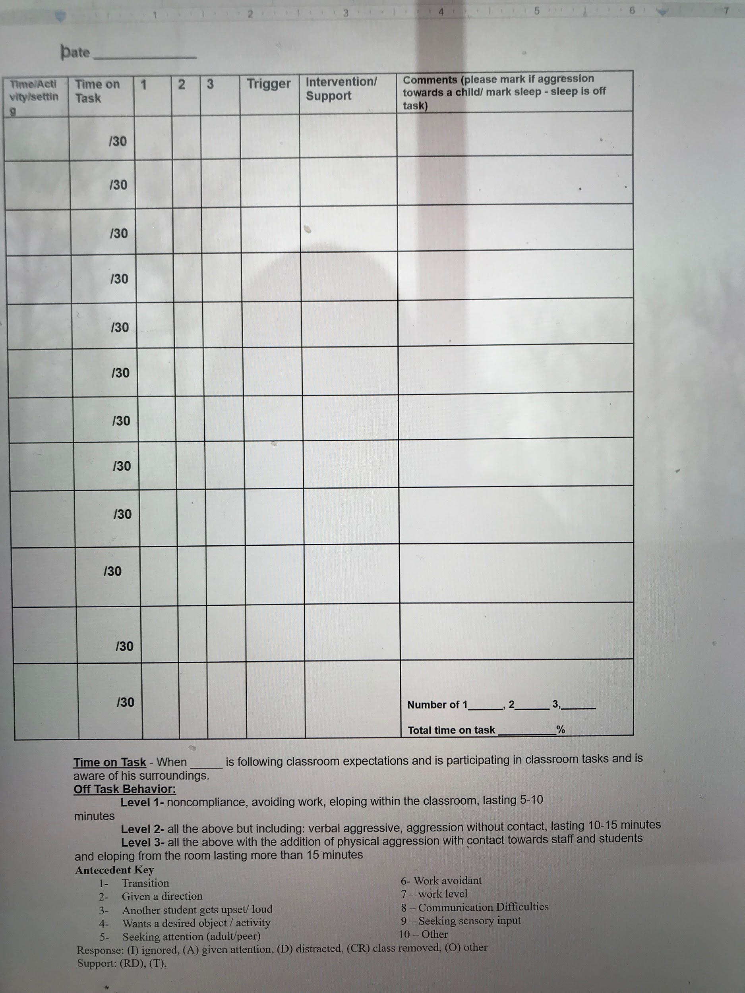
Example of FBA data
Including: Antecedent / Trigger Key
Setting
Duration
Intensity
Latency

Slide 5
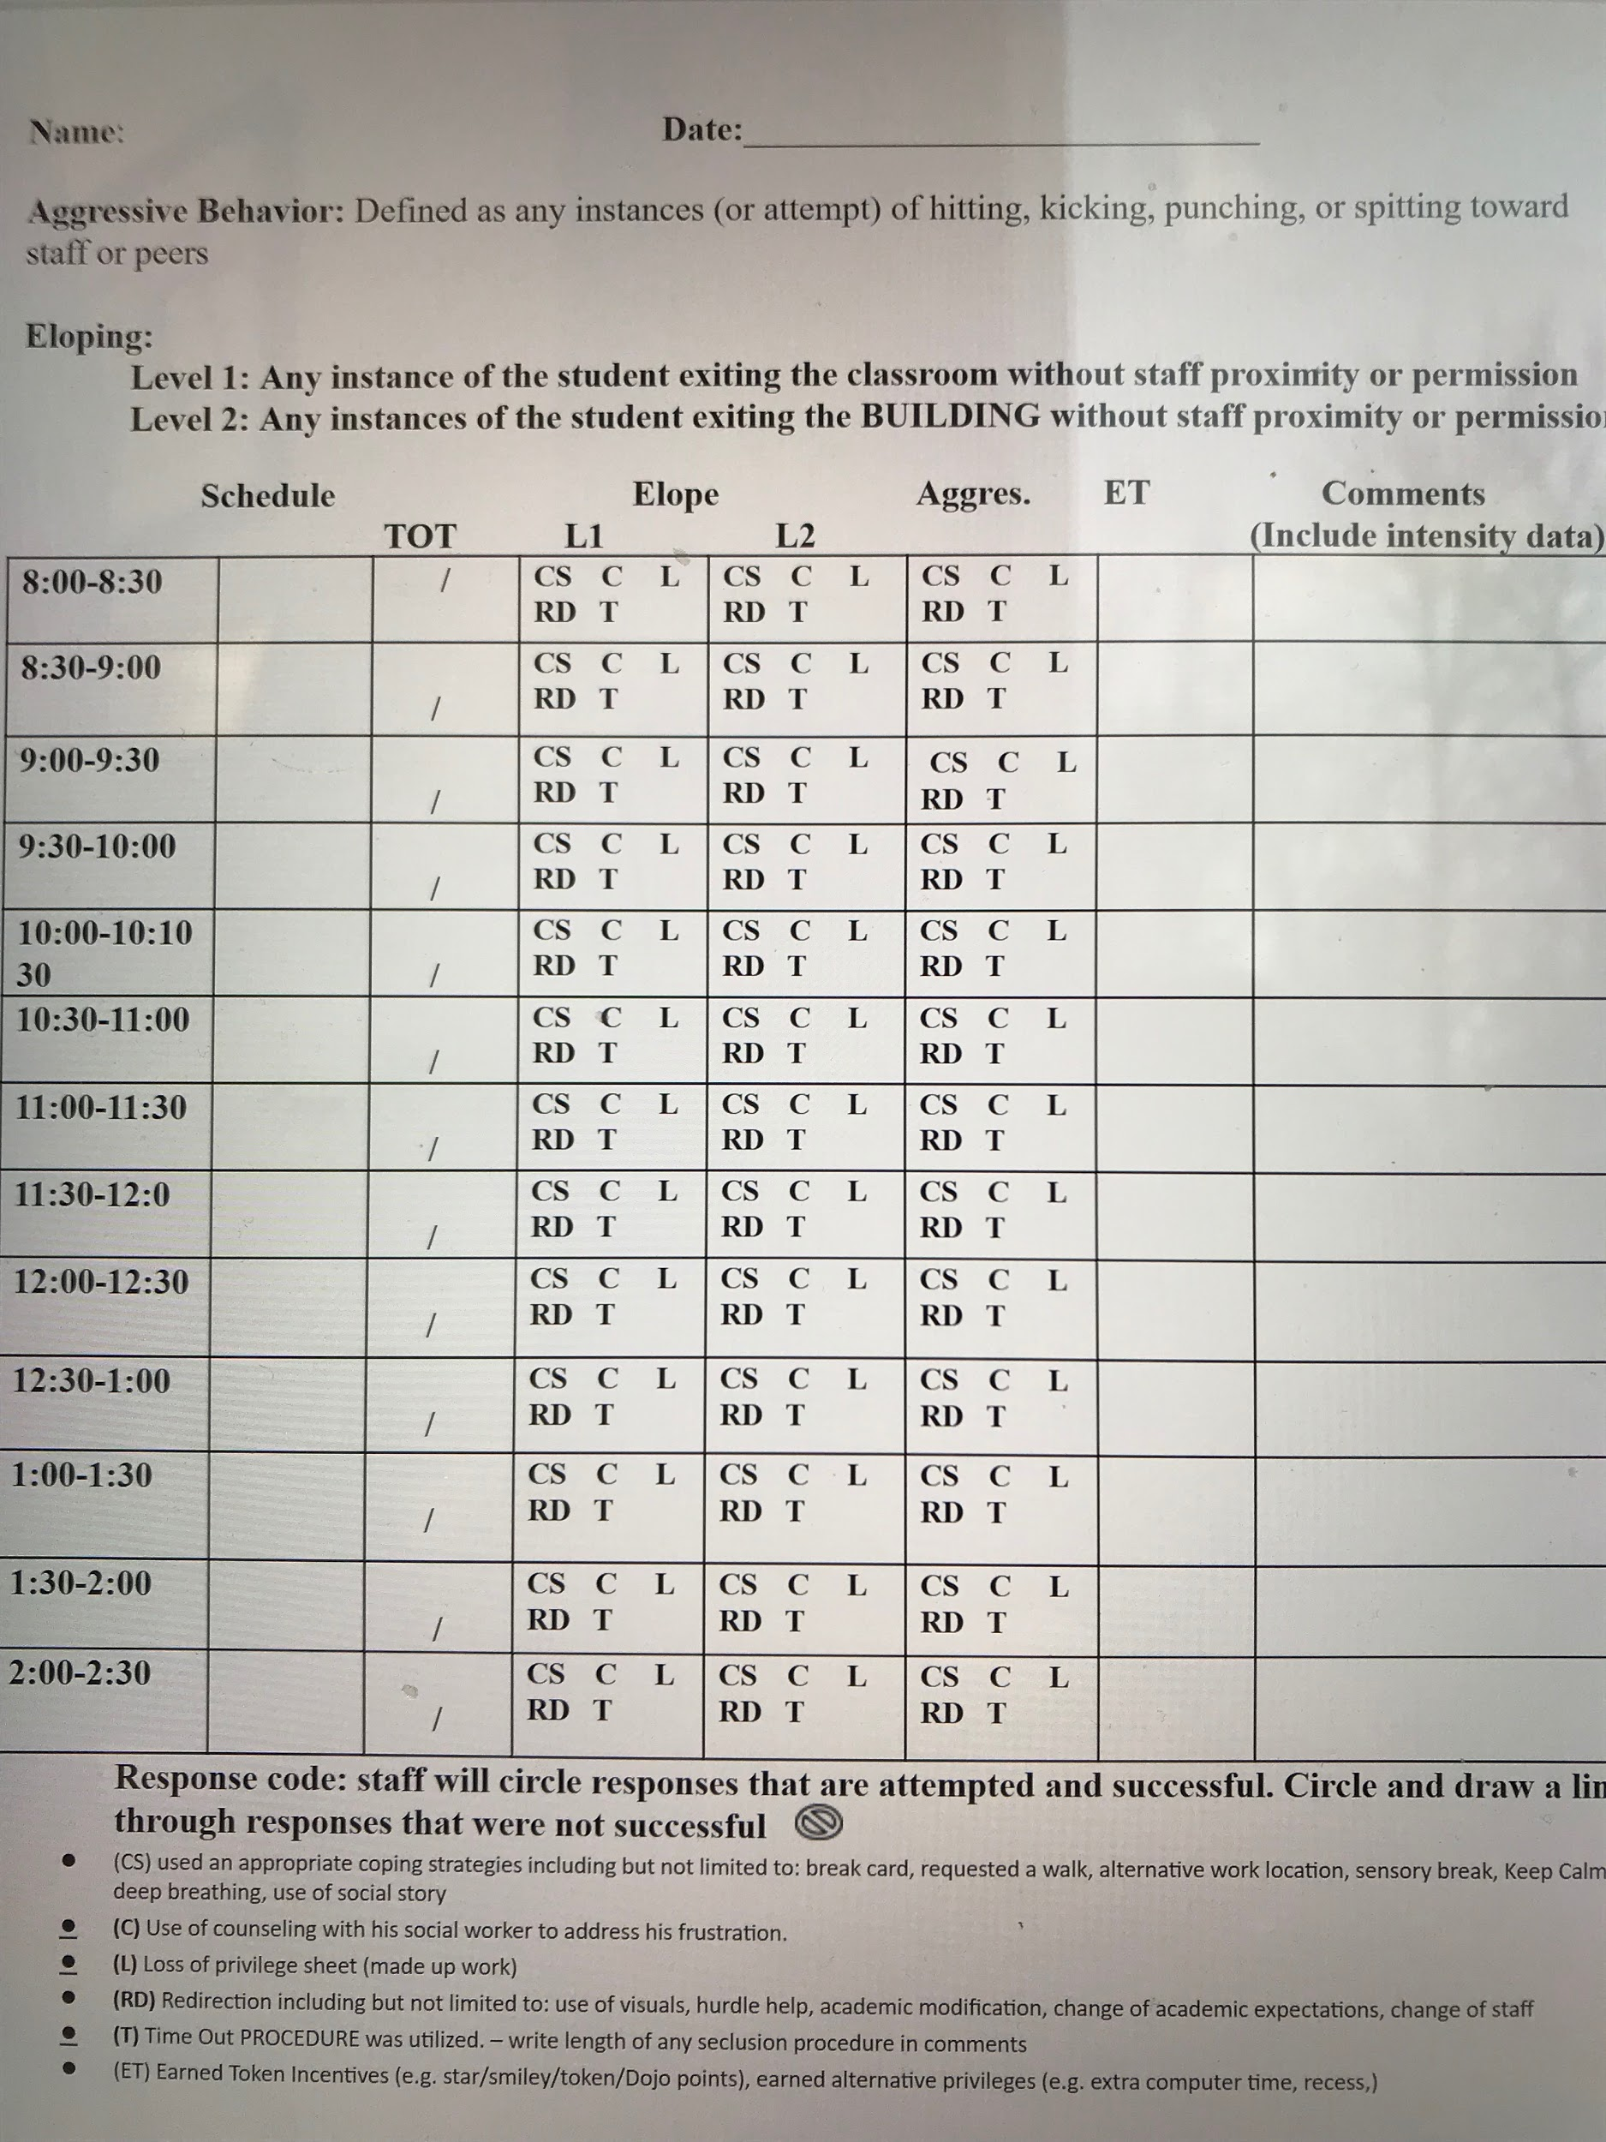
Example of BIP Progress Monitoring Data sheet

Slide 6
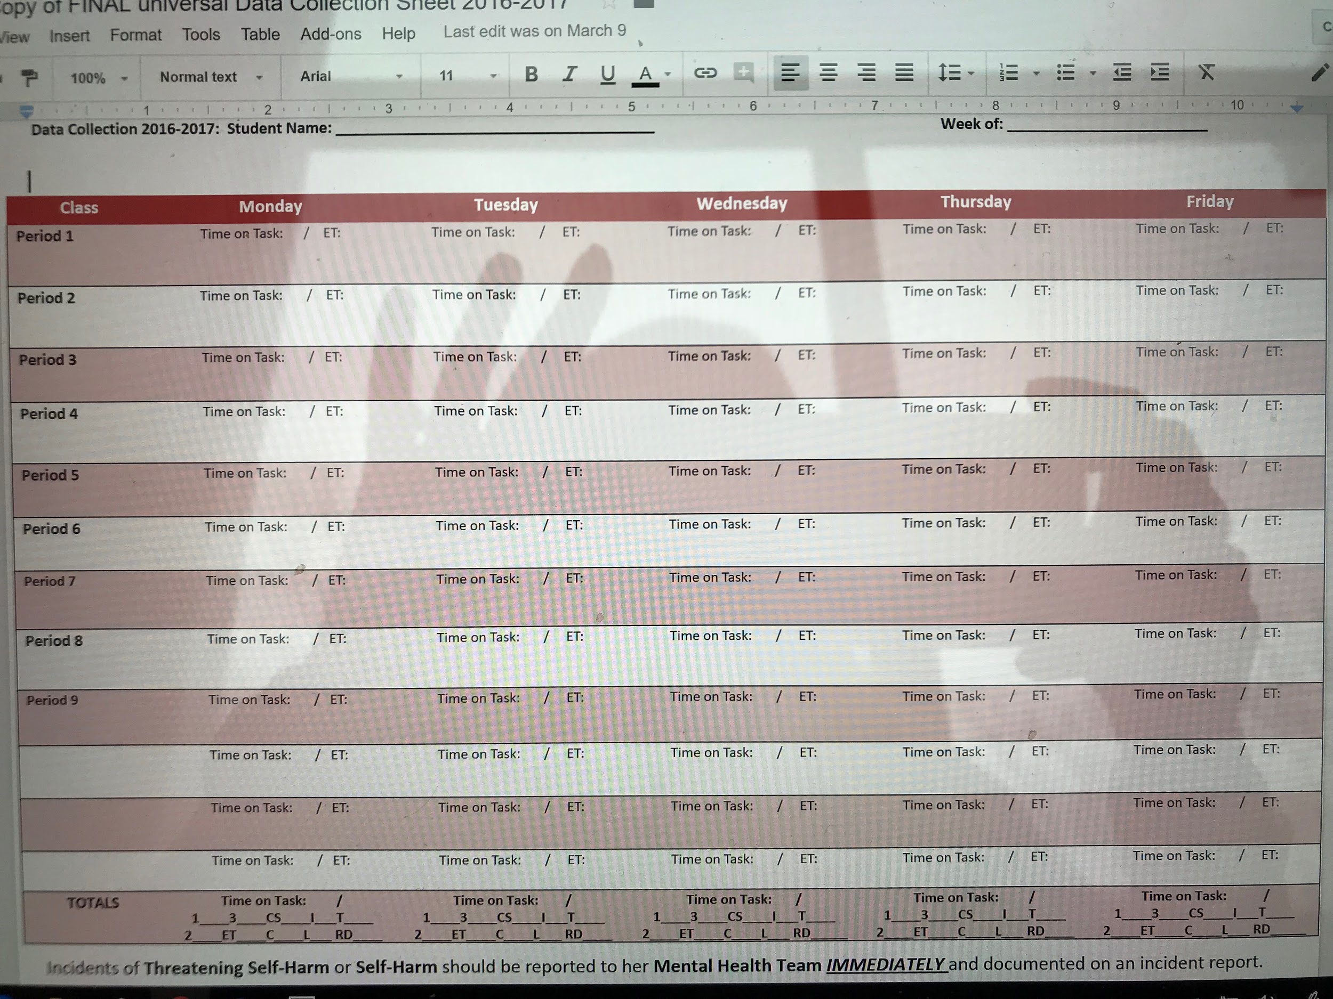
Example of Progress Monitoring for the BIP

Slide 7
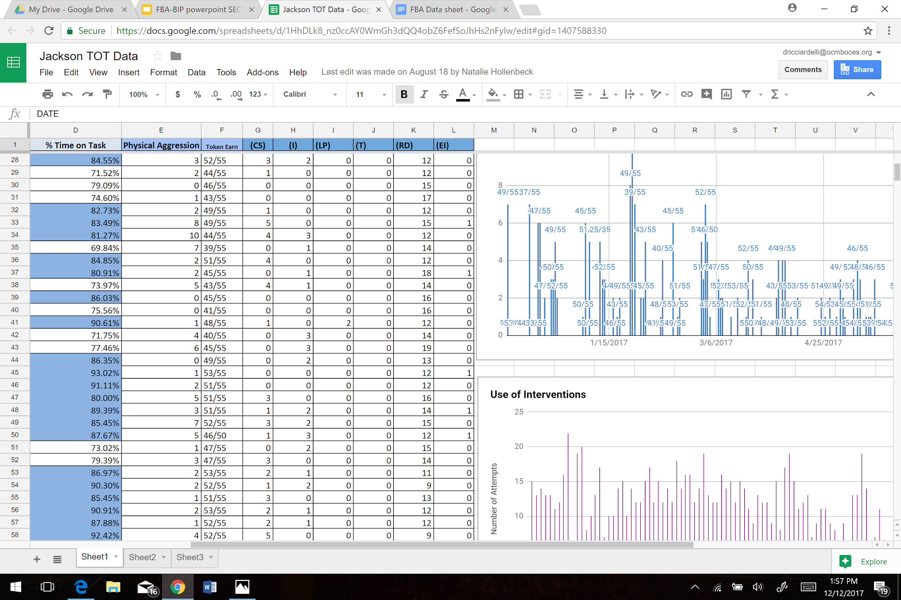
Summary of Daily Behavior

Slide 8
Quick Reminders…...
Parents permission is needed for the FBA to be conducted followed by a CSE for the evaluation review and if meets the level of a BIP
In order to be considered for a higher level of program (BOCES) a FBA / BIP needs to be completed and followed with integrity

