Slide 1
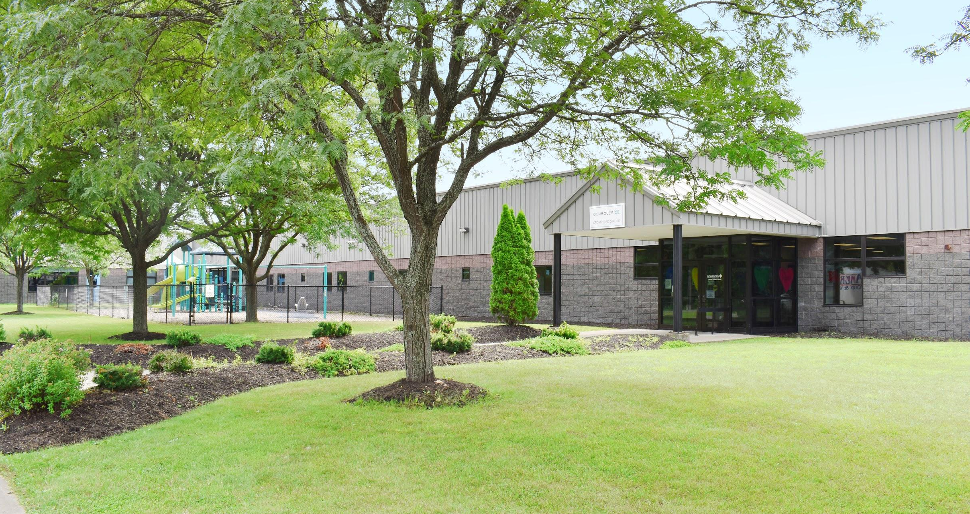

OCM BOCES Crown Road Campus
Responsible Planning for the Future

Slide 2


Why are we here?
OCM BOCES strives to provide a high-quality education for all students while being fiscally responsible to the people who live and work in our 23 component districts.
Notes:
Because of the nature of the varied services a BOCES provides, facilities can be a challenge. Some of our services are provided centrally, others are provided in our component school districts. While leasing provides flexibility, it is not necessarily the most cost-effective approach.

Slide 3
Why are we here?
OCM BOCES has been leasing the Crown Road Campus
for 32 years, since 1987.
The owner, ATRAP, received a purchase offer for $12.85 million. OCM BOCES had first right of refusal.
OCM BOCES met with school superintendents and business officials Aug. 1 to discuss all options for Crown Road.
Today we will review those options and discuss the final recommendation.
Notes:
Because of the nature of the varied services a BOCES provides, facilities can be a challenge. Some of our services are provided centrally, others are provided in our component school districts. While leasing provides flexibility, it is not necessarily the most cost-effective approach.

Slide 4
Agenda
Overview of OCM BOCES Facilities
Facility Overview - Crown Road Campus
Options
Proposed Solution: Financial Analysis
Next Steps

Slide 5
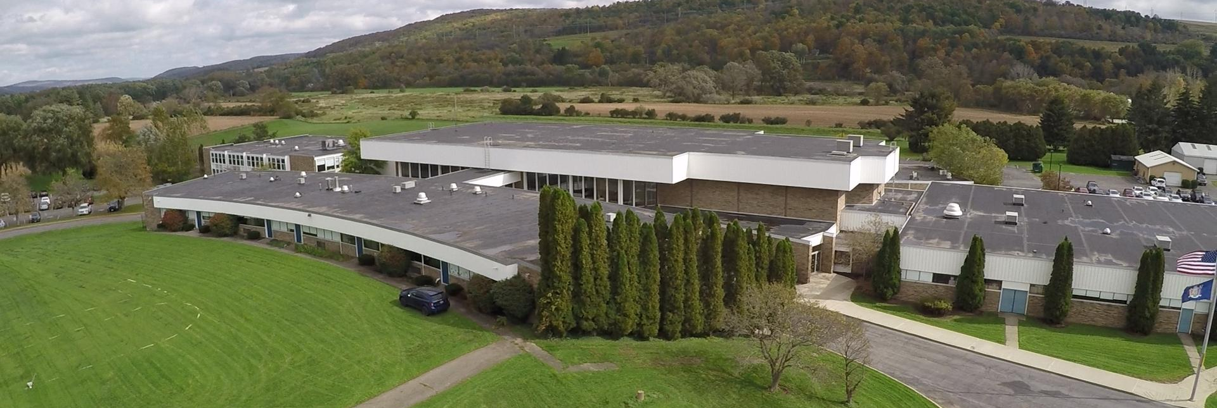
Current Facilities
Owned
Cortlandville Campus – McEvoy Building (acquired 1969)

Slide 6
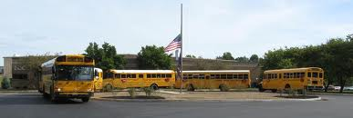
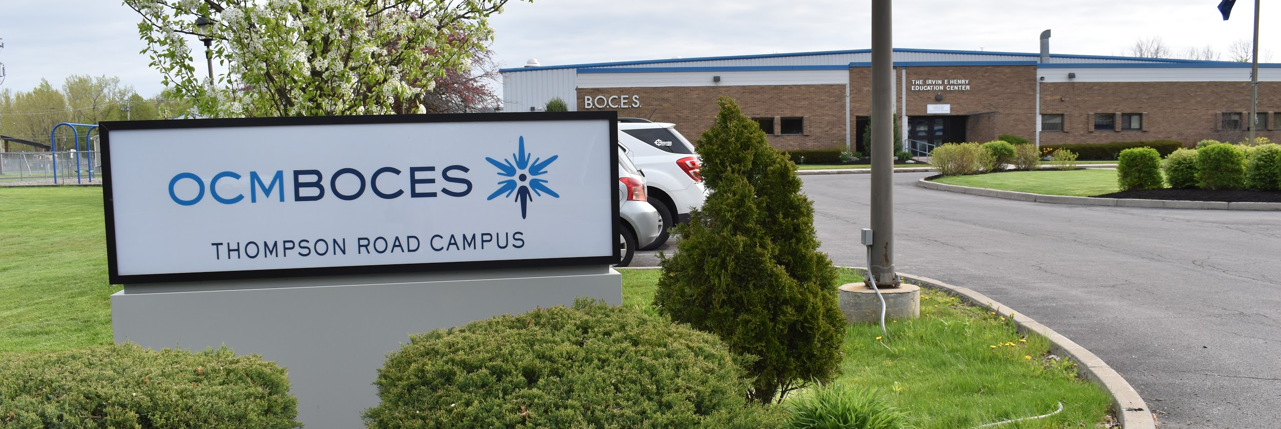
Current Facilities
Owned
Thompson Road Campus – Henry Building (acquired 1975)

Slide 7
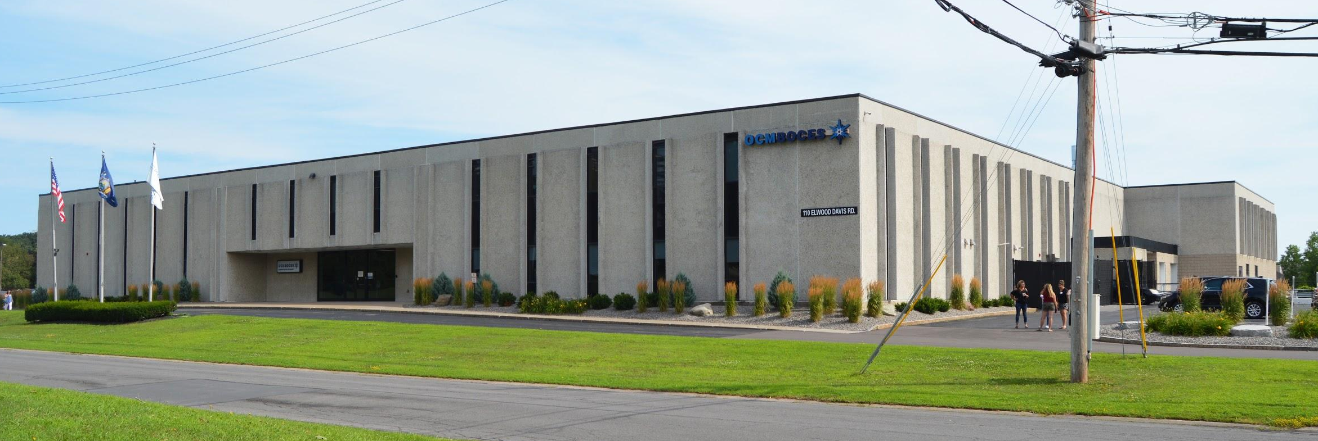
Current Facilities
Owned
Main Campus – (acquired 2014)
Notes:
OCM BOCES owns two campuses; our other sites are leased from school districts or other community entities
saving district money through collaboration
collapsed leases and purchased this building provided improved space for Special Ed, Innovation Tech and Adult Ed and improved conference space

Slide 8
Current Facilities
Major Leases
Crown Road Campus
Rodax 1-3, 7/8 (CNYRIC & Innovation Tech)
800 Fourth Street, Liverpool
Cortland Alternative School
Seven Valleys New Tech Academy

Slide 9
Crown Road Campus
Facility Overview
83,600 square feet
15.6 acres
3 acres available for development

Slide 10
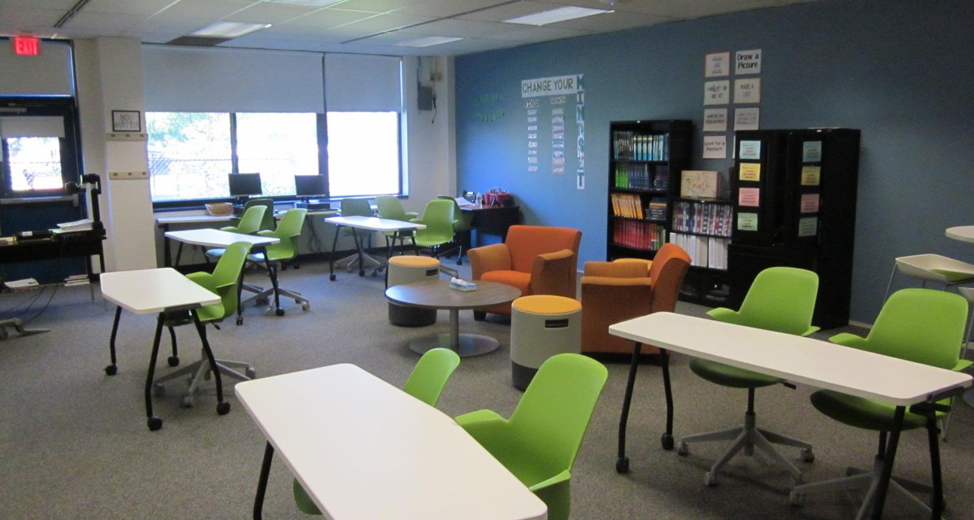
Regular Classrooms

Slide 11
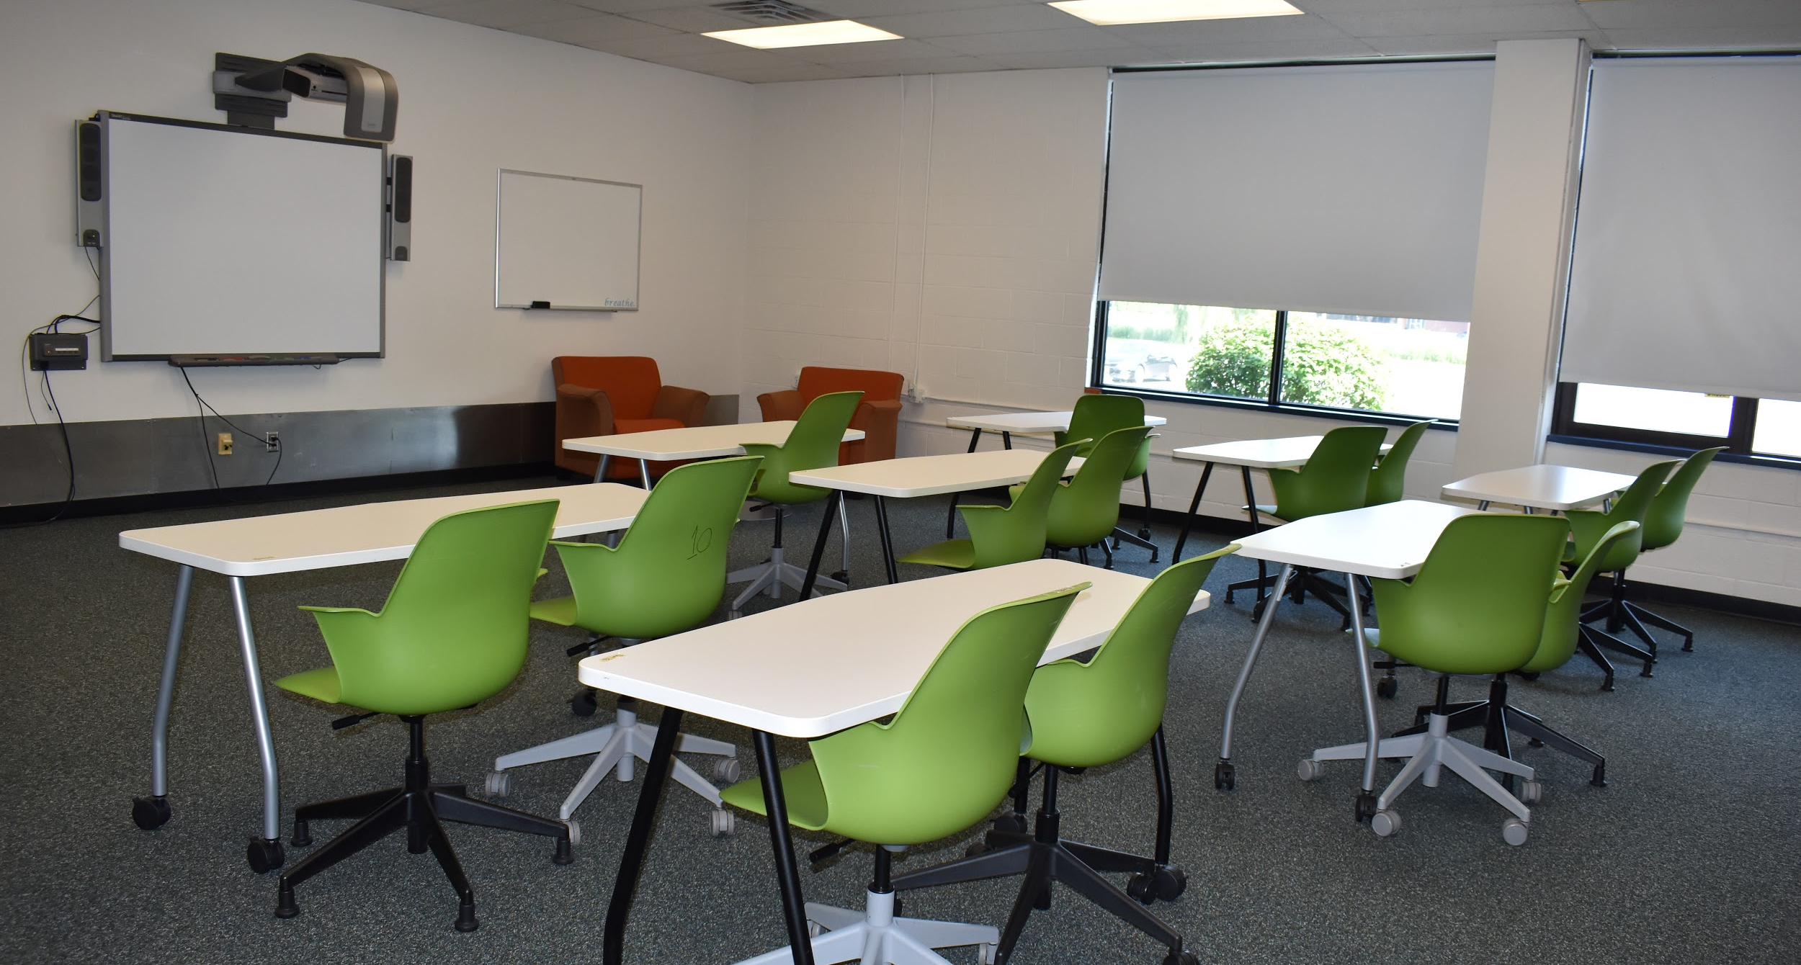
Regular Classrooms

Slide 12
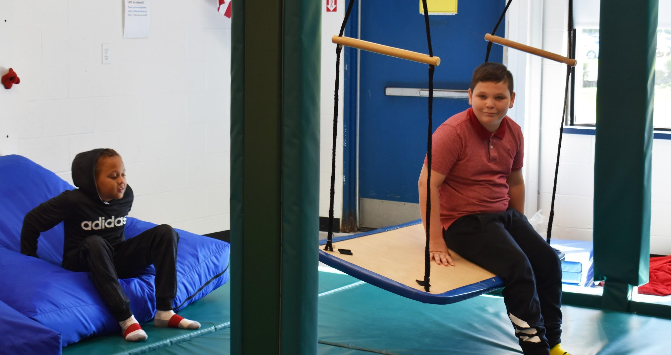
Rooms for Related Services

Slide 13
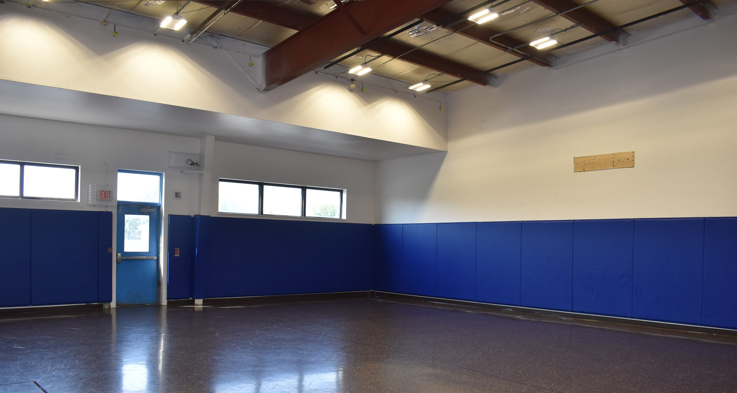
Three Activity Rooms

Slide 14
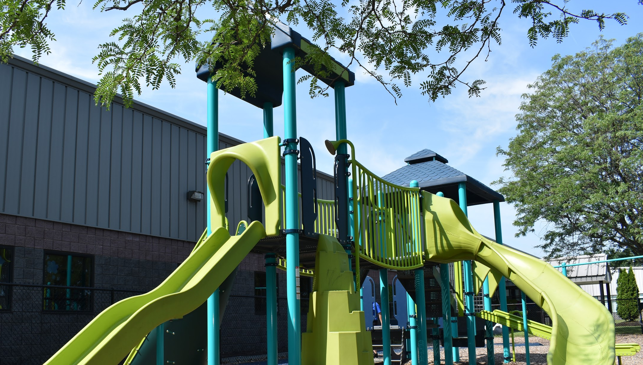
Playground

Slide 15
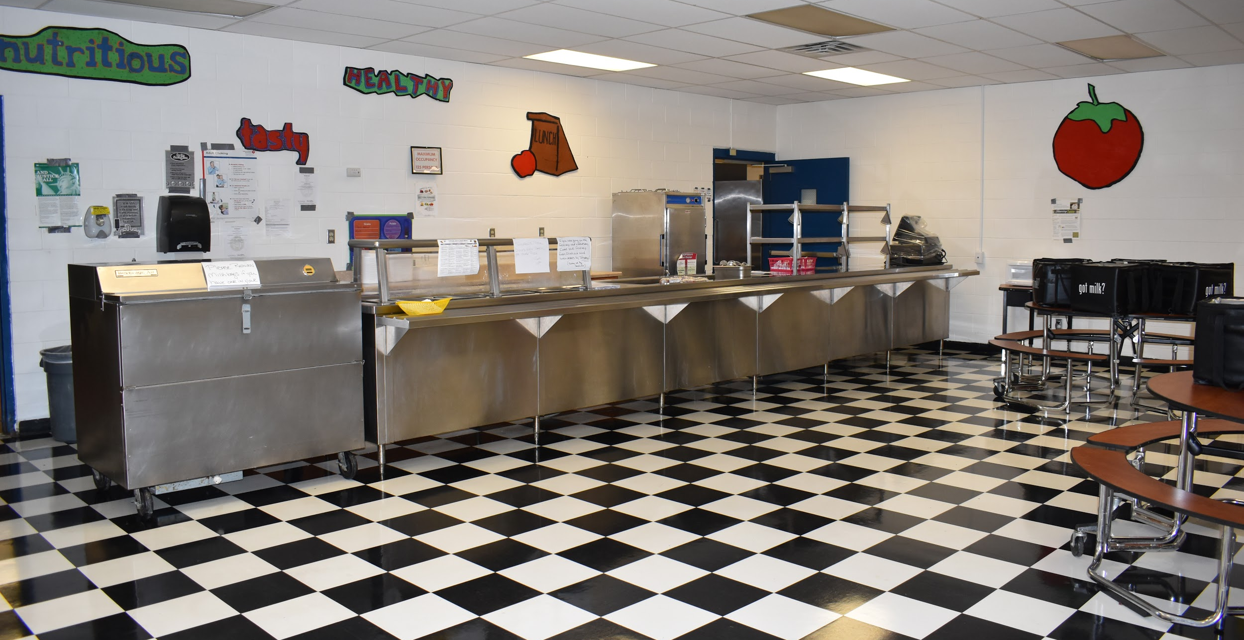
Cafeteria

Slide 16
Crown Road Campus
Facility Overview
Building condition
  Very good
    New HVAC 2017
    Main hallways are block
    Flooring in good repair
  Standard classrooms and rooms for related services
  Specially designed sensory rooms
  Three activity rooms
  Cafeteria
  Playground

Slide 17
Crown Road Campus
Current Programs
Special Education (K-12)
  20 8:1:1 classrooms for students with emotional disabilities
  4 12:1:4 classrooms for students on Autism spectrum with behavioral issues

Slide 18
Crown Road Campus
Current Programs
Innovative Education - Reach (Grades 7/8)
Mental Health Clinic staffed by Liberty Resources

Slide 19
Options
Option #1: Remain a tenant at Crown Road Campus for the duration of the lease and potentially beyond
Option #2: Relocate after end of lease term and enter into a new lease at a different location
Option #3: Build a new building
Option #4: Purchase Crown Road Campus

Slide 20
Option #1 Lease
2018-19 school year was the first year of
a 10-year lease
Initial lease term expires after the 2027-28 school year.
Lease includes two, 5-year options after initial lease term.

Slide 21
Crown Road Campus Lease
For the remainder of the lease, namely 2019-20 through 2027-28, OCM BOCES will pay ATRAP Corporation approximately $10,428,000 in lease payments and taxes.
During the first 5-year option after expiration of the current lease, OCM BOCES will pay ATRAP Corporation an estimated $6,505,000 for a 14-year total of approximately $16,933,000.
During the second 5-year option, OCM BOCES will pay ATRAP Corporation an estimated $6,982,000 for a 19-year total of approximately $23,915,000.
Notes:
National investment company out of Chicago - who they received the offer from

Slide 22
Option #2 Relocate
Enter into a new agreement
Renovate the space
$215-$260 per square foot for renovations
Renovations on our behalf would be reflected in our lease terms

Slide 23
Option #3 Build New
$435-$520 per square foot for new construction (Source: Fiscal Advisors)
$435 x 83,600 sq feet = $36,366,000

Slide 24
Option #4: Purchase (Recommended)
Make purchase offer for $12,850,000
(cost savings to districts)
Assumptions
20-year bond repayment schedule
4-5% interest rate
Finance through the Dormitory Authority of New York (DASNY)

Slide 25
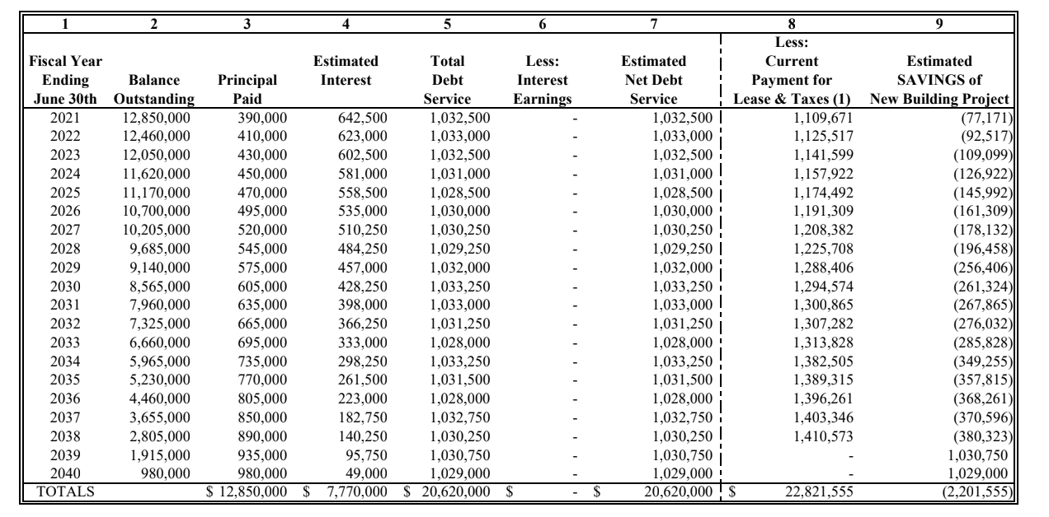
Estimated Savings
Source: Fiscal Advisors, Project Estimates

Slide 26
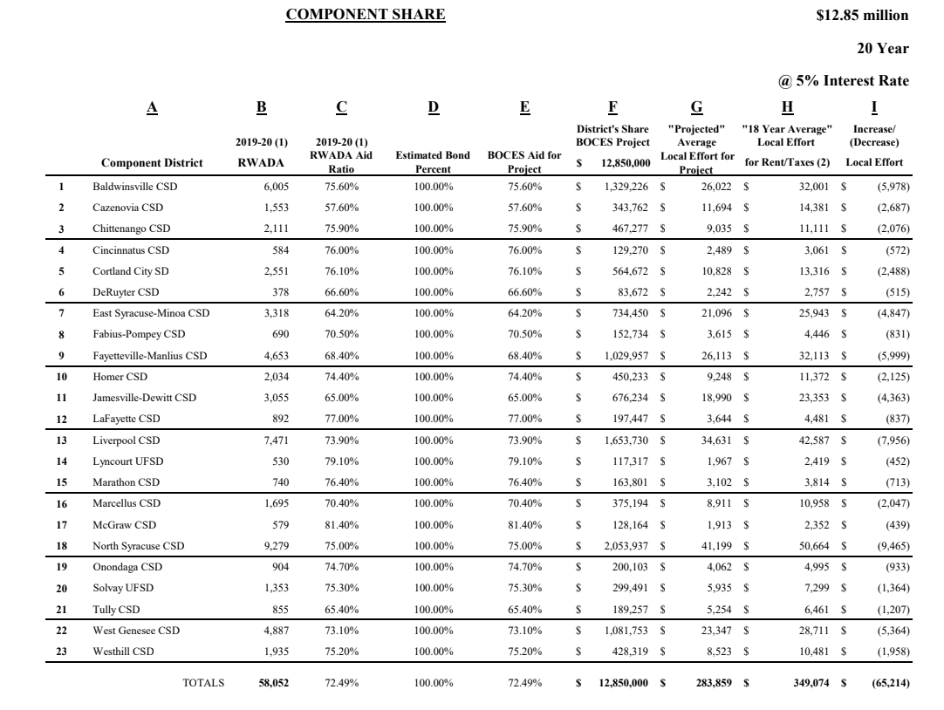
Impact by Component

Slide 27
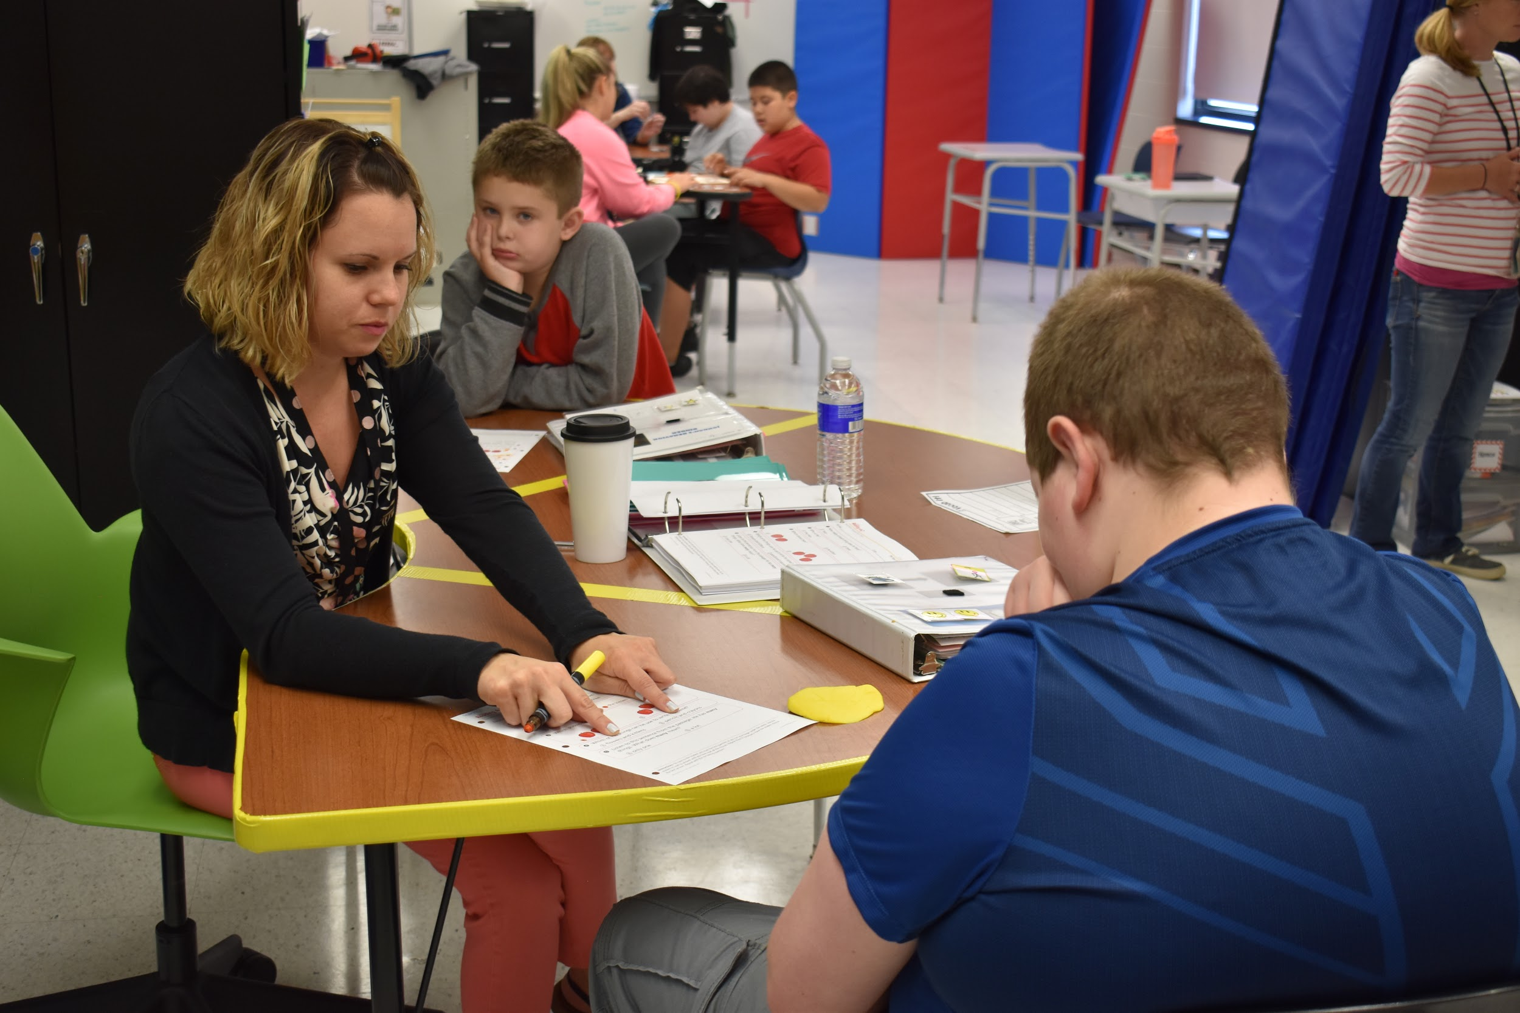
The Benefits
Purchasing the facility would create a better return on investment for OCM BOCES and our 23 component districts.
Notes:
Because of the nature of the varied services a BOCES provides, facilities can be a challenge. Some of our services are provided centrally, others are provided in our component school districts. While leasing provides flexibility, it is not necessarily the most cost-effective approach.

Slide 28
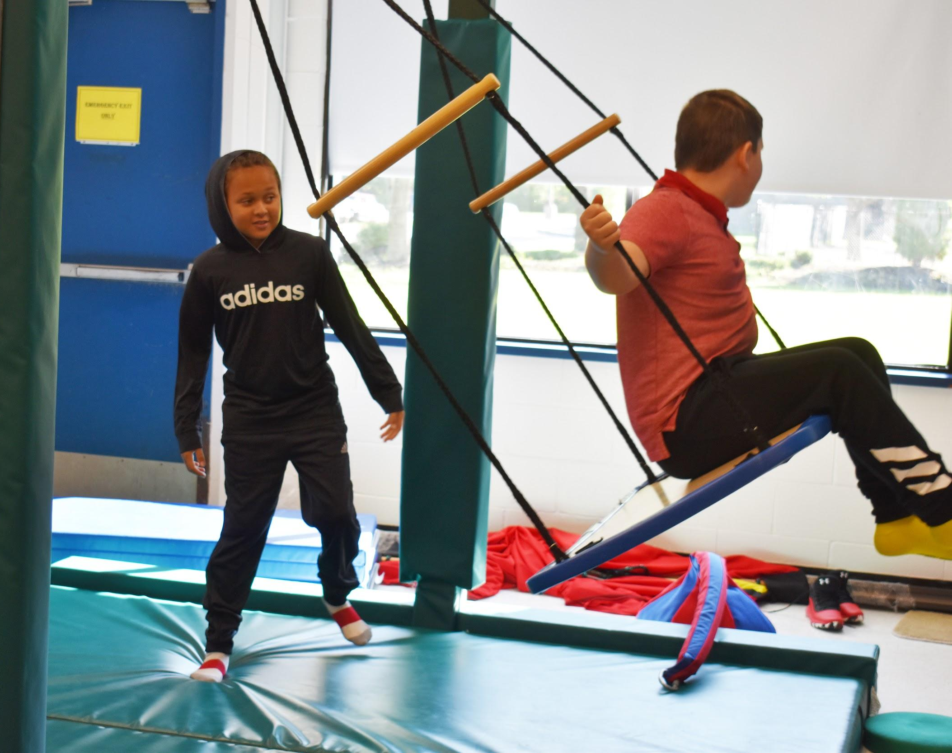
The Benefits
Purchasing the site offers
a sound investment opportunity, just as buying
a home offers a source
of financial equity and potential appreciation.
Notes:
Because of the nature of the varied services a BOCES provides, facilities can be a challenge. Some of our services are provided centrally, others are provided in our component school districts. While leasing provides flexibility, it is not necessarily the most cost-effective approach.

Slide 29

The Benefits
The building is in good physical condition, with updated HVAC and well-maintained floors and rooms that meet the needs of all students.
Notes:
Because of the nature of the varied services a BOCES provides, facilities can be a challenge. Some of our services are provided centrally, others are provided in our component school districts. While leasing provides flexibility, it is not necessarily the most cost-effective approach.

Slide 30

The Benefits
The campus is centrally located for most of our component districts,
with easy access from major highways.
Notes:
Because of the nature of the varied services a BOCES provides, facilities can be a challenge. Some of our services are provided centrally, others are provided in our component school districts. While leasing provides flexibility, it is not necessarily the most cost-effective approach.

Slide 31
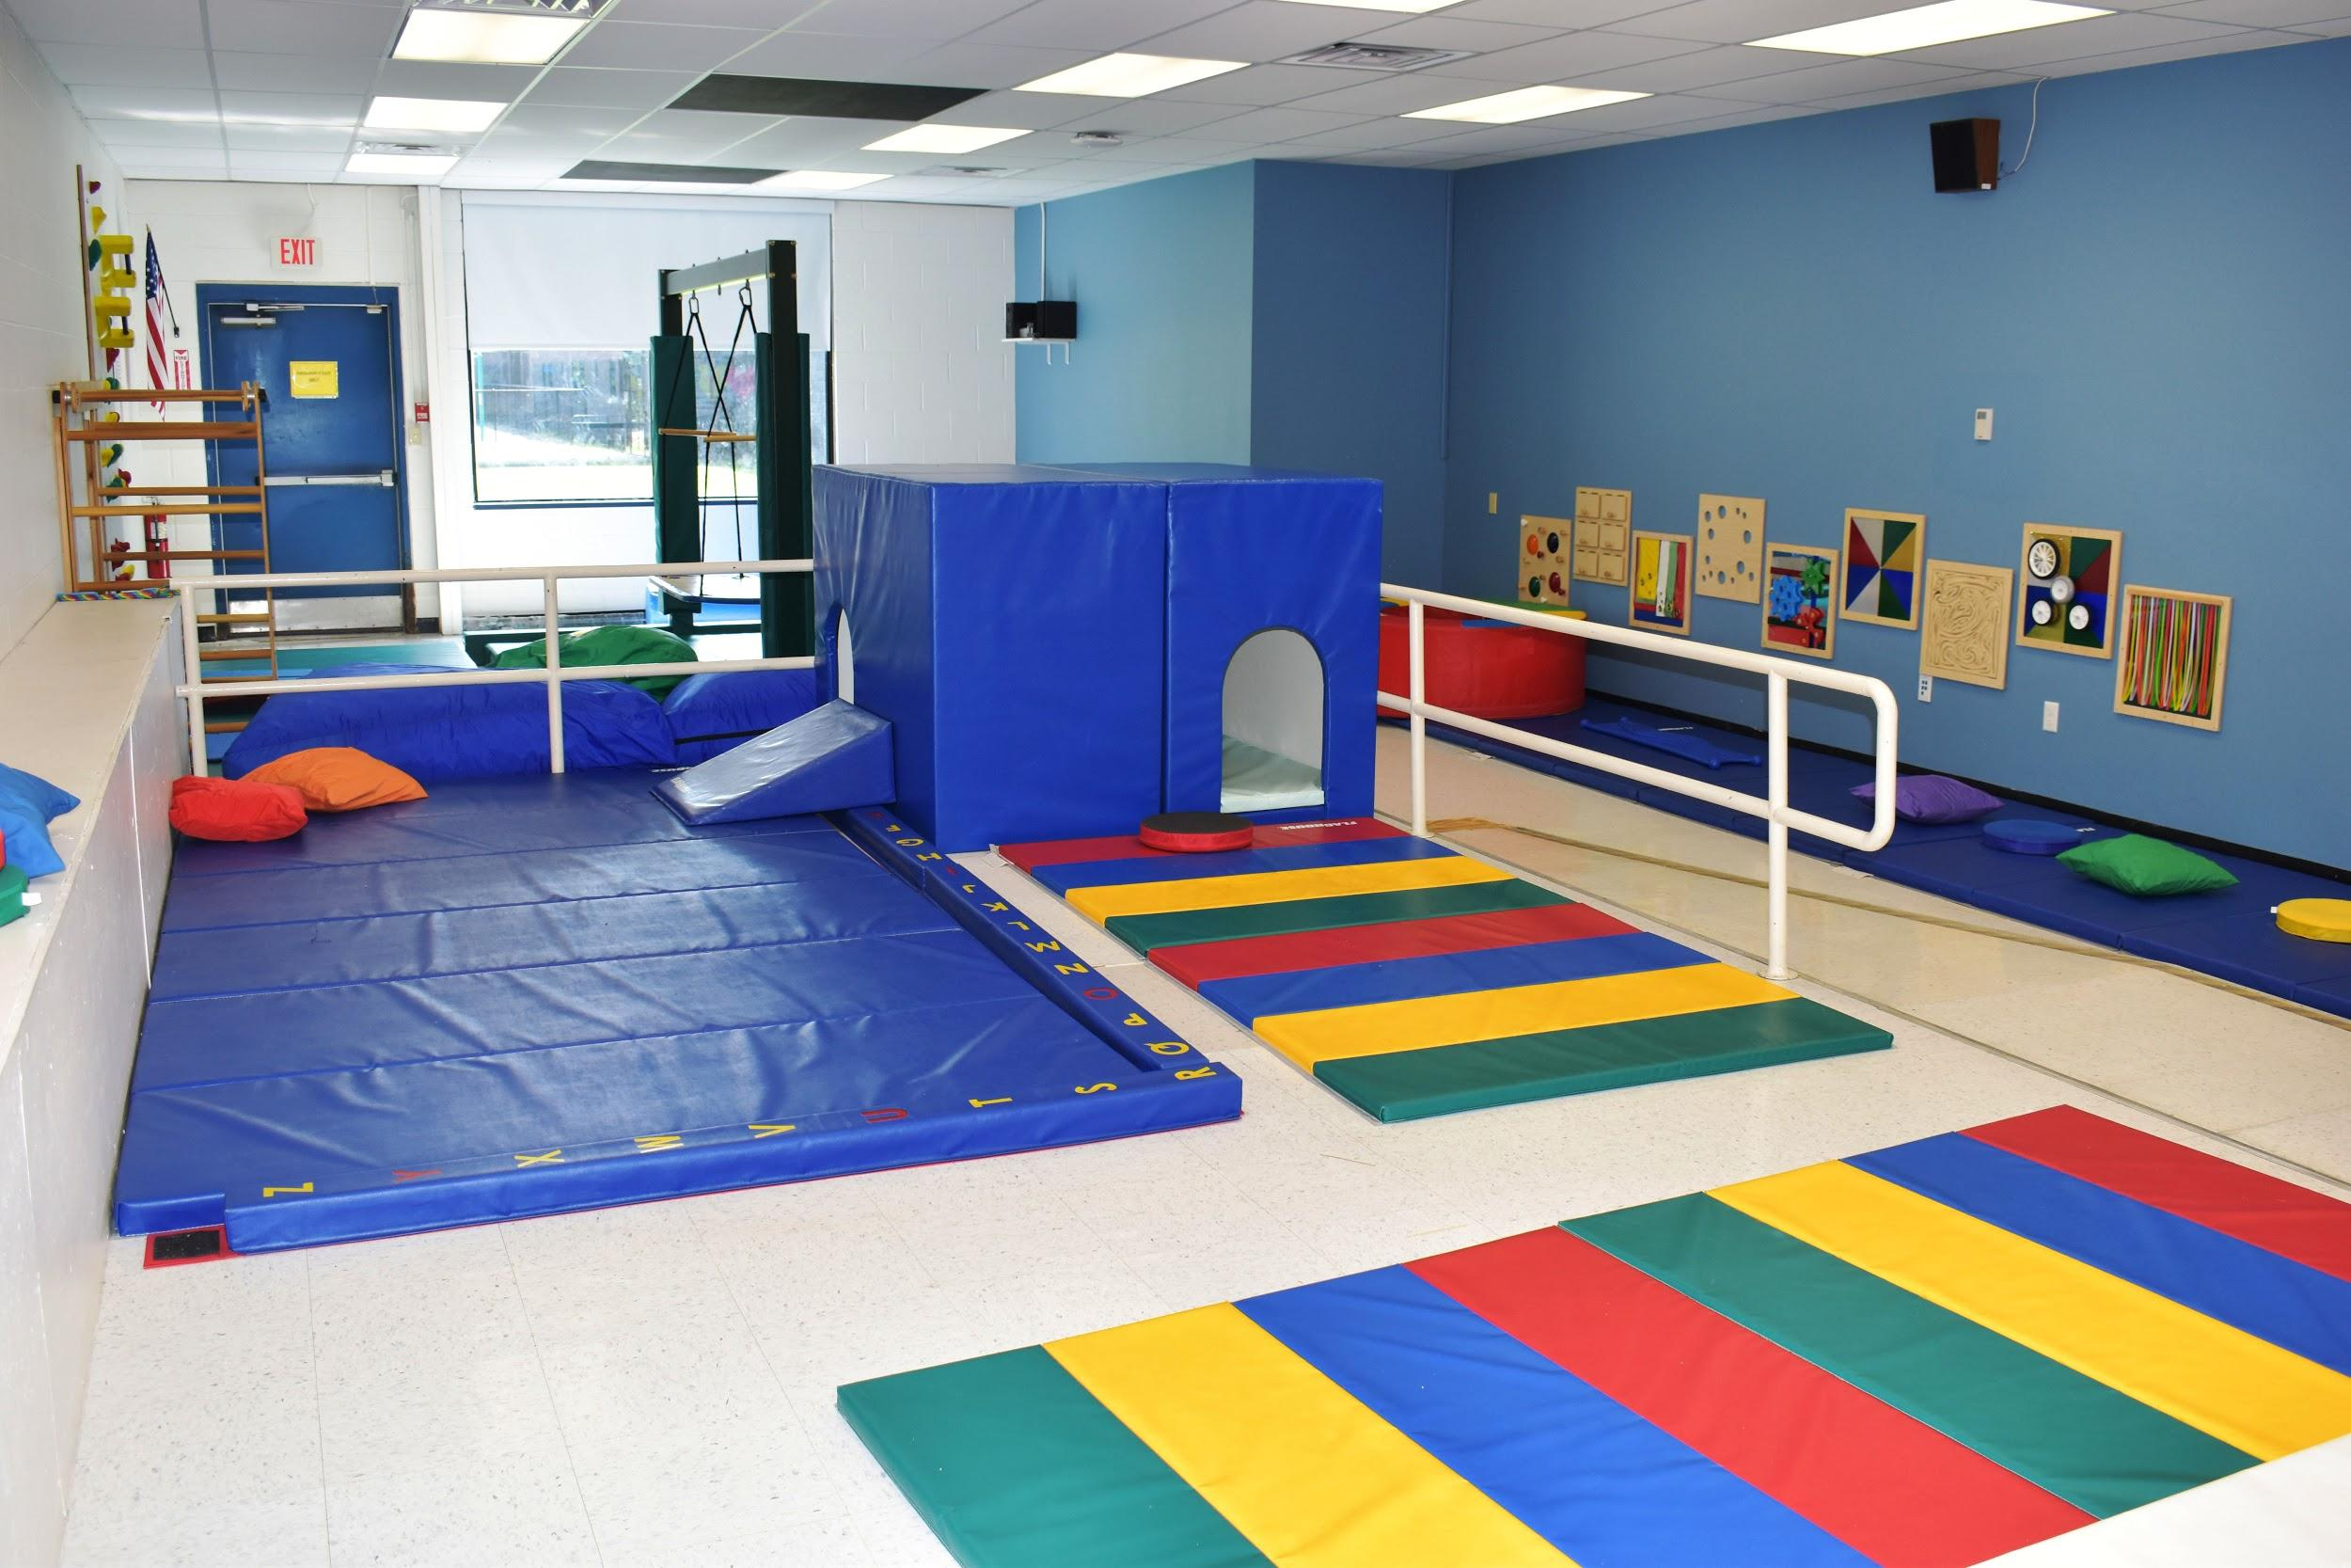
The Benefits
This building was specifically designed for students at OCM BOCES and continues to meet our needs.
Notes:
Because of the nature of the varied services a BOCES provides, facilities can be a challenge. Some of our services are provided centrally, others are provided in our component school districts. While leasing provides flexibility, it is not necessarily the most cost-effective approach.

Slide 32
#1 Benefit:
The purchase of Crown Road Campus would result in no additional cost
to our 23 component districts.
Notes:
Because of the nature of the varied services a BOCES provides, facilities can be a challenge. Some of our services are provided centrally, others are provided in our component school districts. While leasing provides flexibility, it is not necessarily the most cost-effective approach.

Slide 33
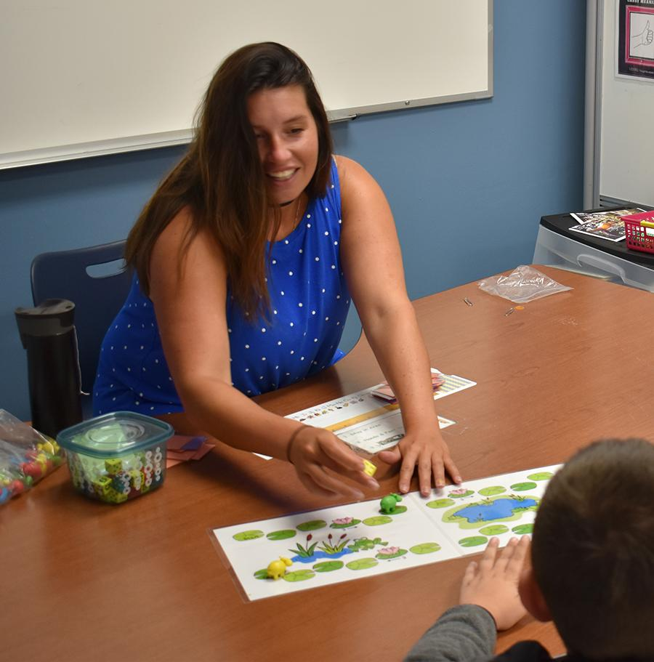
Summary of Benefits
Maintain a quality facility for our students
Discontinue lease payments —
better return on investment for districts
Net cost of purchase to component districts = $0
Notes:
Highlighted points

Slide 34
Next Step
Purchasing the Crown Road Campus requires a referendum of the qualified voters of the OCM BOCES district.
Notes:
A referendum is required to approve the purchase of the building.

Slide 35
Voting Eligibility
To be eligible to vote, residents must be:
A citizen of the U.S.
18 years old or older
A resident within an OCM BOCES component district for 30 days prior to the referendum
Notes:
A referendum is required to approve the purchase of the building.

Slide 36
Voting Eligibility
Voters do not need to be an officially “registered” voter, but they will be asked to show proof of residency.
Notes:
A referendum is required to approve the purchase of the building.

Slide 37
Voting Locations
OCM BOCES Main Campus
110 Elwood Davis Road, Liverpool
Crown Road Campus
4500 Crown Road, Liverpool
Cortlandville Campus - McEvoy
1710 NYS Route 13, Cortland
Thompson Road Campus - Henry
6820 Thompson Road, East Syracuse
Notes:
A referendum is required to approve the purchase of the building.

Slide 38
Voting Date & Time
Tuesday, November 19, 2019
10 a.m. to 8 p.m.
Notes:
A referendum is required to approve the purchase of the building.

Slide 39
Learn More
ocmboces.org/crownroadcampus

Slide 40
Questions?

