Slide 1
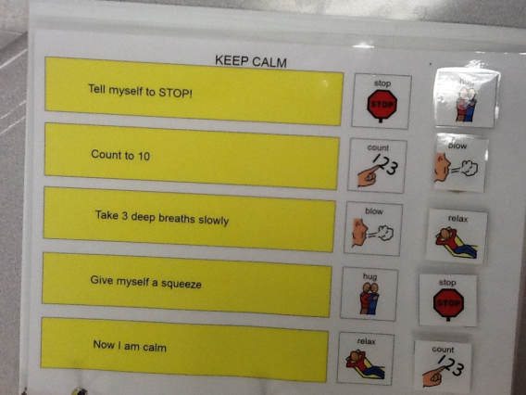
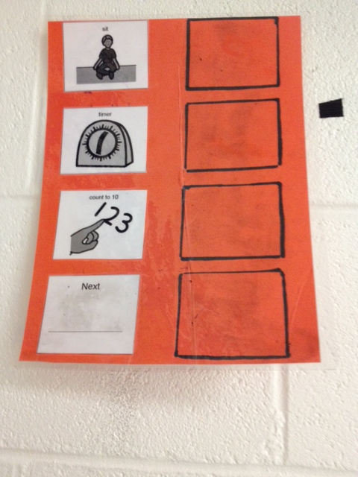
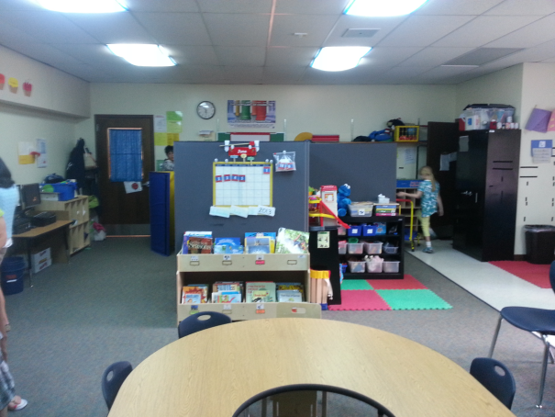
CETAS:
Past - Present - Future

Slide 2
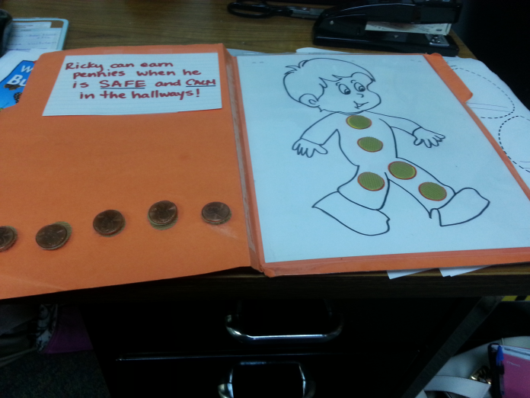
Currently What is CETAS
CETAS is a collaborative consultation and support service designed to assist school districts with students who require:
specialized academic
behavioral strategies
technological interventions to promote successful student outcomes.

Slide 3
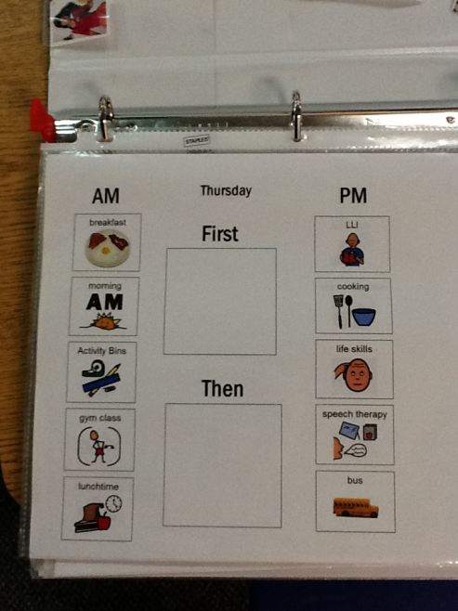
What’s the Goal
FIRST:
To collaborate with school districts
Provide supports for students, classrooms, and building wide with positive behavioral supports
THEN:
Provide follow-up, coaching, training,
and consultation

Slide 4
Staff Development
CETAS provides district-based supports for staff, administration, students, and families in the following ways:
Changing classroom / building climate to be more proactive
Responding effectively to students with challenging behavior
Classroom observation feedback and consultation
Effective FBA / BIP development following NYS regulations (pre / post data collection and progress monitoring)
Crisis Intervention Strategies
Coaching for paraprofessionals and specialized workshops

Slide 5
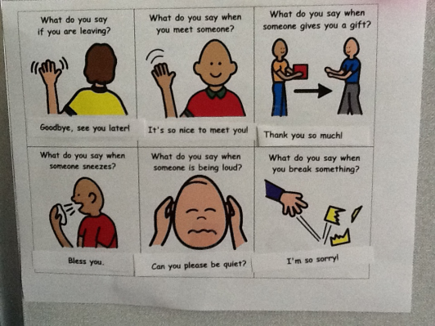
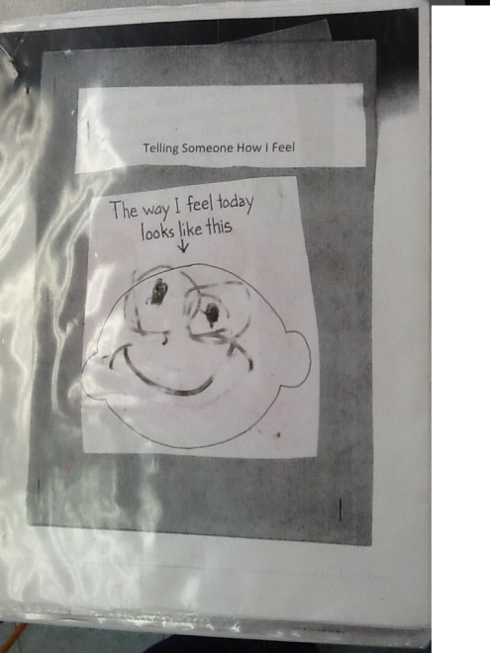
Workshop
FBA / BIP development (state regulations, data collection, progress monitoring)
Strategies for children with Executive Functioning Deficits
Classroom Behavior Management
Learning Styles
Building Independence
Assistive Technology

Slide 6
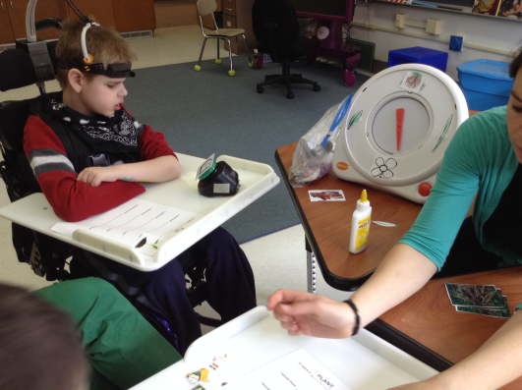
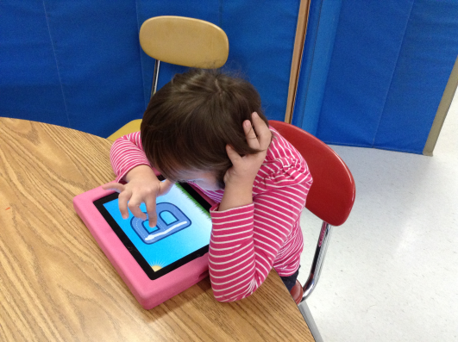
Assistive Technology Services
Maureen Aliani, OTR/L
Marianne Hunt, M.S Speech and Lanugage Therapist

Slide 7
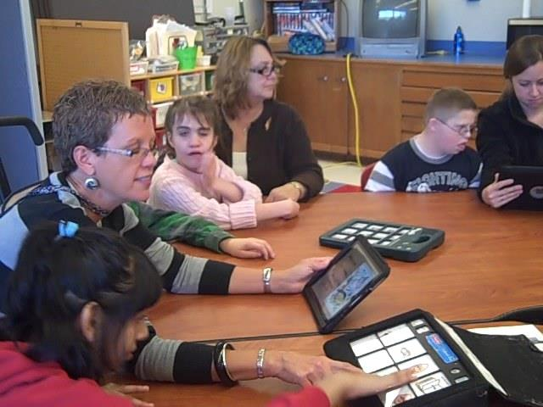
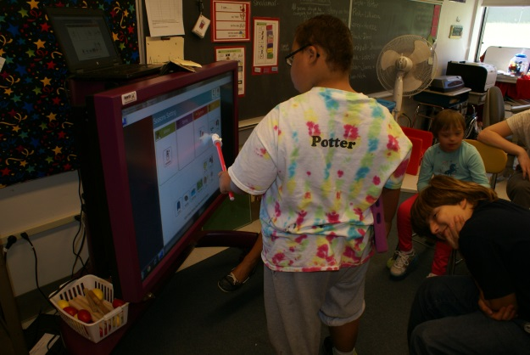
AT Services
Training: integration of technology into curriculum
Training: use of technology for student support (schedules, timers, organization, and data tracking)
Training: effective use of augmentative communication devices in school

Slide 8
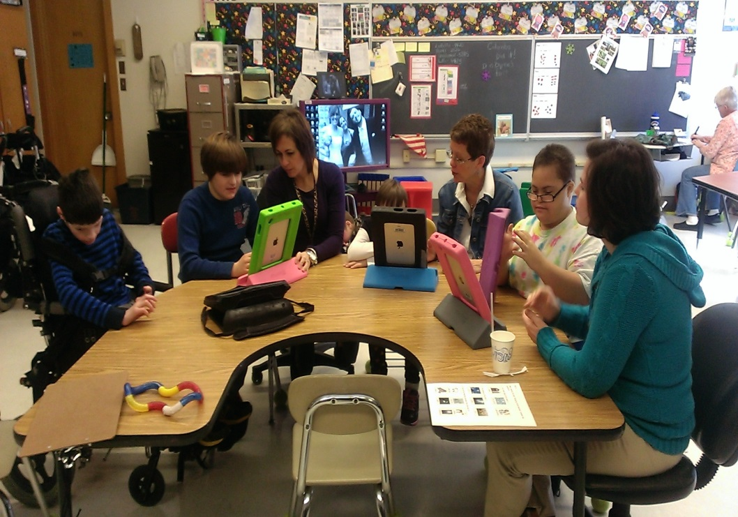
Technology integrated with curriculum

Slide 9
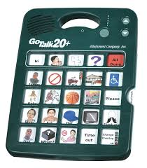
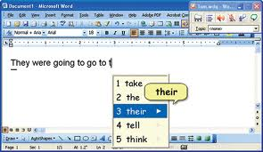
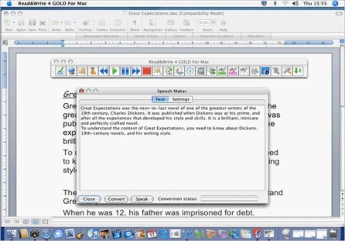
AT Services
Evaluation/consult: augmentative communication
Evaluation/consult: technological supports for struggling readers/writers
Evaluation/consult: access to technology for students with cognitive or physical disabilities

Slide 10
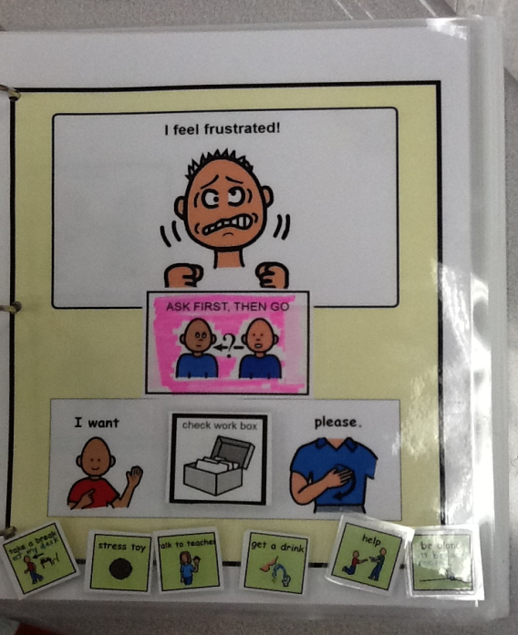
Billing
Full Day Consultation / Workshops
$765.00
Half Day Consultation / Workshops
$383.00

Slide 11
Contact Information
Dominique Ricciardelli, Psy.D
dricciardelli@ocmboces.org
All CETAS requests and forms
Are found on the OCMBOCES
website under the special education tab
- Parent permission is required
There are specific request forms NOT green sheets

