Slide 1
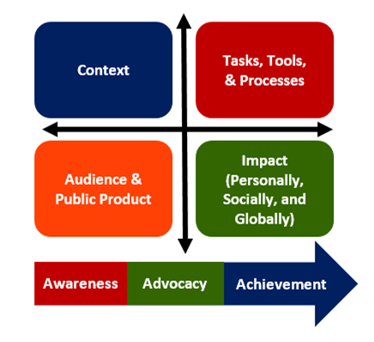
Authenticity
Notes:
The more authentic the project the more likely that students will be motivated and engaged to achieve at higher levels.
Context: Bringing learning to life, why do I need to know this? And matches what happens in the real world. This is where you could have a simulation as means to reach this type of authenticity.
Tasks & Tools: match what people do in the real world
Impact on the world: Making a difference in their community or the world
Personal Impact: Speaks to students’ personal concerns, interests or issues in their lives or cultural community.

Slide 2
Selecting Products
Individual
Team
Written Argument
Team Debate
Research
Infographic
Process Report
Flow Chart
Blog
Interactive Timeline
Reflection Paper
Proposal Presentation
Notes:
Here are ways we can create both Individual and Team Products/Performances
Individual might write an argument to prepare for a team debate…etc (Work across)

