Slide 1
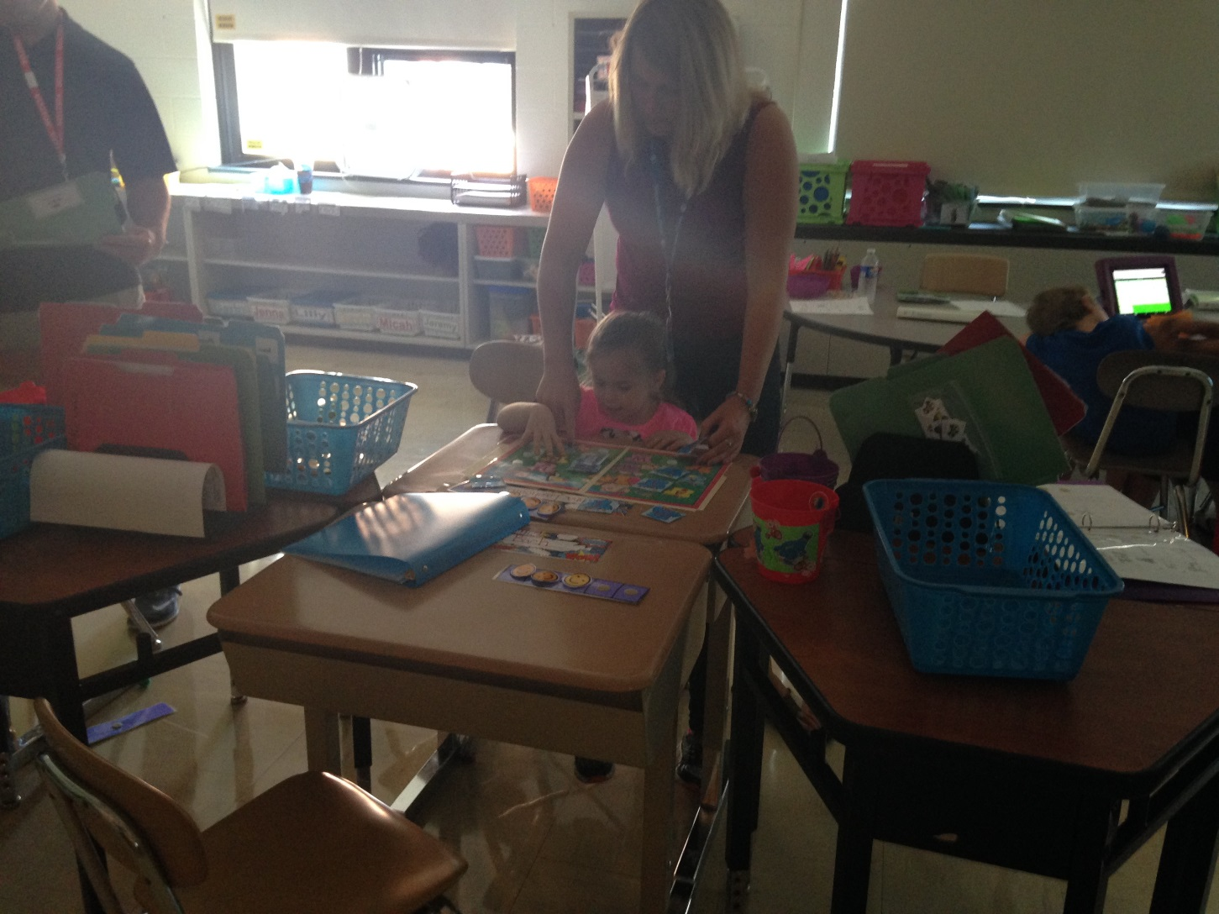
One to One Teaching Assistant Support

Slide 2
1:1 TA Process in OCM BOCES
Three forms:
Requesting TA support:
Reviewing annually TA support
Students entering a BOCES program with
adult support.
All forms have a review process with the teacher, direct supervisor, and special ed director’s signature .

Slide 3
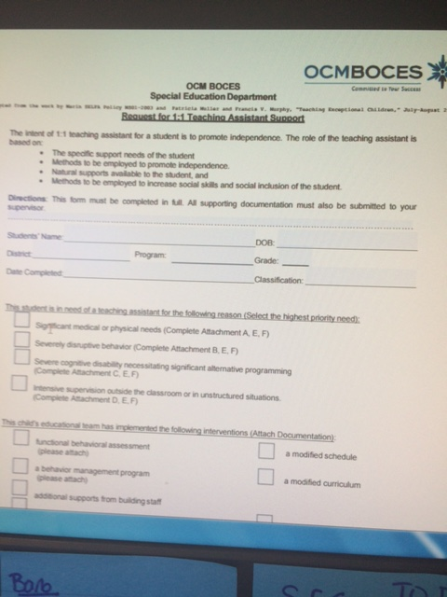
Request for 1:1 TA
Administrator observation
Plan to fade support
Rubric for targeting student independence

Slide 4
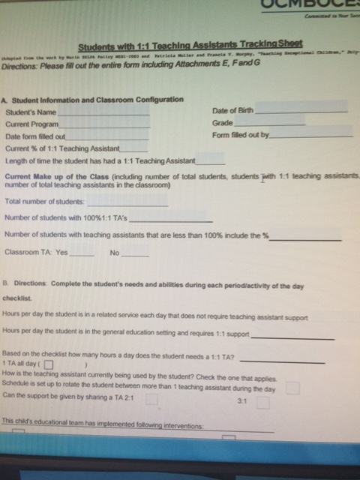
Students with 1:1 TA Support
Target areas or skills to promote student independence based on the rubric
Observation checklist
Reviewed annually

Slide 5
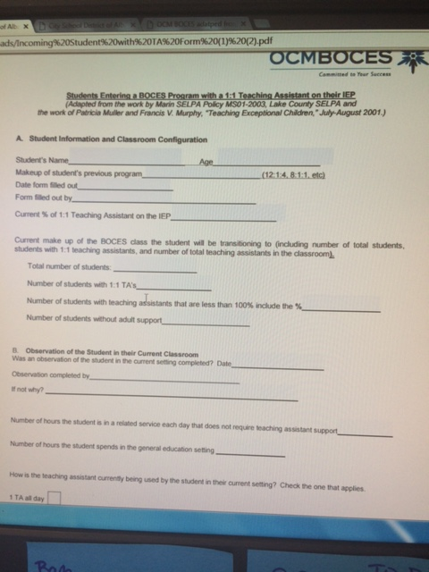
Students who enter the program with a 1:1 TA
Review of classroom student is entering from
Review of staffing in the current classroom
Review of needs

Slide 6
Forms
Forms should be sent to the district prior to the scheduled CSE meeting for review
Forms should have all necessary signatures
Questions?

