Slide 1
PBLNY Project-based Learning for All
Engaging and Challenging Students with Disabilities
Randi Downs and Rosanna Grund

Slide 2
The Training
3 Full Days
Co- Facilitated
Multi-disciplinary teams ( special ed teachers, program teaching assistants, related service providers)
Training specialized for special classes
On going coaching to support planning and implementation

Slide 3
“When Children develop a sense of themselves as successful problem solvers who can change the world, they are assets to themselves, their families, our communities, and the world.”
Sylvia Martinez

Slide 4
PL 94-142 and IDEA
“requires that all students have access to the same rich curriculum as all other students and that they be held to the same level of accountability as all other students. With those requirements, there can no longer be different curricula and standards…”

Slide 5
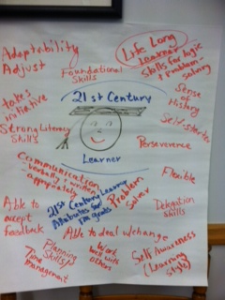
We asked teachers to share outcomes for their graduates…

Slide 7
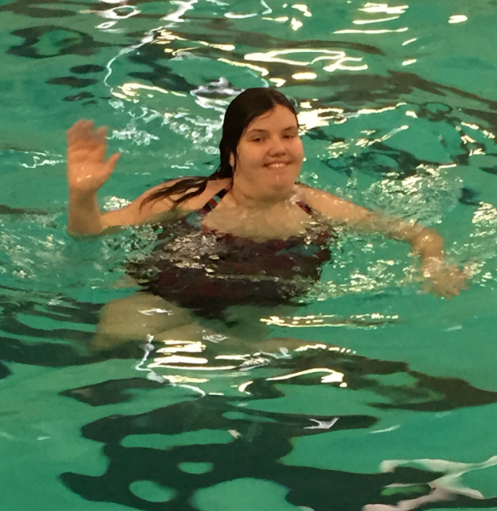
Challenging Question:
How do we help our students develop a sense of themselves as successful problem solvers who can change the world so they become assets to themselves, their families, our communities, and the world?

Slide 8
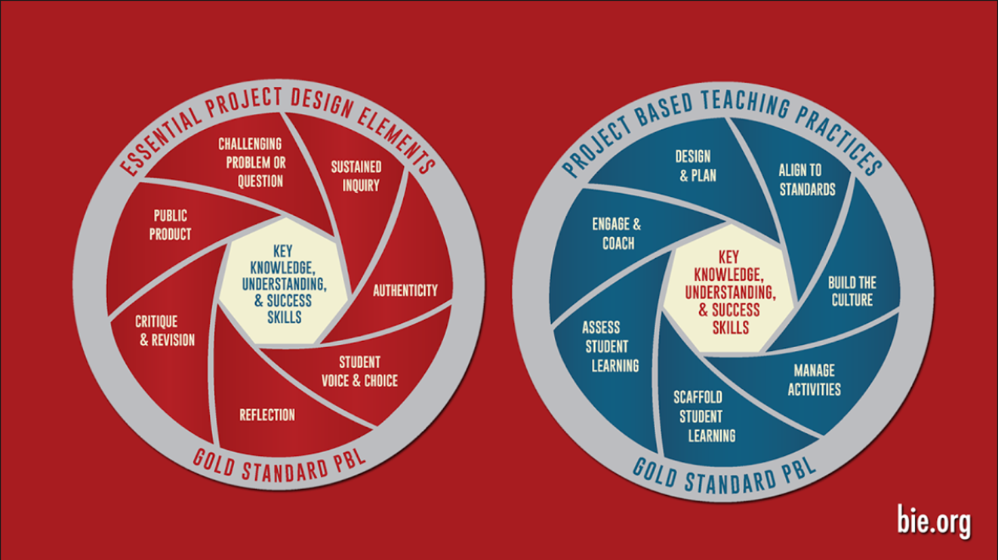
Buck Institute Gold Standard PBL

Slide 9
Key Knowledge, Understanding, & Success Skills
What IEP goals might be assessed through the PBL experience?
What success skills will students practice and acquire?
Where will our students need extra support?

Slide 10
Our Journey (Fishbowl Reflection May 2015)

Slide 11
Significant Content Activity- Unpack the Core
•Select a grade level that is typical of your students
•Select a Common Core Standard within that grade level
–Unpack the Standard
–Analyze the sub-skills
•Present your standard and results
Include accommodations you would need to make
OSPI/WEA

Slide 12
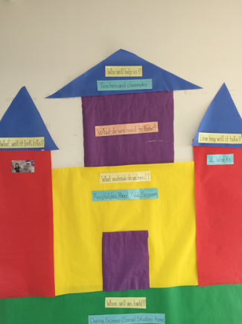
NYSAA

Slide 13
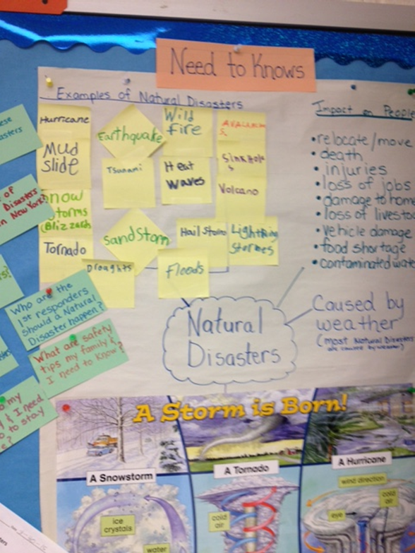
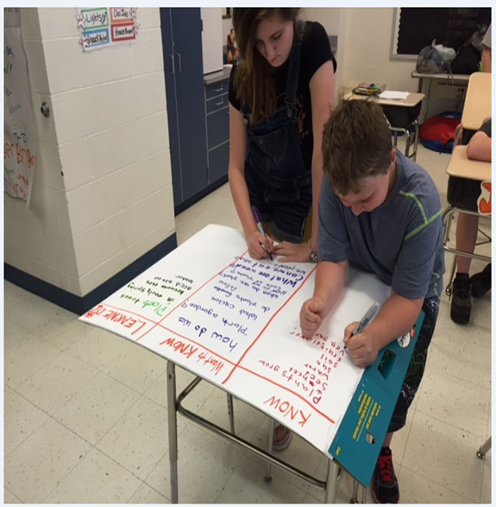
PBL to Promote Inquiry

Slide 14
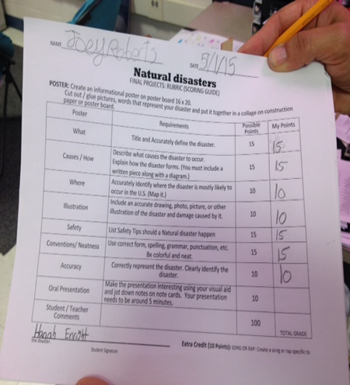
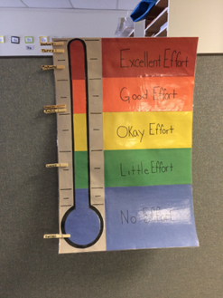
PBL to Assess the Learning

Slide 15
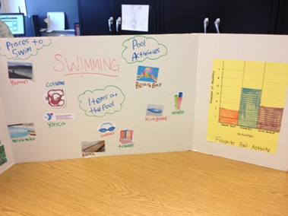
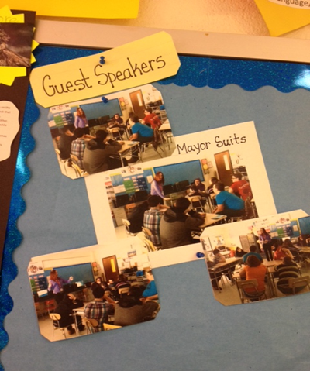
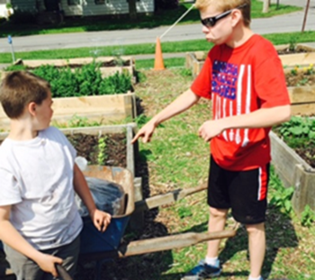
PBL to Engage with the Community

Slide 16
From Planning to Action
Please Welcome…
Kelly Buck: Teacher for the “Team” classroom at Solvay Middle School
Sarah Snyder: for the “Stellata” program at OCM BOCES McEvoy (Now at “SKATE” at Homer Elem))
Ann Currie: STAR at Homer Elementary

Slide 17
Thank you!
rdowns@ocmboces.org
rgrund@ocmboces.org
@randidowns45

