Slide 1
Examples of FBA / BIP
Progress Monitoring Data

Slide 2
SchoolTools:
Started to train the Social Workers
Hope to have all FBA / BIPs uploaded for the end of the school year

Slide 3
FBA Must Haves: BIP Must Haves:
 | Obtain parental consent
 | Contact student’s home district to request parental consent for completion of an FBA/BIP. District will ask if the parent has been notified District may ask for a written justification for an FBA Follow-up with district monthly to monitor status of consent
 | Identify the behavior in concrete terms (observable, measurable, concrete language)
 | Behavior should be identified as a team (staff members working with student)
 | Identify contextual factors that contribute to the behavior
 | Collect data and gather information
 | Identify sequence of events that reliably predict the behavior (Antecedent Events, Setting Events, Maintaining Consequences)
 | Direct observation of student – Collect Baseline Data. Observe student for at least 10-20 minutes across settings over at least three occasions or until data is stable. Data should address frequency, duration, latency, intensity.
 | Complete interviews with teacher, parent and student (if appropriate)
 | Complete motivation / behavior checklists
 | Review student records (academic, behavior, assessments, medical)
 | Generate hypotheses statements
 | Global Hypothesis: “(Student) is a young person who enjoys…. And is interested or successful in …. Student might benefit from….”
 | Specific Hypothesis: “When (describe context), this student (describe behavior) to (get / avoid consequences). This pattern is more likely to occur when…
 | Build a “Competing Behavior Pathway” to identify possible elements of a behavioral intervention plan
 | Includes setting event, triggering antecedent, desired / problem / replacement behaviors and maintaining consequences
 | Replacement behavior should ultimately lead to desired behavior
 | Replacement behavior and problem behavior must have the same function
 | Replacement behavior must be easier or more motivating for the student
 | Determine need for development of a Behavior Intervention Plan
 | Review following guidelines to determine next steps: The CSE or CPSE shall consider the development of a BIP, as such term is defined in 200.1(mmm) for a student with a disability when: (i) the student exhibits persistent behaviors that impede his or her learning or that of others, despite consistently implemented general school-wide or classroom-wide interventions; (ii) the student’s behavior places the student or others at risk of harm or injury; (iii) the CSE or CPSE is considering more restrictive programs or placements as a result of the student’s behavior. Section 201.3 If the manifestation team makes the determination that the behavior was a manifestation of the student’s disability – conduct and implement and /or modify the BIP.
 | A Behavioral Intervention Plan must include:
 | Baseline measure of problem behavior, including frequency, duration, intensity and / or latency of targeted behaviors. Baseline measure must include data taken across activities, settings, people and times of day. Baseline will be used as a standard to evaluate intervention effectiveness.
 | Expected behavioral changes (general outcome, long and short-term goals, maintenance & generalization)
 | What methods will be used to measure and monitor progress toward goals (How will progress be recorded, at what frequency and by whom?)
 | What form will data be collected, displayed and shared in?
 | Create decision rules / criteria to determine if the BIP should be maintained, faded, modified or discontinued
 | Determine individual responsible for monitoring progress and integrity of implementation
 | Intervention Strategies
 | Strategies to alter antecedent events and prevent the occurrence of behaviors
 | Strategies to teach individual alternative and adaptive behaviors to the student
 | Provision of consequences for targeted inappropriate behavior(s)
 | Provision of alternative, acceptable behaviors
 | Procedural steps for crisis intervention
 | BIP must include the individual(s) responsible for each step
 | Schedule to measure effectiveness of the interventions
 | Must include frequency, duration and intensity of targeted behaviors at scheduled intervals
 | Progress Monitoring
 | Implementation must include regular progress monitoring of frequency, duration and intensity of behavioral intervention
 | BIP must specify how frequently progress should be monitored and reviewed
 | A student’s need for a behavioral intervention plan must be documented on the student’s IEP and reviewed at least annually by the CSE / CPSE

Slide 4
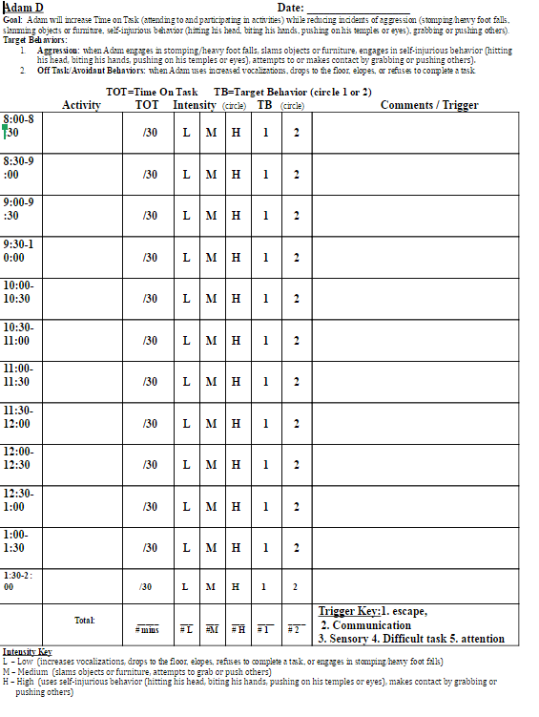
Example of FBA data
Including: Antecedent / Trigger Key
Setting
Duration
Intensity
Latency

Slide 5
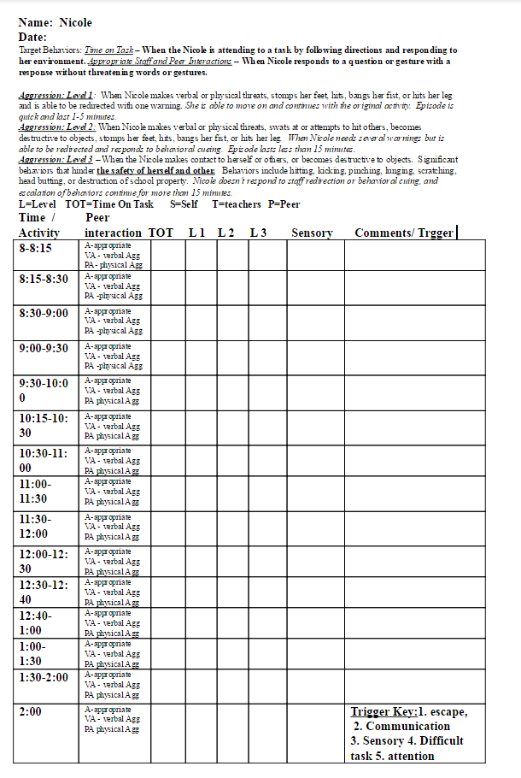
Example of FBA data collection:
Includes: Antecedent key
Intensity
Duration
Latency

Slide 6
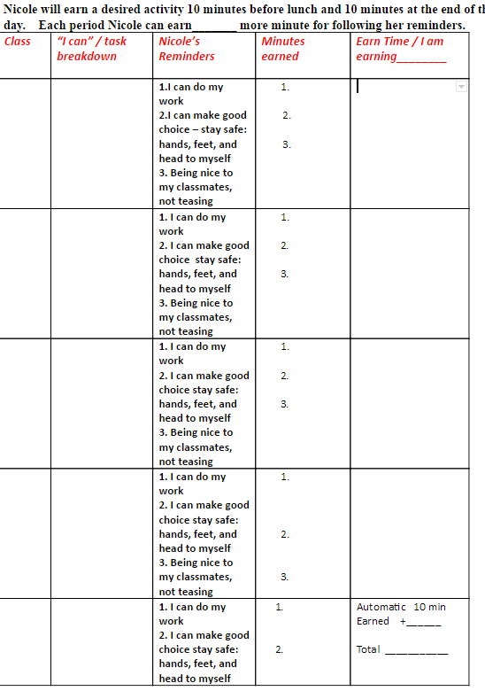
Progress Monitoring for the BIP
Needs to reflect the strategies that are being addressed in the BIP

Slide 7
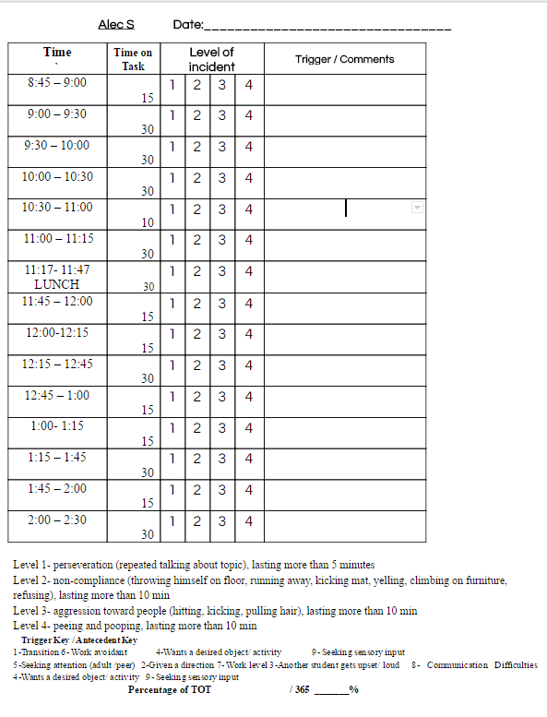
Example of FBA data
Including: Antecedent / Trigger Key
Setting
Duration
Intensity
Latency

Slide 8
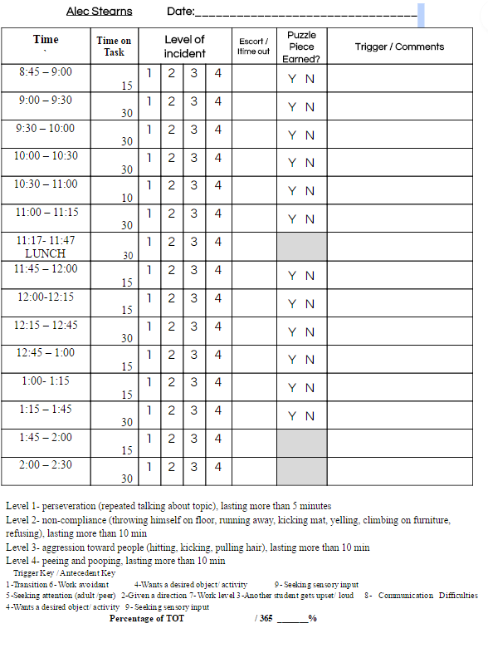
Example of BIP Progress Monitoring Data sheet

Slide 9
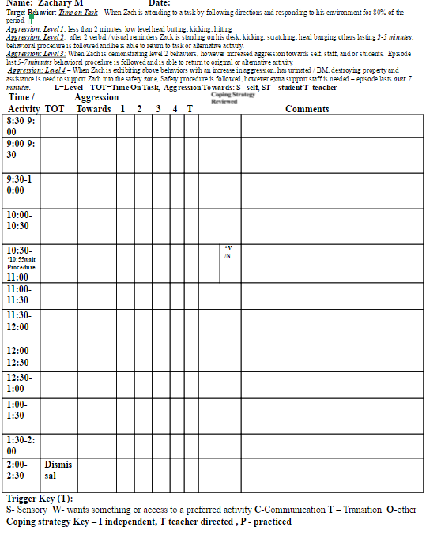
Example of Progress Monitoring for the BIP

Slide 10
Target Behavior: Time on Task – When Zach is attending to a task by following directions and responding to his environment for 80% of the period.
Aggression: Level 1: less than 2 minutes, low level head butting, kicking, hitting
Aggression: Level 2: after 2 verbal / visual reminders Zack is standing on his desk, kicking, scratching, head banging others lasting 2-5 minutes, behavioral procedure is followed and he is able to return to task or alternative activity.
Aggression: Level 3: When Zach is demonstrating level 2 behaviors, however increased aggression towards self, staff, and or students. Episode last 5-7 minutes behavioral procedure is followed and is able to return to original or alternative activity.
Aggression: Level 4 – When Zach is exhibiting above behaviors with an increase in aggression, has urinated / BM, destroying property and assistance is need to support Zach into the safety zone, Safety procedure is followed, however extra support staff is needed – episode lasts over 7 minutes. L=Level TOT=Time On Task, Aggression Towards: S - self, ST – student T- teacher
Time / Aggression
Activity TOT Towards L 1 L 2 L 3 L4 T Comments
8:30-9:00
9:00-9:30
9:30-10:00
10:00-10:30
10:30-11:00
11:00- 11:30
11:30- 12:00
12:00-12:30
12:30- 1:00
1:00- 1:30
1:30-2:00
2:00- 2:30 | Dismissal
Trigger Key (T):
S- Sensory W- wants something or access to a preferred activity C-Communication T – Transition O-other TOT: ________/365, _____%
Greeting Others with Prompts (Please mark Y or N for each trial)1- 2- 3- 4- 5- Greeting Others without Prompts 1- 2- 3- 4- 5-

