Slide 1
BCIC
May 5, 2015
Dr. Richard Allington
Tim Shanahan

Slide 2
Dr. Richard Allington
Professor of Education at the University of Tennessee
Research interests include reading, learning disabilities and effective classroom instruction

Slide 3
Tim Shanahan
Professor at the University of Illinois
Leadership role on the National Reading Panel and helped author the Common Core Learning Standards

Slide 4
Compare and Contrast
Dr. Richard Allington
Tim Shanahan

Slide 5
Conflicting Ideas

Slide 6
Big Ideas
Allington
Shanahan
Match readers with instructional level texts
High success, independent, silent reading
Guided reading with leveled texts (small group)
Silent reading
Increased student talk time; decreased teacher talk time during oral reading
Complex texts and explicit instruction with scaffolding
Accountability for independent reading
Small group with more complex texts
Oral reading prior to reading complex text
Reduce teacher talk time- background knowledge, vocabulary

Slide 7
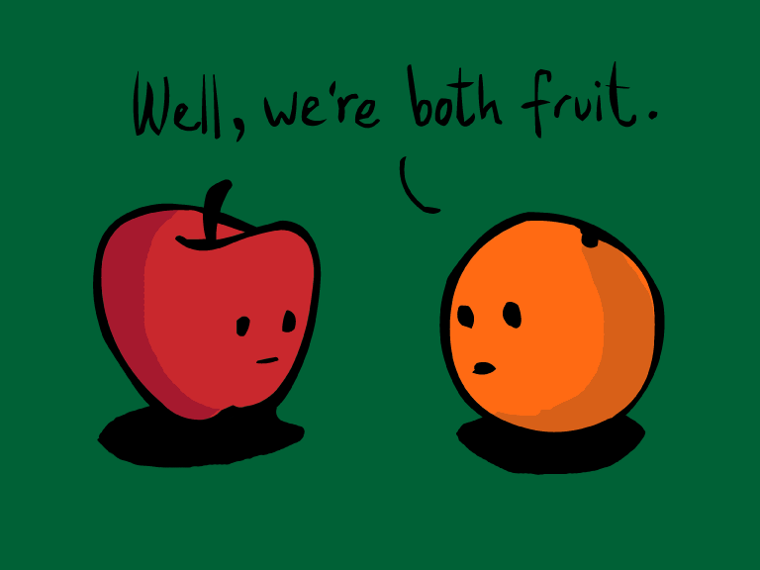
Common Ideas

Slide 8
Common Ideas
Kids need to read more (multiple texts per days, ⅔ of class)
Making meaning, not just isolated skills (more than just decoding)
Focus on strong foundational skills at K-1
Intentional groupings (not just whole group)

Slide 9
Common Ideas
Importance of coherence/connected support services
Importance of literacy in content areas (50%)
Reading outside of the school day (Independent Reading)

Slide 10
Common Idea | Current State | Desired State | Closing the Gap
Volume of Reading- In Class (2/3)
Focus on Meaning
Early Intervention
Intentional Groups
Connection between Core + Intervention
Literacy in the Content Areas (50%)
Volume of Reading- Outside of School

Slide 11
Recommendations
Lesson design with kids doing the reading, writing, thinking and speaking
Balance complex, instructional and independent level texts.
Central text (complex) at grade level
Supplemental texts at instructional and independent level

Slide 12
Recommendations
Scaffolding complex texts to make them an instructional level for students (first identifying the challenging parts).
Intentionally choosing whole group and small group based on the level of scaffolding required by the text.
Teach grammar, sentence structure and vocabulary in the context of reading and writing.

Slide 13
Inquiry Questions
How much time do students spend reading and writing in any given lesson?
How do you balance complex, instructional, and independent level texts throughout a student’s day, week, year?
How might guided reading, or small group instruction, work in secondary classrooms?
What does this look like for students who are significantly below grade level (by more than 4 years) in reading and writing?

Slide 14
16-17 Regional and In-District Offerings
The Teacher’s Literacy Toolbox Series (+ Coaching)
2016-2017 Literacy Leadership Network (Restructured)
Literacy Look-Fors

