Slide 1
BCIC Meeting
June 2016

Slide 2
Welcome
Introductions
Agenda Biggies:
Updates
Planning for 2016-2017
Effective ELA Interventions & Actions

Slide 3
Update and News
June 2016

Slide 4
RTI at Work
Additional seats available*
Response to Intervention at Work Institute will be in Syracuse June 28-30, 2016.
This Solution Tree event will showcase application of PLC!
OCM BOCES has limited discounted seats available for this event. ($489)
TOMORROW is the deadline!

Slide 5
SED Updates
Field Testing
Set-up took some time
Some things did pop up, such as screen orientation, division key, etc.

Slide 6
SED Updates
On-line 3-8 Assessment
On-line testing means on-line scoring
Scorepoint is the platform
Scorepoint can be used with OSC (Optical Solutions Corp)
Be ready for fall selection

Slide 7
SED Updates
CTLE
Questions remain
Still some contention
Guidance expected soon

Slide 8
SED Updates
APPR
Any transition questions?
D questions?
A new plan? E???

Slide 9




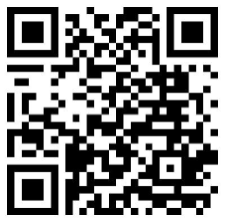

Enjoy HUNDREDS of titles from ASCD, Corwin, ISTE
and Solution Tree, ALL IN ONE PLACE.
Access is FREE using our NEW LINK: slsweb.ocmboces.org/digitalLibrary/ebooks.php

Slide 10


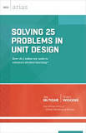


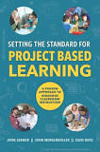



ASCD Titles
All of the 2015 titles just added

Slide 11
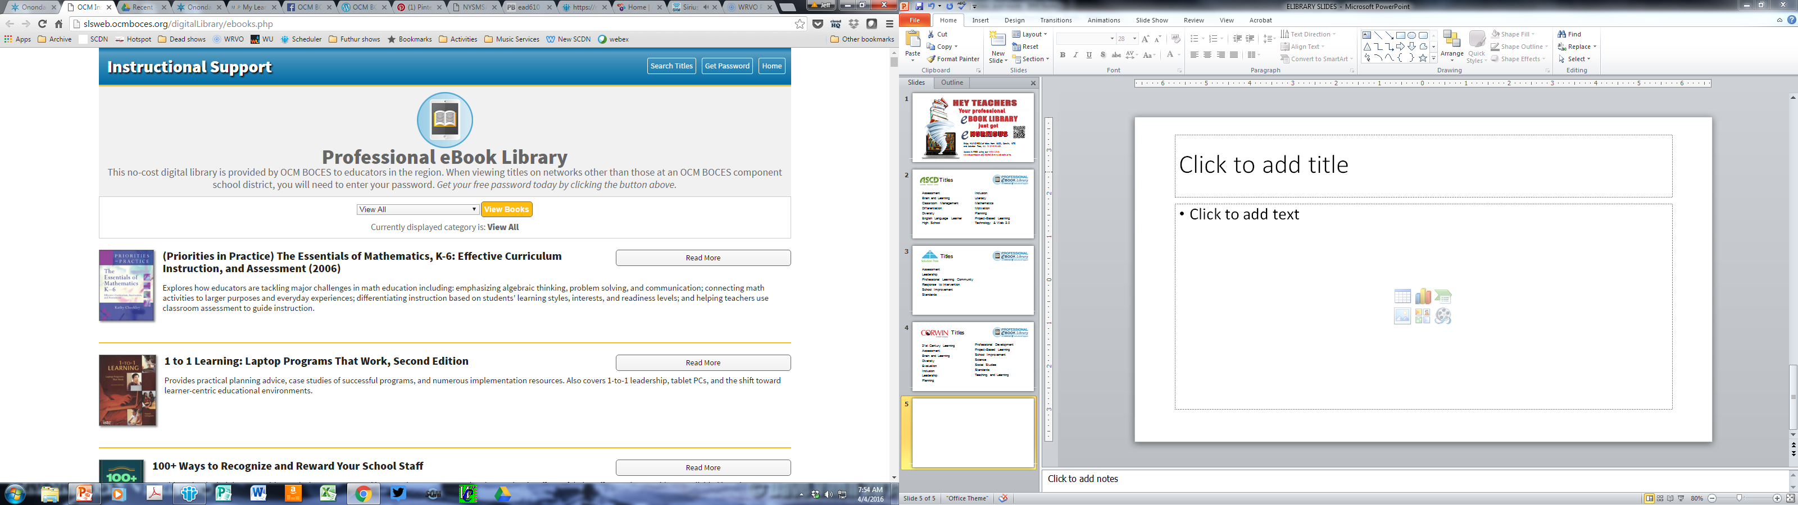
Located under instructional support services at ocmboces.org

Slide 12
You should only need the password outside of an OCM BOCES school: ocmboces

Slide 13
You can browse the entire collection or just certain topics

Slide 14
You can search titles in the whole collection or in topics

Slide 15
With the “Read More” button you can find the text, mp3s, translations, and more.

Slide 16
Enjoy HUNDREDS of titles from ASCD, Corwin, ISTE
and Solution Tree, ALL IN ONE PLACE.
Access is FREE using our NEW LINK: slsweb.ocmboces.org/digitalLibrary/ebooks.php

Slide 17
Regional Vision

Slide 18
PBL Opportunity
Register a team to attend one day of PBL planning and capacity building either June 9 or June 22
This team (minimum of 2- maximum of 8) is then eligible to register for the Summer Making Learning Happen@PBLNY16 for 50% discounted price

Slide 19
Making Learning Happen Project
Teacher librarian(s) & classroom teacher(s) collaboration
Agree to do one deeper learning project, or
Agree to try one makerspace experiment
Participate in several gatherings during the course of the year
Share experience with others
PBLNY “scholarship” for partners/teams

Slide 20
Summer PBL
PBL101 July 25-28
PBL 400 level for administrative teams- July 19 and July 20
PrBL –Problem Based for Math and Science -July 29

Slide 21

Registration Open!
Making Learning Happen @ PBLNY 16 in collaboration with BIE
OnCenter, Syracuse
August 2-5, 2016
Select strand: PBL 101 (BIE), Leadership (BIE), or Open Sessions.
Two keynotes daily!
Vendor exhibits
OCM BOCES component price is $525

Slide 22

New Tech Comes to Cortland
Opening September 2016
Beginning with grades 9 & 10 with 50 learners
Adding grades 11 & 12 in subsequent years
Full enrollment of 100 learners
Districts: Cincinnatus, Cortland, DeRuyter, Homer, Marathon, McGraw, Tully (and potentially more)
Notes:
Rebecca

Slide 23
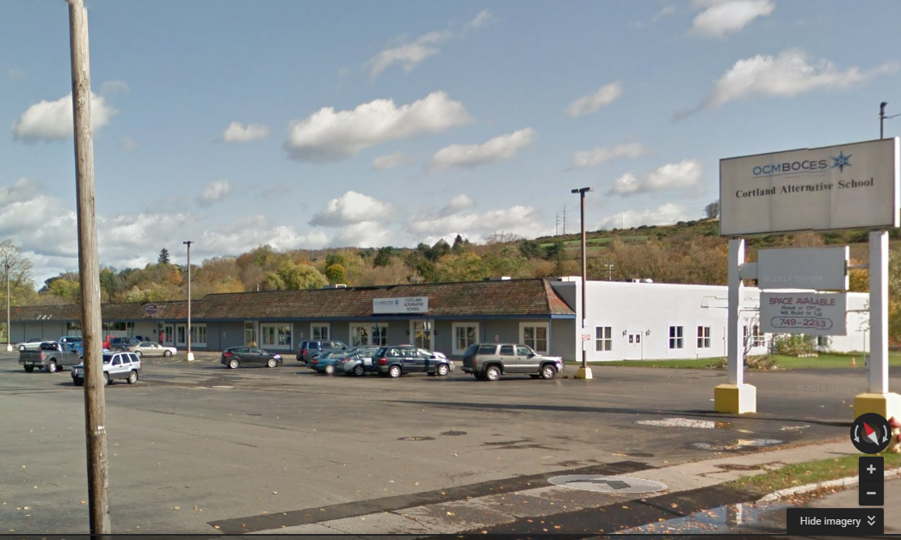
Seven Valleys
Fadden & Associates Physical Therapy
Cortland Alternative School
240 Port Watson St
Notes:
Rebecca

Slide 24
Department Updates

Slide 25

Reminder
Summer Enrollment decisions will be made June 10.

Slide 26
Additional Summer Regional Sessions
Standards Based Planning- Instruction for All July 11-15
Responsive Classroom will also be offered during the summer- August 23-26 in Cortland
Advanced Responsive Classroom
Engaging Academics August 16 and 17
Effective Management August 18 and 19

Slide 27
ITD
Catalog of summer PD is available here:
http://webapps.cnyric.org/itdpdevents.cfm
There is a new curriculum available exclusively for SPHERO. Information can be found here:
http://www.cnyric.org/teacherpage.cfm?teacher=1324

Slide 28
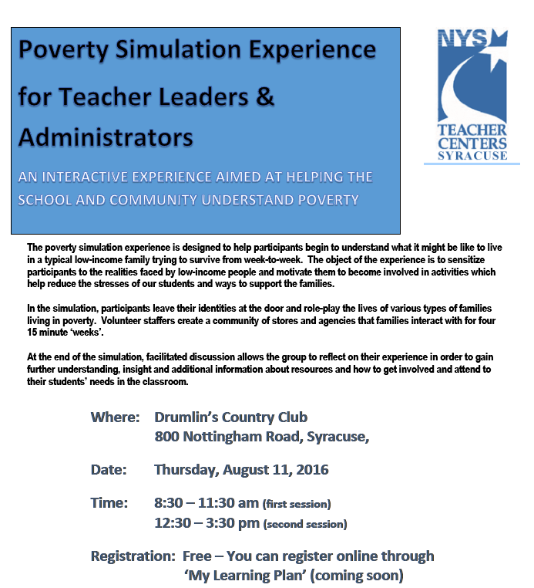
Teacher Centers

Slide 29
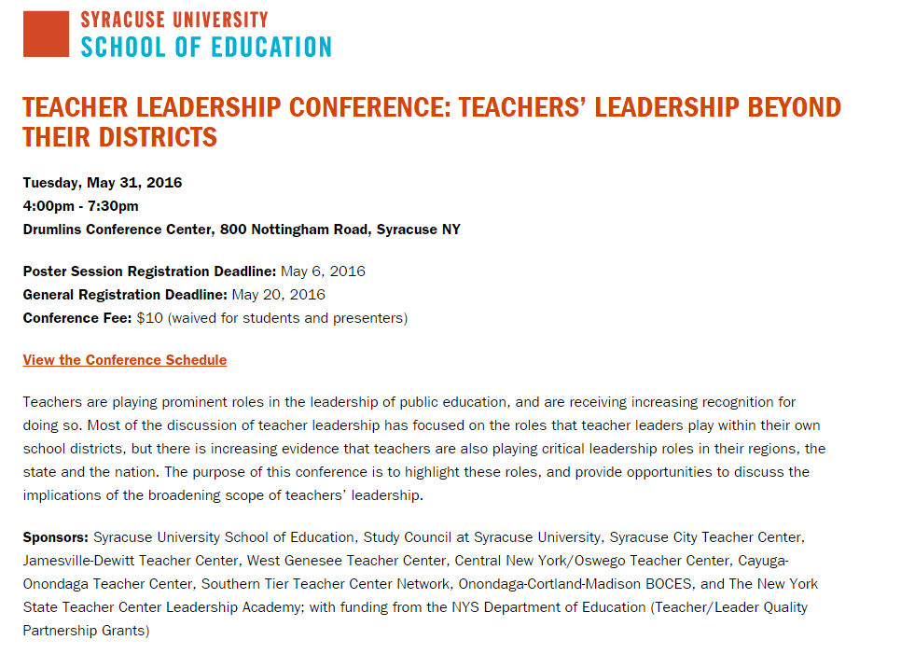

Slide 30
Higher Education

Slide 31
CNY NYS ASCD
Next year’s topics and dates TBD.

Slide 32
K-12 Counseling Plans
Items being prepared for districts:
Maps and timelines
Plans (11x17, of course)
Sample meeting agenda
Checklists, examples statements, etc.

Slide 33
BCIC Meeting
Future Meeting Planning

Slide 34
Next Year
Back to 3rd Thursday
All AM? Test time is avoided in this schedule
Shared doc for notes and minutes
Identify topics in advance for the year
Book to read?
Other ideas?

Slide 35
District Sharing

Slide 36
Sharing Schedule
September:
October:
November:
December:
January:
February:

Slide 37
Standards

Slide 38
Regional Chart
Please update the regional chart:
Module choice
Commercial program implementation
Test choices
https://docs.google.com/spreadsheets/d/1HVCC4MaFiMr_aGRsO4iQhQ8_-UxDusiYUI6PB2SL_28/edit#gid=0

Slide 39
Math
Math Leadership Network
June 8, 1p – 3p
Updates
Focus for the next year

Slide 40
Math
Math Advisory Group
Purpose is to form a cadre of math leaders in the OCM BOCES region to advise/lead math professional development opportunities
At June 8 Math Leadership meeting applications available (minimum of 4)
National Council of Teachers of Mathematics: Oct 31-Nov 2 in Philadelphia
OCM BOCES pay registration and provide transportation (carpool)
District/individual responsible for lodging and meals

Slide 41
Social Studies
Summer Curriculum Work
Summer session for K-4. July 18 - 21
Summer session for 9-12. July 18 - 21

Slide 42
NYSSLS Update
Hopefully BoR receives the standards by the end of June
Possible adoption by BoR early fall
Standards should look very much like the drafts
Implementation of NYSSLS likely to be over several years.

Slide 43
Science Center Updates
Successful year with Science Leadership
Potential for district and/or regional survey coupled with a needs assessment
100Kin10 Grant with Smithsonian
50 K-2 teachers focused on teaching engineering
Pilot Study is near completion (currently conducting interviews with teachers)
Intend to transition from existing kits beginning in 2017-2018 school year
Support for existing kits will continue until replaced

Slide 44


Slide 45
Literacy
Effective Interventions
Allington
Shanahan
Activity: Current State/Desired State

Slide 46
Data

Slide 47
Assessment
3-8 Changes Debrief
Suggested on-line implementation timetable: Is anyone thinking about this yet?

Slide 48
Professional Practice

Slide 49
Planning
Standards Based Planning: Instruction for All
Summer session July 11-15

Slide 50
APPR
Evaluator Training in 16-17
It looks like we’ll run what we did last year:
Year One Lead Evaluator
Ongoing Lead Evaluator Training (3x4) or (3x5)
Ongoing Principal Evaluator Training

Slide 51
Culture

Slide 52
BCIC Meeting
September 15, 2016
Seneca Large Conference Room
Main Campus

