Slide 1
BCIC Meeting
May 2016

Slide 2
Welcome
Introductions
Agenda Biggies:
  Updates
  Professional eBook Collection
  Effective ELA Interventions & Actions

Slide 3
Update and News
May 2016

Slide 4
SED Updates
Assessment
Appeals process modified
Computer-based testing

Slide 5
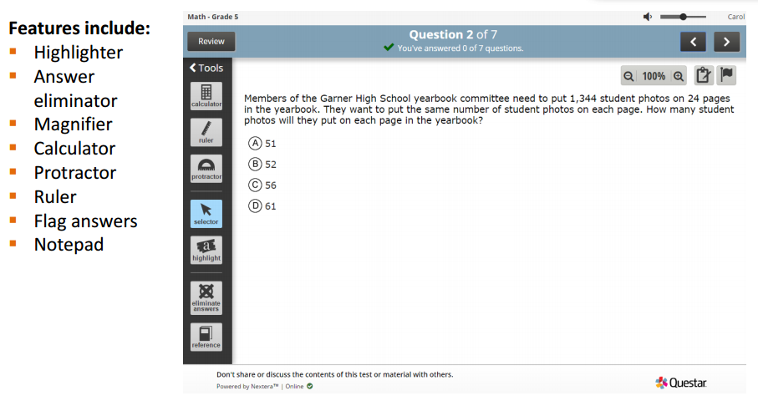

Slide 6
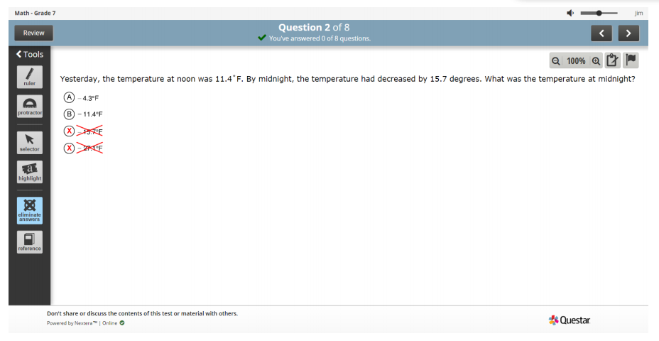

Slide 7
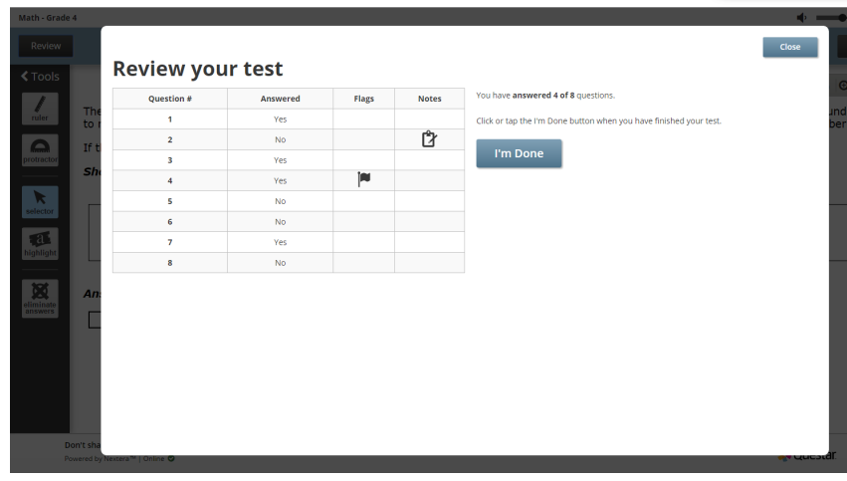

Slide 8
SED Updates
Accountability
Double-testing
A1 in 8th grade
New data requirements
Attendance data and reports
VADIR
AIS

Slide 9
SED Updates
Building Items
Drills changes 12 > 8 + 4
Safety Plans

Slide 10
SED Updates
APPR
Any transition questions?
D questions?
A new plan? E???

Slide 11




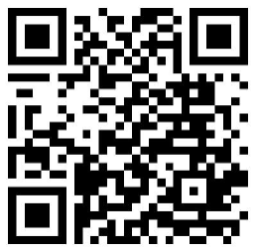

Enjoy HUNDREDS of titles from ASCD, Corwin, ISTE
and Solution Tree, ALL IN ONE PLACE.
Access is FREE using our NEW LINK: slsweb.ocmboces.org/digitalLibrary/ebooks.php

Slide 12





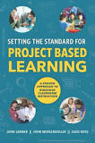



ASCD Titles
All of the 2015 titles just added

Slide 13
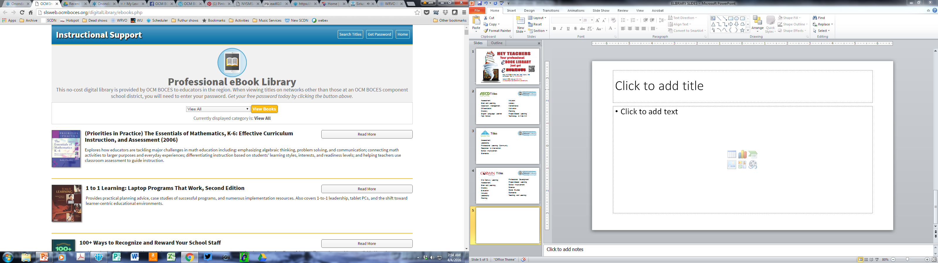
Located under instructional support services at ocmboces.org

Slide 14
You should only need the password outside of an OCM BOCES school: ocmboces

Slide 15
You can browse the entire collection or just certain topics

Slide 16
You can search titles in the
whole collection or in topics

Slide 17
With the “Read More” button you can find the text, mp3s, translations,
and more.

Slide 18
Enjoy HUNDREDS of titles from ASCD, Corwin, ISTE
and Solution Tree, ALL IN ONE PLACE.
Access is FREE using our NEW LINK: slsweb.ocmboces.org/digitalLibrary/ebooks.php

Slide 19
Regional Vision

Slide 20

New Tech Comes to Cortland
Opening September 2016
Beginning with grades 9 & 10 with 50 learners
Adding grades 11 & 12 in subsequent years
Full enrollment of 100 learners
Districts: Cincinnatus, Cortland, DeRuyter, Homer, Marathon, McGraw, Tully (and potentially more)
Notes:
Rebecca

Slide 21
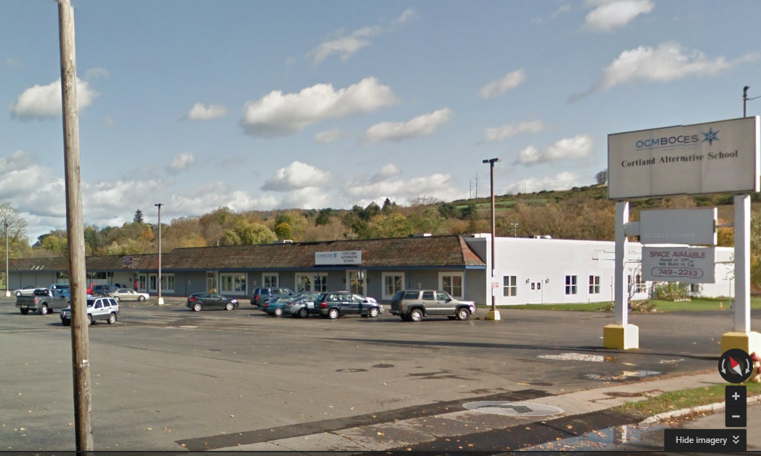
Seven Valleys
Fadden & Associates
Physical Therapy
Cortland Alternative School
240 Port Watson St
Notes:
Rebecca

Slide 22
Project Based Learning
May 11th is the start of the final PBL 101 for this school year.

Slide 23
Summer PBL
PBL 101 July 25-28
PBL 400 level for administrative teams- July 19 or July 20
PrBL – Problem Based for Math and Science July 29

Slide 24

Registration Open!
Making Learning Happen @ PBLNY 16 in collaboration with BIE
OnCenter, Syracuse
August 2-5, 2016
Select strand: PBL 101 (BIE), Leadership (BIE), or Open Sessions.
Two keynotes daily!
Vendor exhibits
OCM BOCES component price is $525

Slide 25
PBL Opportunity
Register a team to attend one day of PBL planning and capacity building either June 9 or June 22
This team (minimum of 2- maximum of 8) is then eligible to register for the Summer Making Learning Happen@PBLNY16 for 50% discounted price

Slide 26

Feedback please
Timing
Cost
Regional Vision not priority for summer work
Keynotes and sessions not relevant

Slide 27
Department Updates

Slide 28
Continuing Leadership and Teacher Networks
Literacy Leadership Network- May 25 is the next gathering.
Instructional Coaches Network -May 12 will be the final session for this school year.
Social Studies Network -May 26 is the final meeting for the year.
Project Based Regional Network -the last session for the year is May 23.

Slide 29
ITD
Catalog of summer PD is available here:
http://webapps.cnyric.org/itdpdevents.cfm
There is a new curriculum available exclusively for SPHERO. Information can be found here:
http://www.cnyric.org/teacherpage.cfm?teacher=1324

Slide 30
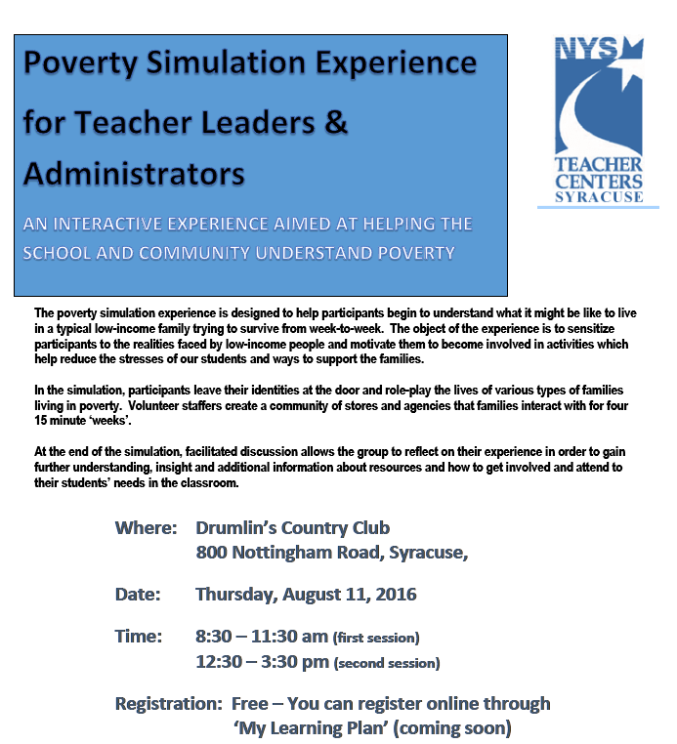
Teacher Centers

Slide 31
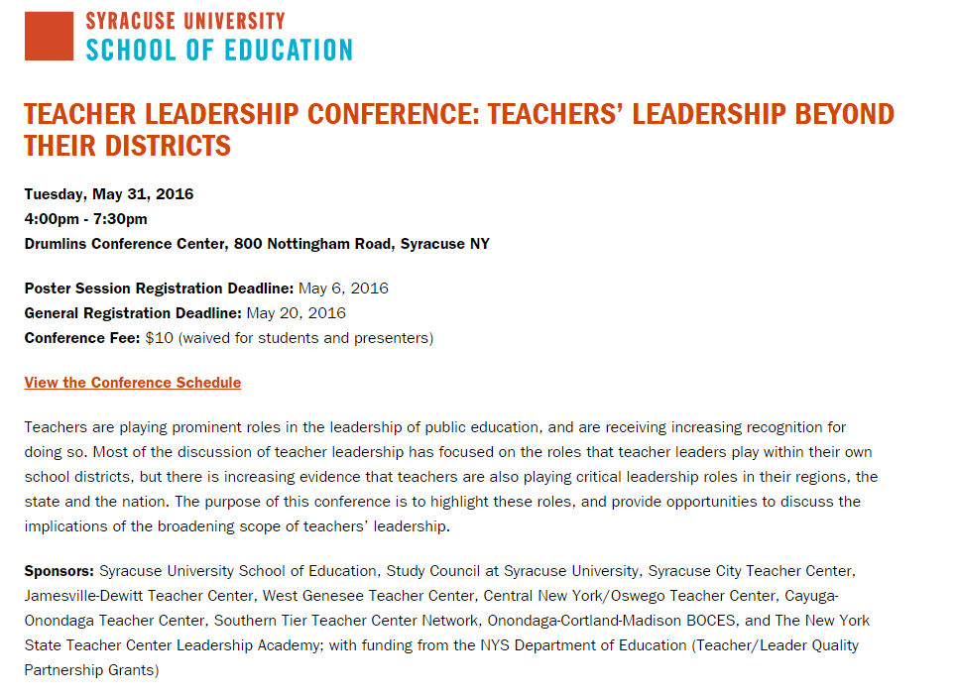

Slide 32
Higher Education

Slide 33
CNY NYS ASCD
May 11 (Laci’s Tapas Bar): Talking about CNY NYS ASCD

Slide 34
K-12 Counseling Plans
Items being prepared for districts:
Maps and timelines
Plans (11x17, of course)
Sample meeting agenda
Checklists, examples statements, etc.

Slide 35
Main Campus Tour

Slide 36
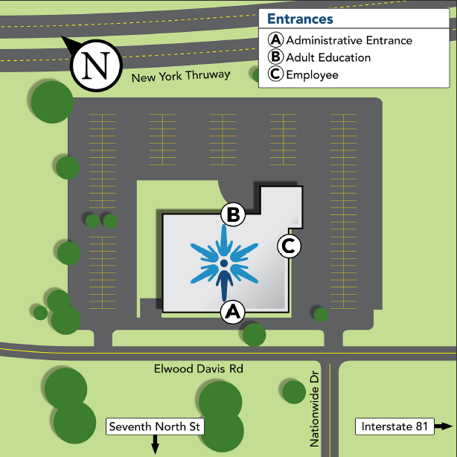

Slide 37
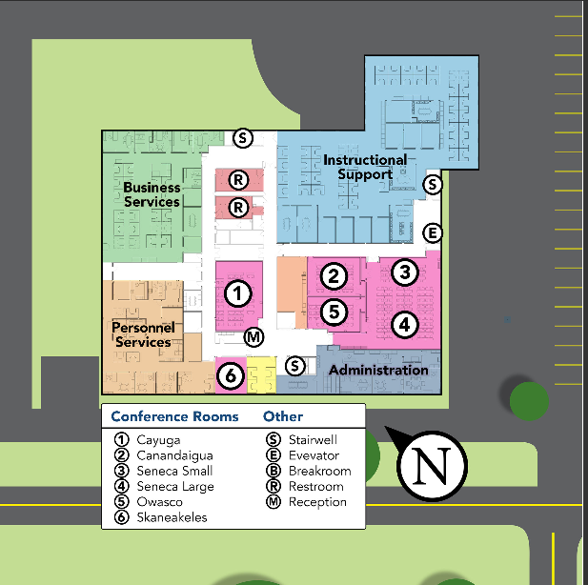

Slide 38
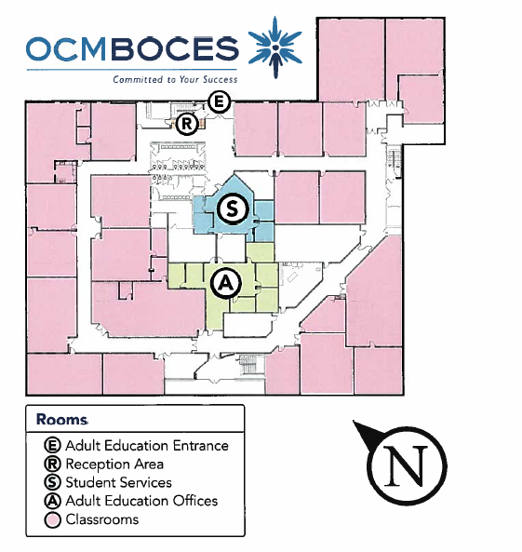

Slide 39
District Sharing

Slide 40
Providing Opportunities
Fayetteville-Manlius Middle schools

Slide 41
Middle School
Building Action Plans
Research diverse course opportunities and master schedule options for middle school students(administrative topic leaders).
Provide additional advanced course opportunities for students in Grade 8.
Increase the number of female students enrolled in Technology & Design department courses.

Slide 42
Grade 8 Schedule Design
Periods 1, 2, 3, 8 & 9
English, Math, Social Studies, LOTE & Science
Periods 4, 5 & 6
Electives, Health, PE & Earth Science lab
Period 7
Lunch
Note: All Program Requirements for Middle Grades in FACS, Health & Technology met by grade 7
http://www.p12.nysed.gov/ciai/mle/mleflex.html

Slide 43
Grade 8 Advanced Courses:
Changes Over Time
2014-15
2015-16
2016-17 (and beyond)
Earth Science
Algebra I Honors
Languages other than English (All students, 2013-14 gr. 7 start French, Spanish, German, Latin)
Studio in Art: Foundations
Music Theory
Earth Science
Algebra I
Languages other than English (All students, 2013-14 gr. 7 start French, Spanish, German, Latin)
Studio in Art: Foundations
Music Theory
Product Design & Engineering
Earth Science
Algebra I
Languages other than English (All students, 2013-14 gr. 7 start French, Spanish, German, Latin)
Studio in Art: Foundations
Studio Music
Product Design & Engineering

Slide 44
Additional Grade 8 Electives
Family and Consumer Sciences
Chorale
Music 8
Computer Applications
Band
Orchestra

Slide 45
Product Design & Engineering
2015-16
20 Week Course 1/2 High School Unit of Credit
This course is designed for students to participate in design, development, production and quality assurance in the production of various products. Computer Assisted Drawing and Design skills will be incorporated in the designing phases. Computer Assisted Manufacturing and various production techniques will be utilized in the fabrication of the products. Students will work with class members in team work and collaborative activities. Members of the class will use the systems approach, problem solving, and analytical skills to solve design and engineering problems.

Slide 46
Product Design & Engineering Enrollment
2015-16
123/364 students = 34%
34% female
2016-17 (projected)
338 students/TBD
TBD

Slide 47
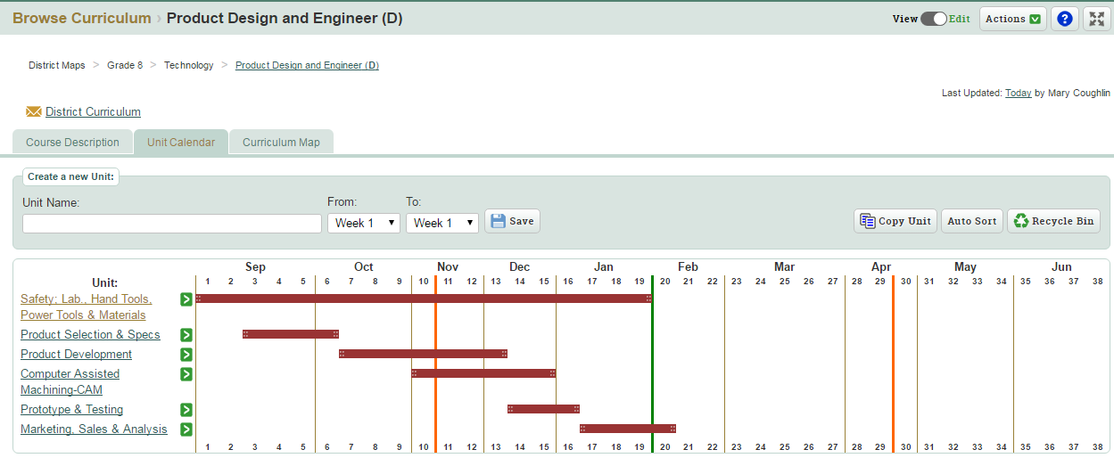

Slide 48
Studio Music
2016-17
20 Week Course ½ High School Unit of Credit
Studio Music is a high school course introducing the concepts of music theory in a technology rich environment. Students will complete projects that might be common in a professional music studio, including jingle writing, soundtracks, and other commercial music. Projects will be produced and recorded with available software such as Sibelius, Finale, Garage Band, and Audacity. Students will develop the necessary skills for authentic performance using a variety of instruments. This course fulfills the prerequisite for Theory II.

Slide 49
“If we’ve helped them evolve into big thinkers instead of small thinkers, then we’ve done our jobs.”

Slide 50
Sharing Schedule
June 2: ESM
September:
October:
November:
December:

Slide 51
Standards

Slide 52
Regional Chart
Please update the regional chart:
Module choice
Commercial program implementation
Test choices
https://docs.google.com/spreadsheets/d/1HVCC4MaFiMr_aGRsO4iQhQ8_-UxDusiYUI6PB2SL_28/edit#gid=0

Slide 53
Math
“Weaving Math Practices into Practice”
May 24th event
Morning will focus on information and background regarding math practices presented by Krystal Barber and AnnMarie O’Neill.
Afternoon structure is small facilitated groups for discussion, application and planning.

Slide 54
Math
Math Leadership Network
June 8, 1p – 3p
Updates
Focus for the next year

Slide 55
Math
Math Advisory Group
Purpose is to form a cadre of math leaders in the OCM BOCES region to advise/lead math professional development opportunities
At June 8 Math Leadership meeting applications available (minimum of 4)
National Council of Teachers of Mathematics: Oct 31-Nov 2 in Philadelphia
OCM BOCES pay registration and provide transportation (carpool)
District/individual responsible for lodging and meals

Slide 56
Social Studies
Summer Curriculum Work
Summer session for K-4. July 18 - 21
Summer session for 9-12. July 18 - 21

Slide 57
Science
The target for getting the new standards to the Board of Regents is June.
Science Advisory May 17th
Science Leadership Network May 17th (special Skype guest to announce a great opportunity for the region)
Science Conference – November 8th
  Details and formal invitations by the end of the month
  Working to keep cost as low as possible
  Hope districts will send K-12 team of teachers and administrators (total attendance capped at 300)

Slide 58
Literacy
Intervention Training
Reading Recovery- Continuing and Initial
Leveled Literacy- Professional Development and on-site support for all levels (color systems)
Sonday System:
  Only Chittenango has requested Sonday 1
  No requests for Sonday 2

Slide 59
LLI Requests
District | K-2- no kits | Intermediate | On-going
Cortland | 2 | 3
DeRuyter | 1
North Syracuse | 1
Onondaga |  | 1 with gold system 1 with no kit
Cazenovia |  |  | 6
Chittenango |  |  | 4
Homer |  |  | 1
Jamesville DeWitt |  |  | 1
Lyncourt |  |  | 3

Slide 60
Literacy
Foundations of Literacy
Six days from September-February ($1500)-REVISED PRICING
Purpose: to develop a strong foundation for literacy instruction of a the elementary level.
Audience: classroom and AIS teachers who provide initial instruction (tier one) and interventions (tier two).

Slide 61
Literacy
Effective Interventions
Allington
Shanahan
Activity: Current State/Desired State

Slide 62
Data

Slide 63
Assessment
3-8 Changes Debrief
Suggested on-line implementation timetable: Is anyone thinking about this yet?

Slide 64
Professional Practice

Slide 65
Planning
Standards Based Planning: Instruction for All
Summer session July 11-15

Slide 66
APPR
Evaluator Training in 16-17
It looks like we’ll run what we did last year:
  Year One Lead Evaluator
  Ongoing Lead Evaluator Training (3x4) or (3x5)
  Ongoing Principal Evaluator Training

Slide 67
Substitute Teachers
Schools and Substitute Teachers
Substitute Teacher Training

Slide 68
Culture

Slide 69
RTI at Work
Additional seats available*
Response to Intervention at Work Institute will be in Syracuse June 28-30, 2016.
This Solution Tree event will showcase application of PLC!
OCM BOCES has limited discounted seats available for this event. ($489)
May 23rd is the deadline!

Slide 70
Classroom Culture
Spring Institute: The Responsive Classroom® Course
Dates for the Spring Institute are: May 25, 26 and June 2, 3.

Slide 71
Classroom Culture
Responsive Classroom
Responsive Classroom will be offered during the summer in Cortland - August 23-26
Advanced Responsive Classroom
  Engaging Academics August 16 and 17
  Effective Management August 18 and 19

Slide 72
BCIC Meeting
Future Meeting Planning

Slide 73
Next Year
Back to 3rd Thursday?
AM, except for test time?
Shared doc for notes and minutes?
Identify topics in advance for the year?
Other ideas?

Slide 74
BCIC Meeting
June 2nd, 2016
Cayuga Conference Room
Main Campus

