Slide 1
New York State Science Learning Standards

Slide 2




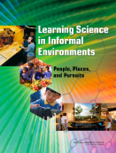


Building on the Past;
Preparing for the Future
Phase I
Phase II
1990s
1990s-2009
7/2011 – April 2013
1/2010 - 7/2011
Credit – Okhee Lee

Slide 3
NYSSLS
2013 Survey
Edits made by First Standards Writing Team
Edits made by Second Standards Writing Team
Review by Science Steering Committee
Draft NYSSLS
2015 Survey
Reviewed by BOR
SED Finalizing NYSSLS
Review by Science Steering Committee

Slide 4

Conceptual Shifts in the NGSS and NYSSLS
K-12 science education should reflect the interconnected nature of science as it is practiced and experienced in the real world.
The Next Generation Science Standards are student performance expectations.
The science concepts build coherently from K-12 (i.e., learning progressions).
Science and engineering practices are integrated from K–12.
NGSS content is focused on preparing students for the next generation workforce.
The NGSS and Common Core State Standards for English language arts and mathematics are aligned.
Credit – Okhee Lee

Slide 5
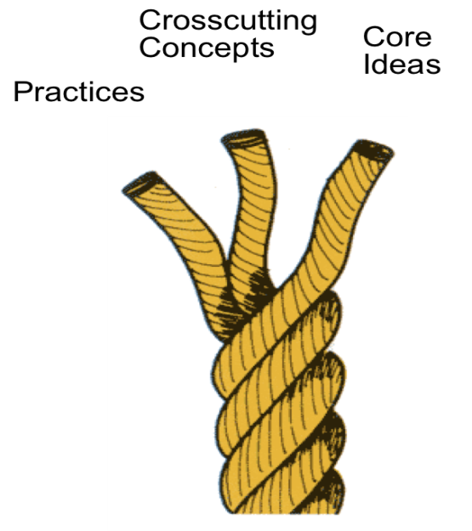
Three-Dimensional Learning
Blending of Three Dimensions
Science and engineering practices
Crosscutting concepts
Disciplinary core ideas

Slide 6
Dimension 1:
Science and Engineering Practices
Ask questions (for science) and define problems (for engineering)
Plan and carry out investigations
Use mathematics and computational thinking
Analyze and interpret data
Develop and use models
Construct explanations (for science) and design solutions (for engineering)
Engage in argument from evidence
Obtain, evaluate, and communicate information

Slide 7
Science and Engineering Practices
Ask questions (for science) and define problems (for engineering)
Plan and carry out investigations
Use mathematics and computational thinking
Analyze and interpret data
Develop and use models
Construct explanations (for science) and design solutions (for engineering)
Engage in argument from evidence
Obtain, evaluate, and communicate information
Investigation Practices

Slide 8
Dimension 1:
Science and Engineering Practices
Ask questions (for science) and define problems (for engineering)
Plan and carry out investigations
Use mathematics and computational thinking
Analyze and interpret data
Develop and use models
Construct explanations (for science) and design solutions (for engineering)
Engage in argument from evidence
Obtain, evaluate, and communicate information
Sense Making Practices

Slide 9
Dimension 1:`
Science and Engineering Practices
Ask questions (for science) and define problems (for engineering)
Plan and carry out investigations
Use mathematics and computational thinking
Analyze and interpret data
Develop and use models
Construct explanations (for science) and design solutions (for engineering)
Engage in argument from evidence
Obtain, evaluate, and communicate information
Critiquing Practices

Slide 10
Asking questions and defining problems
Obtaining, evaluating, and communicating information
Developing and Using Models
Engaging in argument from evidence
Planning and carrying out investigations
Construction explanations and designing solutions
Analyzing and interpreting data
Using mathematics and computational thinking
Credit – Okhee Lee

Slide 11
Dimension 2:
Crosscutting Concepts
Patterns
Cause and effect
Scale, proportion, and quantity
Systems and system models
Energy and matter
Structure and function
Stability and change

Slide 12
Dimension 3:
Disciplinary Core Ideas
Physical sciences
Life sciences
Earth and space sciences
Engineering, technology and applications of science

Slide 13
Dimension 3:
Disciplinary Core Ideas
Physical Sciences
PS 1: Matter and its interactions
PS 2: Motion and stability: Forces and interactions
PS 3: Energy
PS 4: Waves and their applications in technologies for information transfer
Life Sciences
LS 1: From molecules to organisms: Structures and processes
LS 2: Ecosystems: Interactions, energy, and dynamics
LS 3: Heredity: Inheritance and variation of traits
LS 4: Biological Evolution: unity and diversity
Earth and Space Sciences
ESS 1: Earth’s place in the universe
ESS 2: Earth’s systems
ESS 3: Earth and human activity
Engineering, Technology, and the Applications of Science
ETS 1: Engineering design
ETS 2: Links among engineering, technology, science, and society

Slide 14
Scientific and Engineering Practices
1. Asking questions (for science) and defining problems (for engineering)
2. Developing and using models
3. Planning and carrying out investigations
4. Analyzing and interpreting data
5. Using mathematics and computational thinking
6. Constructing explanations (for science) and designing solutions (for engineering)
7. Engaging in argument from evidence
8. Obtaining, evaluating, and communicating information
Crosscutting Concepts
1. Patterns
2. Cause and effect: Mechanism and explanation
3. Scale, proportion, and quantity
4. Systems and system models
5. Energy and matter: Flows, cycles, and conservation
6. Structure and function
7. Stability and change
Disciplinary Core Ideas
Physical Sciences
PS 1: Matter and its interactions
PS 2: Motion and stability: Forces and interactions
PS 3: Energy
PS 4: Waves and their applications in technologies for information transfer
Life Sciences
LS 1: From molecules to organisms: Structures and processes
LS 2: Ecosystems: Interactions, energy, and dynamics
LS 3: Heredity: Inheritance and variation of traits
LS 4: Biological evolution: Unity and diversity
Earth and Space Sciences
ESS 1: Earth’s place in the universe
ESS 2: Earth’s systems
ESS 3: Earth and human activity
Engineering, Technology, and Applications of Science
ETS 1: Engineering design
ETS 2: Links among engineering, technology, science, and society

Slide 15
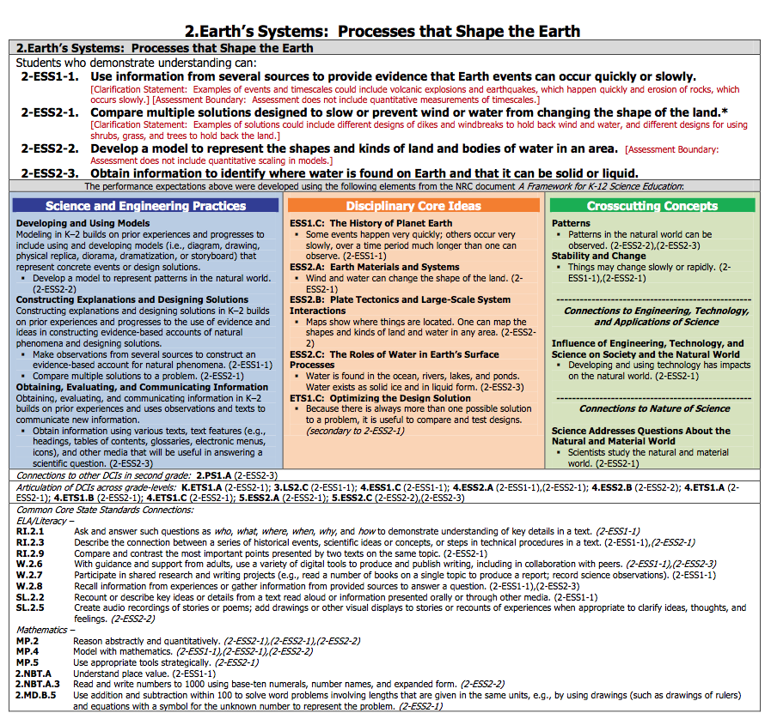
Performance Expectations
Foundation Boxes
Connection Boxes
Credit – Okhee Lee

Slide 16
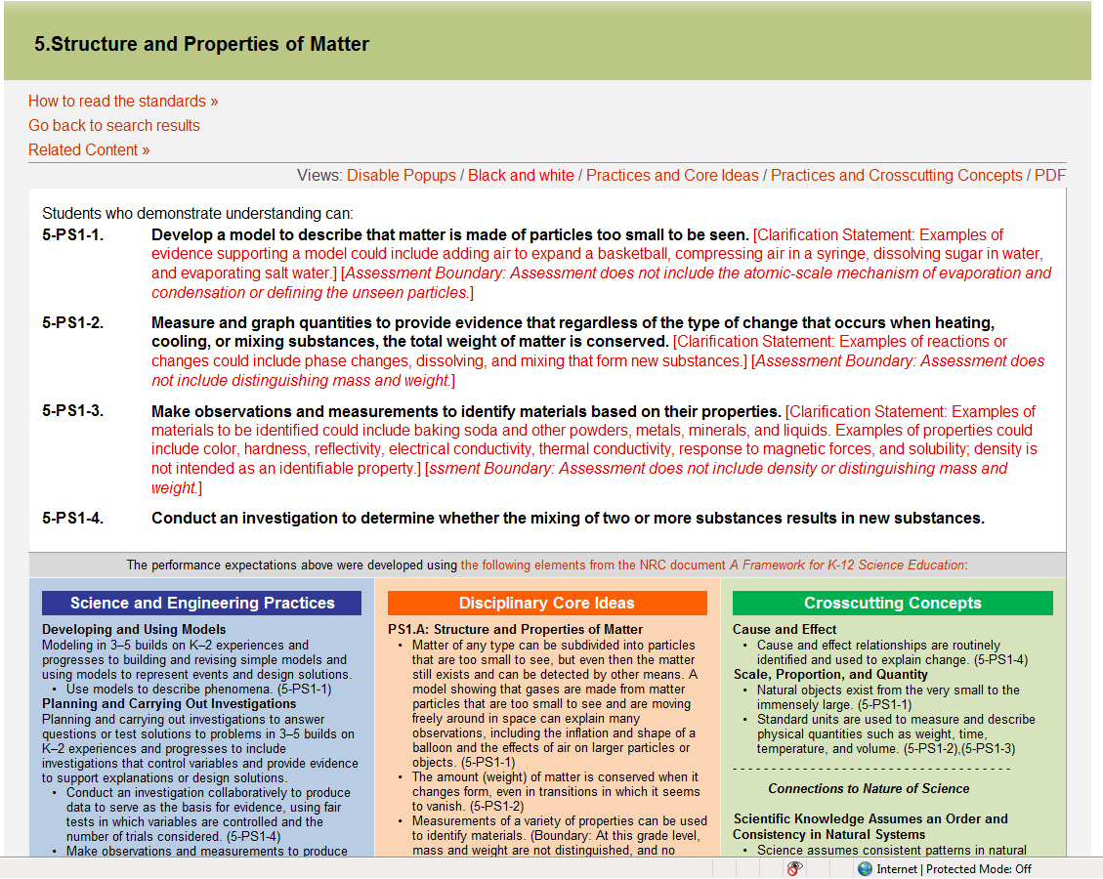


Slide 17
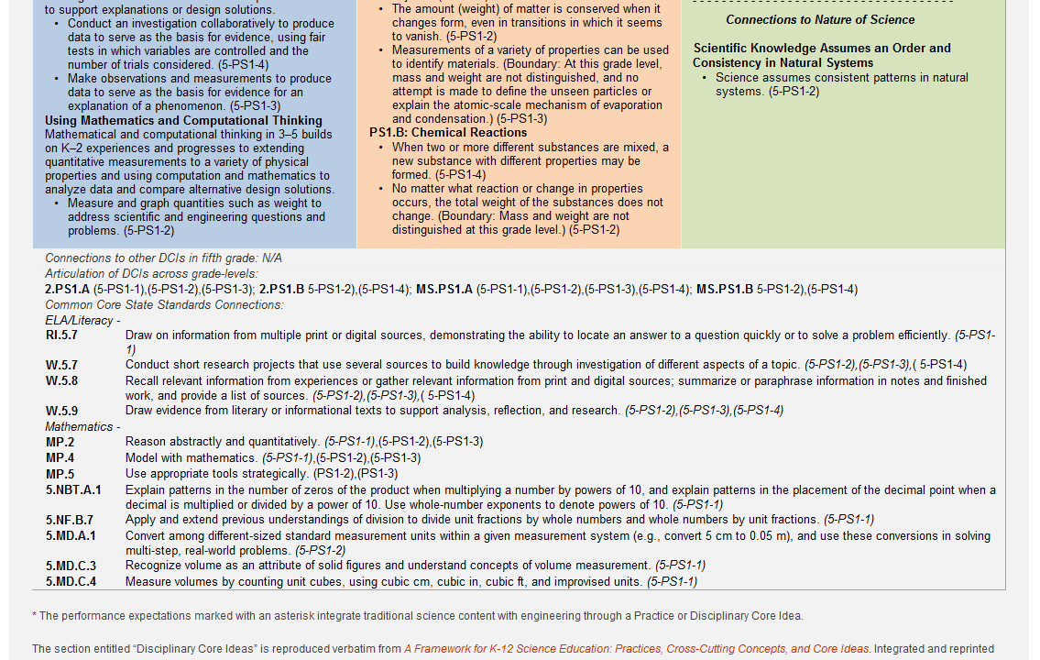

Slide 18
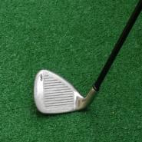
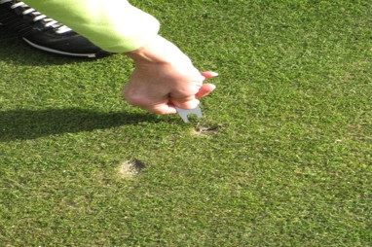






3-Dimensional Learning Analogy
Game Basics
(Core Ideas)
Sportsmanship, Following Rules, Keeping Score
(Crosscutting Concepts)
Golf Tools & Techniques
(Practices)
Playing the Game
(Three-dimensional Learning)
Credit – Okhee Lee
Source: Rita Januszyk

Slide 19
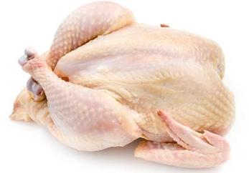

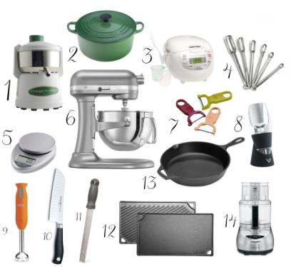

3-Dimensional Learning Analogy
Basic Ingredients
(Core Ideas)
Herbs, Spices, & Seasonings
(Crosscutting Concepts)
Kitchen Tools & Techniques
(Practices)
Preparing a Meal
(Three dimensional Learning)
Credit – Okhee Lee
Source: NSTA

Slide 20


NGSS Instructional Shifts
Focus on explaining phenomena or designing solutions to problems
Three-dimensional learning
  Disciplinary core ideas
  Science and engineering practices
  Crosscutting concepts
Coherence (i.e., learning progressions): build and apply ideas across time

Slide 21

As you engage in two related investigations, consider:
How students explore anchoring phenomena and driving questions in a local context of home and community
How students engage in 3-dimensional learning
How students build and apply ideas over time (i.e., coherence or learning progressions)

Slide 22
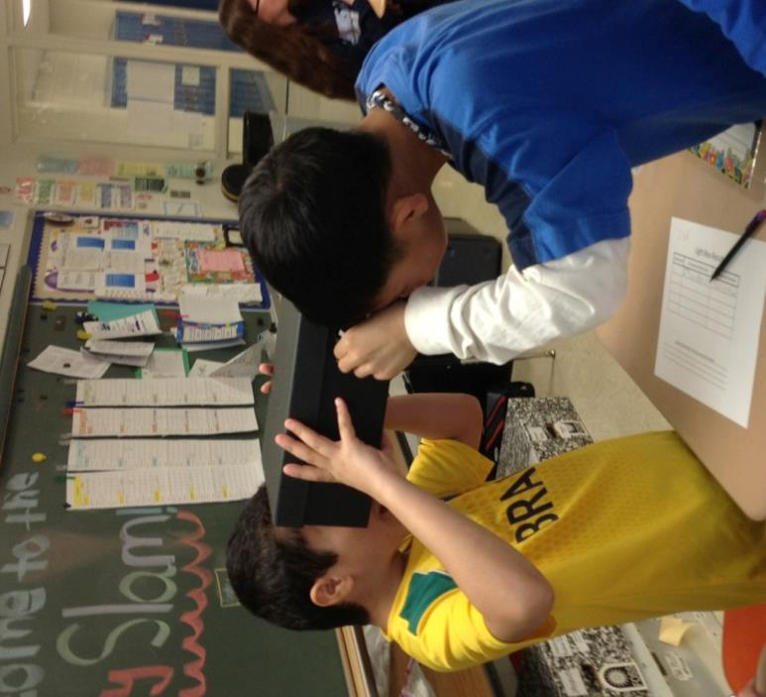
How do you see an object?
Developed Okhee Lee & Rita Januszyk
Former Elementary School Teacher
NGSS Writer and NGSS Diversity and Equity Team Member

Slide 23
Can you see an object in the dark?
What phenomena would you consider using to teach this NGSS performance expectation (PE) to first grade students? The phenomena need to be:
Student-centered based on prior experience or knowledge
In a context
Generative over a period of instruction

Slide 24
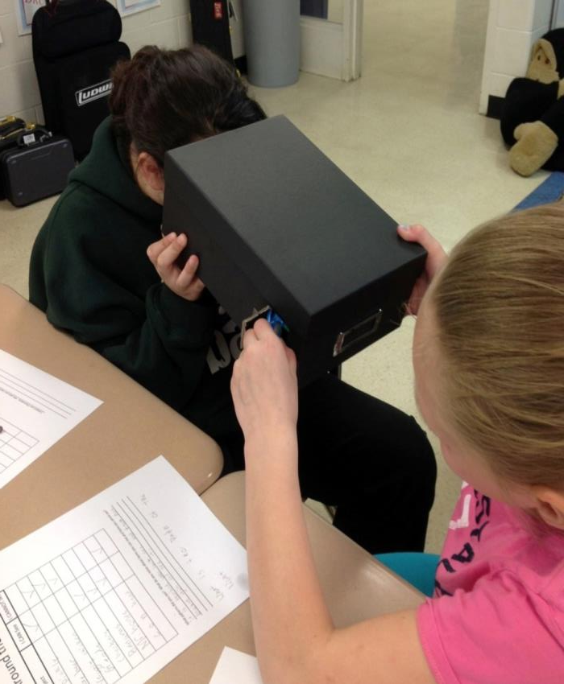
Can you see an object in the dark?
Step 1
Look into the shoebox
with the flap closed
What do you observe?

Slide 25
Can you see an object in the dark?
Step 2
Look into the shoebox
with the flap open
What do you observe?

Slide 26
Can you see an object in the dark?
Step 3
Look into the shoebox with the flashlight shining through the flap
What do you observe?

Slide 27
Can you see an object in the dark?
Discuss with your partner the cause and effect relationships between:
An object
Light source
Open space or view not blocked
Can you see an object in the dark?

Slide 28
NGSS Performance Expectation – Grade 1
1-PS4 (Grade 1, Physical Science, Core Idea 4): Waves and their Applications in Technologies for Information Transfer
1-PS4-2. Make observations to construct an evidence-based account that objects can be seen only when illuminated. [Clarification Statement: Examples of observations could include those made in a completely dark room, a pinhole box, and a video of a cave explorer with a flashlight. Illumination could be from an external light source or by an object giving off its own light.]

Slide 29
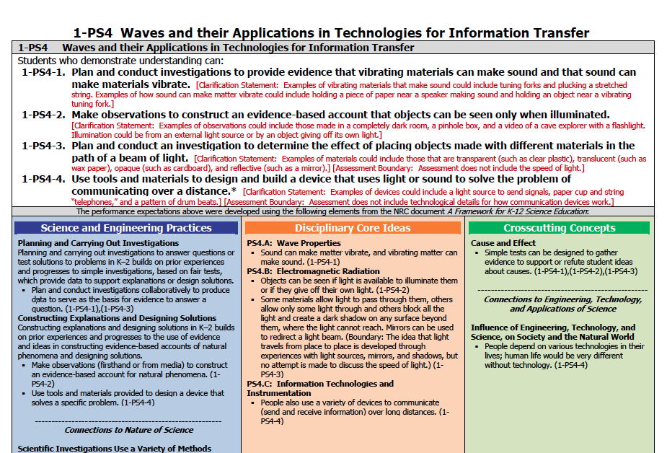

Slide 30
How do you see an object?
Group Investigation (4th grade)
Talk with your group before developing the model that explains how you see the object.
Make sure your group’s model shows relationships between (1) the eye, (2) object, (3) path of light, and (4) open space.
Draw only one model per group.
Be ready to share your group’s model with all the participants.

Slide 31
NGSS Performance Expectation – Grade 4
4-PS4 (Grade 4, Physical Science, Core Idea 4): Waves and their Applications in Technologies for Information Transfer
4-PS4-2 Develop a model to describe that light reflecting from objects and entering the eye allows objects to be seen. [Assessment Boundary: Assessment does not include knowledge of specific colors reflected and seen, the cellular mechanisms of vision, or how the retina works.]

Slide 32
How do you see an object?
How does “draw a picture” change into “develop a model”?
Develop a model to explain how you see the object in the shoebox
Models show relationships
Models help to explain phenomena
Models specify the cause and effect
Models can be used to make predictions

Slide 33
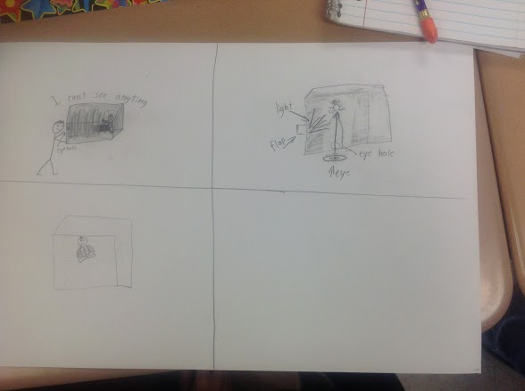
Initial Model

Slide 34
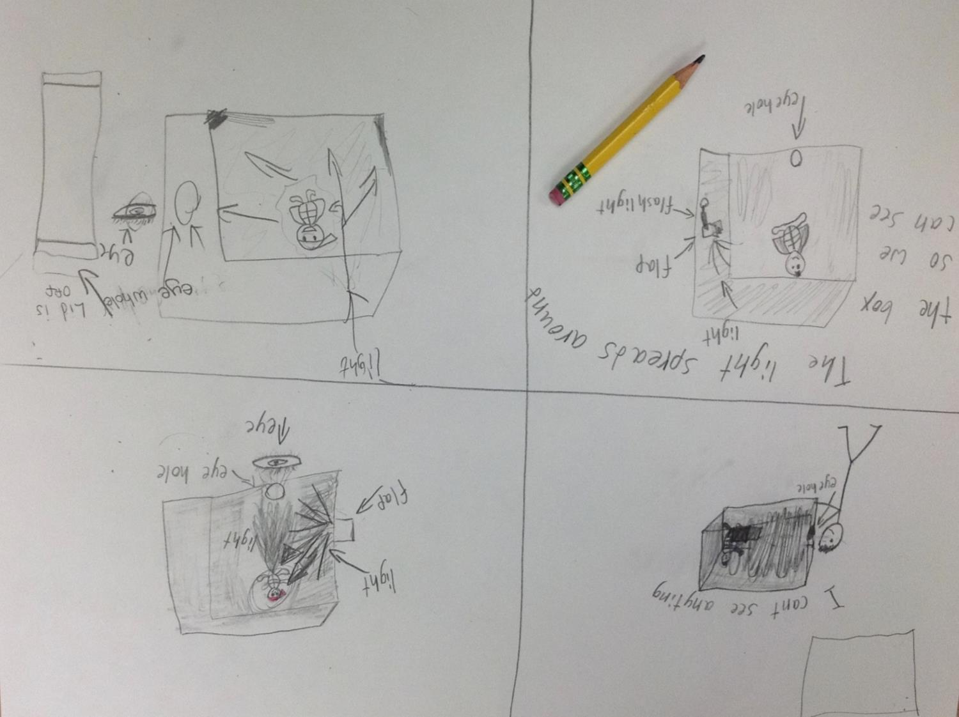
Revised Model

Slide 35
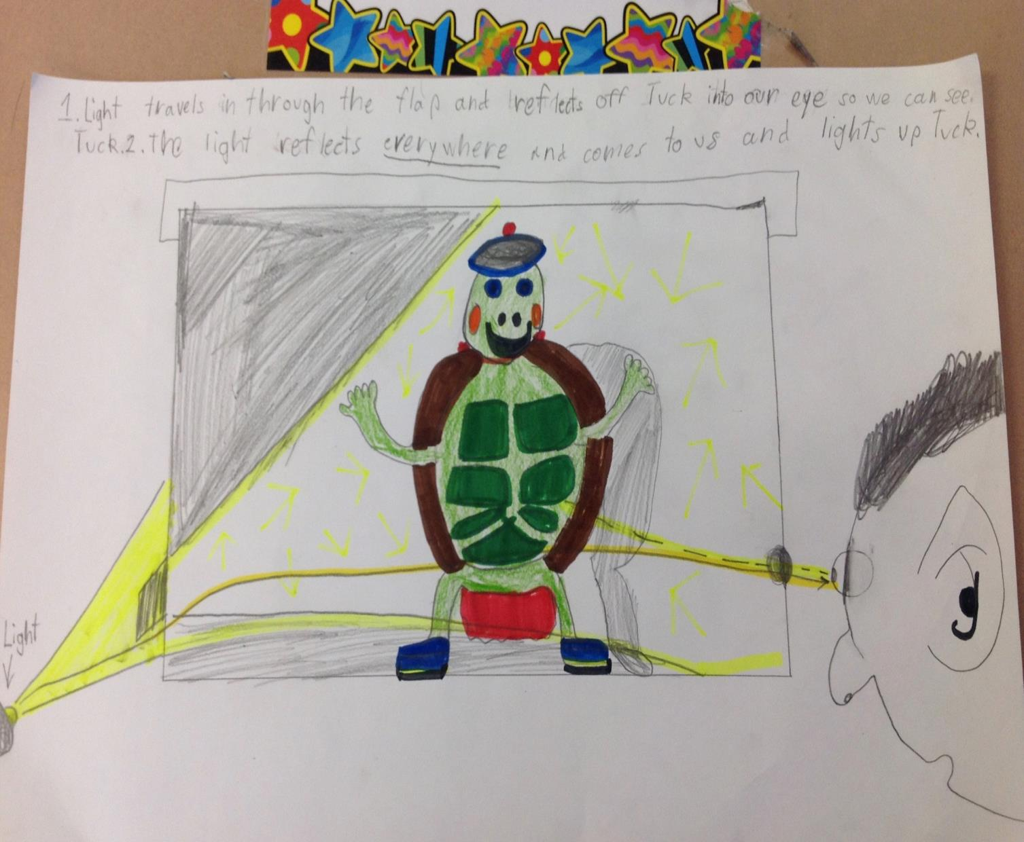

Slide 36
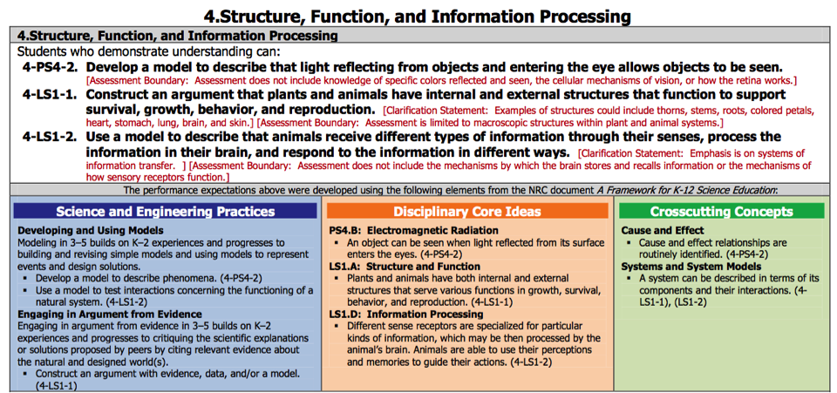

Slide 37
Coherence (or Learning Progressions) –
Performance Expectations
1-PS4-2
Make observations to construct an evidence-based account that objects in darkness can be seen only when illuminated.
1-PS4-3
Plan and conduct investigations to determine the effect of placing objects made with different materials in the path of a beam of light.
4-PS4-2
Develop a model to describe that light reflecting from objects and entering the eye allows objects to be seen.
MS-PS4-2
Develop and use a model to describe that waves are reflected, absorbed, or transmitted through various materials.
HS-PS4-3
Evaluate the claims, evidence, and reasoning behind the idea that electromagnetic radiation can be described either by a wave model or a particle model, and that for some situations one model is more useful than the other.

Slide 38
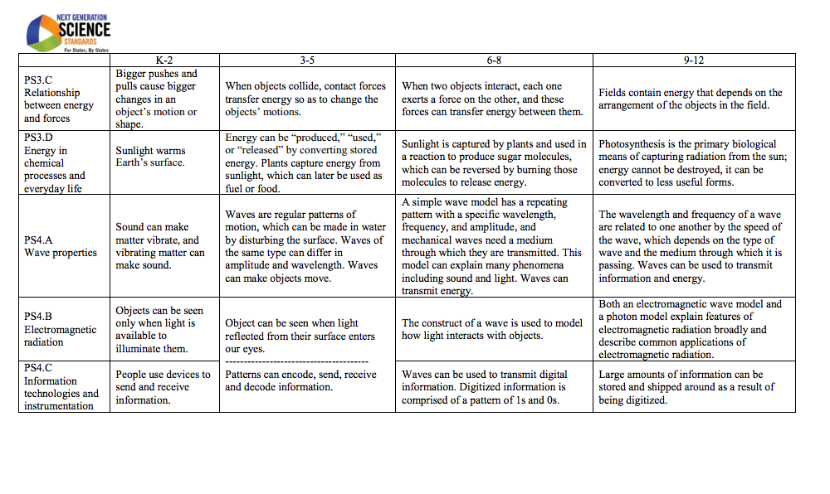
Disciplinary Core Ideas: Learning Progressions
(NGSS Appendix E)
Greater Sophistication

Slide 39
Develop a Model: Learning Progressions
(NGSS Appendix F)
Greater Sophistication
Grades K - 2 | Grades 3 - 5 | Middle School | High School
Develop and/or use a model to represent amounts, relationships, relative scales (bigger, smaller), and/or patterns in the natural and designed world(s) | Develop and/or revise a model based on evidence that shows the relationships | Develop and/or use a model to predict and/or describe phenomena (more abstract phenomena) | Develop, revise, and/or use a model based on evidence to illustrate and/or predict the relationships between systems or between components of a system

Slide 40
Cause and Effect: Learning Progressions
(NGSS Appendix G)
Greater Sophistication
Grades K - 2 | Grades 3 - 5 | Middle School | High School
Events have causes that generate observable patterns | Cause and effect relationships are routinely identified | Cause and effect relationships may be used to predict phenomena in natural or or designed systems | Cause and effect relationships can be suggested and predicted for complex natural and human designed systems by examining what is know about smaller scale mechanisms within the system

Slide 41
Charles K. Kettering
“There is a great difference between knowing and understanding: you can know a lot about something and not really understand.”

