Slide 1
BCIC Meeting
April 2016

Slide 2
Welcome
Introductions
Overview of Agenda Biggies:
  Updates
  Professional eBook Collection
  Science

Slide 3
Update and News
March 2016

Slide 4
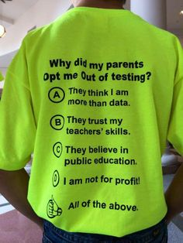
SED Updates
Assessment
Refusals?
Look for another data
collection this year

Slide 5
SED Updates
Standards
Science will likely be the draft
Arts standards survey ready in queue
Common Core revision timeline:
  Revisions spring 2015-16
  Comment fall 2016-17
  Revisions adopted winter 2016-17
  Implementation 2017-18
  Assessment change in 2018-19

Slide 6
SED Updates
Certification
Everyone must register
Professional certificate = 100 hrs
There are a few exceptions:
  NBCT
  Independent evaluator time
Sponsor approval required

Slide 7
SED Updates
APPR
Any transition questions?
D questions?

Slide 8




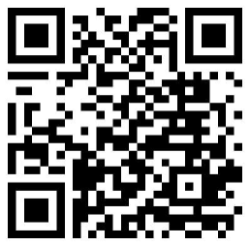

Enjoy HUNDREDS of titles from ASCD, Corwin, ISTE
and Solution Tree, ALL IN ONE PLACE.
Access is FREE using our NEW LINK: slsweb.ocmboces.org/digitalLibrary/ebooks.php

Slide 9


ASCD Titles
Assessment
Brain and Learning
Classroom Management
Differentiation
Diversity
English Language Learner
High School
Inclusion
Literacy
Mathematics
Motivation
Planning
Project-Based Learning
Technology & Web 2.0

Slide 10

ASCD Titles
Blended Learning
Flipped Learning
Project-Based Learning
Technology Education
Web 2.0

Slide 11

Soluti Titles
Assessment
Leadership
Professional Learning Community
Response to Intervention
School Improvement
Standards

Slide 12

CorwinTitles
21st Century Learning
Assessment
Brain and Learning
Diversity
Evaluation
Inclusion
Leadership
Planning
Professional Development
Project-Based Learning
School Improvement
Science
Social Studies
Standards
Teaching and Learning

Slide 13
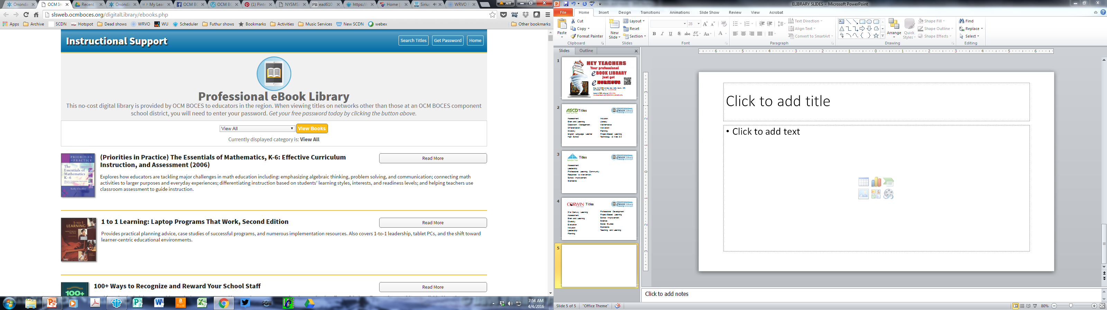
Located under instructional support services at ocmboces.org

Slide 14
You should only need the password outside of an OCM BOCES school: ocmboces

Slide 15
You can browse the entire collection or just certain topics

Slide 16
You can search titles in the
whole collection or in topics

Slide 17
With the “Read More” button you can find the text, mp3s, translations,
and more.

Slide 18
Enjoy HUNDREDS of titles from ASCD, Corwin, ISTE
and Solution Tree, ALL IN ONE PLACE.
Access is FREE using our NEW LINK: slsweb.ocmboces.org/digitalLibrary/ebooks.php

Slide 19
Regional Vision

Slide 20

New Tech Comes to Cortland
Opening September 2016
Beginning with grades 9 & 10 with 50 learners
Adding grades 11 & 12 in subsequent years
Full enrollment of 100 learners
Districts: Cincinnatus, Cortland, DeRuyter, Homer, Marathon, McGraw, Tully (and potentially more)
Notes:
Rebecca

Slide 21
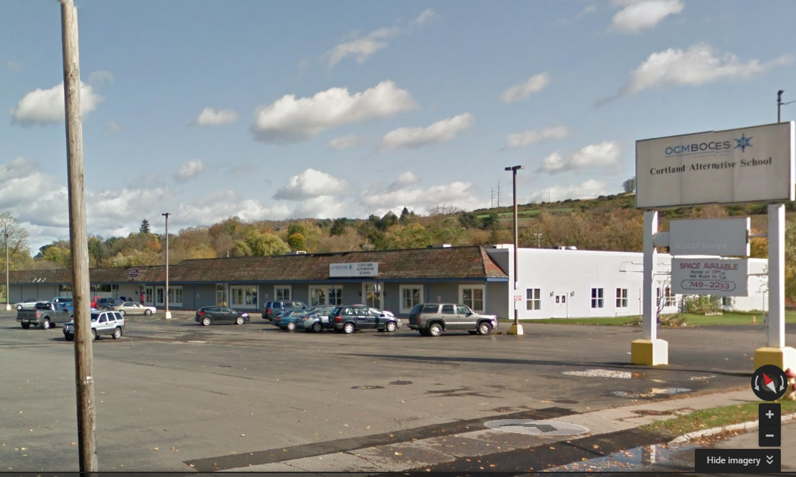
Seven Valleys
Fadden & Associates
Physical Therapy
Cortland Alternative School
240 Port Watson St
Notes:
Rebecca

Slide 22



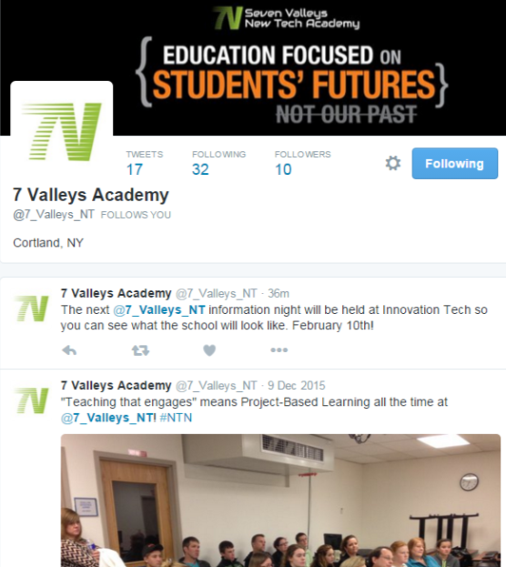
www.sevenvalleys.us
Notes:
@7_Valleys_NT

Slide 23
PBL Training So Far This Year
Components
Non-Components
Cincinnatus
Cortland
FM
Homer
JD
Liverpool
Marcellus
Onondaga
Solvay
ESM
OCM BOCES
West Genesee
Westhill
Beaver River
Dryden
General Brown
Gouveneur
Geneva
NYC Teacher’s Consortium
Oriskany
Southern Cayuga
Town of Webb
Trumansburg
CiTi BOCES
HFHO BOCES
Jeff Lewis BOCES
St Lawrence Lewis BOCES

Slide 24
PBL Coaching This Year
Components
Non-Components
Cincinnatus
Cortland
ESM
FM
Liverpool
Marcellus
North Syracuse
OCM BOCES
Solvay
Tully
Westhill
Central Valley
Fulton
Southern Cayuga
CiTi BOCES

Slide 25
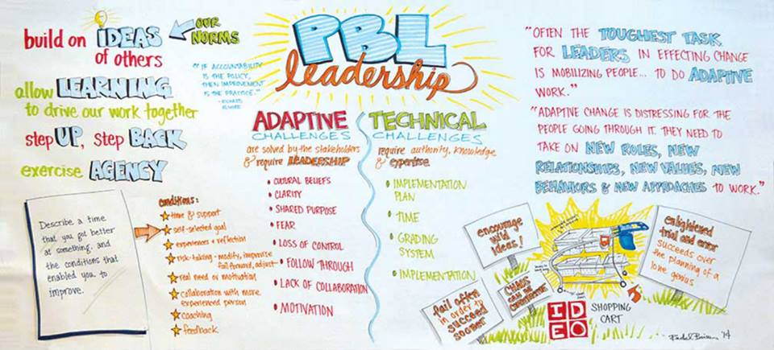
PBL Leadership This Year
Components
Non-Components
DeRuyter
OCM BOCES
Westhill
Central Square
Southern Cayuga
CiTi BOCES
St Lawrence Lewis BOCES

Slide 26
Department Updates

Slide 27
CI&A Summer
On-Site Work: North Syracuse, OCM BOCES, Westhill
Social Studies Curriculum Development
PBL101
PBL 400 level for administrative teams
PrBL –Problem Based for Math and Science
Standards Based Planning- Instruction for All July 11-15
Responsive Classroom- Level One and Advanced

Slide 28
Continuing Leadership and Teacher Networks
Literacy Leadership Network- May 25 is the next gathering.
Instructional Coaches Network -May 12 will be the final session for this school year.
Social Studies Network -May 26 is the final meeting for the year.
Project Based Regional Network -the last session for the year is May 23.

Slide 29
New Networking Opportunity for Teachers of Advance Placement Courses:
April 12 is for Science and Math
April 13 is for Social Studies and ELA
April 14 is for Art, Psychology, and World Languages

Slide 30

CI&A 2016-17
Included days at 4,3,2 depending on district size
Regional professional development sessions included
Survey Monkey to gather feedback to structure and plan regional sessions
Individual district visits will start in June

Slide 31
ITD
Save the Date:
ITD TALKS about Making #CSforAll a Reality
October 19, 2016
http://www.cnyric.org/teacherpage.cfm?teacher=946
Instructional Technology
Professional Development Opportunities
Check the link below for our growing list of PD offerings
http://webapps.cnyric.org/itdpdevents.cfm

Slide 32
Teacher Centers

Slide 33
Higher Education

Slide 34
CNY NYS ASCD
May 11 (Laci’s Tapas Bar): Talking about CNY NYS ASCD

Slide 35
K-12 Counseling Plans
Items being prepared for districts:
Maps and timelines
Plans (11x17, of course)
Sample meeting agenda
Checklists, examples statements, etc.

Slide 36
District Sharing

Slide 37
Sharing Schedule
May 5: FM
June 2: ESM

Slide 38
Standards

Slide 39
Social Studies Curriculum Work
Grades 5-8: continuing work. Remaining sessions are: March 22, April 19, and May 17
Summer session for K-4. July 18 - 21
Summer session for 9-12. July 18 - 21

Slide 40
Regional Chart
Please update the regional chart:
Module choice
Commercial program implementation
Test choices
https://docs.google.com/spreadsheets/d/1HVCC4MaFiMr_aGRsO4iQhQ8_-UxDusiYUI6PB2SL_28/edit#gid=0

Slide 41
Math Conference Day
Weaving Math Practices into Practice
May 24
Morning will focus on information and background regarding math practices presented by Krystal Barber and AnnMarie O’Neill.
Afternoon structure is small facilitated groups for discussion, application and planning.

Slide 42
Science
See separate slide deck

Slide 43
Data

Slide 44
Assessment
3-8 Changes
Errata
Practice 3-8 items available
2017 3-8 can be on-line for anyone who wants to use that format
Suggested implementation timetable

Slide 45
Professional Practice

Slide 46
Culture

Slide 47
Culture for Community of Learning
Spring Institute: The Responsive Classroom® Course Dates for the Spring Institute are: May 25, 26 and June 2, 3.
Responsive Classroom will also be offered during the summer- August 23-26 in Cortland
Advanced Responsive Classroom
  Engaging Academics August 16 and 17
  Effective Management August 18 and 19

Slide 48
Adaptive Schools
Developing Collaborative Groups Using the Adaptive Schools Framework
This workshop will prepare team members to build strong collaborative and caring work cultures focused on continuous school improvement. May 3, 4, 24 and 25 are the dates for this school year.

Slide 49
BCIC Meeting
Future Meeting Planning

Slide 50
Next Year
Back to 3rd Thursday?
AM, except for test time?
Shared doc for notes and minutes
Identify topics in advance for the year?
Other ideas?

Slide 51
BCIC Meeting
May 5th, 2016
Cayuga Conference Room
Main Campus

