Slide 1
BCIC Meeting
February 2015

Slide 2
Welcome
Introductions
Overview of Agenda Biggies:
Updates
Standards
Mental Health

Slide 3
Update and News
February 2015

Slide 4
SED Updates
Accountability
NCLB v. ESSA
“Catching” more districts

Slide 5
Department Updates

Slide 6
CI&A General
Resources! Keeping the conversation going regarding Response to Intervention, clarity on standards, formative assessments---- it is about student learning--- there are two texts to distribute
Schedules for remainder of school year are just about done--- (Feb 1 is the target)
Please don’t wait to submit requests for substitute reimbursement

Slide 7
CI&A: Leadership and Teacher Networks
Literacy Leadership Network-meeting is February 24.
Instructional Coaches the next meeting will be Feb 10.
Social Studies Network session is February 25.
Project Based Learning Regional Network will be March 31 .

Slide 8
ITD

Slide 9
Teacher Centers

Slide 10
Higher Education

Slide 11
CNY NYS ASCD
March 10 (West Genesee High School): Talking About Standards-Based Grading
May 11 (Laci’s Tapas Bar): Talking about CNY NYS ASCD

Slide 12
K-12 Counseling Plans
NYS Regulations have gone to public comment
Board of Regents in April?
Comprehensive developmental school counseling programs beginning in 2017-2018 (preK – 12)
Annual individual progress review plan
School counseling core curriculum instruction
Direct student services
Indirect student services
Agreement of duties between counselor and administrator
Data Analysis
Advisory Council

Slide 13
Counseling Updates
NYS School Counselor Regulations/ASCA Model Training for teams of Administrator/Lead Counselor from each district March 8th

Slide 14
Clinically Rich Intensive Teachers Institute – TESOL (CR-ITI-TESOL) Opportunity
Guest:
Dr. Pat Russo
Co-Director
CR-ITI-TESOL Program at SUNY Oswego

Slide 15
Purpose
To help ensure that school districts have enough trained and qualified faculty to meet the new, more stringent state requirements under Commissioner Regulations Part 154 to support ELs

Slide 16
District Sharing

Slide 17
Sharing Schedule
February 4: Baldwinsville
March 3: Liverpool (ENL)
April 7: Chittenango
May 5: FM
June 2: ESM

Slide 18
Curriculum Process Overview
February, 4, 2016
Presented by Baldwinsville Learning Coaches
Tonya Buda, Julie Jones-Beckwith, Jessica Ancona, & Eric Ziegler
Notes:
Tonya

Slide 19
Survey Results vs Collective Goal
Current Reality
Collective Goal
Some subjects not addressed in
more than 5 years
Inconsistent Implementation
Materials and supplies driving instruction
ALL subject areas will be addressed this school year and in the upcoming summer. Work in ALL areas will be continued throughout next school year.
Grade levels will have a consistent curriculum that each teacher will implement within the same time frame
We will work to determine the “what” students need to know within each subject and grade. Materials and supplies are the “how” students will learn.
Notes:
TonyaTonya

Slide 20
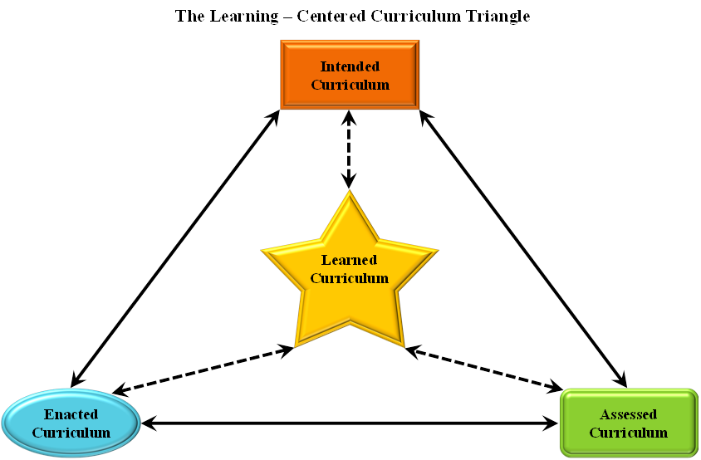
A Guaranteed and Viable Curriculum...
“ One of the most significant factors that impacts student achievement is that teachers commit to implementing a guaranteed and viable curriculum to ensure no matter who teaches a given class, the curriculum will address certain essential content.”
-Marzano, 2003
Notes:
Tonya
Only happens when teachers-who are called upon to deliver the curriculum-work collaboratively to:
Study the intended curriculum and agree on priorities within the curriculum.
Clarify how the curriculum translates into specific student knowledge and skills.
Establish pacing guidelines for delivering the curriculum.
Commit to one another that they will actually teach the curriculum.

Slide 21
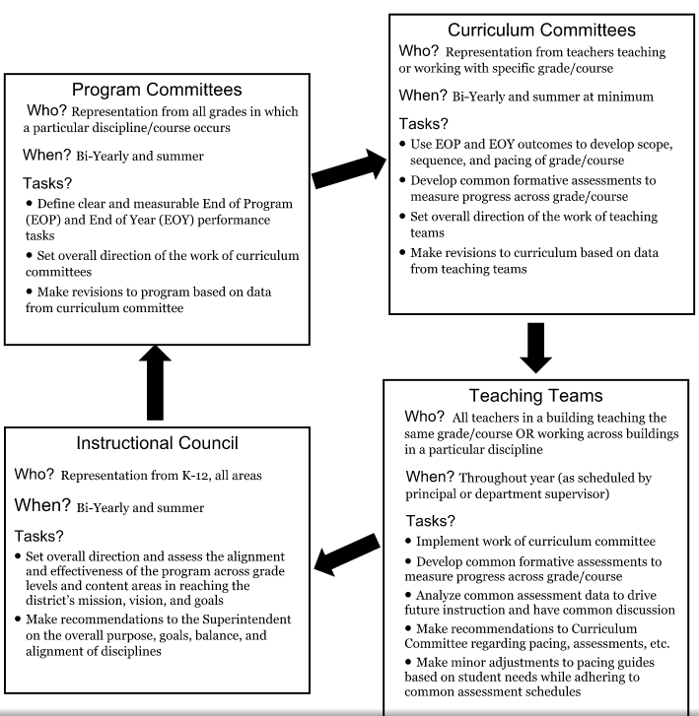
Program Committee & Curriculum Committee
Notes:
Eric
Bville’s rationale is to have a district wide PLC where there is teacher input at all different levels and steps of the process. Also there is representation from different schools and different grade levels. Teacher input is valued all throughout this process. (Eric)

Slide 22
Collaborative Team Process
What we ARE asking you to do:
Work together to identify essential learning for ALL students.
Identify common window for administering common formative and summative assessments.
Analyze TEAM data to pinpoint objectives that either need to be covered more thoroughly or taught in a different way.
What we ARE NOT asking you to do:
Become “cookie-cutter” teachers.
Give up instructional decision-making in your classroom.
Follow a prescribed lesson plan.
Notes:
Julie

Slide 23
What did Program Committee do?
Prioritize Standards & Develop Performance Tasks
Each tasks has priority and supporting standards chosen that support the development of the task, in both reading and writing.
How is a priority standard chosen?
Consider the task and what skills students need
Look at the standards to determine what matches the task
Analyze data to find support for the priorities
What are performance tasks in ELA?
Narrative
Text Analysis
Opinion/ Argument
Research
What are the performance in SS?
Argument
Public Speaking
Evidence-Based Analysis
Research
Informed Decision Making
Notes:
Julie for SS/ Jessica ELA
SS- Examined exemplars, aligned standards the practices
Greater clarity regarding the interpretation of standards
Greater consistency regarding the importance of different standards
Greater consistency in the amount of time devoted to different standards (common pacing)
Common outcomes and common pacing are essential prerequisites for a team to create common assessments and team interventions
Greater ownership of and commitment to standards
SS Progress
Program Committee has met three times so far
Built background knowledge with the C3 Framework (College, Career, and Civic Life), NYS SS Framework, CCLS (reading, writing, and literacy standards in History)
Prioritized SS practices at each grade level and studied the inquiry model
Identified and defined 5 performance tasks for K-12
Studied the NYS SS Framework to determine units according to the framework.
Aligned performance tasks and prioritized SS practices to units

Slide 24
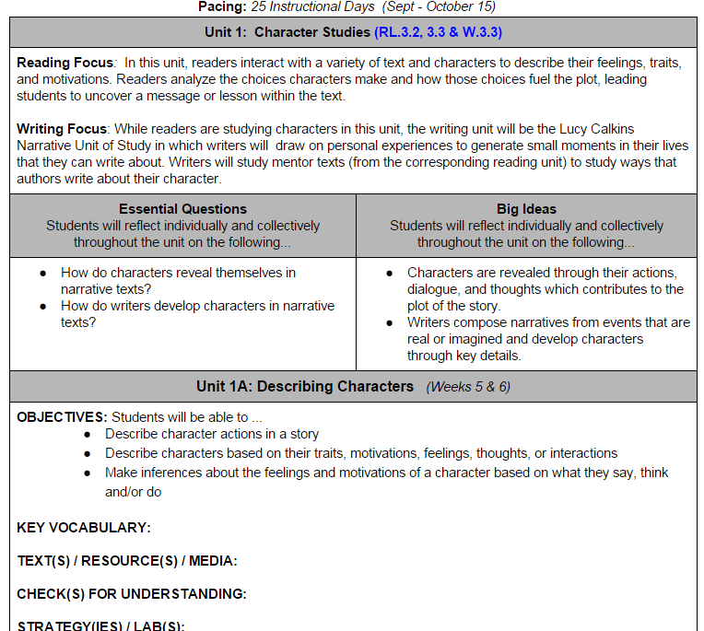
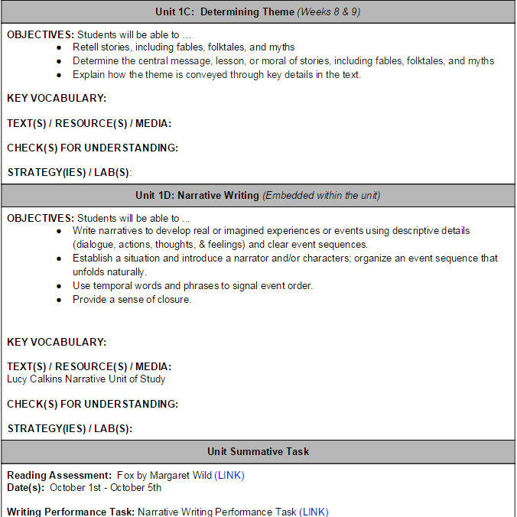
What will our units look like?
Notes:
Eric/ JessicaThese two pages are the required information in the curriculum

Slide 26
Standards

Slide 27
Curriculum Work
Social Studies- small core group is reporting this opportunity is beneficial. February 23 is the next facilitated day (opportunities also March, April and May).

Slide 28
Summer Curriculum Work- Social Studies
Two strands:
9-12
K-4
July 18-21
Registration open!

Slide 29
Standards and Instruction
Preparing and supporting learning for diverse students can be challenging! Scaffolding for Student Outcomes: Meeting Diverse Needs starts February 24. Educators will examine how standards-based education and differentiation work together to promote appropriately high levels of achievement for all students.
Standards Based Planning for the 21st Century - Instruction for All is a comprehensive course that is very well received and beneficial whether you are in your second year of teaching or 20th year! The spring sessions begin March 4 and run for five sessions between then and June.

Slide 30
Regional Chart
Please update the regional chart:
Module choice
Commercial program implementation
Test choices
https://docs.google.com/spreadsheets/d/1HVCC4MaFiMr_aGRsO4iQhQ8_-UxDusiYUI6PB2SL_28/edit#gid=0

Slide 31
Literacy Interventions
Sonday One- underway
Sonday Two- coming
LLI- Continues with levels K-12 now!
Reading Recovery- is there interest in an initial class for 2016-17?
LETRS- Interest for 2016-17? Cost if we have class of 15 is about $3900/teacher

Slide 32
Literacy Interventions
What Really Works for Struggling Learners
Suggest change to BCIC topic schedule to make March meeting
Have summaries of some research (Allington’s updated) to share and review
Has RTI implications

Slide 33
Social Studies
Summer Curriculum Work :
Two strands:
9-12
K-4
July 18-21
Registration open soon

Slide 34
Draft NYSSLS Regional Feedback
Engaged in collegial discussions and collected feedback from over 100 people representing 31 districts
Points of debate and disagreement but there was overwhelming agreement in several areas
Filled out survey as OCM BOCES Science Coordinator
Composing a letter to SED that will be shared with selected individuals and groups
Includes feedback from our discussions
Feedback from faculty discussions at SU and Cortland

Slide 35
Regional Agreement About Draft NYSSLS
Questioning rationale and cohesiveness of PreK PEs
Questioning rationale for 14 added PEs and edits made to approximately 30 PEs
Grade specific PEs K-8
Addition of 14 PEs (6 of which are in HS PS)
Over crowding of MS and HS with additions
Subtraction through addition
Learning progression
People are excited about new standards and really want support to successfully implement
Time for elementary science
PD

Slide 36
Plans for Regional Support
November science conference- Building regional professional capital to support NYSSLS
Kick off to our next several years of work
Begin the process of developing a shared understanding of the NYSSLS and their relationship to changes in instruction, curriculum, and student learning
Partnering with higher education
Key notes and breakout sessions with leaders in the field of science education
Would like to have a district host the day
Need:
Auditorium
Cafeteria
Classrooms for breakout sections

Slide 37
A2
Is anyone thinking about A2 as a 1.5 year course because it seems to be so much?

Slide 38
Data

Slide 39
Assessment
3-8 Changes
Assessment Calendar(s)
Practice 3-8 items available soon (practice with the math tools)
2017 3-8 can be on-line for anyone who wants to use that format

Slide 40
Professional Practice

Slide 41
Project Based Learning-PBL 101
Upcoming sessions will begin March 1 and March 14 (almost full).
May 11 is the first day of the last PBL 101 for this school year.
There will be one summer session offered by OCM (separate from conference).

Slide 42
NEW-PBL Opportunities
March 7 will be PBL Educamp.
Problem-Based Learning for Math and Science Teachers: May 2

Slide 43
Project Based Learning

Slide 44
OPEN FOR REGISTRATION
Making Learning Happen PBL16 in collaboration with BIE
OnCenter, Syracuse
August 2-5, 2016
Select strand: PBL 101 (BIE), Leadership (BIE), or Open Sessions.
Two keynotes daily!
Vendor exhibits
OCM BOCES component price is $525

Slide 45
Culture

Slide 46
Mental Health
Kathy Miller, Youth Development

Slide 47
Culture for Community of Learning
For educators implementing Responsive Classroom: Join a two day advanced session on Effective Management February 25 and 26
Spring Institute: The Responsive Classroom® Course Dates for the Spring Institute are: May 25, 26 and June 2,3.
Responsive Classroom will also be offered during the summer.

Slide 48
Adaptive Schools
Developing Collaborative Groups Using the Adaptive Schools Framework
This workshop will prepare team members to build strong collaborative and caring work cultures focused on continuous school improvement. May 3,4, 24 and 25 are the dates for this school year.

Slide 49
Hierarchy of Change
Student Achievement
Instruction & Assessment
Policies & Structure
Culture & Relationships
Purpose & Mission
Notes:
Remove gradient

Slide 50
RTI at Work Institute?
Response to Intervention at Work Institute will be in Syracuse June 28-30, 2016. This Solution Tree event will showcase application of PLC! OCM BOCES has limited discounted seats available for this event. ($489)
Any seats still open February 15 will be open to districts outside of OCM region.

Slide 51
Solution Tree Videos
Any comments? Interest?
Suggestions for regional purchase?

Slide 52
Regional Vision

Slide 53
Planning

Slide 54
Poverty
Cortland area
Regional?

Slide 55
BCIC Meeting
NEXT
March 3, 2015
Rodax 8 Large Conference Room

