Slide 1
BCIC Meeting
January 2015

Slide 2
Welcome
Introductions
Overview of Agenda Biggies:
Updates
Standards
Imagination Library

Slide 3
Update and News
January 2015

Slide 4
SED Updates
Assessment
SED has a workgroup looking at the Regents exams, scales, and results
Scale change possible
Also looking at passing rates (particularly Algebra) and the 2022 problem?

Slide 5
APPR Updates
From the Regents item:
During the transition period, transition scores and HEDI ratings will replace the scores and HEDI ratings for teachers and principals whose HEDI scores are based, in whole or in part, on State assessments in grades 3-8 ELA or mathematics (including where State-provided growth scores are used) or on State-provided growth scores on Regents examinations.

Slide 6
APPR Updates
From the Regents item:
Transition scores and ratings will be determined based upon the remaining subcomponents of the annual professional performance review that are not based on the grade 3-8 ELA or mathematics State assessments and/or a State-provided growth score on Regents examinations.

Slide 7
APPR Updates
From the Regents item:
Back-up SLO[s] shall be developed by the district/BOCES consistent with guidelines prescribed by the Commissioner using assessments approved by the Department that are not State assessments.

Slide 8
APPR Updates
From the Regents item:
State provided growth scores will continue to be computed for advisory purposes.

Slide 9
APPR Updates
What we know right now:
The Board of regents has passed emergency action that will subsequently be confirmed in February (according to their procedures).
The changes apply this year to districts operating under §3012-c or §3012-d.
Scores that are derived from 3-8 Common Core-based tests will not be allowed to be used, until at least 2019-2020, for teacher evaluation purposes.

Slide 10
APPR Updates
What we know right now:
Scores that are derived from Common Core-based Regents examinations will not be allowed to be used, until at least 2019-2020, for teacher evaluation purposes. Note: this is not completely certain at this point.
During the “transition period,” summative evaluation scores or labels will be based on remaining subcomponents.
Guidance is promised.

Slide 11
APPR Updates
What we don’t know:
How do we make back-up SLOs in the middle of the school year that are in alignment with the Common Core-based prohibition?
Can we use the observation component (§3012-d) or multiple measures components (§2012-c), alone, for the summative score?
Are any school-based or district-based measures that include any Common Core-based Regents examination scores prohibited?

Slide 12
APPR Updates
Potential consequences we would want to avoid:
An actual increase in the amount of assessment for APPR purposes, which is possible because we will still administer state assessments but not be able to use them for APPR, thus potentially pressuring districts to add assessments which is contrary to other recommendations from the Commission.
A continued emphasis on human capital over social capital and professional capital as drivers of improved teaching and learning.

Slide 13
APPR Updates
What should we do at the moment?
Negotiations and APPR committee meetings should probably focus solely on the observation aspects of a 3012-d plan and wait, for now, before worrying about any student performance measures.
Leaders will have to continue to do as they’ve done for five years, trying to downplay the drama and distractions while encouraging good, collaborative teaching and that might actually result in increased learning.

Slide 14
APPR Updates
APPR Informal Session 13th
Come if you want to talk about the development of an APPR plan under 3012-d.
Not sure whether we'll have APPR guidance or not by then.
The 13th is also the day of the Governor's State of the State/Budget message.
12:30p (or so) on January 13th

Slide 15
Department Updates

Slide 16
CI&A: Leadership and Teacher Networks
Literacy Leadership Network-meeting is February 24.
Instructional Coaches the next meeting will be Feb 10.
Social Studies Network session is February 25.
Project Based Learning Regional Network will be March 31 .

Slide 17
ITD

Slide 18
Teacher Centers

Slide 19
Higher Education

Slide 20
CNY NYS ASCD
March (West Genesee High School): Talking About Standards-Based Grading
May 11 (Laci’s Tapas Bar): Talking about CNY NYS ASCD

Slide 21
K-12 Counseling Plans
NYS Regulations still have not gone to public comment
Comprehensive developmental school counseling programs beginning in 2017-2018 (preK – 12)
Annual individual progress review plan
School counseling core curriculum instruction
Direct student services
Indirect student services
Agreement of duties between counselor and administrator
Data Analysis
Advisory Council

Slide 22
Counseling Updates
ASCA National Model Training – Jan. 12th
Counselor Round Tables focused on ASCA model implementation – Feb. 4th, April 11th
NYS School Counselor Regulations/ASCA Model Training for teams of Administrator/Lead Counselor from each district March 8th

Slide 23
Imagination Library
Onondaga County
Madison County
Cortland County

Slide 24
Examining the Impact of the Imagination Library Program on Kindergarten Readiness
Presentation by Dr. Frank Ridzi & Virginia Carmody
January 7, 2016

Slide 25
Our Vision Statement: 100% Literacy through 100% Community Engagement Our Mission Statement: Our Mission, as the birthplace of the modern literacy movement, is to collectively build and support community initiatives that improve literacy levels across the lifespan in Onondaga County.

Slide 26
Why Imagination Library?
Dolly Parton’s Imagination Library has been a key component of our school readiness strategy, which mails age-appropriate books monthly to all enrolled children from birth to age 5 in the City of Syracuse, and is in alignment with the Campaign for Grade-Level Reading.

Slide 27
What is the Campaign for Grade-Level Reading?
The Campaign focuses on an important predictor of school success and high school graduation—grade-level reading by the end of third grade.

Slide 28
Imagination Library Logic Model
Books Arrive Monthly /
Activities Conducted
Family Reading Behavior Changes
English Language Arts Scores Increase
Kindergarten Screening Scores Increase

Slide 29
Snapshot as of Jan. 2016
107,000+ Books Distributed
8,000+ Children Served
80+ Referral Partners
2,700+ in Family Literacy Programming
2010
Launched in May in 13203 & 13208
2011
Preliminary local Research- Families Reading More
2012
Expansion to half of the City of Syracuse
More local Research confirms positive findings in interviews with refugees
2013
Syracuse named a Pacesetter Community by the Campaign for Grade-Level Reading
2014
City and County have committed to funding first 3 years of expansion to entire City of Syracuse
2015
Local Research Finds Children Consistently Enrolled More Kindergarten Ready

Slide 30
Previous Research
Longer enrollment in Imagination Library was associated with more child-directed reading and story discussion.
Even when controlling for child age, gender, income, parental education, race, parental nation of birth, and primary language spoken at home.
Ridzi, F., Sylvia, M.R., & Singh, S. (2014). The Imagination Library Program: Increasing parental reading through book distribution, Reading Psychology, 35, 548-576. doi: 10.1080/02702711.2013.790324

Slide 31
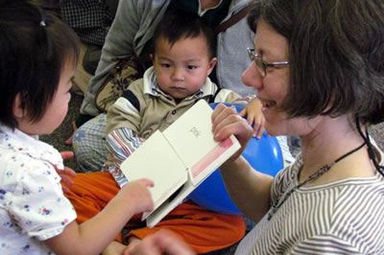
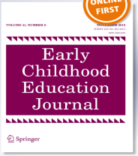
Refugee Families
Participant observations and interviews with parents and program providers indicated that, while the family literacy practices mostly centered on oral traditions, participation in Imagination Library and related programming led to familiarity and use of print-based forms of literacy.
Additionally, parents reported an interaction with books that were reaching their homes and consciously modeling the shared reading practices demonstrated by the program providers.
Singh, S., Sylvia, M.R., & Ridzi, F. (2015). Exploring the literacy practices of refugee families enrolled in a book distribution program and an intergenerational family
Literacy program. Early Childhood Education Journal, 43, 37-45. doi: 10.1007/s10643-013-0627-0

Slide 32
Research Question
Is participation in the Imagination Library program associated with higher levels of kindergarten readiness?

Slide 33
Measurement Action Team Members
*Dr. Brandan Keaveny, Chief Accountability Officer, Office of Shared Accountability, SCSD
*Dr. Frank Ridzi (Co-Chair) CNYCF and LMC
*Dr. Jeff Craig (Co-Chair) Onondaga-Cortland-Madison BOCES, Assistant Superintendent for Instructional Support Services
*Dr. Monica Sylvia , Associate Professor of Psychology, Le Moyne College, LMC
*Dr. Xiaofen Qiao, Data Analyst, Office Of Shared Accountability, Syracuse City Multiple Consultant Staff
*Virginia Carmody, LCOC Executive Director
Dr. Jonnell Allen, SU Community Geographer
Laurie Black , Administrator, SYRACUSE 20/20
Katherine Byrnes, LCOC Program Director
Mark Clary , Associate Director, Catholic Charities
Kelly Cooney, SCSD Adult Education Data Manager
Cynthia Doss , Asst. Director, Syracuse Educational Opportunity Center
Pat Driscoll, Ex. Director , Say Yes to Education Syracuse
Carol Dwyer, SU Community Benchmarks Director
Melissa Hidek, P.EACE, Inc./Head Start
Dr. Kathleen Hinchman, SU Associate Dean and Professor
Peter Knoblock, ACTS (Alliance of Communities Transforming Syracuse)
Cynthia O'Connor, Consultant, Apter and O'Connor
Stephanie Pasquale, City of Syr. Dep. Comm. Neighborhood & Business Dev.
Susan Reckhow , Onondaga County Public Library, Adm. For Branch Services
Ann Rooney , Onondaga County, Deputy County Executive for Human Services
Joan Royle, Executive Director, Westcott Community Center
Nora Rudewicz, Childcare Solutions, Data Manager
Debbie Stack, WCNY, Director of Interactive Education
Mari Ukleya, Director of Adult Education, OCM BOCES
Dave Wall, OCC, Director of Corporate and Public Partnerships
Carol Williams , Consultant, CW Associates

Slide 34
Research Method
We tested whether consistent exposure to the program (i.e. 3 or 4 years) has a significant effect on level of ability identified in a screening test.

Slide 35
Letter Naming Fluency (LNF)
Early exposure to print is associated with the development of oral language, emergent literacy skills and motivation to read (Raikes et al. 2006).
The National Reading Panel (2000) has identified some critical pre-reading skills that should be assessed in Kindergarten and early Grade 1, including phonemic awareness, and elements of phonics, including letter names and sounds and the ability to read non-real (nonsense) words.
Letter Naming Fluency – identified frequently as the best single indicator of risk for reading failure (Elliot, Lee & Tollefson 2001, Hintze, Ryan & Stoner 2003).

Slide 36
Using the AIMSweb LNF score of 13 as the standard cutoff we find that:
For those consistently enrolled in the program (i.e. 3-4 years), there was a 28.9% increase in children ready for kindergarten, according to this measure.
This percentage increase is calculated as follows: 61.1-47.4= 13.7/47.4= 28.9%
This difference was statistically significant at the p< .05 level.
N=2,659

Slide 37
Significance
We find that being consistently enrolled in the Imagination Library program (i.e. 3 or 4 years) is associated with increased likelihood
of being ready for kindergarten (i.e. 13 or higher score on LNF), even after controlling for:
race,
gender,
age (i.e. only testing kindergarteners),
ESL status,
Special Education Status, and
Free and Reduced Lunch Status.

Slide 38
Across the County… Percent Ready for Kindergarten in Onondaga County
Consistent enrollment in the DPIL program (i.e. 3-4 years) was associated with children performing above the county average, while non-enrollment was below county average.

Slide 39
Children not enrolled in DPIL had kindergarten readiness on a level similar
to the lowest school district in the county. Those with consistent enrollment
in the DPIL program (i.e. 3-4 years) had kindergarten readiness scores
on a level similar to the middle performing schools in the county.

Slide 40
In Summary…
There is evidence that children who are consistently enrolled in the Imagination Library program in Syracuse are 28.9% more likely to be ready for kindergarten than those who do not participate.

Slide 41
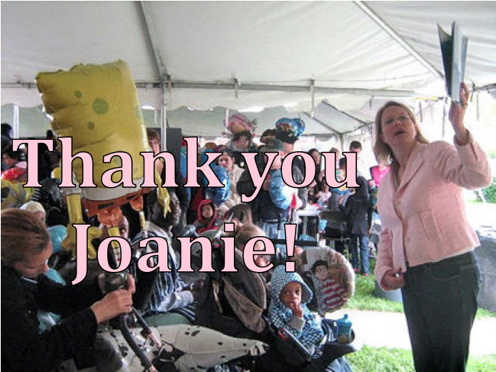
P-S Editorial on August 19, 2015
“These results so impressed County Executive Joanie Mahoney, she's asking the county Legislature for another $200,000 to expand the program to the entire county. That would be on top of the $100,000 the county already commits to Imagination Library. Expanding Imagination Library countywide is a long-term investment our children. It sounds like a wise one to us.”

Slide 42
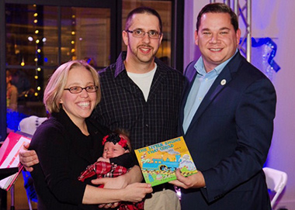
Our 100,000 book milestone!
At our 3rd Annual Stories of the Season event, during the Holiday Tree Lighting Ceremony in Clinton Square, newborn Caroline Hofmann received our
100,001st Imagination Library Book.

Slide 43
If you have any further questions, please feel free to contact us: If you have any further questions, please contact us: Virginia Carmody, Executive Director, Literacy Coalition of Onondaga County at vcarmody@unitedway-cny.org or 428-8129. Frank Ridzi, Ph.D., Director of Research & Community Initiatives at the Central New York Community Foundation and Associate Professor at Le Moyne College at fridzi@cnycf.org or 422-9538.
Visit us at www.onliteracy.org,
on facebook or twitter too!

Slide 44
District Sharing

Slide 45
Sharing Schedule
January 7: Fabius-Pompey (Imagination Library Experience)
February 4: Baldwinsville
March 3: Liverpool (ENL)
April 7: Chittenango
May 5: FM
June 2: ESM

Slide 46
Standards

Slide 47
AimHighNY Survey Results
December 2, 2015

Slide 48
Summary
Respondents were well represented by
Teachers
Long Island residents
Public schools
Overall, a higher proportion of responses agreed with standards, and this was true for both Math and ELA
It should be noted that respondents did not view the same Standards
For instance, one standard (CCSS.ELA-Literacy.RL.PK.1 - With prompting and support, ask and answer about detail(s) in a text.) received feedback from 616 respondents, while another (S-CP.7 - Apply the Addition Rule, 𝘗(𝘈 or 𝘉) = 𝘗(𝘈) + 𝘗(𝘉) – 𝘗(𝘈 and 𝘉), and interpret the answer in terms of the model.) received feedback from just 7 respondents.

Slide 49
Of the respondents, almost half are teachers, and over one fifth are from Long Island
* Categories following the top 8 were categorized into “Other”

Slide 50
Most teachers, administrators, and students are associated with public schools

Slide 51
The majority of respondents agreed with the standards that they reviewed
Average feedback per user was 23 standards
Average feedback for Math was 15 standards
Average feedback for ELA was 23 standards
*Note that n for each subject area is not equal

Slide 52
Of those who said that they disagreed with standards, most suggested removing the standard altogether
*Note that n for each subject area is not equal

Slide 53
The proportion of business partners disagreed the most with standards, while administrators, school board members, and students disagreed the least
*Note that n for each classification is not equal

Slide 54
Proportionally, Bronx respondents disagreed with standards the most, while respondents from Chautauqua and Oneida disagreed the least.
*Note that n for each county is not equal; counties with <1000 respondents are not represented

Slide 55
Feedback highlights overall
There were far more ELA standards (1132) than math standards (492) available for feedback
It should be noted that respondents did not view/provide feedback on the same standards
As demonstrated in previous slides, the majority of respondents agreed with standards

Slide 56
Feedback highlights (Math)
The standard with the highest approval rating (90%) was G-GPE.7 - Use coordinates to compute perimeters of polygons and areas of triangles and rectangles, e.g., using the distance formula.
The standard with the lowest approval rating (25%) was S-ID.6.b - Informally assess the fit of a function by plotting and analyzing residuals.
As described above, respondents did not all view the same standards.
Only 49 respondents left feedback on standard GPE.7, and 60 left feedback on S-ID.6.b

Slide 57
Feedback highlights (ELA)
The standard with the highest approval (94%) was CCSS.ELA-Literacy.L.K.5a - Sort common objects into categories (e.g., shapes, foods) to gain a sense of the concepts the categories represent.
The standard with the lowest approval (30%) was CCSS.ELA-Literacy.RL.4.4 - Determine the meaning of words and phrases as they are used in a text, including those that allude to significant characters found in mythology (e.g., Herculean).
As described above, respondents did not all view the same standards.
There were only 227 respondents who left feedback on CCSS.ELA-Literacy.L.K.5a, but 352 respondents left feedback on CCSS.ELA-Literacy.RL.4.4

Slide 58
Next Steps
Recommendations go to the BOR this month
Direction to move forward with recommendations
Any changes will be review by CAP
New standards will go to the BOR for adoption

Slide 59
Standards and Instruction
Repeated by request! The Teacher's Literacy Toolbox Series: Reading, Writing and Research in a Common Core Classroom. Starts January 11th .
Co-Teaching: What to do with two teachers in the room? January 28th session will address the question: How might instruction look different with two teachers?
Preparing and supporting learning for diverse students can be challenging! Scaffolding for Student Outcomes: Meeting Diverse Needs meets for four days during February and March. Educators will examine how standards-based education and differentiation work together to promote appropriately high levels of achievement for all students.

Slide 60
Regional Chart
Please update the regional chart:
Module choice
Commercial program implementation
Test choices
https://docs.google.com/spreadsheets/d/1HVCC4MaFiMr_aGRsO4iQhQ8_-UxDusiYUI6PB2SL_28/edit#gid=0

Slide 61
Literacy Interventions
Sonday One- underway
Sonday Two- coming
LLI- Continues with levels K-12 now!
Reading Recovery- is there interest in an initial class for 2016-17?
LETRS- Interest for 2016-17? Cost if we have class of 15 is about $3900/teacher

Slide 62
Literacy Interventions
What Really Works for Struggling Learners
Suggest change to BCIC topic schedule to make March meeting
Have summaries of some research (Allington’s updated) to share and review
Has RTI implications

Slide 63
Social Studies
Summer Curriculum Work :
Two strands:
9-12
K-4
July 18-21
Registration open soon

Slide 64
Draft NYSSLS Survey
Released Dec. 8th and will be open until Feb. 5th
Criteria referenced survey
Four focus areas (total of 43 questions)
Organization of standards
Coherence
Clarity and specificity
Content and rigor
One question for general feedback
One question for general comments about implementation

Slide 65
Draft NYSSLS
Two more NYSSLS Draft Parties
Today at McEvoy
Jan. 29th at Science Center 3:30-5:30
Science Leadership – Jan. 8th
Updates from SED
Transition to comprehensive and phased implementation

Slide 66
Curriculum Materials Pilot Study
Selecting two commercially available curriculum materials to pilot test in the field
Physical Science: Matter and Its Interaction
2nd Grade focus on observable properties of matter
5th Grade focus on developing a particle model understanding of matter, conservation of mass, mixing of matter, and measurable properties
Content is congruent with current standards

Slide 67
Pilot Study Requirements
Students and teachers take a pre and post test related to content
Videotaping lessons
Photocopy of student work
Copies of all lesson and unit planning artifacts
Record of duration and frequency of instruction
Teacher survey
Two teacher interviews with Jessica

Slide 68
Pilot Study
Need responses to indicate participation by February 5th
We are limited to the number of classrooms we can supply pilot materials to
Make selection decisions to maximize diversity of classrooms included
Participants will receive
All materials they need to teach the unit
Support to initiate the unit
Districts will receive two days of customizable on-site PD
Teachers will receive, on permanent loan, instructional materials valuing approximately $200

Slide 69
A2
Is anyone thinking about A2 as a 1.5 year course because it seems to be so much?

Slide 70
Data

Slide 71
Assessment
World languages:
The exams created in 2012 should still be considered secure because there are districts using them
Use Spanish Version C for January (Call if you need to know versions for other languages)
Teams for French and Spanish created revised checkpoint B

Slide 72
Assessment
Practice 3-8 items available soon (practice with the math tools)
2017 3-8 can be on-line for anyone who wants to use that format
No plan for Regents exams to be computer-based at this time

Slide 73
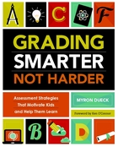
Standards Based Grading and Reporting 2015-16
February 9, 2016 with Myron Dueck

Slide 74
Professional Practice

Slide 75
Project Based Learning
The next PBL 101 cohort Begins Feb 3rd. It is a general session for teachers K-12.
Another cohort will begin March 1.

Slide 76
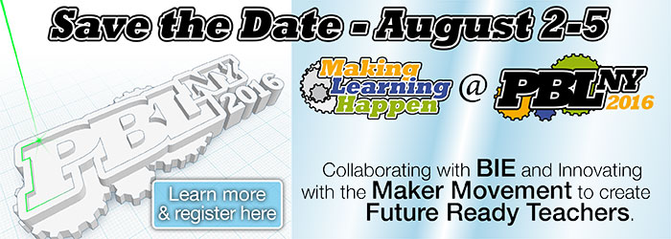
Project Based Learning

Slide 77
Culture

Slide 78
Poverty and It’s Impact
Students from Generational Poverty- January 25th: Extend your understanding about the impact poverty and learn how to expand your understanding of challenges, strengths and implications.
Instructional Strategies for Students from Poverty-February 10th: Eric Jensen's findings and suggestions will be incorporated with Hattie, McREL and Budge & Parrott. Specific moves and decisions teachers can make in their instructional design will be explained.

Slide 79
Classroom Environment
For teachers and administrators already trained and implementing Responsive Classroom, there are opportunities to extend skills. The next opportunity is December 15th and 16th on Engaging Academics.
Responsive Classroom - Are you ready to start to learn more about this proven approach? Join the next professional development opportunity beginning January 11th.

Slide 80
Hierarchy of Change
Student Achievement
Instruction & Assessment
Policies & Structure
Culture & Relationships
Purpose & Mission
Notes:
Remove gradient

Slide 81
RTI at Work Institute?
It’s a go!
June 28-30th
Oncenter
Will have 200 discounted seats
Think carefully about who should go (it’s not just your IS/AIS providers)

Slide 82
Regional Vision

Slide 83
Planning

Slide 84
BCIC Meeting
NEXT
February 4, 2015
Rodax 8 Large Conference Room

