Slide 1
BCIC Meeting
October 2015

Slide 2
Welcome
Introductions
Overview of Agenda Biggies:
Updates
APPR
3-8 and Economic Circumstance
Standards-Based Grading and Reporting
Solution Tree demonstration

Slide 3
Update and News
October 2015

Slide 4
APPR
Waiver window is open (don’t wait)
Assessments are being approved
Locally-Developed
STAR (so far)
Even state assessments will need to be submitted for use as supplemental assessments

Slide 5
Standards
Standards-survey
Standards-review
Likely delay of survey about new science standards

Slide 6
3-8 Assessments and Economic Circumstances
2014-2015

Slide 7
2014-2015 Correlations
Assessment | Pearson r
3 ELA | -0.84
3 math | -0.78
4 ELA | -0.81
4 math | -0.83
5 ELA | -0.81
5 math | -0.67
6 ELA | -0.76
6 math | -0.65
7 ELA | -0.73
7 math | -0.79
8 ELA | -0.71
8 math | -0.64
average* | -0.76

Slide 8
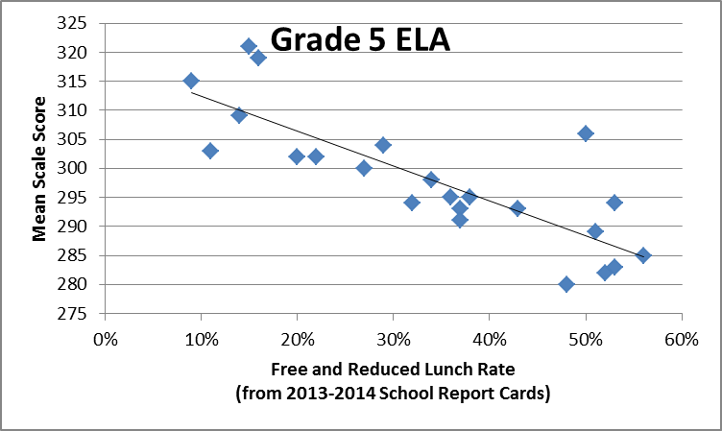

Slide 9
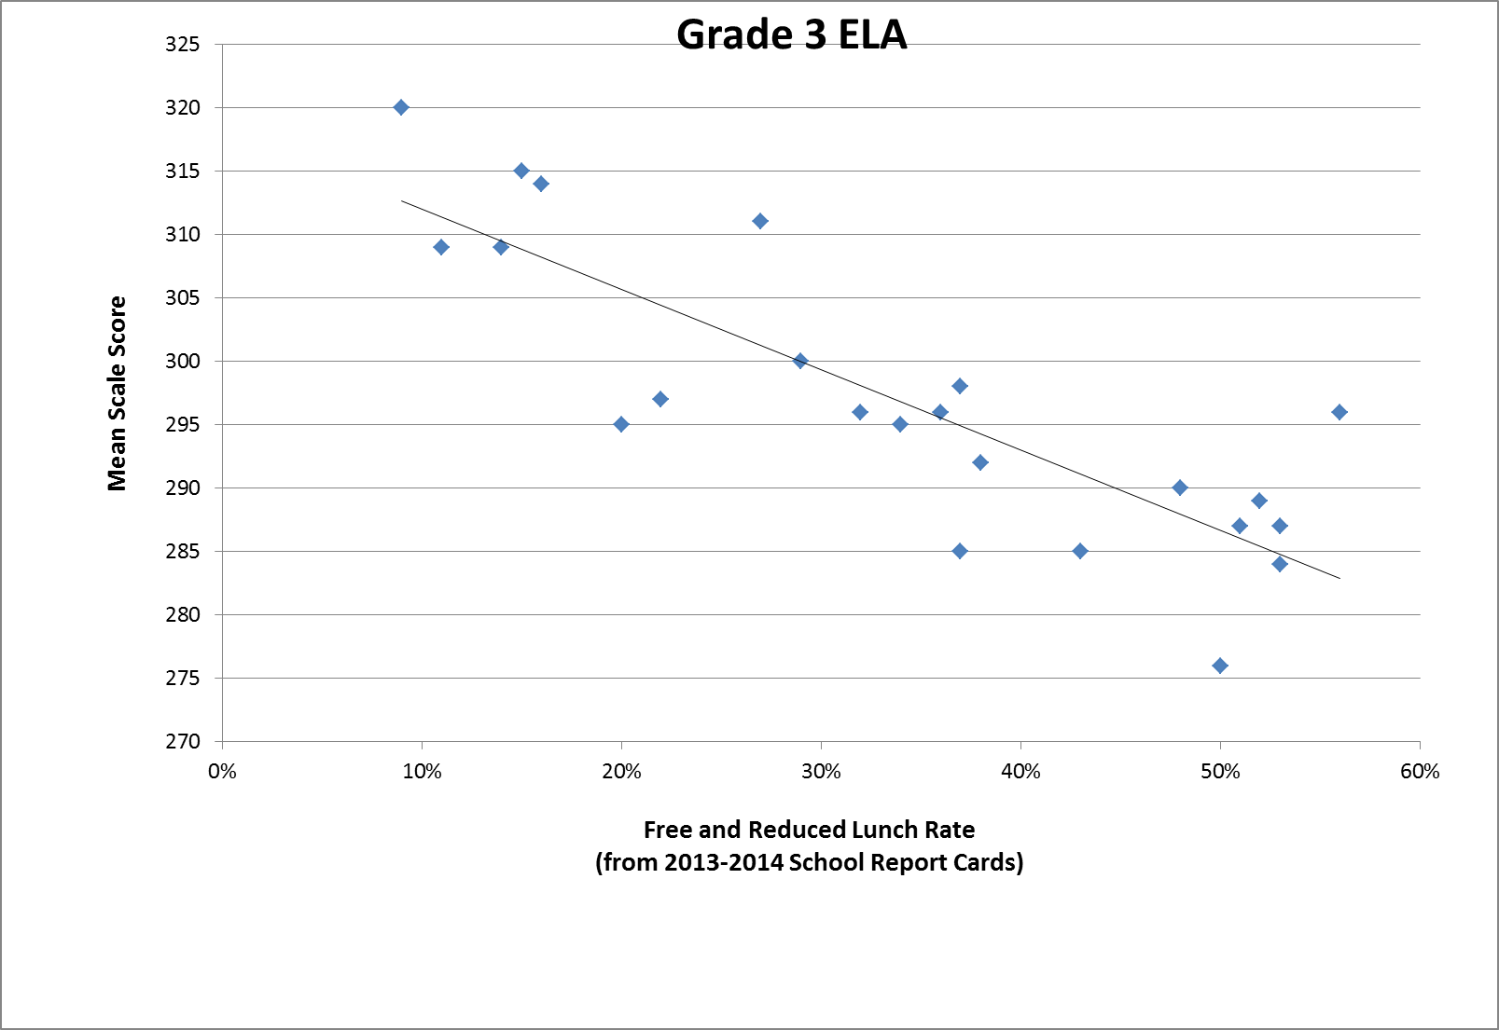

Slide 10
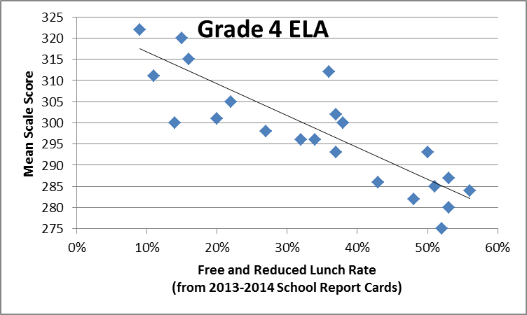

Slide 12
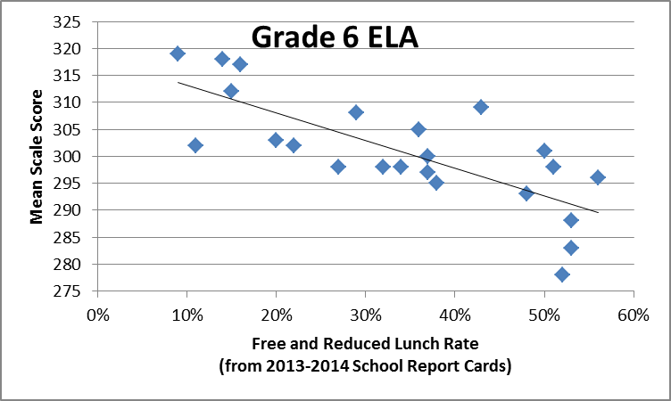

Slide 13
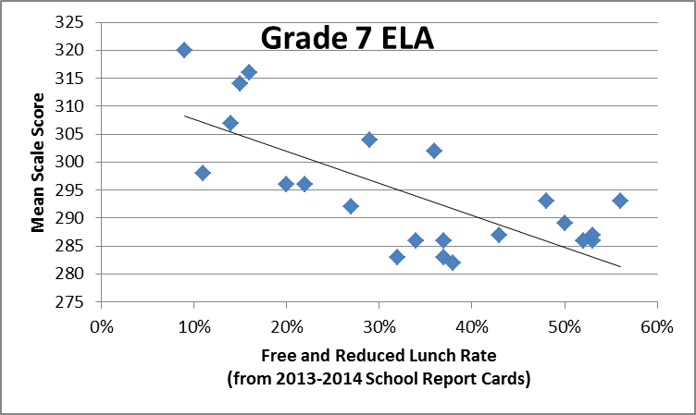

Slide 14
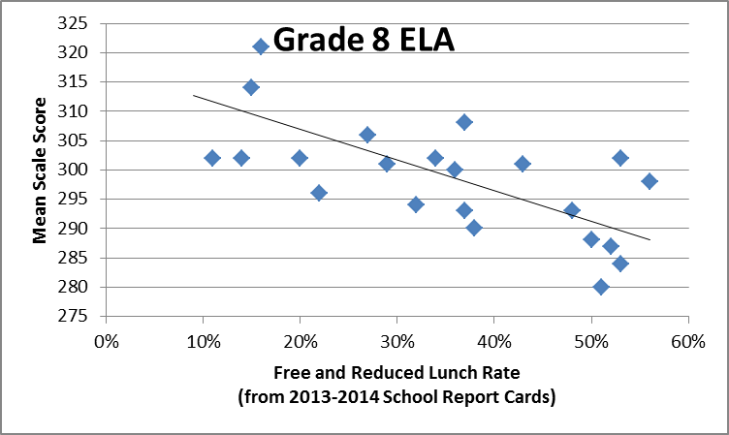

Slide 15
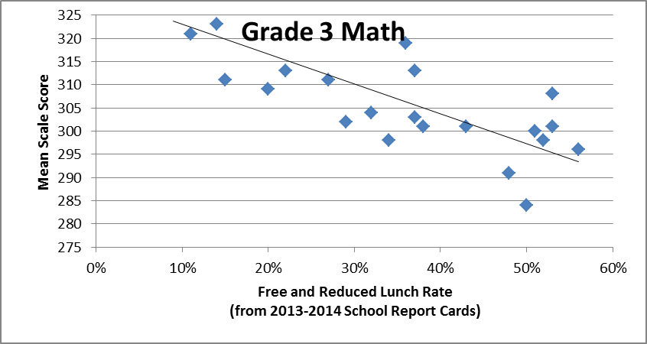

Slide 16
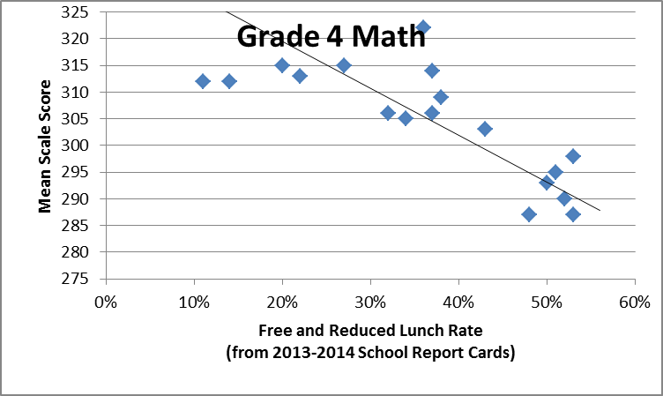

Slide 17
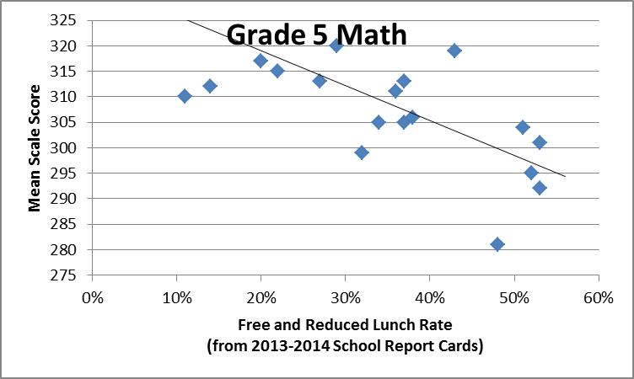

Slide 18
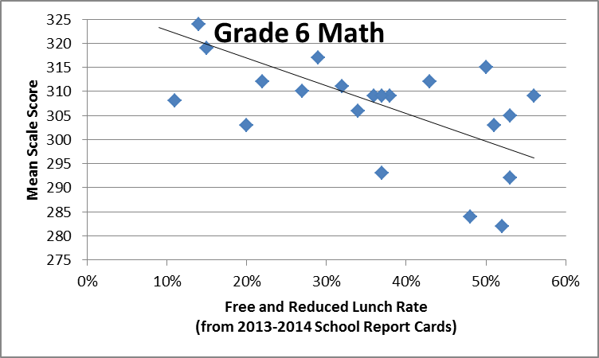

Slide 19
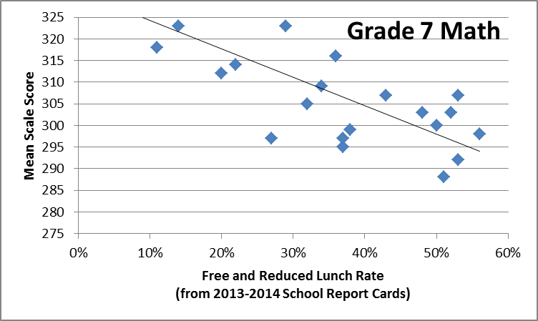

Slide 20
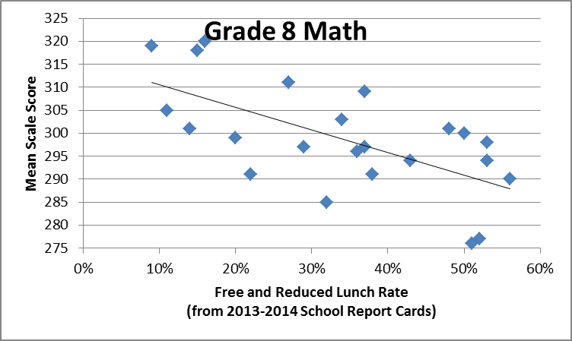

Slide 21
2014-2015 Correlations
Assessment | Pearson r
3 ELA | -0.84
3 math | -0.78
4 ELA | -0.81
4 math | -0.83
5 ELA | -0.81
5 math | -0.67
6 ELA | -0.76
6 math | -0.65
7 ELA | -0.73
7 math | -0.79
8 ELA | -0.71
8 math | -0.64
average* | -0.76

Slide 22
Assessment
A2T and A2 overlap
Scale score explanation and study group
Computer-based field testing
Two approaches to NYSAA

Slide 23
Counseling
Certification changes
Counseling plan changes

Slide 24
AIS
Cut-points set as expected

Slide 25
Department Updates

Slide 26
Leadership and Teacher Networks
Literacy Leadership Network-November 10.
Responsive Roundtable -November 13
Implementing Algebra 2 Common Core Learning Standards will be November 6.
Instructional Coaches network meets October 26 and December 8.
Social Studies Network session is November 19.
Project Based Regional Network will be December 18.

Slide 27
CI&A: Standards and Instruction
For Leaders of Literacy: Literacy Look-Fors for Leaders Elementary- November 4- Morning and Literacy Look –Fors for Leaders Secondary- November 4- Afternoon. Focus will be protocols to identify specific English Language Arts & Literacy practices that help students meet the standards.
Instructional Alignment to the Common Core ELA Regents session will be November 6. Explore what students need to know and be able to do to be successful on the newly structured Common Core English Regents Exam.
Strategies to Engage the Learner: fill a toolbox with strategies designed to support a student-centered classroom with an emphasis on interacting with content to support deep learning. Join this engaging and interactive group December 8.

Slide 28
ITD

Slide 29
Teacher Centers

Slide 30
Higher Education

Slide 31
CNY NYS ASCD
December 15 (ESM High School): Talking About Homework with Kathy Vatterot
March (West Genesee High School): Talking About Standards-Based Grading
May 11 (Laci’s Tapas Bar): Talking about CNY NYS ASCD

Slide 32
District Sharing

Slide 33
Sharing Schedule
October 22: Grading and reporting group share
December 3: __________
January 7: __________
February 4: __________
March 3: __________
April 7: __________
May 5: __________
June 2: __________

Slide 34
Standards

Slide 35
Regional Chart
Please update the regional chart:
Module choice
Commercial program implementation
Test choices
https://docs.google.com/spreadsheets/d/1HVCC4MaFiMr_aGRsO4iQhQ8_-UxDusiYUI6PB2SL_28/edit#gid=0

Slide 36
Stop! Wait!
Don’t forget the Connie Muther process for choosing materials and resources.

Slide 37
Social Studies
Follow-up for Summer Curriculum Work – Grades 5-8:
Facilitated sessions are for teachers and administrators who participated in the Summer 2015 Social Studies Curriculum Work to continue the process of curriculum mapping, unit design and inquiry writing.
Group will meet October 26. The next session is November 17 and will be followed by another opportunity December 15.

Slide 38
Science Updates
Release of draft NYSSLS probably in November
PD about Framework held on October 20th
Science Advisory on October 7th
Science Leadership Meeting
Oct. 7th meeting was attended by over 50 people
Next meeting is January 8, 2016
Handed out 50 copies of the Framework

Slide 39
Mathematics
Mathematics Leadership Network – Nov. 5th, 1:30-3:30 (Rodax 8 Large Conference Room)
Working to identify areas of need to design future PD around
Focus on continuous improvement
Implementing the Algebra 2 Common Core Learning Standards – Nov. 6th, 8:30-3:00

Slide 40
Data

Slide 41
Assessment
3-8 Stand-alone field testing can be computer-based
Practice items available soon (practice with the math tools)
No plan for Regents exams to be computer-based at this time

Slide 42
Assessment Design
The Authentic Assessment Academy will be an opportunity for teams of teachers to explore best practices in assessment design as they experience creation/revision of authentic/performance/standards-based assessments. There will be three cohorts: starting in Nov, Dec and Jan. Registration is open.
We are going to revise the World Languages Checkpoint B assessments. Districts that send at least one participant will have access to all of the final products. Registration is open on MLP for Spanish, French, German, Latin and Italian. These start on November 12.

Slide 43
Standards-Based Grading
Getting Ready:
Card Sort
Experience and brainstorm how else might sort, where and when might you use
Survey
Collective read
Canon

Slide 44
Standards-Based Grading
Events:
Guskey and Jun on November 3rd at SRC
Kathy Vatterott on December 16th: Rethinking Homework
Myron Dueck February 9th: Grading Smarter Not Harder
“Cannon” for each district at September BCIC meeting
Connecting events during the year

Slide 45
Resources
Resource collection ( the canon) are in bags
Number of bags is according to district size

Slide 46
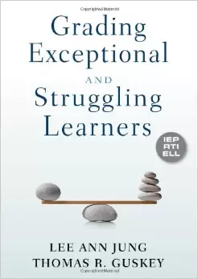
Standards-Based Reporting
What is the message?
Split in to half and then half again.
Each group comes up with a three-point “message” based on the book

Slide 47
3x3 Messaging Example
In a situation such as bullying or hazing:
Nothing is more important to us than our student’s safety and well-being.
We have policies and procedures to ensure an environment of respect.
We respond promptly to any and all concerns raised by students and adults.

Slide 48
Your Three-Point Message:
Standards-Based Grading and Reporting:
Or
Grading and Reporting (Exceptional and Struggling Learners):

Slide 49
Professional Practice

Slide 50
Project Based Learning
November 9th is the beginning of the next cohort at McEvoy.
Another cohort is especially for elementary teachers starts December 2nd.

Slide 51
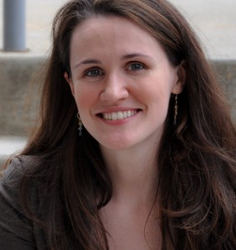
School Counselors
Professional Development
November 3rd
OCC
Keynote: Liz Murray
Workshops
Regs, plans, admissions, data, panels, opportunities, future, etc.
$65 per person (breakfast & lunch included)

Slide 52
Culture

Slide 53
Classroom Environment
For teachers and administrators already trained and implementing Responsive Classroom, there are opportunities to extend skills. These sessions replace previously offered Advanced Responsive Classroom Course. The second series is November 5th and 6th and will focus on Effective Management.

Slide 54
Hierarchy of Change
Student Achievement
Instruction & Assessment
Policies & Structure
Culture & Relationships
Purpose & Mission
Notes:
Remove gradient

Slide 55
RTI at Work Institute?
It’s a go!
June 28-30th
Oncenter
Will have 200 discounted seats
Think carefully about who should go (it’s not just your IS/AIS providers)

Slide 56
Regional Vision

Slide 57
Planning

Slide 58
BCIC Meeting
NEXT
December 3, 2015
Rodax 8 Large Conference Room

