Slide 1
BCIC Meeting
September 2015

Slide 2
Welcome
Introductions
Overview of Agenda Biggies:
Updates
APPR
Standards-Based Grading and Reporting

Slide 3
SED Update
September, 2015

Slide 4
Assessment
A2T and A2 overlap
Scale score explanation and study group
Computer-based field testing
Two approaches to NYSAA

Slide 5
Counseling
Certification changes
Counseling plan changes

Slide 6
AIS
Cut-points set as expected

Slide 7
Department Updates

Slide 8
Curriculum, Instruction and Assessment (CI&A)
Facilitates support for learning through:
Regional workshops/courses
Custom on-site workshops/courses
Regional networks
Coaching
Facilitation of groups
Planning
Special projects

Slide 9
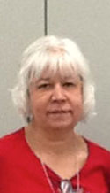
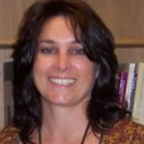
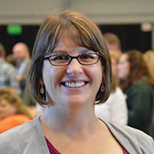
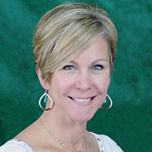
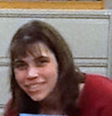
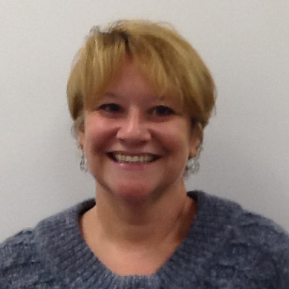
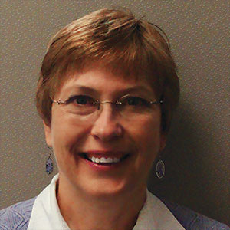
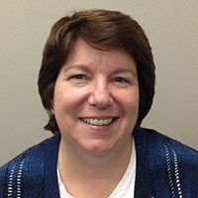
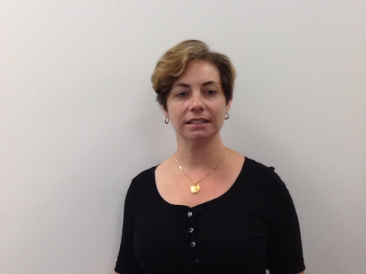

Slide 10
Regional Opportunities
Regional events at no additional costs
Regional events developed based on district input
Registration is usually through My Learning Plan
Registration is generally open until week before scheduled session
Monthly PD enews, MLP, ISS weekly dispatch

Slide 11
In-District Support
Included days
4 days
3 days
2 days
Additional days
.030 allocated funds
Adjustment to contract

Slide 12
In-district days:
Contracted through On-Site Agreement (OSA)
If cancel within 30 days of event, half charge applies
If contract 10 or more days, discounted pricing
Blocks of half day minimum
Component pricing
$975/day
$590/ half day
$700/discounted pricing

Slide 13
Networks- Scheduled across the year
Literacy Leadership Network- The first meeting is September 17.
Responsive Roundtable -This is new for 2015-16!
Instructional Coaches Network- September 21. New this year!
Social Studies Network - September 24.
Project Based Regional Network will begin October 19.

Slide 14
Upcoming Regional Especially for Math Teachers:
Implementing Algebra 2 Common Core Learning Standards will meet October 2.
A series of sessions will begin on October 15 for Providers of AIS Mathematics.

Slide 15
Project Based Learning
A session for secondary education teachers only will be October 7,8,14 and 15 on the McEvoy Campus.
These sessions will be followed by another session on the Henry Campus October 21, 22, 28, 29
Especially for math teachers: Problem Based Learning- This workshop will guide math teachers through a learning process in which they will gain an understanding of the key differences between Project-Based Learning (PBL) and Problem-Based Learning (PrBL). Join us Sept 28.

Slide 16
Classroom Environment
Responsive Classroom-Fall Institute- This popular and effective course is October 26, 27 and Nov 19, 20. This is for teachers and administrators new to Responsive Classroom.
For teachers and administrators already trained and implementing Responsive Classroom there are opportunities to extend skills in two separate times. These sessions replace the Advanced Responsive Classroom Course previously offered. The first opportunity is Engaging Academics Oct 1 and 2.

Slide 17
Standards and Instruction
Standards Based Planning for the 21st Century- Instruction for All is a comprehensive course. The fall sessions begin Oct 7 and run for five sessions between then and December.
*********************************************************The Teacher's Literacy Toolbox Series: Reading, Writing and Research in a Common Core Classroom will be October 5, Nov 2 and Dec 7. The first session will focus on making complex texts accessible through the practice of Close Reading. The second session will emphasize Writing from Evidence. The third session will wrap up the series with focus on inquiry.

Slide 18
Assessment Design
Authentic Assessment Academy will be an opportunity for teams of teachers to explore best practices in assessment design as they experience creation/revision of authentic/performance/standards based assessments. There will be three cohorts – starting in Nov, Dec and Jan. Registration is open.
World Languages will have the opportunity to revise Checkpoint B. Districts that send at minimum one participant will have access to the final product. Registration is open on My Learning Plan for Spanish, French, German, Latin and Italian.

Slide 19
School Improvement
Two or more districts share the costs
Follow-up for 18 months is also eligible
Further information

Slide 20
Literacy Interventions
Reading Recovery
Leveled Literacy Interventions- K-HS
Sonday System-Oct 15
Intervention Study Group- Oct 14
Essential Foundations- LETRS- Cancelled

Slide 21
ELLs and Part 154
Under the revised C.R. Part 154 regulationshere are some key areas:
Changes to the delivery of ENL services will impact all districts. These changes affect all teachers (i.e. content, ESOL)
Changes to how districts and school buildings support, track and monitor English Language Learners.
Changes to PD requirements for all stake holders, even districts with no ELLs.
Changes to CEP plans for ELLs for all districts, even districts with no ELLs who must have a plan in place.

Slide 22
ELLs and Part 154
Also of note::
CR Part 154 Data Reports All forms are due September 30, 2015. Link - http://www.p12.nysed.gov/biling/bilinged/CRPart154.html
LEAs with ELLs must submit ALL forms in the CR Part 154 Data/Information Report.
LEAs with NO ELLs must submit forms A-1 and A-4.
All LEAs must submit the “2015-2016 CR Part 154 LEA General Information Form” signed in blue ink by the Chief District Administrative Officer (original signature required).

Slide 23
ELLs and Part 154
Sessions have been scheduled:
Oct 19 - Rodax 8 Large 4:00p - 7:00p
Oct 23 - Rodax 8 Large all day for 2 sessions 8:30a to 11:30a or 12:30a to 3:30a
Oct 26 - McEvoy - all day for 2 sessions 8:30a to 11:30a or 12:30p to 3:30p

Slide 24
ITD

Slide 25
Teacher Centers

Slide 26
Higher Education

Slide 27
CNY NYS ASCD
October 15 (Willowfield Elementary School, Liverpool): Talking About Coaching
December 15 (ESM High School): Talking About Homework with Kathy Vatterot
March (West Genesee High School): Talking About Standards-Based Grading
May 11 (Laci’s Tapas Bar): Talking about CNY NYS ASCD

Slide 28
District Sharing

Slide 29
Sharing Schedule
September 17: Set schedule
October 22: Grading and reporting group share
December 3: __________
January 7: __________
February 4: __________
March 3: __________
April 7: __________
May 5: __________
June 2: __________

Slide 30
Standards

Slide 31
Social Studies
This year’s plans:

Slide 32
Arts
In the queue; ready
No timeline yet

Slide 33
New York State Science Learning Standards (NYSSLS)
Mirror the NGSS
First round of edits made in Summer 2015
Reviewed by NYS Science Steering Committee
Second round of standards writers editing standards in late September
Draft NYSSLS expected late October

Slide 34
Planning for NYSSLS Short term
Science Leadership Network – Oct. 7th
PD focused on Framework – Oct. 20th
Open informational review of Draft NYSSLS on Nov. 4th or 18th (4-6 pm)
Pilot Study for future elementary science curriculum this year
Using a systematic review process

Slide 35
Planning for NYSSLS Long term
Planned and deliberate phase-in of new curriculum materials informed by assessment timetable
Compressive and cohesive professional development plan
Continuous improvement plan – ongoing research of student and teacher learning
Differentiated teacher professional development plan

Slide 36
Short-term Implementation Plan
Understanding context of new standards
Building regional shared understanding of standards
Professional Development to understand second order shift to new standards
Transition to new science curriculum materials with associated PD

Slide 37
Start with the Framework
A Framework for K-12 Science Education: Practices, Crosscutting Concepts, and Core Ideas (NRC, 2012)
Science for ALL students to prepare them for their future
Science education is not about creating engineers and scientists

Slide 38
Key Aspects of the Framework
Learning progression
Coherent and cohesive K-12 learning experience
Focused on a core set of cross cutting concepts, disciplinary core ideas, and scientific and engineering practices
NOT focused on discrete facts
Instruction focused on understanding essential phenomena (not teaching topics)
“The NGSS require a much deeper understanding of the phenomena as opposed to the memorization of the vocabulary alone.” (Pruitt, 2014, p. 154).

Slide 39
Science Center Plan
Regional deep understanding of Framework
Develop shared understanding of standards
Assessment (state and local)
Professional development – on going and differentiated
Continuous improvement of curriculum materials and teacher supports

Slide 40
Project-Based Learning

Slide 41
PBLNY – The Event
PBL^{NY} 2016 is in the works… likely collaboration with Buck Institute and combined with Making Matters event

Slide 42
Data

Slide 43
Assessment
A2 next year
Different transition than other math courses

Slide 44
Standards-Based Grading
Getting Ready:
Card Sort
Experience and brainstorm how else might sort, where and when might you use
Survey
Collective read
Canon

Slide 45
Standards-Based Grading
Events:
Guskey and Jun on November 3rd at SRC
Kathy Vatterott on December 16th: Rethinking Homework
Myron Dueck February 9th: Grading Smarter Not Harder
“Cannon” for each district at September BCIC meeting
Connecting events during the year

Slide 46
Resources
Resource collection ( the canon) are in bags
Number of bags is according to district size

Slide 47
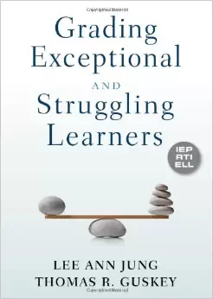
Standards-Based Reporting
Which do you want to read first?

Slide 48
Professional Practice

Slide 49
School Counselors
Professional Development
November 3rd
Likely at OCC
Keynote: Liz Murray
Workshops
Regs, plans, admissions, data, panels, opportunities, future, etc.

Slide 50
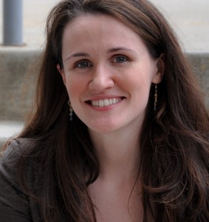
School Counselors
Professional Development
November 3rd
OCC
Keynote: Liz Murray
Workshops
Regs, plans, admissions, data, panels, opportunities, future, etc.
$65 per person (breakfast & lunch included)

Slide 51
APPR
Year One Lead Evaluator Training
Ongoing Lead Evaluator Training
Ongoing Principal Evaluator Training
Year One Principal Evaluator Training???
Training required
Demonstrated “Good Faith Effort”

Slide 52
Culture

Slide 53
Hierarchy of Change
Student Achievement
Instruction & Assessment
Policies & Structure
Culture & Relationships
Purpose & Mission
Notes:
Remove gradient

Slide 54
RTI at Work Institute?
It’s a go!
June 28-30th
Oncenter
Will have 200 discounted seats
Think carefully about who should go (it’s not just your IS/AIS providers)

Slide 55
Regional Vision

Slide 56
Pre-Service Teacher Training
Early College and Dual Enrollment
Professional Development
School:
Visitations
Observation
Training (Buck Institute and NTN)
Coaching
Co-teaching
PBL^{NY}
New Tech Network Model
New Tech High School
CNY New Tech High School in Cortland County
(opening September 2016)
OCM BOCES Programs
Innovation Tech at the Career Academy (opened September 2014)
District/School-Based
Integrated PBL Courses
Future School Adoption
Standards (CCLS, NGSS, SS Framework, NYS Teaching Standards, 4Cs, ISTE, etc.)
Business Partnerships

Slide 57
Pre-Service Teacher Training
Early College and Dual Enrollment
Professional Development
School:
Visitations
Observation
Training (Buck Institute and NTN)
Coaching
Co-teaching
PBL^{NY}
New Tech Network Model
New Tech High School
CNY New Tech High School in Cortland County
(opening September 2016)
OCM BOCES Programs
Innovation Tech at the Career Academy (opened September 2014)
District/School-Based
Integrated PBL Courses
Future School Adoption
Next: October 9th
Cortland area businesses
Standards (CCLS, NGSS, SS Framework, NYS Teaching Standards, 4Cs, ISTE, etc.)
Business Partnerships

Slide 58
Expanding choices for students
More student/parent choice
Pre-Service Teacher Training
Early College and Dual Enrollment
Professional Development
School:
Visitations
Observation
Training (Buck Institute and NTN)
Coaching
Co-teaching
PBL^{NY}
New Tech Network Model
New Tech High School
CNY New Tech High School in Cortland County
(opening September 2016)
OCM BOCES Programs
Innovation Tech at the Career Academy (opened September 2014)
District/School-Based
Integrated PBL Courses
Future School Adoption
Standards (CCLS, NGSS, SS Framework, NYS Teaching Standards, 4Cs, ISTE, etc.)
Business Partnerships

Slide 59
SUNY Cortland
Four SUNYs
RIT
Consortium Event
Pre-Service Teacher Training
Early College and Dual Enrollment
Professional Development
School:
Visitations
Observation
Training (Buck Institute and NTN)
Coaching
Co-teaching
PBL^{NY}
New Tech Network Model
New Tech High School
CNY New Tech High School in Cortland County
(opening September 2016)
OCM BOCES Programs
Innovation Tech at the Career Academy (opened September 2014)
District/School-Based
Integrated PBL Courses
Future School Adoption
Standards (CCLS, NGSS, SS Framework, NYS Teaching Standards, 4Cs, ISTE, etc.)
Business Partnerships

Slide 60
Pre-Service Teacher Training
Early College and Dual Enrollment
PBL 101 & 102
PBL 400 series
PBLNY 2016
Coaching
Professional Development
School:
Visitations
Observation
Training (Buck Institute and NTN)
Coaching
Co-teaching
PBL^{NY}
New Tech Network Model
New Tech High School
CNY New Tech High School in Cortland County
(opening September 2016)
OCM BOCES Programs
Innovation Tech at the Career Academy (opened September 2014)
District/School-Based
Integrated PBL Courses
Future School Adoption
Standards (CCLS, NGSS, SS Framework, NYS Teaching Standards, 4Cs, ISTE, etc.)
Business Partnerships

Slide 61
Pre-Service Teacher Training
Early College and Dual Enrollment
Professional Development
School:
Visitations
Observation
Training (Buck Institute and NTN)
Coaching
Co-teaching
PBL^{NY}
New Tech Network Model
New Tech High School
CNY New Tech High School in Cortland County
(opening September 2016)
OCM BOCES Programs
Innovation Tech at the Career Academy (opened September 2014)
District/School-Based
Integrated PBL Courses
Future School Adoption
Added another class; will be 9th, 10th & 11th grade
Study tours each month
Standards (CCLS, NGSS, SS Framework, NYS Teaching Standards, 4Cs, ISTE, etc.)
Business Partnerships

Slide 62
Pre-Service Teacher Training
Early College and Dual Enrollment
Professional Development
School:
Visitations
Observation
Training (Buck Institute and NTN)
Coaching
Co-teaching
PBL^{NY}
New Tech Network Model
New Tech High School
CNY New Tech High School in Cortland County
(opening September 2016)
OCM BOCES Programs
Innovation Tech at the Career Academy (opened September 2014)
District/School-Based
Integrated PBL Courses
Future School Adoption
Many projects at elementary, mid-level, and high schools
Connections: October 9th
Standards (CCLS, NGSS, SS Framework, NYS Teaching Standards, 4Cs, ISTE, etc.)
Business Partnerships

Slide 63
Pre-Service Teacher Training
Early College and Dual Enrollment
Professional Development
School:
Visitations
Observation
Training (Buck Institute and NTN)
Coaching
Co-teaching
PBL^{NY}
New Tech Network Model
New Tech High School
CNY New Tech High School in Cortland County
(opening September 2016)
OCM BOCES Programs
Innovation Tech at the Career Academy (opened September 2014)
District/School-Based
Integrated PBL Courses
Future School Adoption
Met with Cortland businesses
Location secured
Information nights in the fall
On-schedule
Standards (CCLS, NGSS, SS Framework, NYS Teaching Standards, 4Cs, ISTE, etc.)
Business Partnerships

Slide 64
Planning

Slide 65
BCIC Meeting
NEXT
October 22, 2015
Rodax 8 Large Conference Room

