Slide 1
Getting Ready…
for Social Studies in NY
October 2014 Update

Slide 2
SS Learning Standards
Learning Standards
Part of Standards issued in 1996
Resource Guides in 1999
12th grade (Econ & P.I.G.) updated in 2002
Other misc. Updates

Slide 3
Graduation Requirements
Students must have 4 units of credit in social studies, which includes:
1 unit in American history; and
1/2 unit of credit in Economics and 1/2 unit of credit in Participation in Government (or equivalent)

Slide 4
State Assessment in SS
Regents Examinations:
Global History and Geography
US History and Government
Note: State assessments at the elementary and intermediate levels were discontinued due to the lack of funding. The last 5th and 8th grade tests were last administered in 09-10.

Slide 5
Getting Ready…
for Social Studies in NY
October 2014 Update

Slide 6
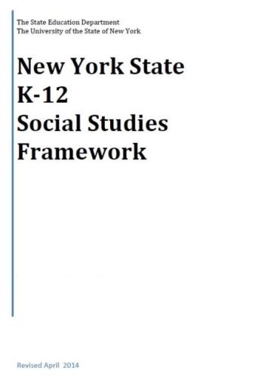
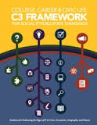
+
[
]
+
=

Slide 7
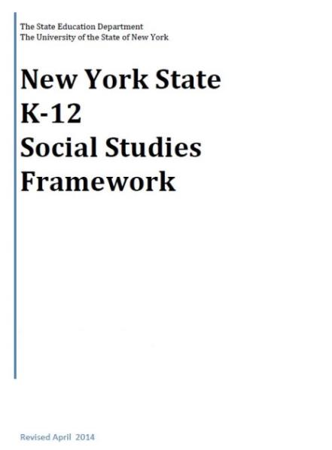
K-12 Social Studies Framework
Adopted April 2014
Intended to serve as a guide for local districts to develop Social Studies curriculum

Slide 8
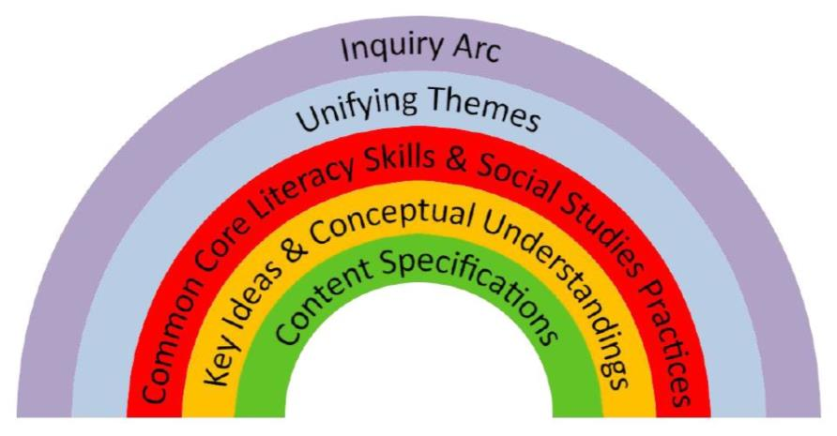
The Framework
Emphasis on:
Balance of content and skills
Civics and preparing students for citizenship and to take informed action

Slide 9
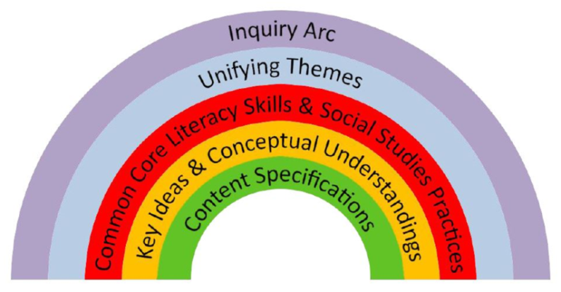
The Framework
Inquiry Arc (NCSS C3 Framework )
Developing questions and planning inquiries
Applying disciplinary concepts and tools
Evaluating sources and using evidence
Communicating conclusions and taking informed action
Notes:
NCSS – National Council for the Social Studies

Slide 10
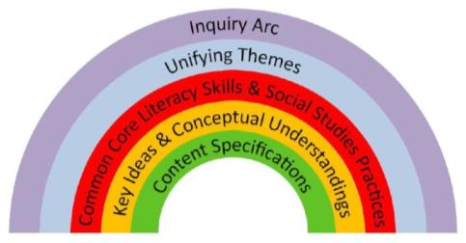
The Framework
Unifying Themes (NCSS)
Individual Development and Cultural Identity
Development, Movement, and Interaction of Cultures
Time, Continuity, and Change
Geography, Humans, and the Environment
Development and Transformation of Social Structures
Power, Authority, and Governance
Civic Ideals and Practices
Creation, Expansion, and Interaction of Economic Systems
Science, Technology, and Innovation
Global Connections and Exchange

Slide 11
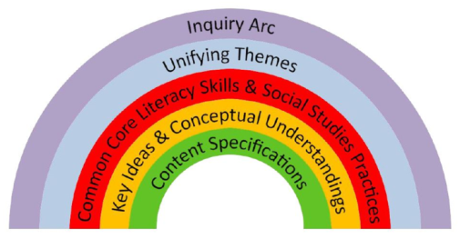
The Framework
New York State Common Core Learning Standards
Reading, Writing, Speaking and Listening
Literacy in History/Social Studies 6-12 (with addition of grade 5 to the 6-8 band)

Slide 12
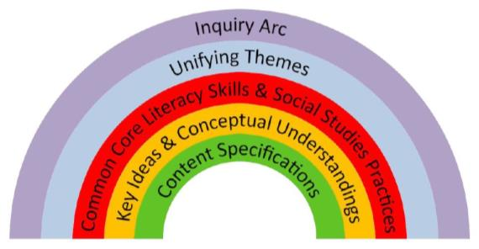
The Framework
Social Studies Practices
Gathering, Using, and Interpreting Evidence
Chronological Reasoning and Causation
Comparison and Contextualization
Geographic Reasoning
Economics and Economics Systems
Civic Participation

Slide 13
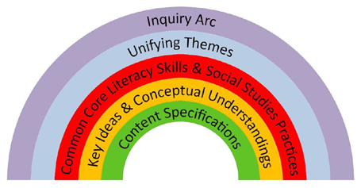
The Framework
Social Studies Learning Standards and Core Curriculum for Social Studies
History of the United States and New York
World History
Geography
Economics
Civics, Citizenship, and Government

Slide 14
Content Sequence
Kindergarten Self and Others
Grade 1 My Family and Other Families, Now and Long Ago
Grade 2 My Community and Other United States Communities
Grade 3 Communities around the World
Grade 4 Local History and Local Government
Grade 5 The Western Hemisphere
Grade 6 The Eastern Hemisphere
Grade 7 History of the United States and New York – I
Grade 8 History of the United States and New York – II
Grade 9 Global History and Geography – I
Grade 10 Global History and Geography – II
Grade 11 US History and Government
Grade 12 PIG/Econ
Caution!
This is a change!

Slide 15
Field Guide
Not yet released – soon?
Guidance about how to integrate social studies content, practices, and CCLS in the context of rigorous, inquiry-driven instruction.

Slide 16
Toolkit
Social Studies Toolkit
Released March 2015

Slide 17
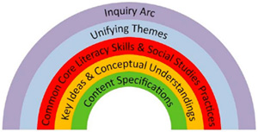
“Inquiries”
No modules or curriculum from the state, instead: “Inquiries”
Unit-like but not a unit
Compelling Questions
One annotated inquiry per grade
5 blueprints per grade

Slide 18
Parts of an “Inquiry”
Compelling Question
Supporting Questions: develop the content
Formative Performance Tasks: demonstrate emerging understandings
Featured Sources: provide background knowledge
Summative Task: demonstrates evidence-based arguments
Taking Informed Action: offers opportunities for thoughtful engagement

Slide 20
State Assessment in SS
Assessment Timetable:
Spring 2015 - Item writer training
Spring 2016 - Piloting of items
Spring 2017 - Field testing of items
June 2018 - Global first administration
June 2019 - US History first administration

Slide 21
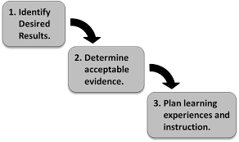
Curriculum Writing
Summer 2015
8th Grade!
5-7th grade next priority?
Summer 2016
9&10th Grade!
3-5 band
K-2 band
Summer 2017
US History!
12th grade?

Slide 22
Getting Ready
Prepping the region:
C3 w/ SG Grant (January 29, 4-6p session)
SS and NY Overview (4-6p session)
NYSCSS Annual Conference in Syracuse
Opening the Toolkit (4-6p session)
Prepping to Write:
Jay McTighe May 14 & 15
UbD, Essential Questions, Facets, more

Slide 23
SS Leadership Network
Collaborate, share
Turnkey presentations
Strategic representation
Suggest each district to have at least one rep

