Slide 1
Home Sweet Home
Notes:
Many things have change on this planet. While it might be true that things haven't change on other planets, here, on earth, things have changed.

Slide 2
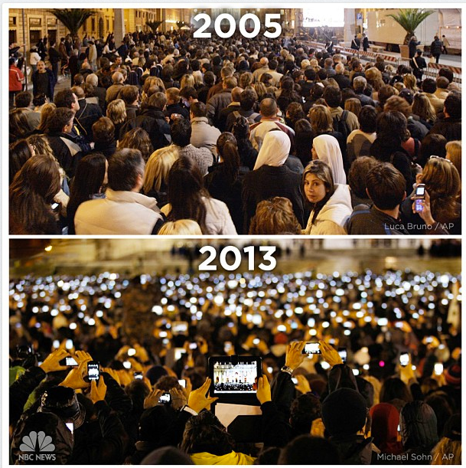
Pope Benedict
XVI
Pope Francis
Notes:
For example… Popes change. Oh, by the way, what else do you see that has changed?

Slide 3
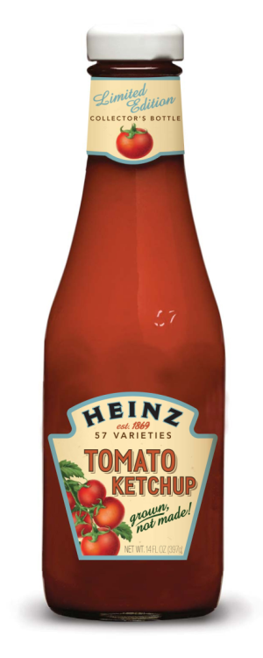
Notes:
Even Heinz ketchup bottles have changes. I’m particularly thankful for this but of evolution. It particularly maddening to go into a dinner these days and have to labor to get ketchup out of a narrow-necked glass bottle.

Slide 4
School of the Past
Knowledge
History
Biology
Chemistry
Physics
Math
Literacy
Economics
Government
Culture
Current events
Notes:
Take a look at the most common things we teach in our high schools. Are these the things that business ask about when hiring new employees? Were you asked about these things when you were interviewed for your present job?
Slide courtesy of Stacia Snow, Tech Valley High School, Albany, NY

Slide 5
School of the Future
Skills
Collaboration
Critical thinking
Communication
Creativity
Problem solving
Technology
Literacy
Numeracy
Researching
Time management
Knowledge
History
Biology
Chemistry
Physics
Math
Literacy
Economics
Government
Culture
Current events
Attributes
Persistence
Resilience
Patience
Self-worth
Confidence
Adaptability
Curiosity
Flexibility
Risk taking
Responsibility
Agency
Notes:
Or, do we want these to be the lists we plan and program for?
Slide courtesy of Stacia Snow, Tech Valley High School, Albany, NY

Slide 6
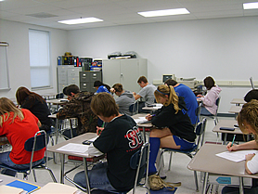
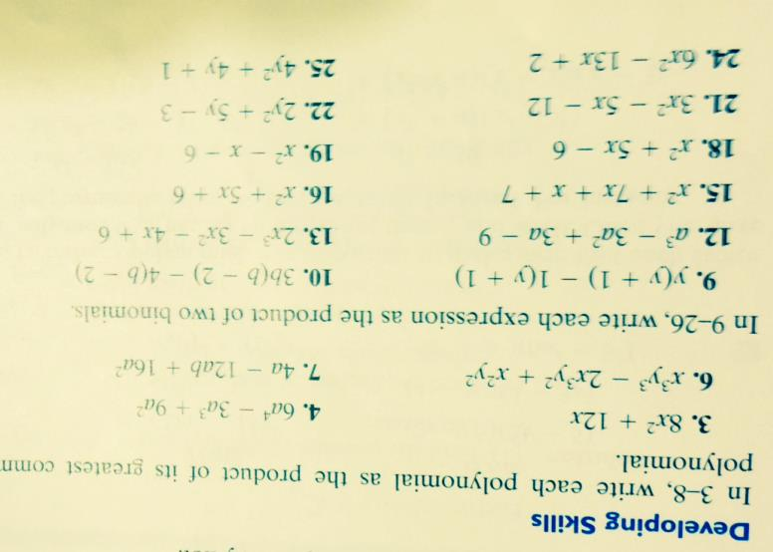
Notes:
From http://hs.sparta.k12.il.us/departments/math.shtml

Slide 7
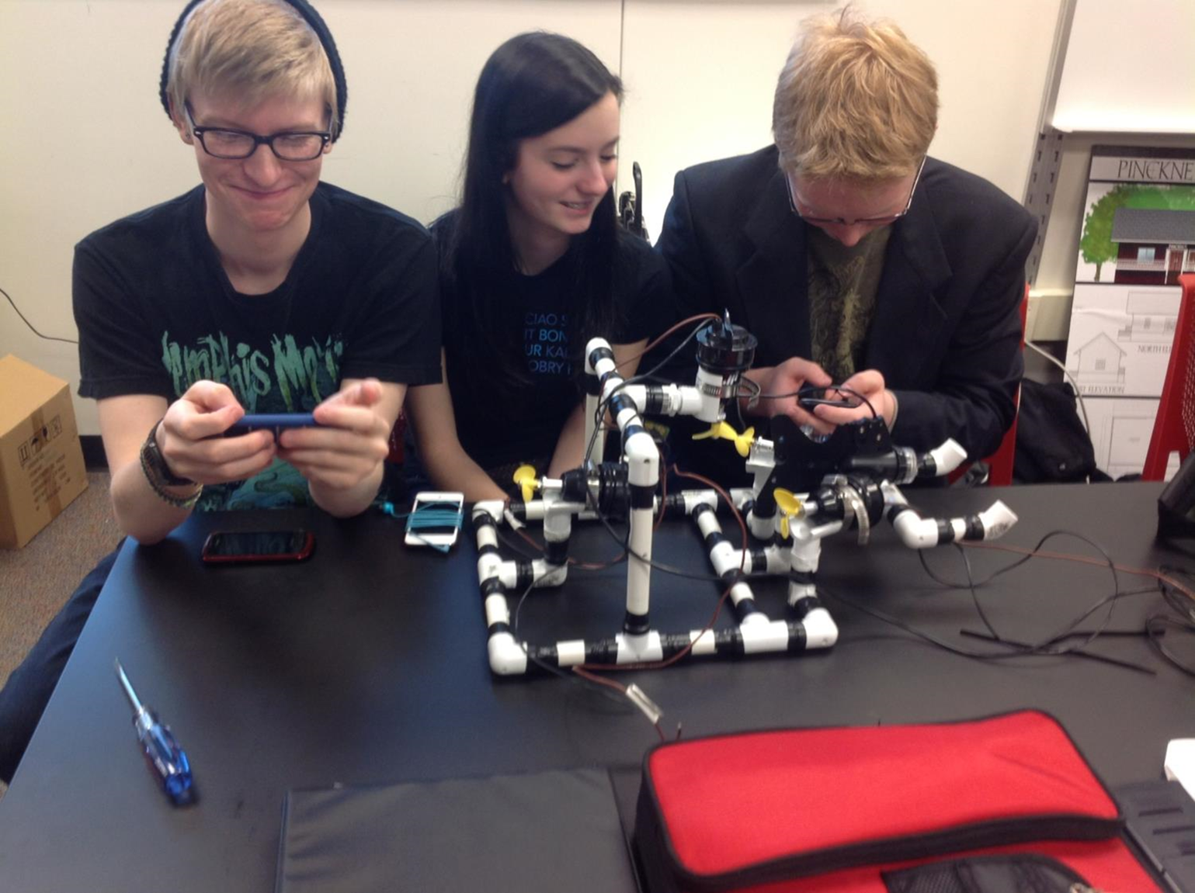
Notes:
Or consider this integrated course: High School, state-standards Geometry, High School Technology, a for-credit college course on project management.

Slide 8
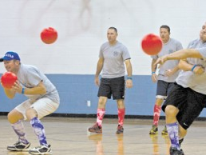

Slide 9
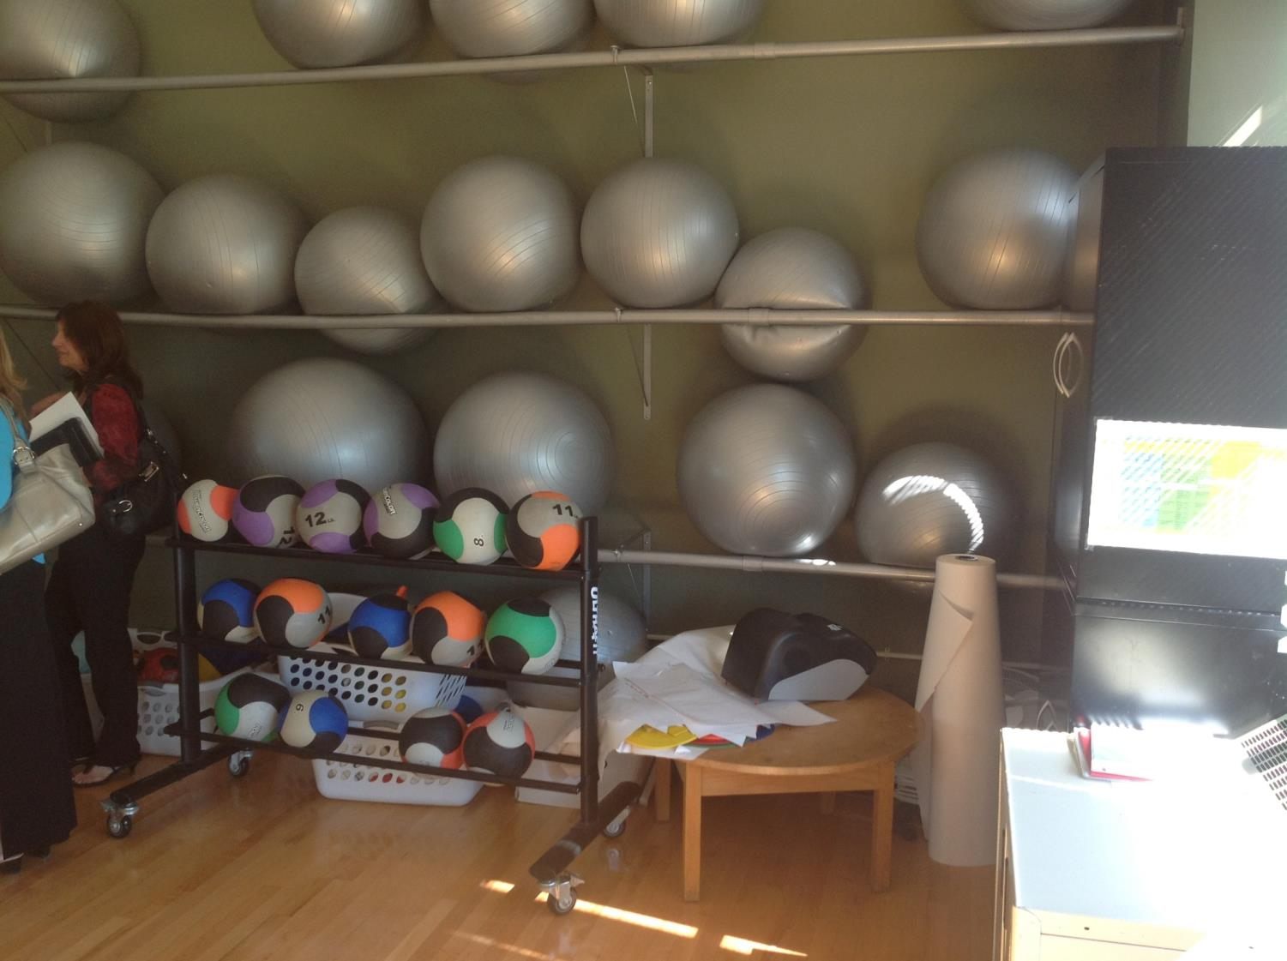

Slide 10
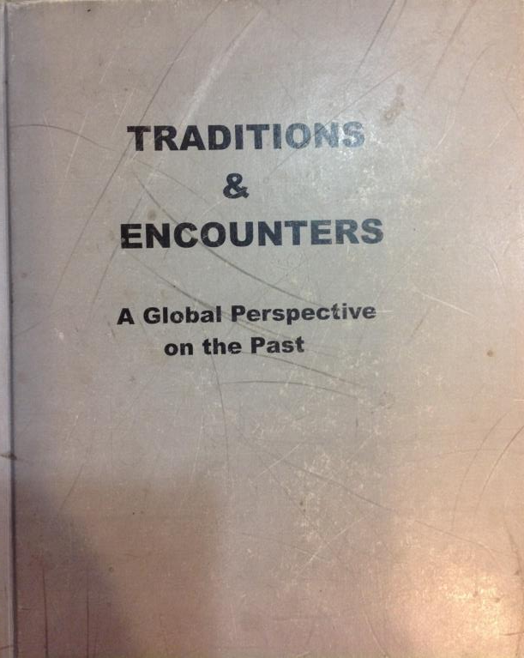
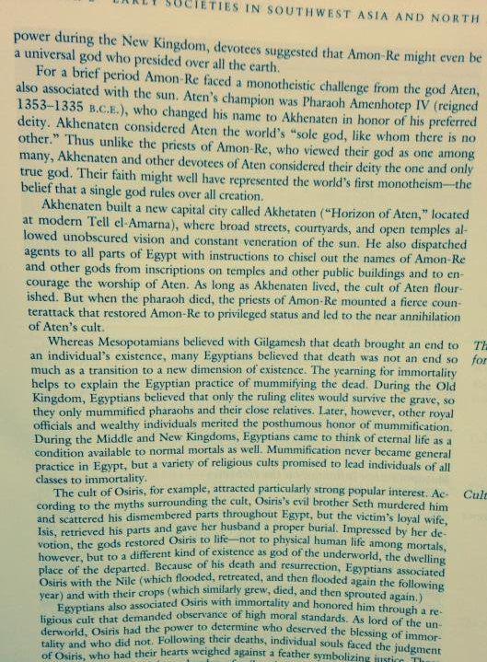
AP World Textbook
Copyright: 1999
Notes:
Think about how we’ve been teaching history and social studies. Textbooks. Lecture. No wonder kids get turned off from school. We couldn’t come up with a better way to teach kids to hate history if we tried!
How about the teacher at open house who boasts about her world history course and all they have to cover. She remarks about how there’s so much to do she nevers gets all the way up to the most recent 50 years!
Or the study of monotheistic religions in our world that is all about the history of the religions rather than starting with the world today and working backward to understand what is going on in our world today.
I was so glad when a my daughter told me they were studying Egypt right in the middle of the Arab Spring. “Finally!” I said to myself. I asked he what her fellow students were saying and what they were discussing. To my deep disappointment they were talking about pharaohs and tombs and the pyramids.

Slide 11
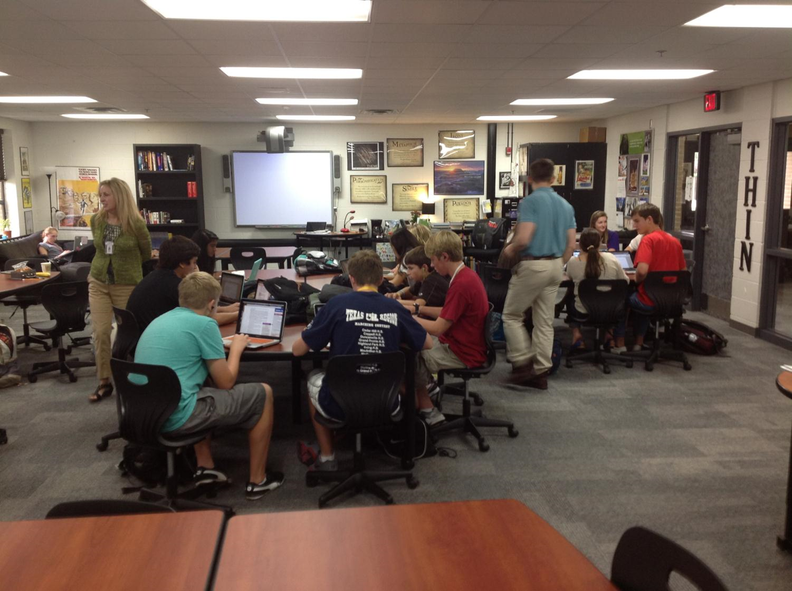
Notes:
We know how to create integrated courses, ELA and social studies, in which students world collaboratively to understand and navigate the world in which we live.
How about we survey kids to fins out what they think about people and government and responsibility, and then put them in similar groups to research different forms of government in order to recommend a system for their community. Only at the end to we introduce the labels Republican, Democrat, Conservative, and Liberal.

Slide 12
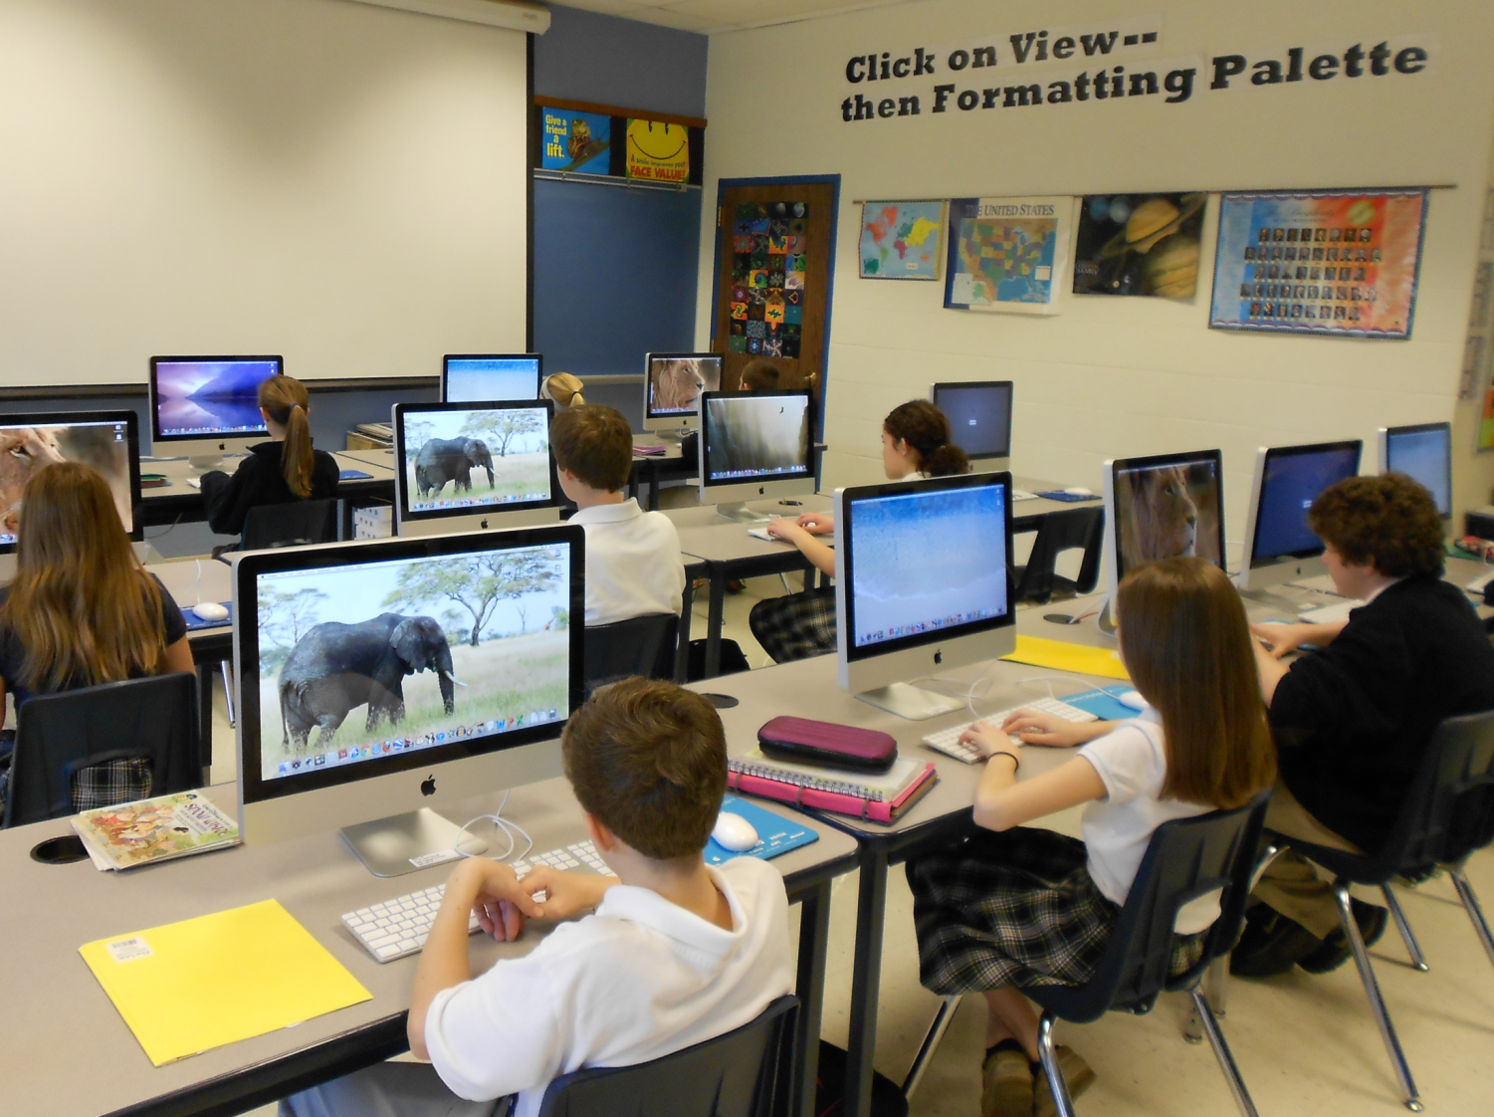
Notes:
Technology by way of the computer lab. Looks nice, eh? What if you were only allowed to use a computer when it was scheduled for you, such as during the last three days of a project or between 10 and 10:42 am on odd days.

Slide 13
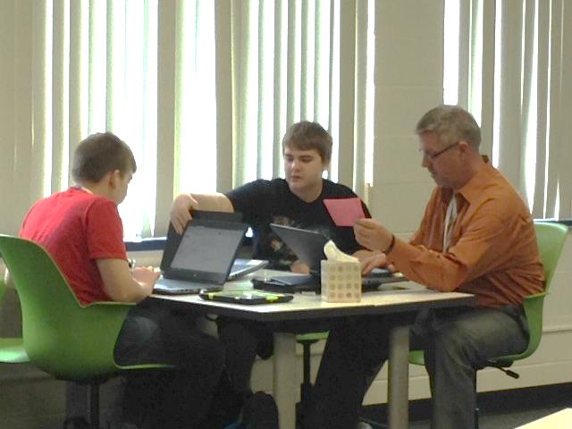
Notes:
Or we use computers (or other technology) when we need it, at our fingertips, just in time, as a normal part of the work we do.

Slide 14
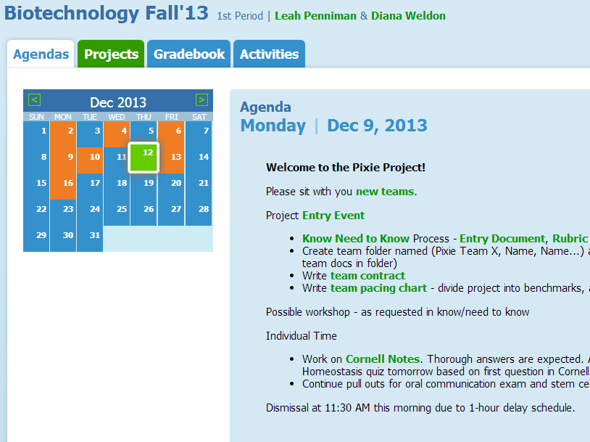

Slide 15
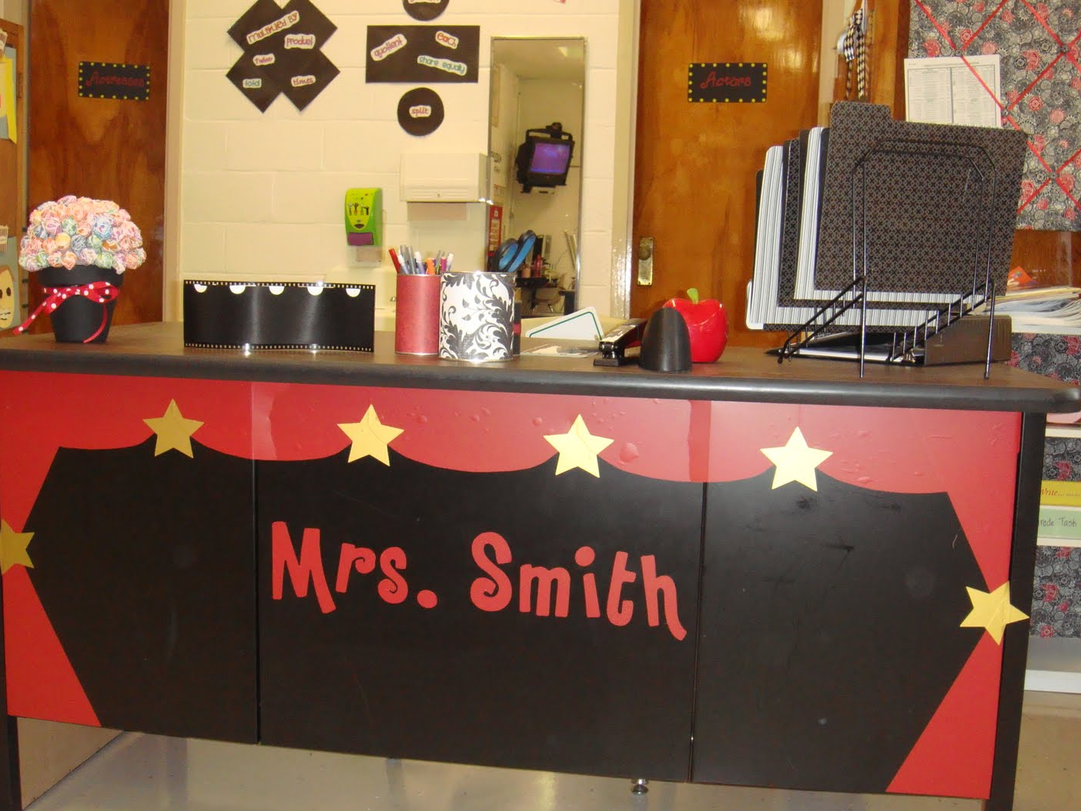
Notes:
Let’s consider how our teachers work and plan.
http://1happyteacher.blogspot.com/

Slide 16
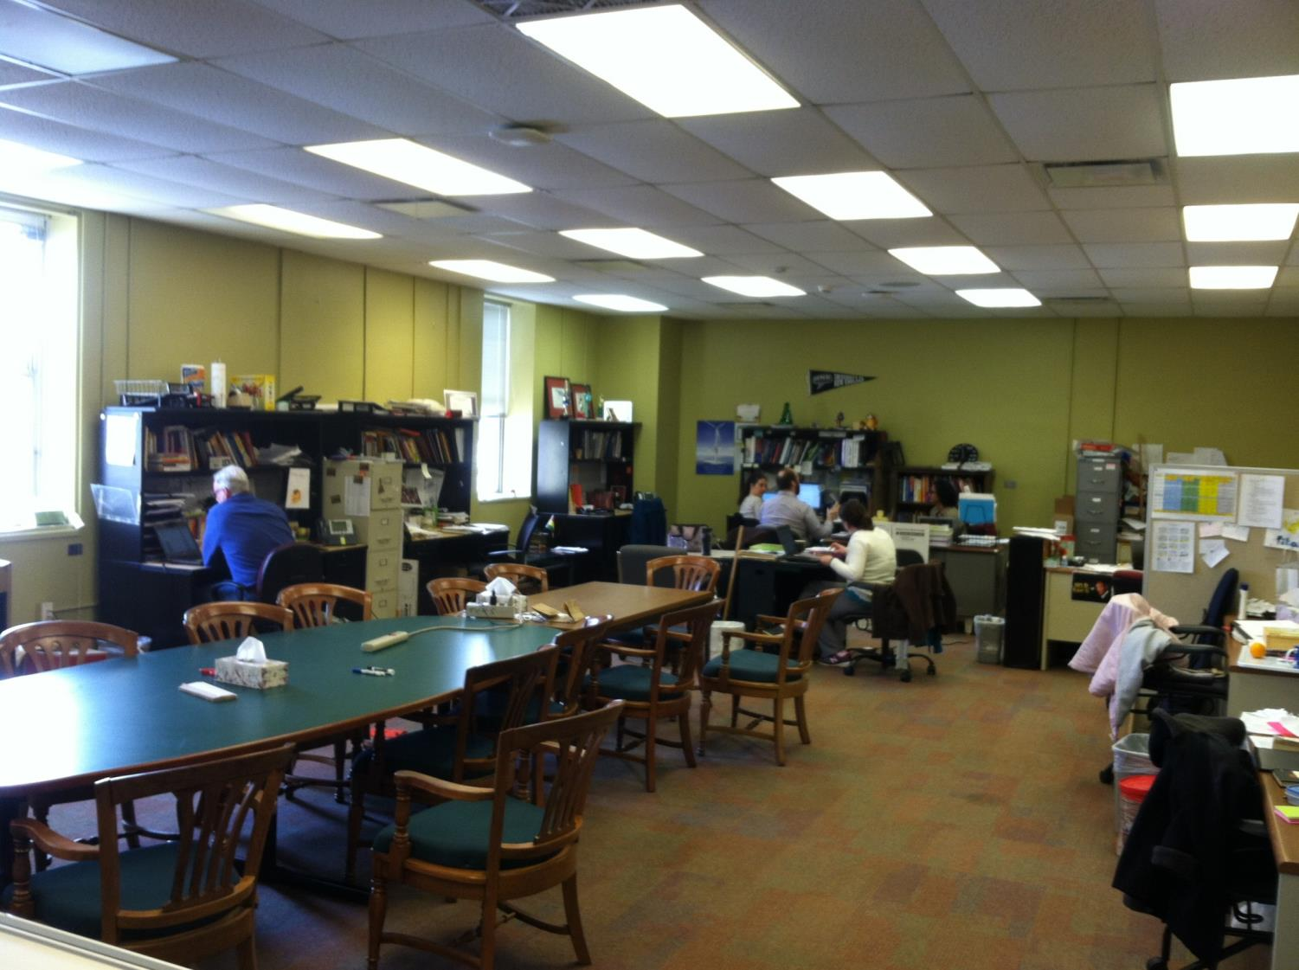
Notes:
Alternatively, teachers should work and plan in settings that promote collaboration.
Tech Valley High School, Albany, NY.

Slide 17
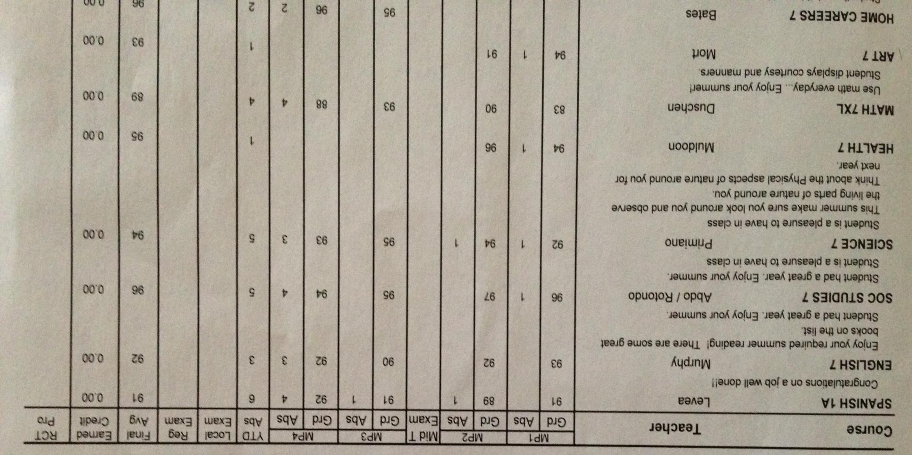

Slide 18
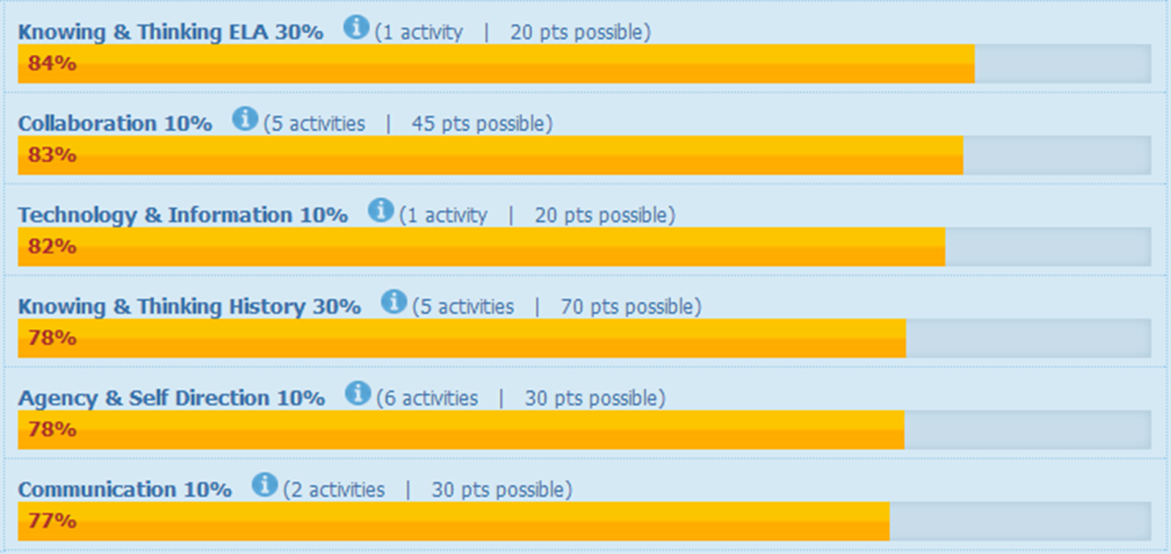
Grades & Feedback in ECHO

Slide 19
Pre-Service Teacher Training
Early College and Dual Enrollment
Professional Development
School:
Visitations
Observation
Training (Buck Institute and NTN)
Coaching
Co-teaching
PBL^{NY}
New Tech Network Model
New Tech High School
CNY New Tech High School in Cortland County
(opening September 2016)
OCM BOCES Programs
Innovation Tech at the Career Academy (opening September 2014)
District/School-Based
Integrated PBL Courses
Future School Adoption
Standards (CCLS, NGSS, SS Framework, NYS Teaching Standards, 4Cs, ISTE, etc.)
Business Partnerships
Notes:
Update on all three of these

Slide 20
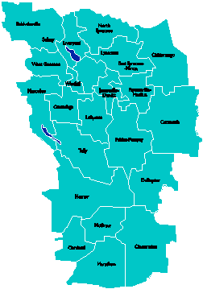
A Vision for Education in Central New York
College, Career & Citizenship Readiness

