Slide 1
BCIC Meeting
June 2015

Slide 2
Welcome
Introductions
Overview of Agenda
Updates
RTI discussion and sharing
Future events

Slide 3
SED Update
June, 2015

Slide 4
CPR
In order to comply with legislation, we will have to do some CPR instruction
One-time during high school
30 minutes would do it
Instruction, not certification
Also need to inform students about AED and where it is (don’t need to practice)

Slide 5
Back-Up SLOs
It is still a district’s responsibility to evaluate all teachers.
SED maintains that a back-up has to be developed.
It is a non-negotiable part of APPR and it is the district's responsibility to do this.
If you have any back-up SLOs for others it might be a good idea to use them with others.
Work with your local counsel on these for advice.

Slide 6
Science Standards
Some content additions suggested for high school; very few deletions.
Almost no addition or deletions for K-8.
Science standards-writing committee being formed now.

Slide 7
Social Studies
First inquiries posted. Inquiries are things that can fit inside a unit plan.
Assessment work has begun.
Videos posted at engageny.

Slide 8
Pathways
FAQs have been posted which are helpful.
Think of it as “four core plus a choice”

Slide 9
APPR 2015
Early June, 2015

Slide 10
Wait! Wait!
The following information should not yet be acted upon.
June Board of Regents Meeting is June 15 & 16.
Legislature is still in session.

Slide 11
The Matrix
Scores from rubrics have to be converted to H-E-D-I levels for the matrix.

Slide 12
The Growth Half
State provided-growth scores, or
School wide growth measures, or
SLOs based derived from assessments that the state approves for growth applications

Slide 13
The Growth Half
School wide growth measures example:
INSERT EXAMPLE HERE

Slide 14
Assessments
All assessments that are used to determine the student growth portion have to be approved assessments.
There will be a RFQ process that allows the submission of assessments for approval.
Assessments will have to be able to be used for growth, not achievement.

Slide 15
The Growth Half
An additional growth measure can be locally negotiated; only approved assessments can be used.
The additional measure can count for 20% of the growth portion.
There is an “ineffective penalty” against this on the matrix*

Slide 16
SLOs
In general, this SLO process will not change in the new APPR.
Assessments will have to be from the approved list, however.

Slide 17
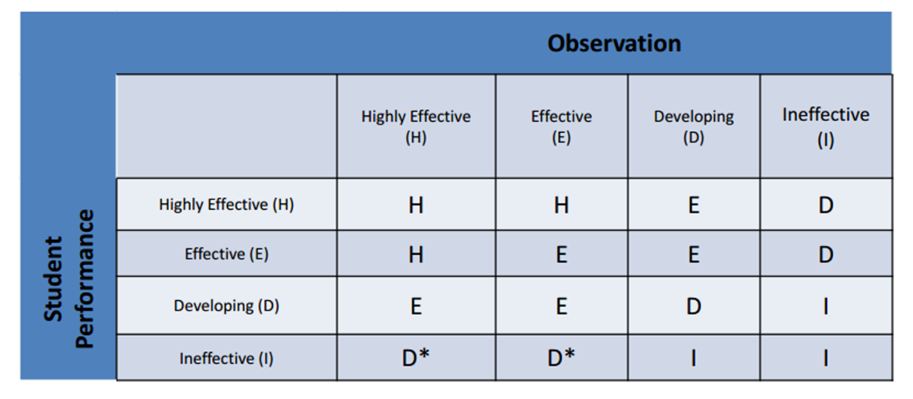
The Growth Half
There is an “ineffective penalty” against the additional measure on the matrix*

Slide 18
Observations
This will likely stay the same as it is in 3012-C.
At least two observations are required, at least one of which has to be unannounced.
No minimum amount of time will be specified.

Slide 19
Independent Observers
The principal will be defined based on the BEDS code. Anyone from outside the BEDS code could be considered an independent observer.
The ratio will likely be 80/20 or 80/10/10

Slide 20
Translating Scores to HEDI
Scores from rubrics have to be converted to H-E-D-I levels for the matrix.
It looks like the cut-points for the ranges will be based on .75 and not .5 as NYSUT advocates:
I |  |  |  |  |  |  | D |  |  |  | E |  |  |  | H
0 | 0.25 | 0.5 | 0.75 | 1 | 1.25 | 1.5 | 1.75 | 2 | 2.25 | 2.5 | 2.75 | 3 | 3.25 | 3.5 | 3.75 | 4

Slide 21
Training
This will likely be very similar to the way it is defined in 3012-C.

Slide 22
Appeals
This will likely be very similar to the way it is defined in 3012-C.

Slide 23
Improvement Plans
The content of improvement plans will be determined by district administration rather than through bargaining or negotiations.

Slide 24
Principal Evaluation
For principals, the independent evaluator is going to be interpreted as a person outside the BEDS code.
The superintendent can serve as both the supervisor evaluator and the independent evaluator. The existing requirement that there be two school visits would take care of this.

Slide 25
Corrective Action
The law requires an examination of APPR and score distributions. SED will have the option of imposing a Corrective Action Plan if there are significant discrepancies.
Previously, Corrective Action could not impinge on anything that had been bargained.
Corrective Action can now be asserted even over things that were bargained.

Slide 26
Hardship Waivers
If documented good faith efforts are not fruitful, a two-month waiver will be granted.
Good faith = negotiating + training
If continued documented good faith efforts are not fruitful, another two-month waiver will be granted.
If a third waiver is needed, the presumption will be that the plan will be prepared for September 2016.

Slide 27
Department Updates

Slide 28
CI&A
Update about summer events
Looking ahead to the fall

Slide 29
ITD

Slide 30
Teacher Centers

Slide 31
Higher Education

Slide 32
CNY NYS ASCD
Improving Your Craft Through Coaching, July 17, Liverpool Middle School
EdCampCNY is scheduled for July 18, in Liverpool
2015-2016 Schedule TBA

Slide 33
Social Workers
OCM BOCES is now certified to provide CEU-earning PD for social workers
Sessions are scheduled for the summer

Slide 34
District Sharing

Slide 35
Sharing Schedule
September 17: __________
October 22: __________
December 3: __________
January 7: __________
February 4: __________
March 3: __________
April 7: __________
May 5: __________
June 2: __________

Slide 36
Standards

Slide 37
Social Studies-Getting Ready
S.G. Grant
Greg Ahlquist
Patricia Polan
Jay McTighe
Leadership Network

Slide 38
Social Studies-Getting Ready
READY
S.G. Grant
Greg Ahlquist
Patricia Polan
Jay McTighe
Leadership Network

Slide 39
Summer Curriculum Work:
Grounded in backwards design with emphasis on standards based planning
June 29-July 2 OR July 7-10
Registration for Summer Curriculum work for grades 5-8 is open. This is NOT through MLP- this alternative registration enables district representatives to register an entire team. For further information click here.

Slide 40
Literacy
Reading Recovery
Leveled-Literacy Interventions
Middle-Level
High School
Sonday System
LTRS

Slide 41
Mathematics
On July 10th there is an Overview of Common Core for Algebra 1, Geometry and Algebra 2. The session will highlight best practices for implementing or adapting these modules into present curriculum and instruction.
Go deeper into Algebra 2, July 17 in Syracuse or August 21st at McEvoy.
Exploring, Refining and Moving Forward with Math Modules is a three day experience for teachers of math to reflect on implementation to date, discover the concepts embedded in modules and explore instructional strategies for the Concrete-Pictorial-Abstract Model for math lessons. It runs July 28th -30th.

Slide 42
Science
Identify your rep (if you haven’t already) for Leadership Network for next year
Will do NGSS-prep PD beginning in the fall (turn-key and regional)
New Science Center Coordinator: Jessica Whisher-Hehl*

Slide 43
Arts
No new information at this time
Leadership Network might form next spring, TBD

Slide 44
Data

Slide 45
Assessment
A2 next year
Different transition than other math courses

Slide 46
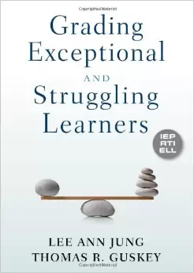
Standards-Based Reporting
Regional support and leadership
Guskey and Jun on November 3rd at SRC
Ken O’Connor? Myron Dueck?
“Cannon” for each district at September BCIC meeting
Connecting events during the year

Slide 47
Standards-Based Reporting
Do we want to choose one of these as our “group read?”

Slide 48
Professional Practice

Slide 49
Project-Based Learning

Slide 50
PBLNY – The Event
PBL^{NY} 2015 is scheduled for August 3-4-5
Expanded format
No PBL 101 embedded
Registration open?
Tiered registration:
OCM $450
Non-Components $550
Out-of-state $650

Slide 51
Most Likely To Succeed

Slide 52
School Counselors
Professional Development
November 3rd
Likely at OCC
Keynote: Liz Murray
Workshops
Regs, plans, admissions, data, panels, opportunities, future, etc.

Slide 53
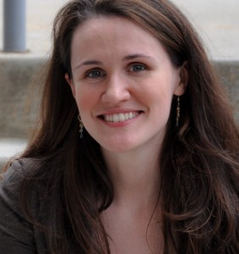
School Counselors
Professional Development
November 3rd
OCC
Keynote: Liz Murray
Workshops
Regs, plans, admissions, data, panels, opportunities, future, etc.
$65 per person (breakfast & lunch included)

Slide 54
APPR
Year One Lead Evaluator Training
Ongoing Lead Evaluator Training
Ongoing Principal Evaluator Training
Year One Principal Evaluator Training???
Training required
Demonstrated “Good Faith Effort”

Slide 55
Culture

Slide 58
Professional Learning Community
Anthony Muhammad will close out the PLC interactive video conversations on June 17th. He’s skilled at transforming school culture, including overcoming staff resistance to change.

Slide 59
PLC at Work Institute
Registration is open for discounted price of $477
OnCenter
August 12-14, 2015
Including: DuFours, Mattos, Brown, Kanold, Cruz, Nielson, Williams

Slide 60
RTI at Work Institute?
Discussion:
Is there interest?
June 27-30th window
July 19-21st window
Need a district location
Would work similar to PLC at Work Institute pricing structure

Slide 61
Regional Vision

Slide 62
Pre-Service Teacher Training
Early College and Dual Enrollment
Professional Development
School:
Visitations
Observation
Training (Buck Institute and NTN)
Coaching
Co-teaching
PBL^{NY}
New Tech Network Model
New Tech High School
CNY New Tech High School in Cortland County
(opening September 2016)
OCM BOCES Programs
Innovation Tech at the Career Academy (opened September 2014)
District/School-Based
Integrated PBL Courses
Future School Adoption
Standards (CCLS, NGSS, SS Framework, NYS Teaching Standards, 4Cs, ISTE, etc.)
Business Partnerships

Slide 63
Pre-Service Teacher Training
Early College and Dual Enrollment
Professional Development
School:
Visitations
Observation
Training (Buck Institute and NTN)
Coaching
Co-teaching
PBL^{NY}
New Tech Network Model
New Tech High School
CNY New Tech High School in Cortland County
(opening September 2016)
OCM BOCES Programs
Innovation Tech at the Career Academy (opened September 2014)
District/School-Based
Integrated PBL Courses
Future School Adoption
Standards-based
Integrated
Transdisciplinary
Readiness
4Cs
Standards (CCLS, NGSS, SS Framework, NYS Teaching Standards, 4Cs, ISTE, etc.)
Business Partnerships

Slide 64
Pre-Service Teacher Training
Early College and Dual Enrollment
Professional Development
School:
Visitations
Observation
Training (Buck Institute and NTN)
Coaching
Co-teaching
PBL^{NY}
New Tech Network Model
New Tech High School
CNY New Tech High School in Cortland County
(opening September 2016)
OCM BOCES Programs
Innovation Tech at the Career Academy (opened September 2014)
District/School-Based
Integrated PBL Courses
Future School Adoption
Next: October 9th
Cortland area businesses
Standards (CCLS, NGSS, SS Framework, NYS Teaching Standards, 4Cs, ISTE, etc.)
Business Partnerships

Slide 65
Expanding choices for students
More student/parent choice
Pre-Service Teacher Training
Early College and Dual Enrollment
Professional Development
School:
Visitations
Observation
Training (Buck Institute and NTN)
Coaching
Co-teaching
PBL^{NY}
New Tech Network Model
New Tech High School
CNY New Tech High School in Cortland County
(opening September 2016)
OCM BOCES Programs
Innovation Tech at the Career Academy (opened September 2014)
District/School-Based
Integrated PBL Courses
Future School Adoption
Standards (CCLS, NGSS, SS Framework, NYS Teaching Standards, 4Cs, ISTE, etc.)
Business Partnerships

Slide 66
SUNY Cortland
Four SUNYs
RIT
Consortium Event
Pre-Service Teacher Training
Early College and Dual Enrollment
Professional Development
School:
Visitations
Observation
Training (Buck Institute and NTN)
Coaching
Co-teaching
PBL^{NY}
New Tech Network Model
New Tech High School
CNY New Tech High School in Cortland County
(opening September 2016)
OCM BOCES Programs
Innovation Tech at the Career Academy (opened September 2014)
District/School-Based
Integrated PBL Courses
Future School Adoption
Standards (CCLS, NGSS, SS Framework, NYS Teaching Standards, 4Cs, ISTE, etc.)
Business Partnerships

Slide 67
Pre-Service Teacher Training
Early College and Dual Enrollment
PBL 101 & 102
PBL 400 series
PBLNY 2015
Coaching
Professional Development
School:
Visitations
Observation
Training (Buck Institute and NTN)
Coaching
Co-teaching
PBL^{NY}
New Tech Network Model
New Tech High School
CNY New Tech High School in Cortland County
(opening September 2016)
OCM BOCES Programs
Innovation Tech at the Career Academy (opened September 2014)
District/School-Based
Integrated PBL Courses
Future School Adoption
Standards (CCLS, NGSS, SS Framework, NYS Teaching Standards, 4Cs, ISTE, etc.)
Business Partnerships

Slide 68
Pre-Service Teacher Training
Early College and Dual Enrollment
Professional Development
School:
Visitations
Observation
Training (Buck Institute and NTN)
Coaching
Co-teaching
PBL^{NY}
New Tech Network Model
New Tech High School
CNY New Tech High School in Cortland County
(opening September 2016)
OCM BOCES Programs
Innovation Tech at the Career Academy (opened September 2014)
District/School-Based
Integrated PBL Courses
Future School Adoption
Adding another class; will be 9th, 10th & 11th grade
Study tours each month
Standards (CCLS, NGSS, SS Framework, NYS Teaching Standards, 4Cs, ISTE, etc.)
Business Partnerships

Slide 69
Pre-Service Teacher Training
Early College and Dual Enrollment
Professional Development
School:
Visitations
Observation
Training (Buck Institute and NTN)
Coaching
Co-teaching
PBL^{NY}
New Tech Network Model
New Tech High School
CNY New Tech High School in Cortland County
(opening September 2016)
OCM BOCES Programs
Innovation Tech at the Career Academy (opened September 2014)
District/School-Based
Integrated PBL Courses
Future School Adoption
Many projects at elementary, mid-level, and high schools
Connections: October 9th
Standards (CCLS, NGSS, SS Framework, NYS Teaching Standards, 4Cs, ISTE, etc.)
Business Partnerships

Slide 70
Pre-Service Teacher Training
Early College and Dual Enrollment
Professional Development
School:
Visitations
Observation
Training (Buck Institute and NTN)
Coaching
Co-teaching
PBL^{NY}
New Tech Network Model
New Tech High School
CNY New Tech High School in Cortland County
(opening September 2016)
OCM BOCES Programs
Innovation Tech at the Career Academy (opened September 2014)
District/School-Based
Integrated PBL Courses
Future School Adoption
Meeting with Cortland businesses
Location secured
Information nights in the fall
On-schedule
Standards (CCLS, NGSS, SS Framework, NYS Teaching Standards, 4Cs, ISTE, etc.)
Business Partnerships

Slide 71
Planning

Slide 72
Planning
District Plans
School Plans
Unit Plans

Slide 73
Planning

Slide 74
BCIC 2015-2016
Try the April meeting in the afternoon?
Topics for next year:
Standards-Based Grading and Reporting
RTI (especially at secondary)
Imagination Library
Mental Health issues
Science
Other suggestions?

Slide 75
BCIC Meeting
NEXT
September 17, 2015
Rodax 8 Large Conference Room

