Slide 1
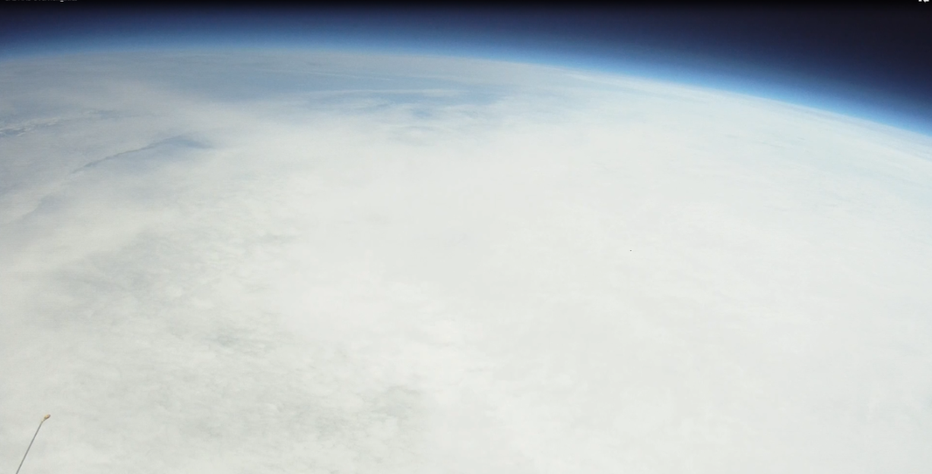
Technology & Engineering
The Key to better scores in math, science, & ela… as well as PR!

Slide 2
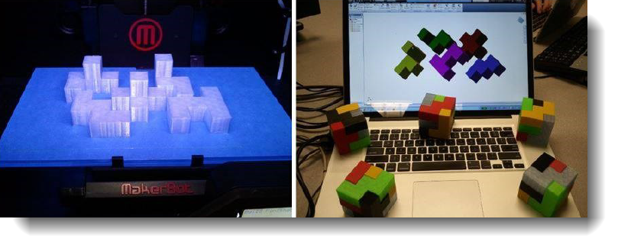
Courses Offered
Introduction to Engineering Design (IED):
The major focus of the IED course is to expose students to a design process, research and analysis, team-work, communication methods, global and human impacts, engineering standards, and technical documentation.

Slide 3
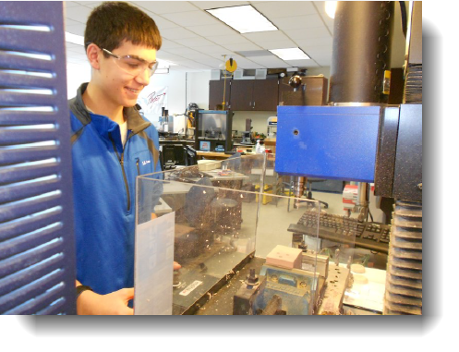
Courses Offered
Computer Integrated Manufacturing (CIM):
How are things made? What processes go into creating objects? Is the process for making a water bottle the same as it is for a musical instrument? How do assembly lines work? How has automation changed the face of manufacturing?
Material Processes/CNC/Robotics/Pneumatics & Hydraulics/Automation are all covered.

Slide 4
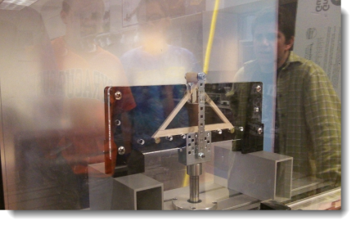
Courses Offered
Principles of Engineering (POE):
This is a broad based, hands-on problem solving course which will enable students to design and build working models of solutions in many engineering areas.
Great course that goes hand in hand with physics.

Slide 5
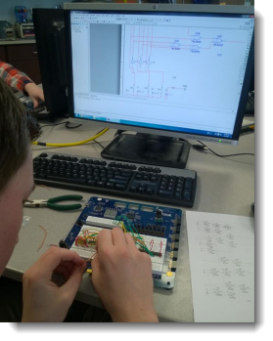
Courses Offered
Digital Electronics (DE):
This course is designed to teach you about applied logic, which introduces you to the basics of electronics and digital systems. The course is designed to expose students to engineering design that is used in the electronics field. Computer simulation software is used to design and test digital circuitry prior to actually constructing them in order to see if the circuits work. Programmable Logic Devices, and Microcontrollers are covered too!

Slide 6
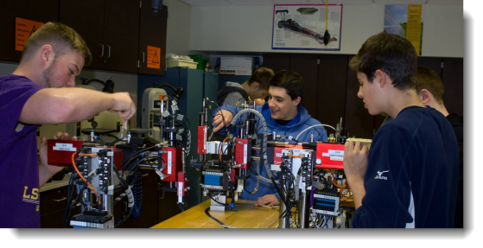
Courses Offered
Engineering Design & Development (EDD):
This is the capstone course of our program. Students will be able to utilize their problem solving skills to design a product, including building a prototype, market research, and testing & analysis with the help of engineers in their chosen field. They work with engineers on a daily basis.

Slide 7
How do we tie In Math & Science?
Prove it!
There is a “Standards & Objectives” Alignment tool at the link below that can be used to tell how Math, ELA, Next Generation Science Standards, and Technological Literacy are being addressed, course by course, unit by unit, lesson by lesson
Digital Electronics: 74 page PDF listing all standards covered!
http://alignment.pltw.org/

Slide 8
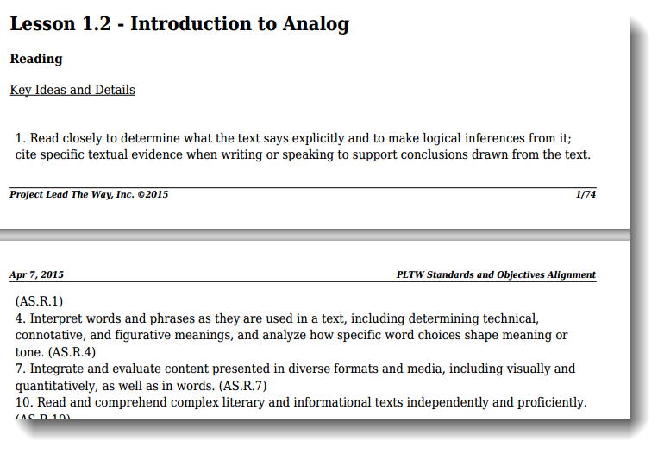
Example: Digital Electronics: HS ELA CCLS

Slide 9
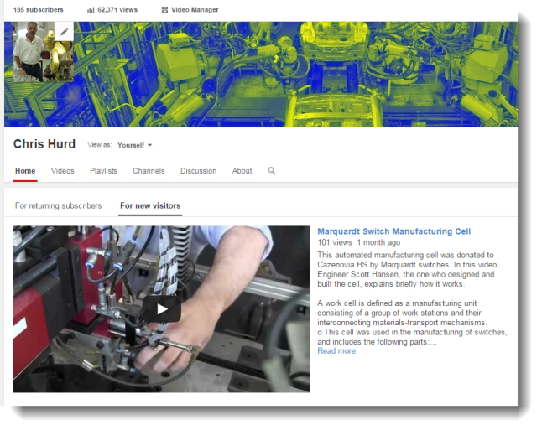
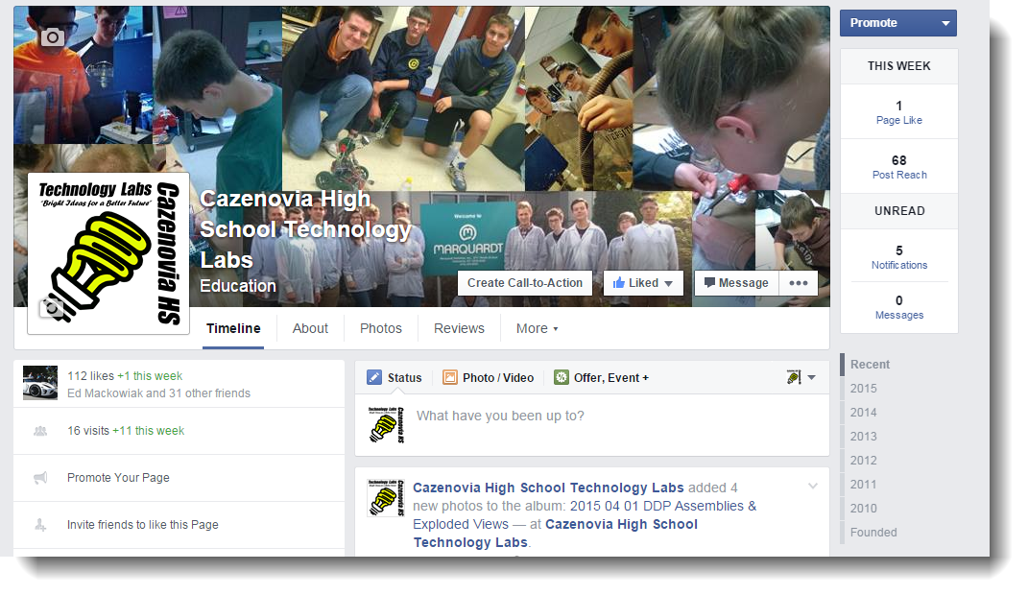
And it can be a PR Machine!
We have used social media to reach out to ALL stakeholders: Students, community, parents, other teachers, etc.:
Facebook
Twitter
Web Presence
School Website
Chris and Jim CIM
YouTube

Slide 10
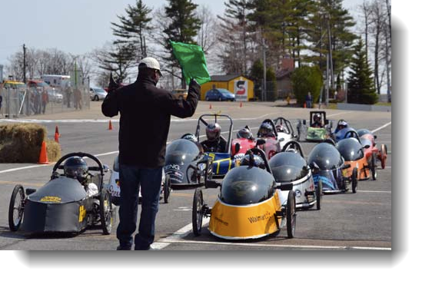
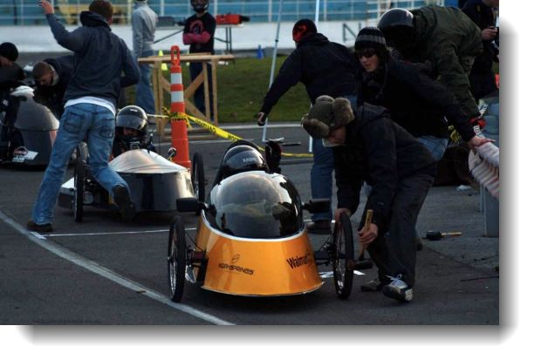
STEM + PR = Amazing Projects!
EDD 2005: Electrathon Race Car
Seven students convince me that they can build a car that they can drive, powered by two car batteries, that can reach speeds of 60 mph!
We started NY Electrathon in CNY.

Slide 11
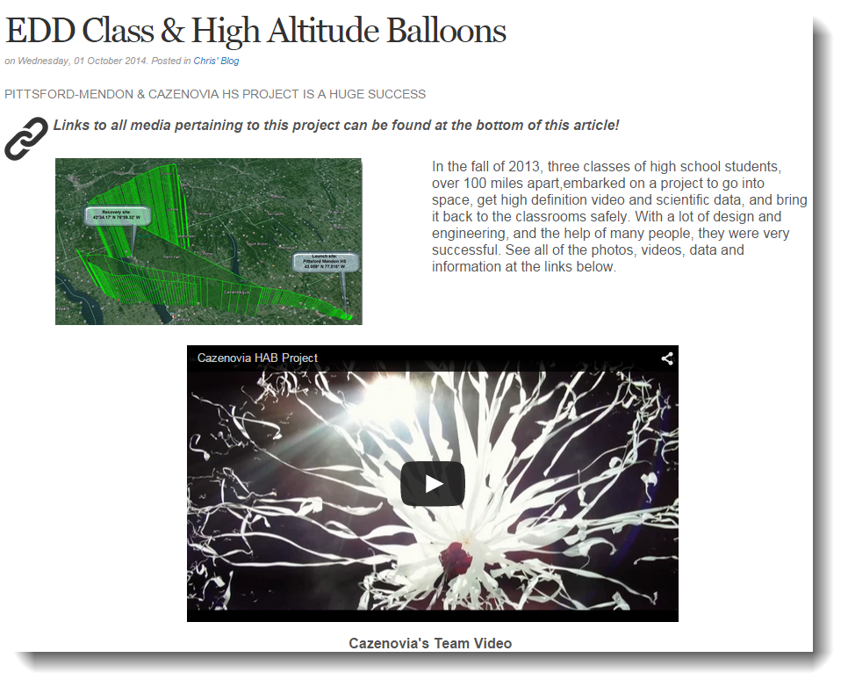
STEM + PR = Amazing Projects!
EDD 2013: High Altitude Balloon Project.
Students sent HD video cameras and scientific payload to the edge of space. Approximately 105,000 feet above the earth!

Slide 12
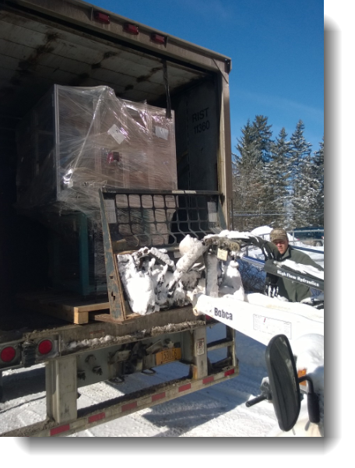
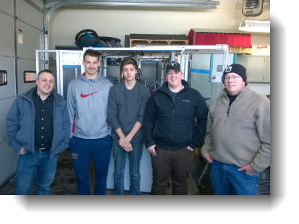
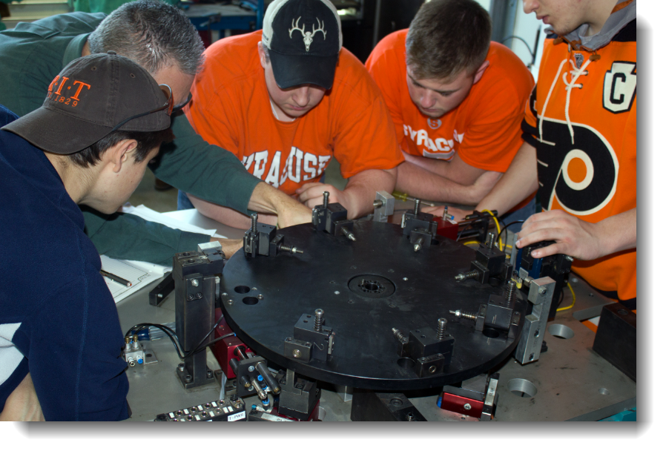
STEM + PR = Amazing Projects!
EDD 2014-15: Automated Workcell donation.
5 students take delivery of $170,000 automated workcell from Marquardt switches, dismantles it, and moves it up two stories, and rebuilds it in the classroom. It should be operational by December 2015.

