Slide 1
BCIC Meeting
March 2015

Slide 2
Welcome
Introductions
Overview of Agenda
Updates
Discussion of assessment decisions (and update chart)
Big events

Slide 3
Update and News

Slide 4
SED News
Guidance/School Counselors
Old plans/new plans
Requirements/certification will be changing

Slide 5
Capitol News
Ending the Public School Monopoly
Charter School Limit
Evaluation changes
Failing schools

Slide 6
CI&A and Network Updates

Slide 7
2015-16 CI&A Included Days
Network Team days will be gone
Planned for 1.5- 3.5 included days BUT are able to increase to 2-4 days (dependent on district size).
Will meet with districts to plan (or call to plan now!)
Survey will be sent later this month to gather data for regional opportunities

Slide 8
Cancellations
On-site agreements for specific days- if cancel within 30 days of scheduled days 50% fee is charged. This includes included-day allotment.
Coaching days- if cancelled within two weeks of scheduled time for reasons other than weather or other school closing or delay, we will try to reschedule but can not guarantee time will be rescheduled.

Slide 9
REVIEW OF REIMBURSEMENTS: Substitutes: Please do not wait until end of June!
Substitute Reimbursement Shared activities coordinated through BOCES and related to goals in a district's annual School Improvement Plan are eligible for aid on expenditures for teacher substitutes.
Events must be BOCES events or coordinated by BOCES.
Districts pays the substitute at the District rate.
District submits forms with all required information and Superintendent's signature.
BOCES will pay the district the total amount, up to our maximum rate.
BOCES will bill the district for payment through our normal budget adjustment process, ensuring aid for these expenses.
Please do not wait until end of June!

Slide 10
ITD
On 3/19, ITD TALKS welcomes a panel of flipped classroom practitioners to discuss the process by which they have transformed their instruction and the impact it has had on student learning. See the link below to view some videos each of the panelists has created in anticipation of the event. It is not too late to register.
Link to panelist videos: http://www.cnyric.org/teacherpage.cfm?teacher=1356
Link to register: https://www.mylearningplan.com/webreg/activityprofile.asp?I=1649500

Slide 11
Teacher Centers
Michael Grinder
April 29th leader emphasis
April 30th teacher emphasis
Turning High-Poverty Schools into High-Performing Schools
Kathleen Budge
Takes it to practical level
May 19th

Slide 12
Higher Education
SUNY Cortland inviting us to March 20th tour of Tech Valley High School

Slide 13
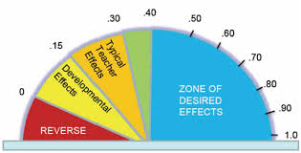
CNY NYS ASCD
2014-2015 Schedule:
March 18, 2015 Visible Learning
May 13, 2015 Annual Meeting

Slide 14
Regional Summer School
Administration Presentations
March 2015

Slide 15
Regional Summer School
Our primary mission is to provide credit recovery opportunities in order to give students a second chance to demonstrate learning. All course work is aligned with the Common Core Learning Standards. Additionally:
We provide some opportunities for the earning of initial credit.
Students can take a Regents exam(s) in August without taking for a course.

Slide 16
2015 Sites
Cicero-North Syracuse High School
Cortland High School
Fayetteville-Manlius Wellwood Middle School
West Genesee High School

Slide 17
Schedules and Courses
Three blocks offered at all sites (consistency among sites)
Expanded course offerings (based on district requests yet customized to districts)

Slide 18
Support for SWDs in 2015
Support block available - districts determine whether a student will attend the extra block or not (not meant to be a punishment)
Some push-in by special educators and paraprofessionals
Consultation with teachers
Testing Center

Slide 19
Support for SWDs
Special education teachers will:
Participate in organizational meetings
Participate in strategic scheduling of students
Have days prior to the start of summer school to review IEPs/504 plans
Create information sheets for teachers
Provide blended support – push-in and extra support block

Slide 20
Support for ELLs
Transitioning to be aligned with part 154 changes
One teacher and paraprofessionals all the time
Additional support as needed
Provide summary sheets to classroom teachers outlining level of ESL services
Coordinate translators, interpreters, etc. as needed
Consultant model
Maintain test center

Slide 21
Final Grade and Credit Flexibility
Two spreadsheets will be sent to the Principal:
One spreadsheet will have the past grading formula:
40% MP1 + 40% MP2 + 20% final exam = Final Average
The second spreadsheet will have data only (MP1, MP2, Final Exam and Regents Exam); districts have the opportunity to customize grading formula based on their home district’s grading policy.
Principal must approve grades and credits earned before report cards are mailed home.

Slide 22
Changes for 2015
Registration and reporting:
SIS phase-out
Schooltool not yet ready for summer school use
We will be using a system called “Summer School SIS” which is used by eight BOCES

Slide 23
Registration Process/Reports
Each district will have training on how to use this system at our guidance counselor meetings.
Districts will receive login information and tutorials on how to register students, view attendance, view grades, and view report cards.
There will be a password protected part of our site that will also have pertinent information.

Slide 24
Trainings
Trainings will be offered for guidance counselors and administrators on:
How to register
Important dates
Programming for SWDs
These 2-hour trainings will be coordinated through the office of Educational Programs between 4/27 and 5/15.

Slide 25
Registration Deadlines
Open registration closes at 4:00 pm on 6/29
Late Registration ends on 7/10
Regents only registration ends 8/5
Note: Earth Science exam only ends 7/31
Earth Science lab practical will be 8/5 and 8/6

Slide 26
Professional Development
“Teaching in the Block” will be offered in 4 sessions from 4:00 pm – 7:00 pm
The dates are: 5/18, 6/1, 6/8, and 6/15.
Resource being referenced is “Meeting the Needs of Diverse Learners” by Paula Rutherford from Just Ask Publications

Slide 27
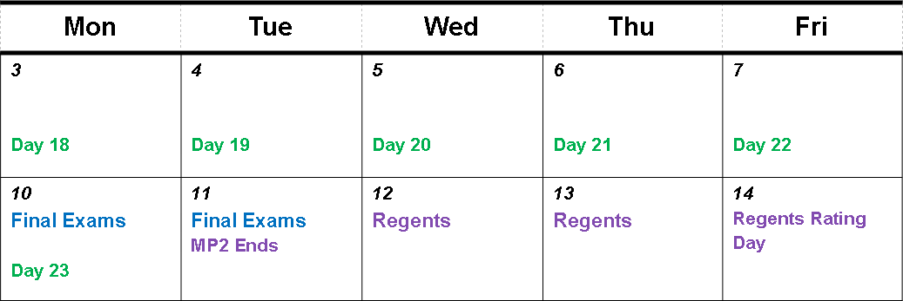
Summer School Calendar
July
August

Slide 28
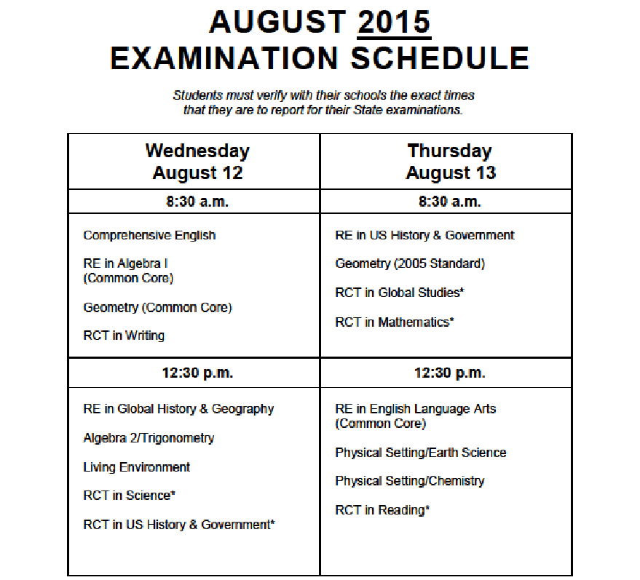
1
7
2
8
3
4
9
5
10
6
11

Slide 29
District Sharing

Slide 30
Sharing Schedule
March: Lyncourt (PLC and RTI)
April: Cazenovia
June: __________

Slide 31
Standards

Slide 32
Social Studies-Getting Ready
Opening the Toolkit w/ Patricia Polan (April 16, 4-6 pm)
UbD and Social Studies w/ Jay McTighe May 14 & 15

Slide 34
Summer Curriculum Work:
Grounded in UbD/backwards-design with emphasis on standards-based planning
June 29-July 2 OR July 7-10
Registration for Summer Curriculum work for grades 5-8 is open. This is NOT through MLP- this alternative registration enables district representatives to register an entire team. For further information click here.

Slide 35
REVIEW OF REIMBURSEMENTS: Summer Curriculum Work
Teacher Stipends Professional staff at BOCES activities can be paid as BOCES employees. This typically applies to summer sessions or others outside the school calendar.
All professional staff attending sessions must complete an abridged BOCES application form, and complete Federal and State W-4 forms.
Each participant will be appointed by the BOCES Board of Education. The participant will also need to complete a time sheet in order to be paid. The BOCES hourly staff and curriculum development rate will be paid, and deductions for federal and state tax, FICA, and, where appropriate, retirement will be taken.
The district will be charged the cost of the stipend, FICA contribution, retirement contribution, unemployment compensation, worker's compensation and a 10% administrative fee.

Slide 36
Literacy Programs: Interventions
In process of contracting with LETRS for the foundational course
Wilson Language Systems- costly to pursue at this time

Slide 37
Science
+
=
85-90%
10-15%
NYSSLS

Slide 38
Data

Slide 39
Assessment
What are we doing about double-testing in math?
What are you doing for ELA 11?
What are we doing for Geometry?

Slide 40
Standards-Based Reporting
Regional support and leadership
Guskey and Jun on November 3rd at SRC
Ken O’Connor? Myron Dueck?
What else would help?

Slide 41
Professional Practice

Slide 42
Fullan’s Three Keys
Leading Learning
Being a District and System Player
Becoming a Change Agent
Discuss Chapters 3, 4 & 5

Slide 43
Project Based Learning
PBL 400’s for Administrators
PBL 401: Bringing PBL to Scale is March 31
PBL 402: Creating a Supportive PBL School Culture is April 2
PBL 403: Teacher Evaluation in a PBL Classroom is April 17
PBL 101:
Secondary Education Teachers only- sessions start April 23
Registration is also open for sessions beginning May 6 or May 19.
Summer Institutes: Four-day PBL 101 July 14-17 OR August 17-20
Coaching: schedule and capacity for next year is underway!

Slide 44
PBLNY – The Event
PBL^{NY} 2015 is scheduled for August 3-4-5
Expanded format
No PBL 101 embedded
Registration open?
Tiered registration:
OCM $450
Non-Components $550
Out-of-state $650

Slide 45
Planning for Deeper Learning & PBL
Following April BCIC Meeting
Some tools to help you develop a long-term plan for PBL/Deeper learning

Slide 46
School Counselors
Professional Development
November 3rd
Likely at OCC
Keynote: Liz Murray
Workshops
Regs, plans, admissions, data, panels, opportunities, future, etc.

Slide 47
School Teacher Leadership
6th Annual Conference
May 16th
Drumlins
Keynote: Tim Kremer
Workshops
Examples, culture & relationships, career ladder, etc.

Slide 48
Culture

Slide 49
RTI
Discussion:
What’s going on? Progress?
Questions?
Go around the room

Slide 50
PLC
Next is Tim Brown on April 22 (this is the rescheduled session from January).

Slide 51
PLC at Work Institute
Registration is open for discounted price of $477
OnCenter
August 12-14, 2015

Slide 52
BCIC Meeting
NEXT
April 16, 2015
Rodax 8 Large Conference Room
PBL Planning Session to Follow

