Slide 1
BCIC Meeting
January 2015

Slide 2
Welcome
Introductions
Overview of Agenda
  Updates
  Discussion of assessment decisions (and update chart)
  Big events

Slide 3
Update and News

Slide 4
SED News
Distributed throughout agenda

Slide 5
Capitol News
Ending the Public School Monopoly
Charter School Limit
APPR salvos via Malatras
Board of Regents priorities:
  Regional high schools
  BOCES salary cap (CTE, only)?
  Some mandate relief
  Technical changes

Slide 6
Help Please…..
Currently have 5.5 CIA and Network
Additional 3 “retirees” on part-time basis
Adding 1 additional in January
Possibly looking for additional hourly (retirees) with background in curriculum, social studies, group facilitation
Looking for suggestions……

Slide 7
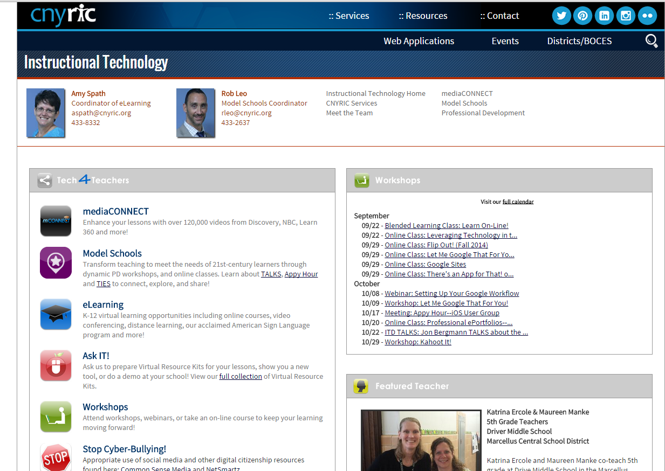
ITD

Slide 8
Teacher Centers
Michael Grinder
  April 29th leader emphasis
  April 30th teacher emphasis
Turning High-Poverty Schools into
High-Performing Schools
  Kathleen Budge
  Takes it to practical level
  May 19th
Echoes and Reflections Holocaust PD
  February 27, Cortland

Slide 9
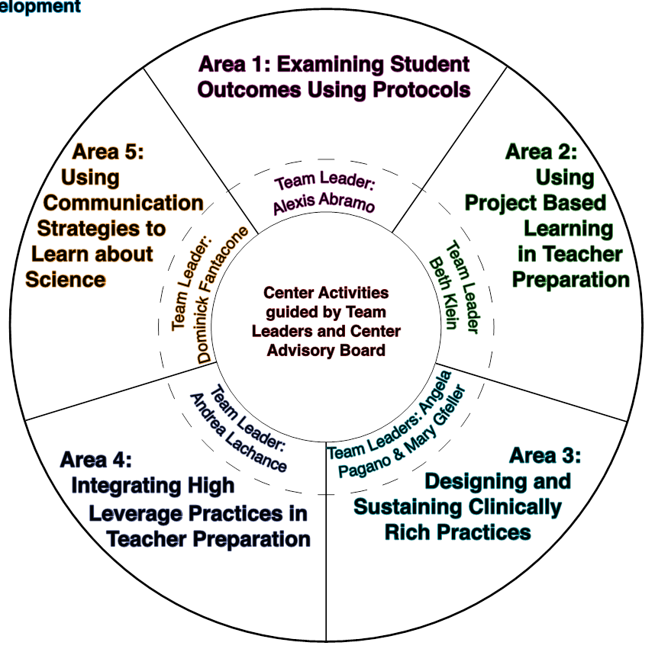
Higher Education
Center for the Preparation of
21st Century Teachers
SUNY Cortland
Focus in five areas
  Data Informed Instruction
  Project-Based Learning
  Clinically Rich Practices
  Communicating about Science
  High Leverage Practices

Slide 10
CNY NYS ASCD
2014-2015 Schedule:
February 12, 2015 Evidence of 6 & 7
March 18, 2015 Visible Learning
May 13, 2015 Annual Meeting

Slide 11
Regional E-Book Collection
Idea for a Regional Collection
Nonfiction, informational
Durable
Leverage

Slide 12
District Sharing

Slide 13
Sharing Schedule
January: Chittenango
February: ________
March: ______

Slide 14
Standards

Slide 15
Getting Ready…
for Social Studies in NY

Slide 16

Social Studies-Getting Ready
C3 w/ SG Grant (January 29, 4-6p)
Bridging from the C3 to New York w/ Greg Ahlquist (February 10, 4-6p)
NYSCSS Annual Conference, March 11-14, Syracuse link to NYSCSS-regular conference fees apply
Opening the Toolkit w/ Pat Polan (April 16, 4-6 pm)
UbD and Social Studies w/ Jay McTighe May 14 & 15

Slide 17
Summer Curriculum Work
Structure: (NYS Field Guide and AP US History Curriculum Framework Evidence Planner)
  Key Ideas
  Standards, Themes (and mapping out the year)
  Essential and Compelling Questions
  Specific Content
  Suggested resources, materials, primary and secondary sources
  Formative and Summative Tasks
Survey Monkey Responses (10 responses so far)
  June 29-July 2 (9/10 responses)
  July 7-10 (still reserve?)
  Grade band approach
Format
  Facilitated days but each district team work on own curriculum (6/10 with 2 responses for both and two responses for collaboratively develop curriculum)

Slide 18
Math
Continuing discussion about math textbooks/resources
Data collection; responses (have heard from WG, Westhill, Marathon, NS, DeRuyter, Lyncourt, Chittenango, Solvay, Cortland, Cincinnatus, JD)

Slide 19



Science
Another comment period is underway about the NGSS
Adaption not adoption seems likely
+
=

Slide 20


Arts
Adapt, not adopt
No timetable at this point
+
=

Slide 21
Leadership Groups
Science – January 20th
Social Studies - January 22nd
Literacy - January 28th
New Group! Teachers of algebra 2! The group will meet January 16th at the Henry Campus and January 23rd at McEvoy Campus.
Geometry teachers - February 6th

Slide 22
Data and
Data-Driven Instruction

Slide 23
Assessment Odds & Ends
3-8 Schedule is out (CSA now working on calendar)
Both Algebra 2/Trigonometry and Chemistry Regents Examinations will be offered in August, 2015
Field tests are required

Slide 24
Assessment Odds & Ends
Currently under certain circumstances students can appeal scores of 62-64 on any required Regents exam.
The revised regulation allows students who are identified as English Language Learners to appeal a score of 55-61 on the ELA Regents Exam. There is a long list of eligibility conditions

Slide 25
2022 Challenge
It is unlikely that there will be an incremental transition of the Common Core Regents expectations for the students in the class of 2020.
Students in that class will be required to get at least a 74 on a Common Core math exam and at least a 79 on the Common Core exam.

Slide 26
CCLS Implementation
Math double-testing
Integrated Algebra Clarification
Geometry - what are districts thinking?
Continue to update the curriculum and assessment chart

Slide 27
CCLS Implementation
ELA – what are districts thinking?
Continue to update the curriculum and assessment chart

Slide 28
For Secondary ELA Teachers
Making the Transition to CCLS Regents
January 23rd
Review of rubric, format and expectations

Slide 29
Districts Requesting Regional Scoring: June
PLEASE MEET BRIEFLY AFTER BCIC
  Tully
  LaFayette (includes physics~10)
  Cortland-Physics only (~30)
  Westhill-Physics only (~80)
  Fabius Pompey-Earth Science only
  Decisions:
    All subjects or interdistrict swap?
    Physics- which model?
    Earth Science- regional or interdistrict swap?

Slide 30
Professional Practice

Slide 31
2014-15 Lead Evaluator Training
Year 1 cohort (smaller this year) almost done
Three ongoing sessions
  Following 6th grade teacher
  Growth producing feedback
  Instructional leadership

Slide 32
2014-15 Principal Evaluator Training
Catch up session
Three ongoing sessions
  Connecting to Lead Evaluator Training

Slide 33
Project-Based Learning
PBL 400’s for Administrators
  PBL 401: Bringing PBL to Scale is March 31st
  PBL 402: Creating a Supportive PBL School Culture is April 2nd
  PBL 403: Teacher Evaluation in a PBL Classroom is April 17th
PBL 101:
  Late January session at McEvoy
  Secondary Education Teachers only- sessions start April 23rd
  Registration is also open for sessions beginning May 6th

Slide 34

Fullan’s Three Keys
Leading Learning
Being a District and System Player
Becoming a Change Agent
Discuss Chapters
3 & 4

Slide 35
Culture

Slide 36
Standards-based Reporting
Middle-Level and Elementary Principals ongoing topic
Topic for future BCIC?
Regional support and leadership?
  Guskey and Jun on October 13th?
  Ken O’Connor?
  Myron Dueck?
  What else would help?

Slide 37
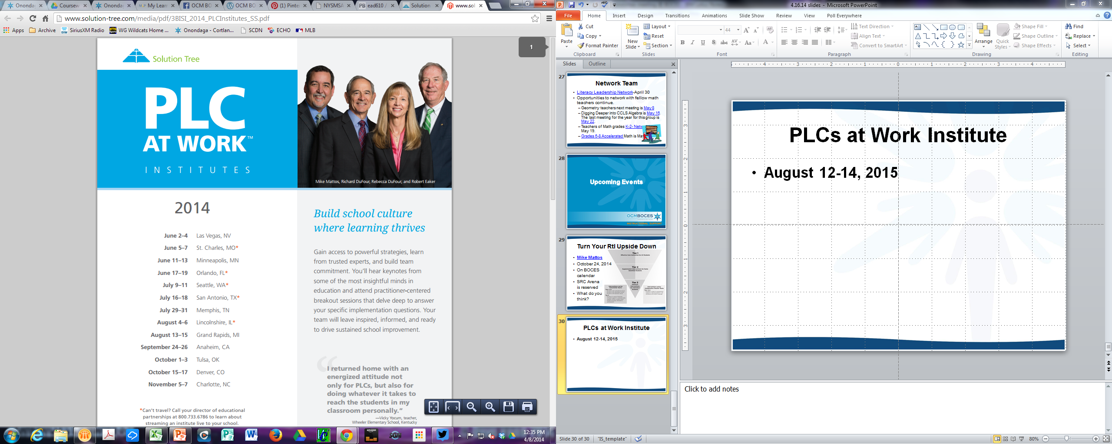
Reenergize your PLC
PLC Networking: four meetings across the year with on-line community, too.
Next meeting is January 22nd.

Slide 38
Connecting the PLC Dots
Connecting Mattos with the PLC Institute, via Interactive Video Conferences:
Tim Brown, January 14, 2015 , 4:00-5:15 pm
Ken Williams, March 4, 2015, 4:00-5:15 pm
Anthony Muhammad, June 17, 2015, 4:00-5:15 pm

Slide 39
PLCs at Work Institute
August 12-14, 2015
OnCenter
$477 per person (discounted from $669)
Through school improvement
Staged registration open
  OCM through February 15th
  Mid-State JMT through March 15th
  NY afterward (if remaining)

Slide 40
Regional Vision

Slide 41
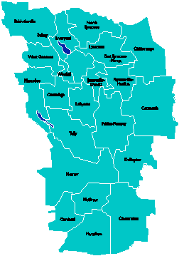
A Vision for Education in
Central New York
UPDATE
College, Career
& Citizenship Readiness
September 2014

Slide 42
A Vision for Education in CNY
Teaching that Engages
Culture that Empowers
Technology that Enables

Slide 43

District Coaching & Training
5th Trainer/Coach hired
In-district coaching for [at least] 11 districts
and 2 BOCES
Our coaches being coached by New Tech Network
PBL 102 has started
PBL 101 will continue with multiple cohorts
Primer to all principal groups
401 Leadership support posted

Slide 44

PBLNY – The Event
PBL^{NY} 2015 is scheduled for August 3-4-5
  Expanded format (closing, optional keynotes)
  No PBL 101 embedded
  Registration up by end of the month
  Tiered registration:
    OCM
    Mid-State JMT
    National (not just NYS)

Slide 45
New Tech South
Hartnett capital project was not approved
Proceeding to look for other sites in Cortland County with CSA south leadership team

Slide 46
BCIC Meeting
NEXT
February 12, 2015
Rodax 8 Large Conference Room

