Slide 1
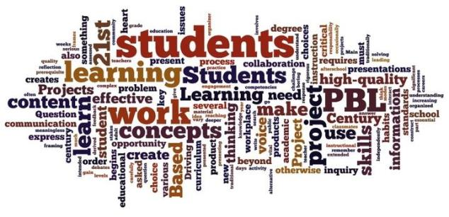

PBL Unit
The Most Amazingly Radical Tectonic Area Project
M.A.R.T.A.

Slide 2
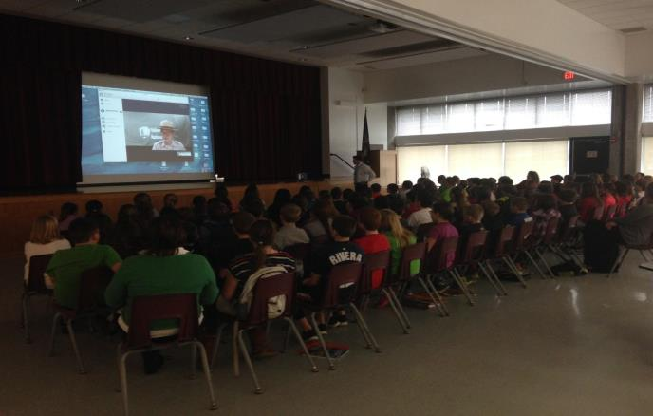
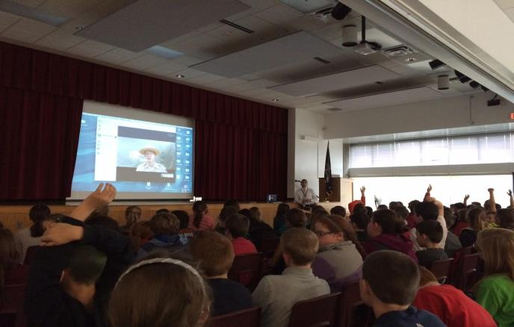
Skype Session
With Ranger Mike from Yellowstone National Park kicked off the project.
He spoke to students about how important what goes on inside the Earth is to Yellowstone.

Slide 3
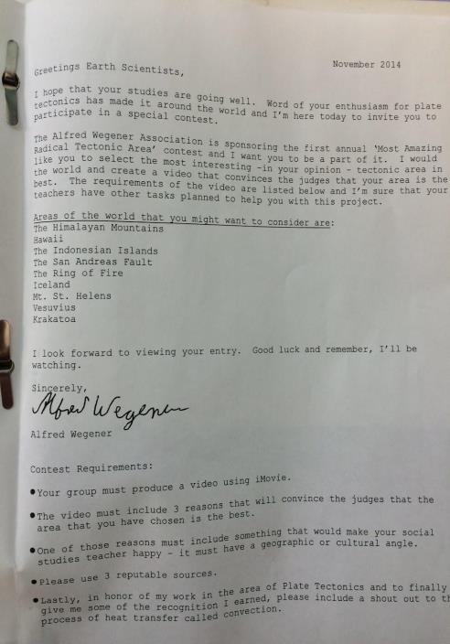
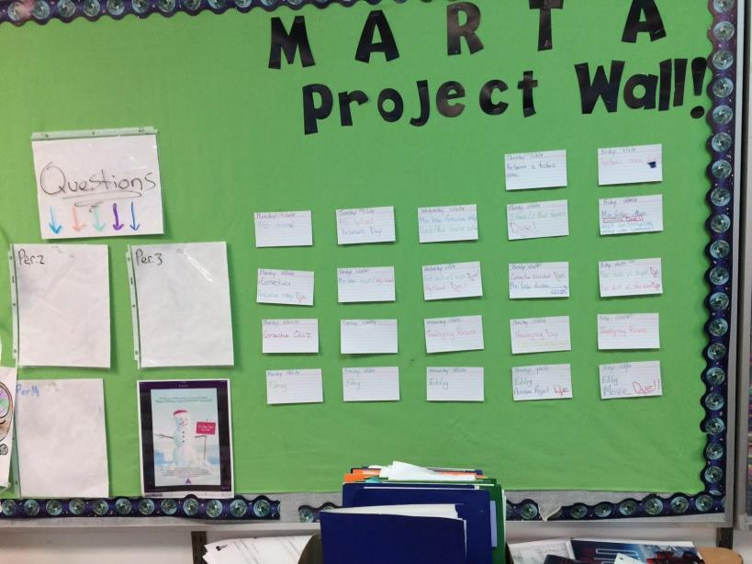
Letter from Alfred Wegener
Students received a letter from Alfred Wegener inviting them to submit a video to the Most Amazingly Radical Tectonic Area Contest.

Slide 4
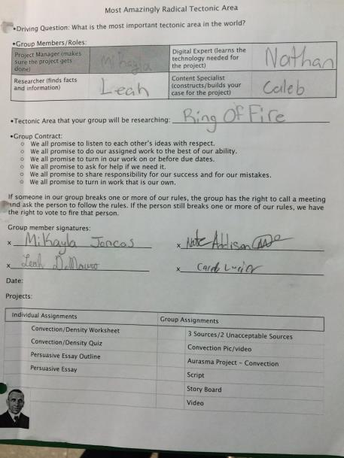
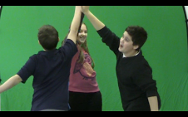
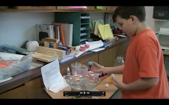
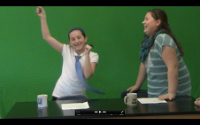
Busy at Work
Students worked as a group to research and select a tectonic area to focus on. The ensuing tasks led them to discover the knowledge (convection, plate tectonics) and build the skills (determining reliable sources, persuasive writing, collaboration, calculating density, use of technology) that they would need to be able to write and create the video.

Slide 5
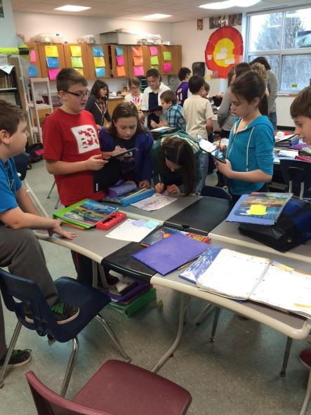
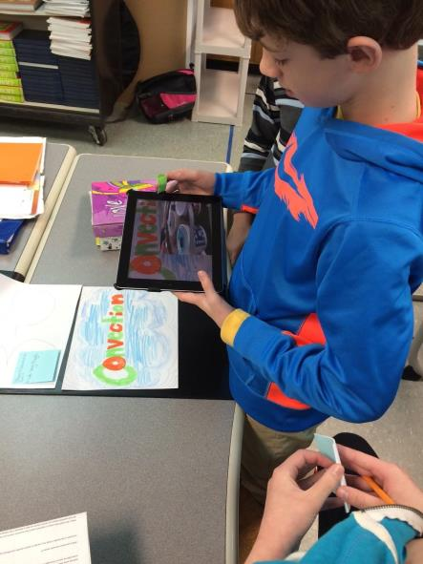
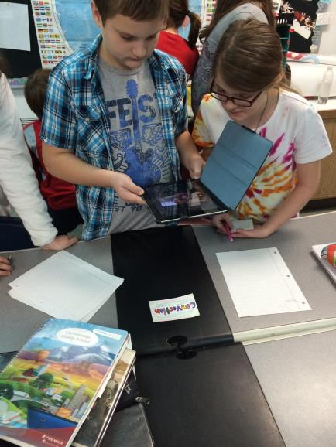
Aurasma
Students used the Augmented reality app to showcase their knowledge of convection.

Slide 6
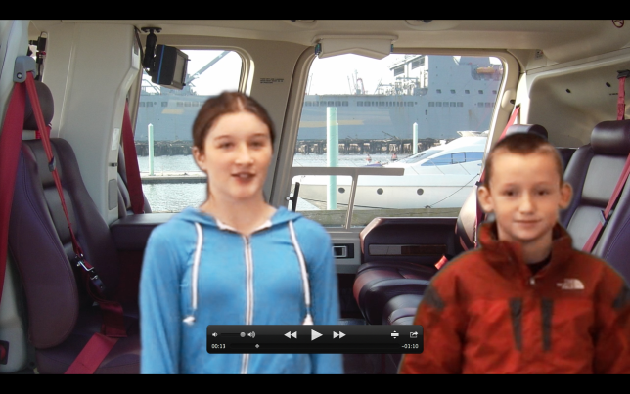
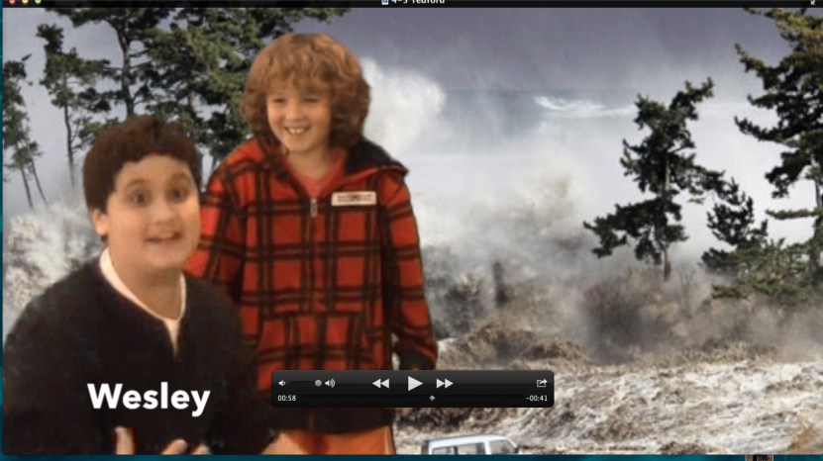
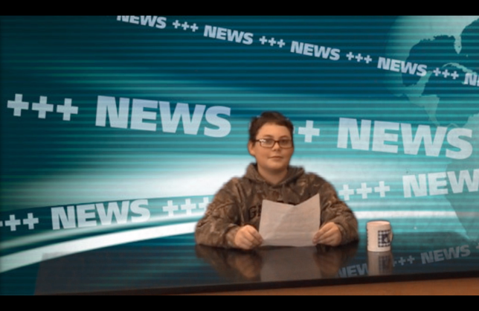
Final Project
The final part of the project was creating the video and sharing it with 8th grade Earth Science students. The Earth Science students determined which group made the best case for their Tectonic Area.

Slide 7


Slide 8
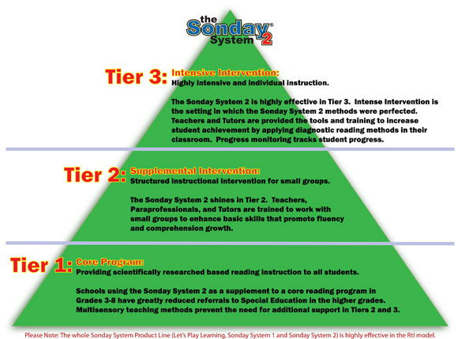

Slide 9
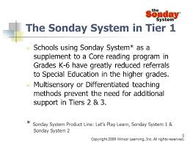

Slide 10
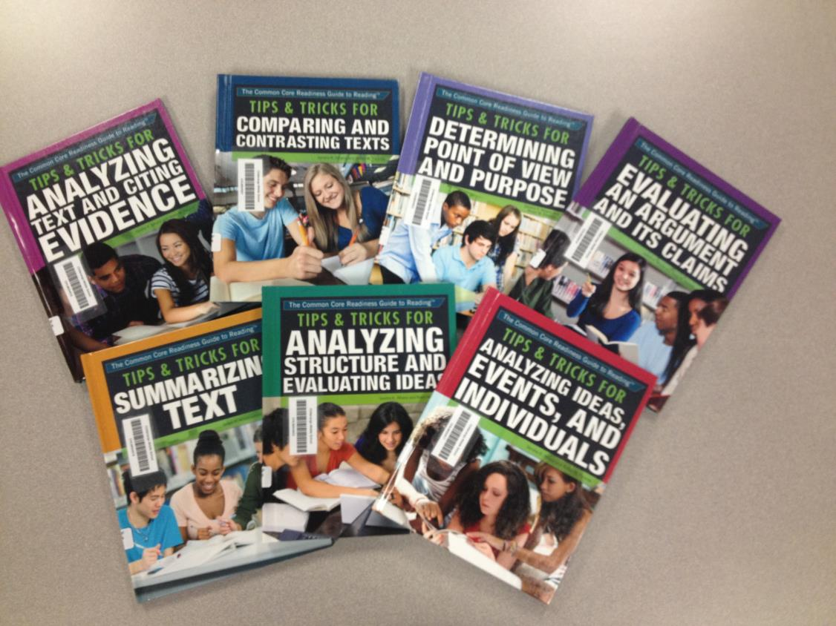

Slide 11
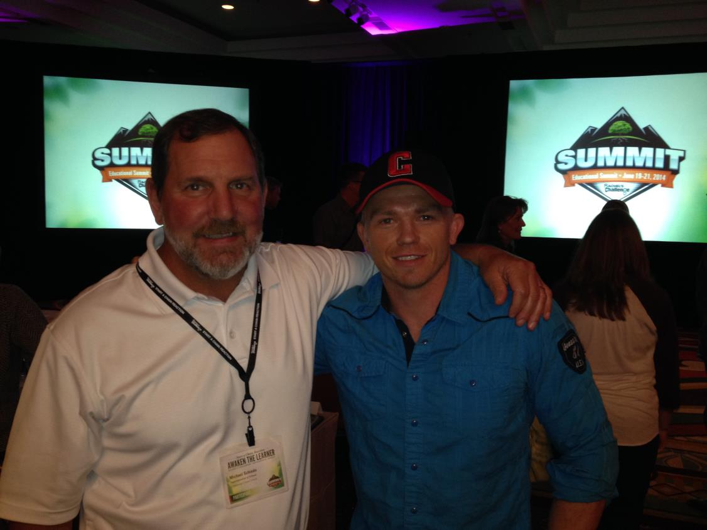

Slide 12
