Slide 1
BCIC Meeting
December 2014

Slide 2
Welcome
Introductions
Overview of Agenda
  Updates
  Discussion of assessment decisions (and update chart)
  DTSDE presentation

Slide 3
Update and News
December 2014

Slide 4
SED News
Distributed throughout agenda

Slide 5
Legislative News
Ending the Public School Monopoly
Charter School Limit
Board of Regents priorities:
  Regional high schools
  BOCES salary cap (CTE, only)?
  Some mandate relief
  Technical changes

Slide 6
Help Please…..
Currently have 5.5 CIA and Network
Additional 3 “retirees” on part-time basis
Adding 1 additional in January
Possibly looking for additional hourly (retirees) with background in curriculum, social studies, group facilitation
Looking for suggestions……

Slide 7
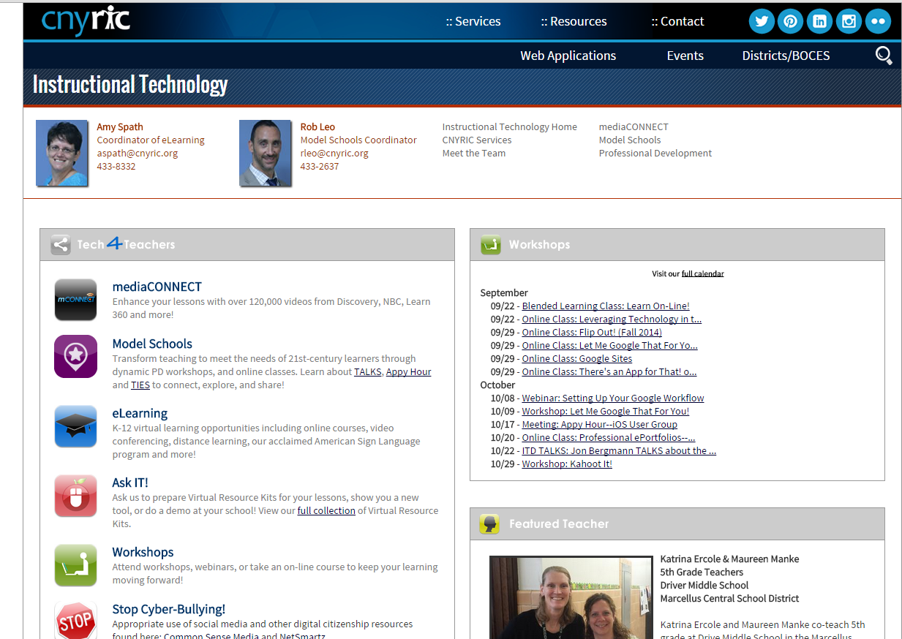
ITD

Slide 8
Teacher Centers

Slide 9
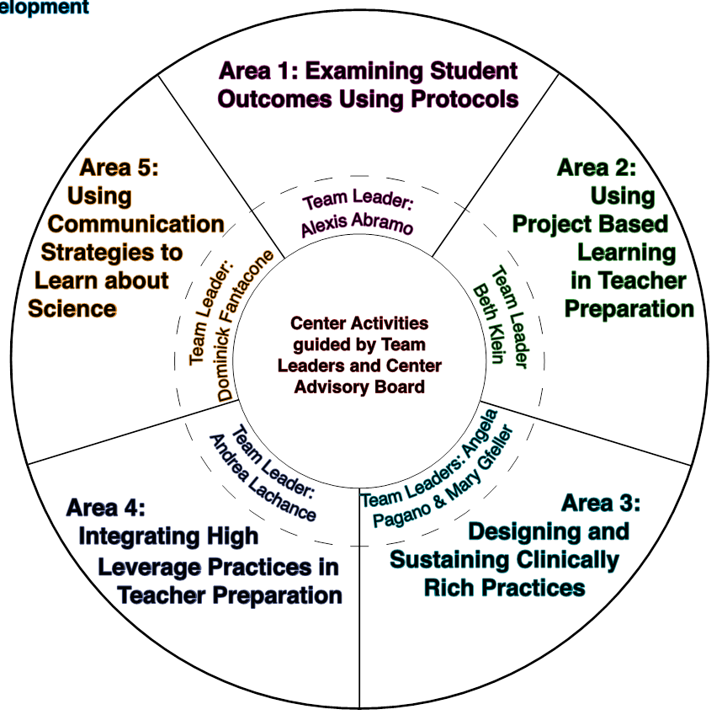
Higher Education
Center for the Preparation of
21st Century Teachers
SUNY Cortland
Focus in five areas
  Data Informed Instruction
  Project-Based Learning
  Clinically Rich Practices
  Communicating about Science
  High Leverage Practices

Slide 10
CNY NYS ASCD
2014-2015 Schedule:
February 12, 2015 Evidence of 6 & 7
March 18, 2015 Visible Learning
May 13, 2015 Annual Meeting

Slide 11
Regional E-Book Collection
Idea for a Regional Collection
Nonfiction, informational
Durable
Leverage

Slide 12
District Sharing

Slide 13
Sharing Schedule
December: Chittenango
January:
February:
March:

Slide 14
Standards

Slide 15
Getting Ready…
for Social Studies in NY

Slide 16

Social Studies-Getting Ready
C3 w/ SG Grant (January 29, 4-6p)
Bridging from the C3 to New York w/ Greg Ahlquist (February 10, 4-6p)
NYSCSS Annual Conference, March 11-14, Syracuse link to NYSCSS-regular conference fees apply
Opening the Toolkit w/ Pat Polan (April 16, 4-6 pm)
UbD and Social Studies w/ Jay McTighe May 14 & 15

Slide 17
Social Studies Network
Looking to have at minimum one representative from each district
Forum for information and resource sharing
Opportunity to collaboratively learn and define expectations and student learning targets
Next meeting Dec 18. Followed by January 22.

Slide 18
Summer Curriculum Work
We are thinking…
  June 29-July 2
  July 7-10
  Four days for grades 5/6
  Four days for grades 7/8
Wondering about the format…
  Send teachers and develop regional curriculum?
  Send teachers for facilitation but districts work on own curriculum?

Slide 19
ELA/Literacy

Slide 20
Literacy Leadership
Literacy Leadership- this is an on-going group that you are welcome to join at any time.
Next session is December 17th.

Slide 21
For Secondary ELA Teachers
Making the Transition to CCLS Regents
January 23rd
Review of rubric, format and expectations

Slide 22
Math
Implementing Geometry CCLS will continue to meet monthly at least through the first implementation
Continuing discussion about math textbooks/resources
Data collection; responses (have heard from WG, Westhill, Marathon, NS, DeRuyter, Lyncourt, Chittenango, Solvay, Cortland, Cincinnatus, JD)

Slide 23



Science
Another comment period is underway about the NGSS
Adaption not adoption seems likely
+
=

Slide 24


Arts
Adapt, not adopt
No timetable at this point
+
=

Slide 25
Data and
Data-Driven Instruction

Slide 26
Assessment Odds & Ends
3-8 Schedule is due out ay time
Both Algebra 2/Trigonometry and Chemistry Regents Examinations will be offered in August, 2015
Field tests are required

Slide 27
Assessment Odds & Ends
Currently under certain circumstances students can appeal scores of 62-64 on any required Regents exam.
The revised regulation allows students who are identified as English Language Learners to appeal a score of 55-61 on the ELA Regents Exam. There is a long list of eligibility conditions

Slide 28
Assessment Odds & Ends
Hypothetically speaking…
What if the time limits on the 3-8 ELA were eliminated?

Slide 29
2022 Challenge
It is unlikely that there will be an incremental transition of the Common Core Regents expectations for the students in the class of 2020.
Students in that class will be required to get at least a 74 on a Common Core math exam and at least a 79 on the Common Core exam.

Slide 30
CCLS Implementation
Math double-testing
Integrated Algebra Clarification
Geometry - what are districts thinking?
Continue to update the curriculum and assessment chart

Slide 31
CCLS Implementation
ELA – what are districts thinking?
Continue to update the curriculum and assessment chart

Slide 32
4 + 1 Pathways
Board of Regents has taken first step
The “4” refers to a requirement of passing four Regents exams
The “1” refers to options that students have for the fifth test
Once finalized by the Regents (according to their procedures), it will go onto effect this year

Slide 33
4 + 1 Pathways
The four required Regents examinations are English language arts, mathematics, science, and either US history or global history and geography.

Slide 34
4 + 1 Pathways
Humanities Pathway options:
Additional social studies Regents Exam
English or social studies assessment from the list of found at http://www.p12.nysed.gov/assessment/hsgen/archive/list.pdf

Slide 35
4 + 1 Pathways
STEM Pathway options:
Any additional science or mathematics Regents Exam
Any science or mathematics examination on the list found at http://www.p12.nysed.gov/assessment/hsgen/archive/list.pdf

Slide 36
4 + 1 Pathways
Bilingual (LOTE) Pathway options:
Assessments have not yet been approved by the Department.
Locally developed Checkpoint B examinations in LOTE are not approved pathway assessments.

Slide 37
4 + 1 Pathways
Arts Pathway options:
Assessments in the Arts have not yet been approved by the Department.

Slide 38
4 + 1 Pathways
CTE Pathway options:
13 assessments have been approved
Blue Ribbon Commission to continue to consider others
Part of an approved CTE program

Slide 39
Collaborative Scoring Districts
3-8
  Eastside Group
  Meeting next week
June Regents
  Tully
  LaFayette
  Cortland-Physics only
  Westhill-Physics only
  Please meet briefly after BCIC meeting to collectively think this out!

Slide 40
Professional Practice

Slide 41
2014-15 Lead Evaluator Training
Year 1 cohort (smaller this year) almost done
Three ongoing sessions
  Following 6th grade teacher
  Growth producing feedback
  Instructional leadership

Slide 42
2014-15 Principal Evaluator Training
Catch up session
Three ongoing sessions
  Connecting to Lead Evaluator Training

Slide 43

Fullan’s Three Keys
Leading Learning
Being a District and System Player
Becoming a Change Agent
Discuss Chapters
3 & 4

Slide 44
Culture

Slide 45
DTSDE
What is it?
How does it work?
How might it translate to a school improvement/reflection/study process?

Slide 46
Standards-based Reporting
Middle-Level Principals ongoing topic
Sharing resources
Topic for future BCIC?
Regional support and leadership?

Slide 47
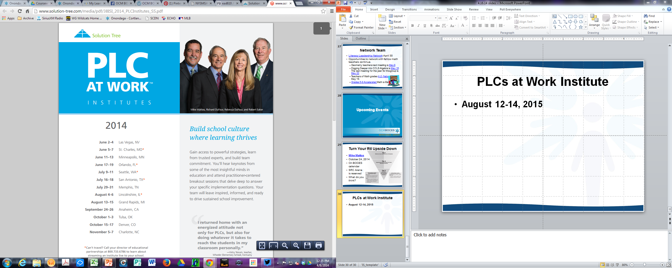
Reenergize your PLC
PLC Networking: four meetings across the year with on-line community, too.
Next meeting is January 22nd.

Slide 48
Connecting the PLC Dots
Connecting Mattos with the PLC Institute, via Interactive Video Conferences:
Tim Brown, January 14, 2015 , 4:00-5:15 pm
Ken Williams, March 4, 2015, 4:00-5:15 pm
Anthony Muhammad, June 17, 2015, 4:00-5:15 pm

Slide 49
PLCs at Work Institute
August 12-14, 2015
OnCenter and Civic Center

Slide 50
Responsive Classroom©
Responsive Classroom: Advanced
For teachers who are implementing Responsive Classroom
Cohort starts December 17th.

Slide 51
Regional Vision

Slide 52
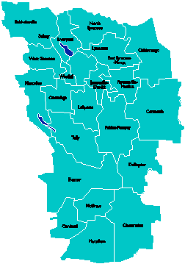
A Vision for Education in
Central New York
UPDATE
College, Career
& Citizenship Readiness
September 2014

Slide 53
A Vision for Education in CNY
Teaching that Engages
Culture that Empowers
Technology that Enables

Slide 54

District Coaching & Training
5th Trainer/Coach hired
In-district coaching for [at least] 11 districts
and 2 BOCES
Our coaches being coached by New Tech Network
PBL 102 has started
PBL 101 will continue with multiple cohorts
Primer to all principal groups
401 Leadership support posted

Slide 55

PBLNY – The Event
PBL^{NY} 2015 is scheduled for August 3-4-5
  Edutopia
  Buck Institute for Education
  New Tech Network
  Sam Saidel
  Sarah Brown Wessling
  Michael Gorman
  Suzie Boss
  Tony Wagner
  More confirmations coming…

Slide 56
BCIC Meeting
NEXT
January 8, 2015
Rodax 8 Large Conference Room

