Slide 1
BCIC Meeting
November 2014

Slide 2
Welcome
Introductions
Overview of Agenda
Updates
Part 154

Slide 3
Update and News
November 2014

Slide 4
SED News
Revised guidance about the CDOS Credential has changed the way that exiting students will be labeled. They will be counted as “high school completers.”
Unaccompanied immigrants
Students in temporary housing
SED is currently working to incorporate the performance of students who take the Algebra Regents instead of Grade 8

Slide 5
Legislative News
Smart Schools Passage
Enduring purchases
Deeper Learning; 21C and PBL

Slide 6
Professional Practice
Standards
Data
Culture

Slide 7
ITD

Slide 8
Teacher Centers
Professional Learning Groups
Parent nights soon
Social Studies Collaboration

Slide 9
Higher Education

Slide 10
CNY NYS ASCD
2014-2015 Schedule:
December 2, 2014 Pulling the Weeds
February 12, 2015 Evidence of 6 & 7
March 18, 2015 Visible Learning
May 13, 2015 Annual Meeting

Slide 11
District Sharing

Slide 12
Sharing Schedule
November: CNYLDP
December: Chittenango
January:
February:
March:

Slide 13
Standards

Slide 14
Getting Ready…
for Social Studies in NY

Slide 15
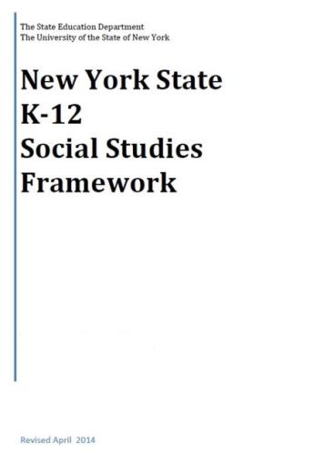
+
[
]
+
=

Slide 16
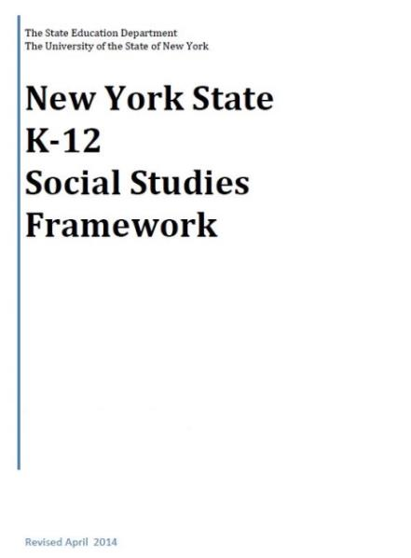
K-12 Social Studies Framework
Adopted April 2014
Intended to serve as a guide for local districts to develop Social Studies curriculum

Slide 17
Field Guide
Introduction
Shifts
Sample “unit”

Slide 18
Social Studies Shift #1
FROM: Focus on Facts
Facts
Breadth of Topics
Recall

Slide 19
Social Studies Shift #1
TO: Focus on Conceptual Understanding
Concepts and Content Knowledge
Depth within Topics
Transfer and Connections

Slide 20
Social Studies Shift #2
FROM: Teacher as disseminator
Teacher as Disseminator
Students Learn Facts from Textbook
Students Retell Interpretations

Slide 21
Social Studies Shift #2
TO: Teacher as facilitator
Teacher as Facilitator of Investigation
Students Investigate the Social Sciences, Using Multiple Sources
Students Retell Students Construct Interpretations and Communicate Conclusions

Slide 22
Social Studies Shift #3
From a classroom where:
Students experience lecture and textbook-focused instruction
Students develop literacy skills and social studies practices separately
Students learn content knowledge

Slide 23
Social Studies Shift #3
To a classroom where:
Students learn to read, discuss, and write like social scientists
Students develop disciplinary literacy skills and social science practices in tandem
Students integrate and apply concepts, skills, and content knowledge

Slide 24
Toolkit
Social Studies Toolkit
Released March 2015

Slide 25
Unit? Not “Inquiries?”
There is one example of an unit:
Reconstruction
End of 7th or beginning of 8th
Compelling Question: Did African Americans gain their freedom during the era of Reconstruction?
Summative task: Claim & evidence writing task

Slide 26
State Assessment in SS
Assessment Timetable:
Spring 2015 - Item writer training
Spring 2016 - Piloting of items
Spring 2017 - Field testing of items
June 2018 - Global first administration
June 2019 - US History first administration

Slide 27
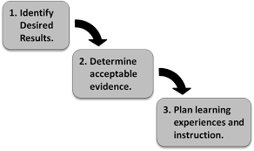
Curriculum Writing
Summer 2015
8th Grade
5-7th grade next priority (or go K-8?)
Summer 2016
9&10th Grade
K-4 band
Summer 2017
US History
12th grade

Slide 28
C3 w/ SG Grant, January 29, 4-6p session
Bridging from the C3 to New York w/ Greg Ahlquist, February 10, 4-6p session
NYSCSS Annual Conference, Mar 11-14
Opening the Toolkit w/ Pat Polan, April 16, 4-6p session
Understanding By Design: Social Studies w/ Jay McTighe, May 14 & 15

Slide 29
Leadership Network”
Collaborate, share
Turnkey presentations
Strategic representation
Suggest each district to have at least one representative

Slide 30
Literacy Leadership
Literacy Leadership- this is an on-going group that you are welcome to join at any time.
Next session is November 19th.
Work has included:
X
X
X

Slide 31
Content Literacy
Upcoming Regional Training/Support:
General Session -- a prerequisite (November 17th). Teachers of grades 6-12
Special Areas (December 1st)
Social Studies (December 2nd)
Science (December 3rd)
Literacy in the Mathematics Classroom (December 4). Teachers of grades 4-9

Slide 32
Math
Implementing Geometry CCLS will continue to meet monthly at least through the first implementation (next sessions are Nov 14 and 21)
Continuing discussion about math textbooks/resources
Data collection; responses (have heard from WG, Westhill, Marathon, NS, DeRuyter, Lyncourt, Chittenango, Solvay, Cortland, Cincinnatus, JD)

Slide 33
Science
Another comment period is underway about the NGSS
Group of secondary science teachers made recommendation against adoption (seems to be favored for some reason)

Slide 34
Arts
The Board of Regents did receive an update about the Arts Standards
No action at this time

Slide 35
Data and Data-Driven Instruction

Slide 36
CCLS Implementation
Double-Testing Waiver has been approved*
ELA Regents old and new approved
Geometry
Continue to update the curriculum and assessment chart

Slide 37
3-8 Assessment Audits
What was your feedback?

Slide 38
4 + 1 Pathways
Board of Regents has taken first step
The “4” refers to a requirement of passing four Regents exams
The “1” refers to options that students have for the fifth test
Once finalized by the Regents (according to their procedures), it will go onto effect this year

Slide 39
4 + 1 Pathways
The four required Regents examinations are English language arts, mathematics, science, and either US history or global history and geography.

Slide 40
4 + 1 Pathways
Pathway options:
Humanities
Science, Technology, Engineering, and Math (STEM)
Languages Other Than English (LOTE)
Career and Technical Education (CTE)
Arts

Slide 41
Professional Practice

Slide 42
2014-15 Lead Evaluator Training
One year 1 cohort (smaller this year)
Three ongoing sessions
Following 6th grade teacher
Growth producing feedback
Instructional leadership

Slide 43
2014-15 Principal Evaluator Training
Catch up session
Three ongoing sessions
Connecting to Lead Evaluator Training

Slide 44
APPR Stuff
No Governor signature yet
October 17th for submitting scores

Slide 45
Fullan’s Three Keys
Leading Learning
Being a District and System Player
Becoming a Change Agent
Discuss Chapters 1 & 2

Slide 46
Culture

Slide 47
Reenergize your PLC
PLC Networking: four meetings across the year with on-line community also. First meeting October 29th.
Interactive Video Conferences (3?) with Solution Tree keynoters between now and August
August 2015 Institute

Slide 48
Turn Your RtI Upside Down

Slide 49
Connecting the PLC Dots
Connecting Mattos with the PLC Institute, via Interactive Video Conferences:
Tim Brown, January 14, 2015 , 4:00-5:15 pm
Ken Williams, March 4, 2015, 4:00-5:15 pm
Anthony Muhammad, June 17, 2015, 4:00-5:15 pm

Slide 50
PLCs at Work Institute
August 12-14, 2015
OnCenter and Civic Center

Slide 51
Regional Vision

Slide 52
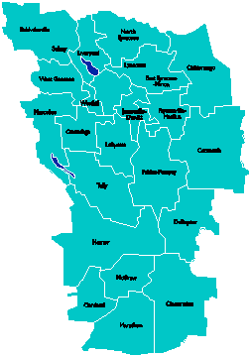
A Vision for Education in Central New York
UPDATE
College, Career & Citizenship Readiness
September 2014

Slide 53
A Vision for Education in CNY
Teaching that Engages
Culture that Empowers
Technology that Enables

Slide 54
District Coaching & Training
4th Trainer/Coach hired; interviewing 5th soon
In-district coaching for [at least] 11 districts and 2 BOCES
Our coaches being coached by New Tech Network
PBL 102 has started
PBL 101 will continue with multiple cohorts
Primer to all principal groups
401 Leadership support

Slide 55
Business & Community Partnerships

Slide 56
PBLNY – The Event
PBL^{NY} 2015 is scheduled for August 3-4-5
Edutopia
Buck Institute for Education
New Tech Network
Sam Saidel
Sarah Brown Wessling
Michael Gorman
Suzie Boss
More confirmations coming…

Slide 57
Part 154 Changes

Slide 58
Stages of the Progression
Entering
Emerging
Transitioning
Expanding
Commanding

Slide 60
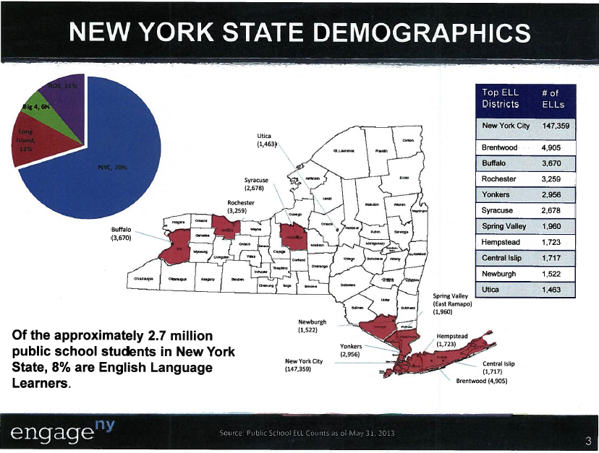

Slide 61
Important Terminology
This chart provides you with the terminology to help inform you as you begin to plan to meet the needs of students.

Slide 62
Stages of the Progression
Entering
Emerging
Transitioning
Expanding
Commanding

Slide 65
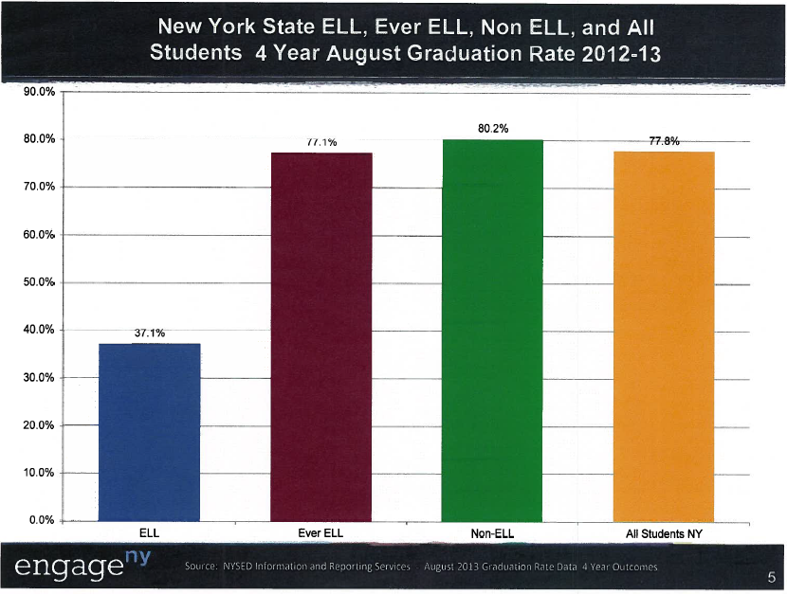

Slide 66
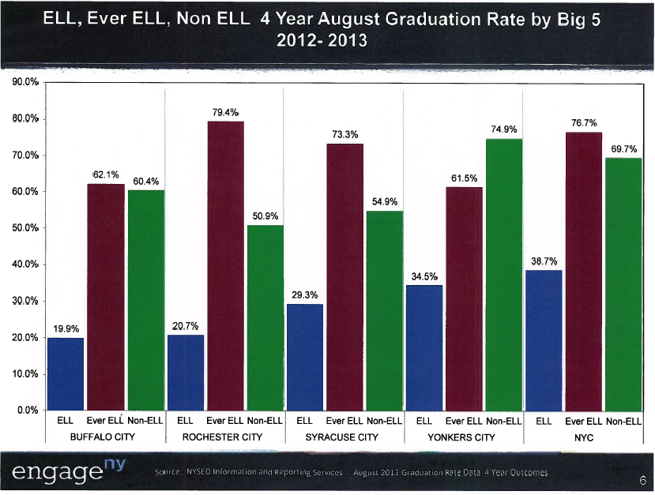

Slide 67
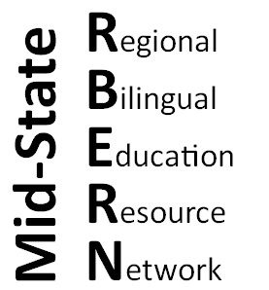
Ensuring Equal Educational Opportunities for English Language Learners
Amended Commissioner’s Regulations Part 154
Adopted 9/15/2014
Facilitator: Tanya Rosado-Barringer, Coordinator
Mid-State RBERN at OCMBOCES

Slide 68
Introductions and Welcome!
What is Mid-State RBERN? (Regional Bilingual Education Resource Network)
Technical support
Professional Development
Resources

Slide 69
COMMISSIONER’S REGULATION PART 154
Commissioner's Regulation Part 154 establishes the legal requirements for the education of English Language Learners (ELLs) in New York State.
On September 15th, 2014, NYSED’s Board of Regents amended CR Part 154 into Subparts:
SUBPART 154-1: Describes the requirements for the 2014-2015 school year. Essentially, the requirements are the same as in CR Part 154 (2007), but include changes in terminology.
SUBPART 154-2: Describes the new and expanded requirements of schools and school districts that are to be fully in effect as of the 2015-2016 school year.
PROPOSED SUBPART 154-3: If adopted by the Board of Regents, will establish:
1) ELL Identification criteria for Students with a Disability; and
2) ELL Exit process and criteria for eligible Students with a
Disability. (Board of Regents Meeting – November 17 and 18)

Slide 70
AREAS OF CR PART 154 REGULATION
ELL Identification
Parent Notification and Information
Retention of Records
ELL Program Placement
Program Requirements
Provision of Programs
Grade Span
Program Continuity
Students with Disabilities
ELL Exit Criteria
Intervention Support for ELLs
Former ELL Services
Graduation Requirements
Professional Development
Certification
School District Planning and Reporting Requirements

Slide 71
IDENTIFICATION
ELL IDENTIFICATION
CR PART 154 EXISTING REGULATION | SUBPARTS 154-1 & 154-2 ADOPTED REGULATION | TIMELINE
A three step ELL identification process by school staff, including: administration of the Home Language Questionnaire; an informal individual interview with the student; and the administration of a statewide English language proficiency identification assessment. Current regulations do not define the qualifications of staff required to administer the identification process. | Implement a three step ELL identification process to ensure holistic and individualized decisions can be made by qualified personnel, including: administration of the Home Language Questionnaire; individual interview with the student; administration of a statewide English language proficiency identification assessment. Qualified personnel is defined as a Bilingual Education or ESOL teacher, or a teacher trained in cultural competency, language development and the needs of English Language Learners.
2015-2016
Full Implementation

Slide 72
ELL IDENTIFICATION Cont’d
CR PART 154 EXISTING REGULATION | SUBPARTS 154-1 & 154-2 ADOPTED REGULATION | TIMELINE
Guidance documents define Students with Interrupted Formal Education, but do not clearly indicate that they should be identified as part of the identification process. | School districts are required to identify ELLs as Students with Interrupted/Inconsistent Formal Education (SIFE) as an additional part of the interview during the identification process. It includes a review of academic history and student work samples to determine level in home language and math. [154-2.3(a)(6)]
Current regulations do not provide the opportunity for a review process addressing possible ELL misidentification. | Upon receiving a written request within an ELL’s first 45 days of enrollment, school districts are required to implement a review process by qualified personnel to determine if a student may have been misidentified. A review of ELL identification determination would commence upon written request by a parent, a teacher with the consent of the parent, or a student, if the student is 18 years old or older. Before a change in ELL determination is final, parental consent, student consent if the student is 18 years or older, and principal and superintendent approval are required. [154-2.3(b)]
2015-2016
Full Implementation
2015-2016
Full Implementation

Slide 73
RETENTION OF RECORDS
CR PART 154 EXISTING REGULATION | SUBPARTS 154-1 & 154-2 ADOPTED REGULATION | TIMELINE
Current regulations do not require school districts to maintain records of a parent’s preferred language or mode of communication, or records of notices and forms generated during the identification and placement process in ELL student’s cumulative record. | School districts are required to collect and maintain: Records indicating parent’s preferred language or mode of communication; and Records of notices and forms generated during the identification and placement process in ELL student’s cumulative record.
PARENT NOTIFICATION AND INFORMATION
Current regulations require school districts to make an effort to meet with parents or persons in parental relation at least twice a year to help them understand the goals of the program and how they might help their children. | Parent notification and communication is required to be in the language best understood by the parents as indicated and on file in each ELL student’s cumulative record. School personnel is required to meet with parents or persons in parental relation at least once a year, in addition to other generally required meetings with parents, to discuss with parents their child’s academic content and language development progress and needs.
2015-2016
Full Implementation
2015-2016
Full Implementation

Slide 74
ELL PROGRAM PLACEMENT
CR PART 154 EXISTING REGULATION | SUBPARTS 154-1 & 154-2 ADOPTED REGULATION | TIMELINE
Current guidance calls for placement in a Bilingual Education / ESL program within 10 school days after initiating the identification process. | ELL identification, parent notification, signed consent, and placement in a Bilingual Education or ENL/ESL program is required to take place within 10 school days after initiating the identification process. [154-2.3(g)(1)]
Current regulations do not require school districts to complete the identification process before an ELL student receives a final school placement. | School districts are required to complete the identification process before an ELL student receives a final school placement. A student is to be provisionally placed in a school until the identification process is completed. [154-2.3(a)(8)]
PROGRAM REQUIREMENTS & PROVISION OF PROGRAMS
Current regulations require school districts to provide English as a Second Language instruction through a Stand-Alone model only. | English as a New Language instruction is required to be offered through two settings: Integrated ENL/ESL (ESL methodologies in content area instruction co-taught or individually taught by a dually certified teacher); and Stand-Alone ENL/ESL (ESL instruction with an ESOL teacher to develop the English language needed for academic success). [152.2(m)and(x)]
2015-2016
Full Implementation
2015-2016
Full Implementation

Slide 75
PROGRAM REQUIREMENTS & PROVISION OF PROGRAMS Cont’d
CR PART 154 EXISTING REGULATION | SUBPARTS 154-1 & 154-2 ADOPTED REGULATION | TIMELINE
Current regulations require each school with 20 or more ELL students of the same grade who speak the same home language to provide a Bilingual Education program. | Each school with 20 or more ELL students of the same grade who speak the same home language continues to be required to provide a Bilingual Education program. [154-2.3(d)(4)]
Current regulations do not require districts to conduct an annual estimate of ELL enrollment, nor create a sufficient number of Bilingual Education programs in the district, if there are 20 or more ELLs of the same grade level who speak the same home language district wide. | School districts are required to annually estimate ELL enrollment before the end of each school year, and create a sufficient number of Bilingual Education programs in the district, if there are 20 or more ELLs district wide of the same grade level who speak the same home language. [154-2.3(d)(1)] New Bilingual Education programs are not to be placed in a school identified as a School Under Registration Review or as a Focus or Priority School. [154-2.3(d)(3)] A school district will be allowed to apply for a one-year waiver for languages that represent less than 5% of the statewide ELL population, if the district can demonstrate it meets established criteria and provides alternate home language supports. [154-2.3(d)(6)]
2015-2016
Full Implementation
2015-2016
Full Implementation
Notes:
PROGRAM REQUIREMENTS AND PROVISION OF PROGRAMS Cont’d
School buildings with 20 or more ELL students in the same grade who speak the same home language continue to be required to provide Bilingual Education programs.
Under the amended regulations, school districts are required to estimate ELL enrollment before the end of school year in order to plan effectively for the provisions of Bilingual Education programs when there are 20 students throughout the school district of the same grade level who speak the same home language.
School districts will have to plan ahead to determine which type of bilingual program will be created in the school district depending on their demographics. Consideration must be also be made to proximity of population and district-provided transportation (ie. busing.) For example, if Dual Language is selected as the most appropriate program, the school district may want to select a location that accommodates ELLs and non-ELLs depending on the model.
A school district will be allowed to apply for a one year Bilingual Education program waiver for languages that represent less than 5% statewide, which currently represents every language other than Spanish and Chinese. The waiver application must include efforts made to open the program, as well as future operational plans.
This one-year exemption request can be extended annually for up to five years.

Slide 76
GRADE SPAN
CR PART 154 EXISTING REGULATION | SUBPARTS 154-1 & 154-2 ADOPTED REGULATION | TIMELINE
Current regulations do not address grade span or program continuity. | The maximum allowable grade span is two contiguous grades for grouping instruction in ENL/ESL and Bilingual Education programs. [154-2.3(i)]
PROGRAM CONTINUITY
Current regulations do not address program continuity. | Districts are required to provide program continuity so that ELLs can continue to receive the program type (Bilingual Education or ENL/ESL) in which they were initially enrolled. [154-2.3(e)] In order to ensure program continuity, schools are required to continue providing a Bilingual Education program if at least 15 students who speak the same home language were enrolled in such a program in the previous school year. [154-2.3(e)]
2015-2016
Full Implementation
2015-2016
Full Implementation
Notes:
GRADE SPAN
Research shows that language instruction must be delivered in the context of academic content. Appropriate academic language instruction must be tied to grade-level content.
See New York State Bilingual Common Core Initiative: Theoretical Foundations. https://www.engageny.org/sites/default/files/resource/attachments/nysbcci-theoretical-foundations.pdf.
Also see Blueprint for English Language Learner Success. Principle 1 states, “All teachers are teachers of English Language Learners, and need to plan accordingly by providing integrated language and content instruction to support language development through language-focused scaffolds…utilizing materials and instructional resources that are linguistically, age/grade appropriate, and aligned to the Common Core Learning Standards (CCLS).”
PROGRAM CONTINUITY
The adopted regulation requires school districts to provide Bilingual program continuity. In order to ensure program continuity, schools need to continue to provide a Bilingual Education program if at least 15 students who speak the same home language were enrolled in such program in the previous school year. Research has shown that students that change programs do not do as well as does that have continuity of programs.

Slide 77
ELL EXIT CRITERIA
CR PART 154 EXISTING REGULATION | SUBPARTS 154-1 & 154-2 ADOPTED REGULATION | TIMELINE
Current regulations only allow students to exit ELL status through one criterion: scoring proficient on the statewide English language proficiency assessment. | Exit criteria has expanded to allow qualified students to exit ELL status by: OPTION 1) Scoring at the Proficient/Commanding level on the NYSESLAT [154-2.3(m)(1)(i)] OPTION 2) Scoring at the Advanced/Expanding level on the NYSESLAT, -and- ➢ 3+ on a grade 3-8 ELA Assessment, -or- ➢ 65 + on the Regents Exam in English [154-2.3(m)(1)(ii)] OPTION 3) Please see Areas of Pending Regulation: Students with Disabilities. [154-2.3(m)(2)]
2015-2016
Full Implementation
Notes:
ELL EXIT CRITERIA
School districts now have the ability to consider 3-8 ELA and Comprehensive Regents scores in addition to NYSESLAT scores to exit ELL status.
This is an opportunity for students to demonstrate proficiency through different pathways.
See Slide: Areas of Pending Regulation - Students with Disabilities for Proposed Subpart 154-3. If adopted by the Board of Regents, Proposed Subpart 154-3 would expand ELL Exit Criteria even further.

Slide 78
INTERVENTION SUPPORT FOR ELLS
CR PART 154 EXISTING REGULATION | SUBPARTS 154-1 & 154-2 ADOPTED REGULATION | TIMELINE
Current regulations do not require school districts to annually identify ELLs not demonstrating adequate performance or provide appropriate support services to achieve and maintain academic success. | Districts are required to annually identify ELLs not demonstrating adequate performance and provide additional support services aligned to district wide intervention plans. [154-2.3(j)]
FORMER ELL SERVICES
Current state and federal guidance calls for school districts to provide one to two years of support services to students who exit out of ELL status (Former ELLs). | School districts are required to provide at least two years of Former ELL services to support students who exit out of ELL status including: A half unit of study of Integrated ENL/ESL in ELA, Math, Science or Social Studies, ~and/or~ With OBEFLS approval, other services that monitor and support each Former ELL’s language development and academic progress. [154-2.3(h)(1)(v)] and [154-2.3(h)(1)(v)]
2015-2016
Full Implementation
2015-2016
Full Implementation
Notes:
INTERVENTION SUPPORT
All students in New York State, including ELLs, regardless of their English language proficiency level are entitled to Academic Intervention Services such as RTI.
School districts are required to annually identify ELLs not demonstrating adequate performance and provide additional supports aligned to district-wide intervention plans. This is very important in order to ensure that ELLs are receiving adequate support that will allow them to make academic progress.
FORMER ELL SERVICES
As well as language development support in the form of Former ELL Services, during their first two years of exiting ELL status, Former ELLs also continue to receive prescribed accommodations on state assessments.
With OBEFLS approval, school districts have flexibility on the provision of Former ELL services.

Slide 79
PROFESSIONAL DEVELOPMENT
CR PART 154 EXISTING REGULATION | SUBPARTS 154-1 & 154-2 ADOPTED REGULATION | TIMELINE
Current regulations require in-service training to all personnel providing instruction or other services to ELLs, but do not require specific types of professional development beyond the general requirement of 175 hours of professional development over 5 years. | School districts are required to ensure that a prescribed percentage of Professional Development hours be specific to the needs of ELLs, co-teaching strategies, and integrating language and content instruction: 15% total hours ELL-specific PD for All Teachers ~and~ 50% total hours ELL-specific PD for Bilingual Education and ENL/ESL teachers
2015-2016
Full Implementation
Notes:
PROFESSIONAL DEVELOPMENT
As stated in NYSED’s recently released Blueprint for ELL Success, ALL teachers are teachers of ELLs.
See http://www.nysed.gov/press/ELLBlueprint
15% of the 175 required professional development hours for all teachers is required to be dedicated to ELL-specific PD.
Professional development should be aligned with other PD. For example, ELLs and Common Core.
See Slide: Areas of Pending Regulation: Professional Development

Slide 80
SCHOOL DISTRICT PLANNING AND REPORTING
CR PART 154 EXISTING REGULATION | SUB-PARTS 154-1 & 154-2 ADOPTED REGULATION | TIMELINE
Current regulations require school districts to provide information in plans regarding programs for ELLs, information provided to parents, methods to annually measure and track ELL progress, and systems to identify, assess, and exit students from ELL status. | School districts are required to provide additional information in comprehensive plans regarding programs for subpopulations of ELLs, information provided to parents in the languages they best understand, methods to annually measure and track ELL progress, and systems to identify, assess, and exit students from ELL status. [154-2.4(b)]
Current regulations do not require school districts to report ELL program information for subpopulations of ELLs or by languages spoken in the school district. Current regulations do require school districts to provide information in reports regarding programs for ELLs, information provided to parents, methods to annually measure and track ELL progress, and systems to identify, assess, and exit students from ELL status | School districts are required to provide additional information in reports regarding programs for subpopulations of ELLs including program information, if offered, by subpopulations and languages spoken in the school district. [154-2.4(c)]
2015-2016
Full Implementation
2015-2016
Full Implementation
Notes:
SCHOOL DISTRICT PLANNING AND REPORTING
School districts are currently required to provide information regarding programs for ELLs and information provided to parents. The only difference now is that we are requiring that they report programs and languages that reflect subpopulations: Newcomers, Developing ELLs, Long-Term ELLs, Students with Interrupted Formal Education (SIFE), Former ELLs, and ELLs with Disabilities.
Definitions of subpopulations can be found in Section 154-2.2.

Slide 82
RBERN Resources
Website
Resource Library
Contacts for Translators & Interpreters
Email List
Administrators Meetings as needed
Regional Professional Development
On-line Learning – Coming soon.
http://rbern.ocmboces.org/

Slide 83
BCIC Meeting
NEXT
December 11, 2014
Rodax 8 Large Conference Room
Focus: DTSDE & School Improvement

