Slide 1
BCIC Meeting
October 2014

Slide 2
Welcome
Introductions
Overview of Agenda
Updates
Social Studies
Supporting PBL

Slide 3
Update and News
October 2014

Slide 4
SED News
AIS relief extended
Pathways at October meeting
Part 154 guide coming
Other SED news is embedded in our agenda…

Slide 5
Legislative News
Technology bond act?

Slide 6
CI&A: What is New/Same/Revised?
Variety of regional opportunities
Based on your requests and suggestions
Based on RTTT/Reform Agenda/Regional Vision
Training and events are advertised:
MLP
PD enews
Weekly Dispatch
Districts have on-site days:
1.5-3.5 CI&A
Network Team Districts have 3 more

Slide 7
Professional Practice
Standards
Data
Culture

Slide 8
ITD

Slide 9
Teacher Centers
New Teacher Welcome Project
Good feedback from participants
Social Studies Collaboration
Details follow SS presentation

Slide 10
Higher Education

Slide 11
CNY NYS ASCD
2014-2015 Schedule:
October 15, 2014 Teachers Talk about PBL
December 2, 2014 Pulling the Weeds
February 12, 2015 Evidence of 6 & 7
March 18, 2015 Visible Learning
May 13, 2015 Annual Meeting

Slide 12
District Sharing

Slide 13
Sharing Schedule
October: ESM
November: CNYLDP
December: volunteer needed

Slide 14
Standards (and Curriculum)

Slide 15
Standards
ELA/Literacy
Math
Science
Social Studies
LOTE/Arts/Others

Slide 16
Standards
ELA/Literacy
Math
Social Studies
Science
LOTE/Arts/Others

Slide 17
Getting Ready…
for Social Studies in NY
October 2014 Update

Slide 18
SS Learning Standards
Learning Standards
Part of Standards issued in 1996
Resource Guides in 1999
12th grade (Econ & P.I.G.) updated in 2002
Other misc. Updates

Slide 19
Graduation Requirements
Students must have 4 units of credit in social studies, which includes:
1 unit in American history; and
1/2 unit of credit in Economics and 1/2 unit of credit in Participation in Government (or equivalent)

Slide 20
State Assessment in SS
Regents Examinations:
Global History and Geography
US History and Government
Note: State assessments at the elementary and intermediate levels were discontinued due to the lack of funding. The 5th and 8th grade tests were last administered in 09-10.

Slide 21
Getting Ready…
for Social Studies in NY
October 2014 Update

Slide 22
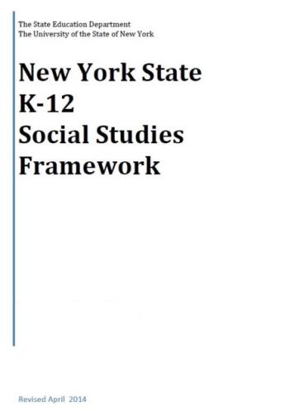
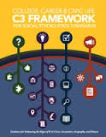
+
[
]
+
=

Slide 23
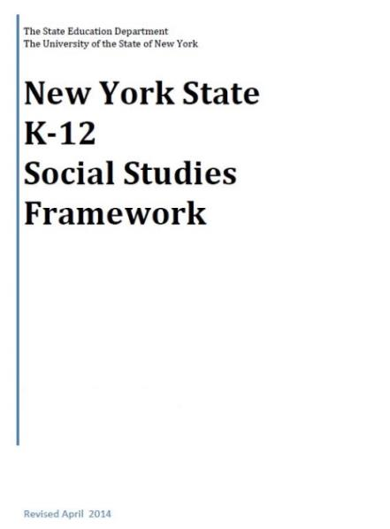
K-12 Social Studies Framework
Adopted April 2014
Intended to serve as a guide for local districts to develop Social Studies curriculum

Slide 24
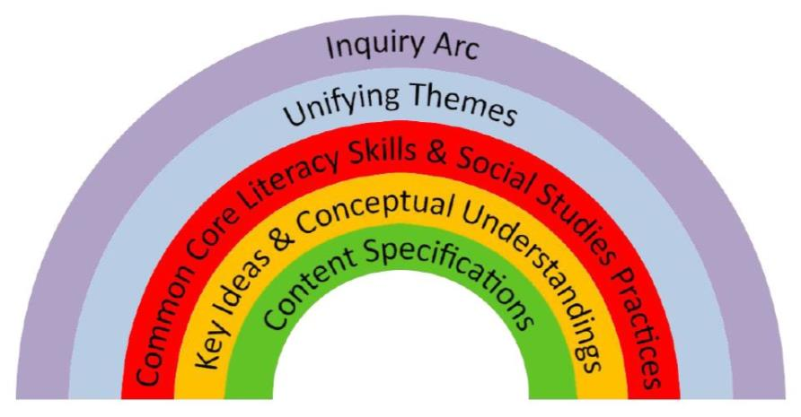
The Framework
Emphasis on:
Balance of content and skills
Civics and preparing students for citizenship and to take informed action

Slide 25
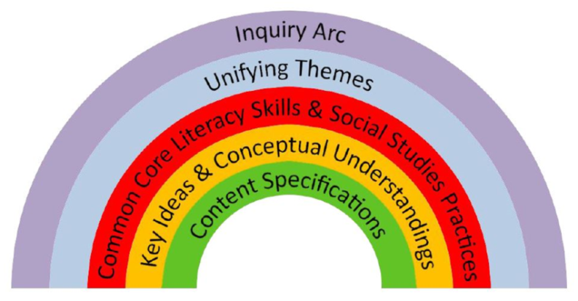
The Framework
Inquiry Arc (NCSS C3 Framework )
Developing questions and planning inquiries
Applying disciplinary concepts and tools
Evaluating sources and using evidence
Communicating conclusions and taking informed action
Notes:
NCSS – National Council for the Social Studies

Slide 26
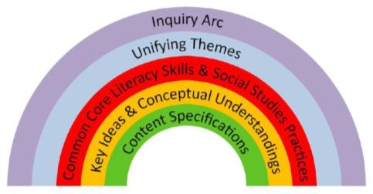
The Framework
Unifying Themes (NCSS)
Individual Development and Cultural Identity
Development, Movement, and Interaction of Cultures
Time, Continuity, and Change
Geography, Humans, and the Environment
Development and Transformation of Social Structures
Power, Authority, and Governance
Civic Ideals and Practices
Creation, Expansion, and Interaction of Economic Systems
Science, Technology, and Innovation
Global Connections and Exchange

Slide 27
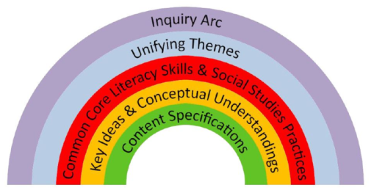
The Framework
New York State Common Core Learning Standards
Reading, Writing, Speaking and Listening
Literacy in History/Social Studies 6-12 (with addition of grade 5 to the 6-8 band)

Slide 28
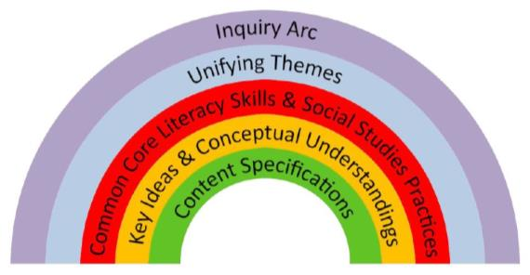
The Framework
Social Studies Practices
Gathering, Using, and Interpreting Evidence
Chronological Reasoning and Causation
Comparison and Contextualization
Geographic Reasoning
Economics and Economics Systems
Civic Participation

Slide 29
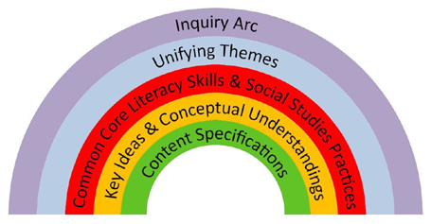
The Framework
Social Studies Learning Standards and Core Curriculum for Social Studies
History of the United States and New York
World History
Geography
Economics
Civics, Citizenship, and Government

Slide 30
Content Sequence
Kindergarten Self and Others
Grade 1 My Family and Other Families, Now and Long Ago
Grade 2 My Community and Other United States Communities
Grade 3 Communities around the World
Grade 4 Local History and Local Government
Grade 5 The Western Hemisphere
Grade 6 The Eastern Hemisphere
Grade 7 History of the United States and New York – I
Grade 8 History of the United States and New York – II
Grade 9 Global History and Geography – I
Grade 10 Global History and Geography – II
Grade 11 US History and Government
Grade 12 PIG/Econ
Caution!
This is a change!

Slide 31
Field Guide
Not yet released – soon?
Guidance about how to integrate social studies content, practices, and CCLS in the context of rigorous, inquiry-driven instruction.

Slide 32
Toolkit
Social Studies Toolkit
Released March 2015

Slide 33
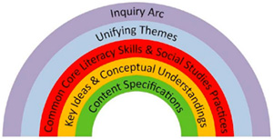
“Inquiries”
No modules or curriculum from the state, instead: “Inquiries”
Unit-like but not a unit
Compelling Questions
One annotated inquiry per grade
5 blueprints per grade

Slide 34
Parts of an “Inquiry”
Compelling Question
Supporting Questions: develop the content
Formative Performance Tasks: demonstrate emerging understandings
Featured Sources: provide background knowledge
Summative Task: demonstrates evidence-based arguments
Taking Informed Action: offers opportunities for thoughtful engagement

Slide 36
State Assessment in SS
Assessment Timetable:
Spring 2015 - Item writer training
Spring 2016 - Piloting of items
Spring 2017 - Field testing of items
June 2018 - Global first administration
June 2019 - US History first administration

Slide 37
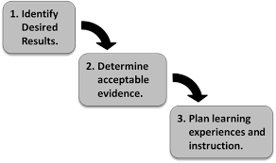
Curriculum Writing
Summer 2015
8th Grade!
5-7th grade next priority?
Summer 2016
9&10th Grade!
3-5 band
K-2 band
Summer 2017
US History!
12th grade?

Slide 38
Getting Ready
Prepping the region:
C3 w/ SG Grant (January 29, 4-6p session)
SS and NY Overview (4-6p session)
NYSCSS Annual Conference in Syracuse
Opening the Toolkit (4-6p session)
Prepping to Write:
Jay McTighe May 14 & 15
UbD, Essential Questions, Facets, more

Slide 39
SS Leadership Network
Collaborate, share
Turnkey presentations
Strategic representation
Suggest each district to have at least one rep

Slide 40
Project Based Learning
Supporting PBL and 21C in Your District (Joanne Keim)

Slide 41
Literacy
LLI overview -This session is rescheduled from Sept- enrollment is open again. Please join us Oct 16.
Literacy Leadership- this is an on-going group that you are welcome to join at any time. The October session is Oct 29. (Next session is Nov 19)
Genre Study: In this workshop, participants will build on their understanding of specific genres and their characteristics, how you can support students through an inquiry process around genre and how to help students apply this knowledge when talking, reading and writing. The first of two sessions is Nov 6.

Slide 42
Content Literacy
Upcoming Regional Training/Support:
General Session -- a prerequisite (November 17th). Teachers of grades 6-12
Special Areas (December 1st)
Social Studies (December 2nd)
Science (December 3rd)
Literacy in the Mathematics Classroom (December 4). Teachers of grades 4-9

Slide 43
Math
Networking for Providers of Math AIS-. The focus will be on critical skills and progressions from CCLS. October 15 is the first meeting
Implementing Geometry CCLS- Oct 17 meets at Henry Campus for the northern end of OCM region and Oct 24 meets at McEvoy. (Next sessions are Nov 14 and 21)

Slide 44
Data and Data-Driven Instruction

Slide 45
CCLS Implementation
Double-Testing Waiver Status
ELA Regents old and new
Geometry
NYSAA redux
PARCC???
Continue to update the curriculum and assessment chart

Slide 46
Professional Practice

Slide 47
2014-15 Lead Evaluator Training
One year 1 cohort (smaller this year)
Three ongoing sessions
Will follow one teacher
Growth producing feedback
Instructional leadership

Slide 48
2014-15 Principal Evaluator Training
Catch up session
Three ongoing sessions
Will connect to Lead Evaluator Training

Slide 49
APPR Stuff
No Governor signature yet
October 17th for submitting scores

Slide 50
For Teachers:
Strategies to Engage Your Learners is all about how to incorporate movement, collaboration and communication into your lessons in order to have highly cognitively engaged students.
November 18th is the date for this very active session.

Slide 51
Fullan’s Three Keys
Leading Learning
Being a District and System Player
Becoming a Change Agent
Do we want to read this, too?

Slide 52
Culture

Slide 53
Reenergize your PLC
PLC Networking: four meetings across the year with on-line community also. First meeting October 29th.
Interactive Video Conferences (3?) with Solution Tree keynoters between now and August
August 2015 Institute

Slide 54
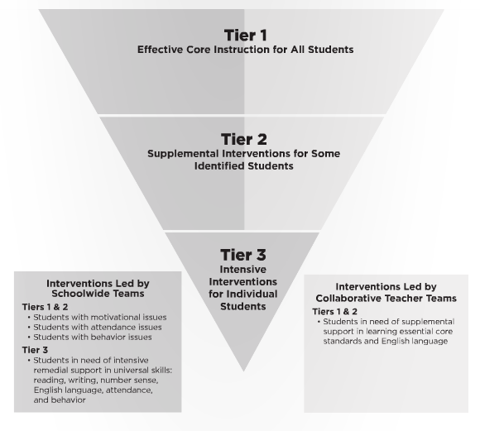
Turn Your RtI Upside Down
Mike Mattos
October 24, 2014
SRC Arena (lunch & materials)
$35 components
$65 non-components
Registration up (group registration is available)

Slide 55
Connecting the PLC Dots
Connecting Mattos with the PLC Institute, via Interactive Video Conferences:
Tim Brown, January 14, 2015 , 4:00-5:15 pm
Ken Williams, March 4, 2015, 4:00-5:15 pm
Anthony Muhammad, June 17, 2015, 4:00-5:15 pm

Slide 56
PLCs at Work Institute
August 12-14, 2015
OnCenter and Civic Center

Slide 57
Thinking Collaboratively
Developing Collaborative Groups: Adaptive Schools. This four day series offered in collaboration with CNYRIC starts October 27th.
Cognitive Coaching: CiTi (Oswego BOCES) offers this opportunity. Fees apply. Days 1-4 are Nov 4 and 5 and Dec 15 and 16. Days 5-8 for those who have previously completed Days 1-4 are Oct 22 and 23 and Nov 13 and 14. Registration is through CiTi MLP.

Slide 58
Regional Vision

Slide 59
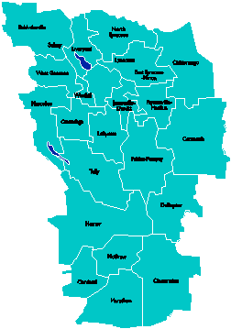
A Vision for Education in Central New York
UPDATE
College, Career & Citizenship Readiness
September 2014

Slide 60
A Vision for Education in CNY
Teaching that Engages
Culture that Empowers
Technology that Enables

Slide 61
District Coaching & Training
4th Trainer/Coach hired; interviewing 5th soon
In-district coaching for [at least] 11 districts and 2 BOCES
Our coaches being coached by New Tech Network
PBL 102 has started
PBL 101 will continue with multiple cohorts
Primer to all principal groups
401 Leadership support

Slide 62
Business & Community Partnerships
October 17th “Making Connections” Event
100 businesses sharing the problems they work on and the projects they do
100 teachers looking for authenticity for their projects
Greater Central New York Education and Business Consortium project

Slide 63
PBLNY – The Event
PBL^{NY} 2015 is scheduled for August 3-4-5
Edutopia
Buck Institute for Education
New Tech Network
Sam Saidel
Sarah Brown Wessling
Michael Gorman
Suzie Boss
More confirmations coming…

Slide 64
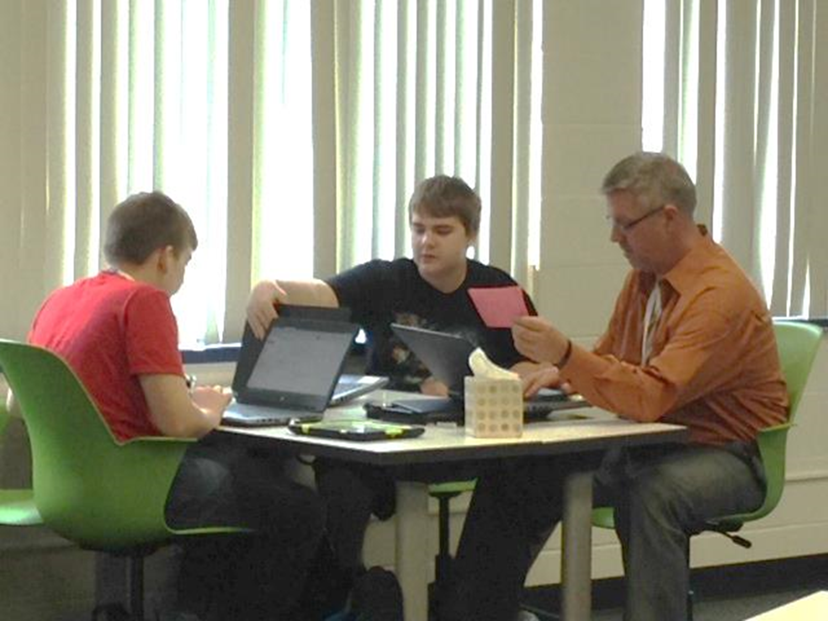
School has started!
Career Academy transformation
75 students enrolled in 9th and 10th grade
Districts: Liverpool, North Syracuse, Baldwinsville, Fayetteville-Manlius, East Syracuse-Minoa, LaFayette, Marcellus, West Genesee

Slide 65
New Tech High School “South”
Multiple districts serving southern part of OCM BOCES region
Target for opening is September 2016
Beginning with grades 9 & 10
Adding grades 11 & 12 in subsequent years
Located at Hartnett School
Homer capital project vote on renovations

Slide 66
Regional Vision Road Show
Presentations Made
Presentations Scheduled
Baldwinsville BoE
Homer BoE
DeRuyter BoE & teachers
Leadership Greater Syracuse
Marathon BoE
FOCUS Greater Syracuse
OCC Leadership
TC3 Leadership
SUNY Cortland leadership
McGraw BoE
North Syracuse Chamber of Commerce
Westhill BoE
???

Slide 67
Pre-Service Teacher Training
Early College and Dual Enrollment
Professional Development
School:
Visitations
Observation
Training (Buck Institute and NTN)
Coaching
Co-teaching
PBL^{NY}
New Tech Network Model
New Tech High School
CNY New Tech High School in Cortland County
OCM BOCES Programs
Innovation Tech at the Career Academy
District/School-Based
Integrated PBL Courses
Baldwinsville School- within-a-School
Standards (CCLS, NGSS, SS Framework, NYS Teaching Standards, 4Cs, ISTE, etc.)
Business Partnerships
Notes:
Update on all three of these

Slide 68
A Vision for Education in CNY
Teaching that Engages
Culture that Empowers
Technology that Enables

Slide 69
Long-term Planning

Slide 70
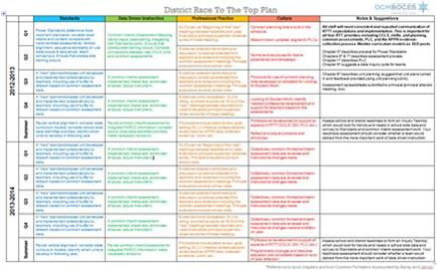
Long-term Planning Evaluation: A Protocol

Slide 71
Other

Slide 72
Long-term Planning Evaluation: A Protocol
RTTT Road Map
District RTTT 2-Year Plan
District RTTT Self-Assessment & Action Planning Tool

Slide 73
BCIC Meeting
NEXT
November 13, 2014
Rodax 8 Large Conference Room
Focus: Part 154; DTSDE; Writing?

