Slide 1
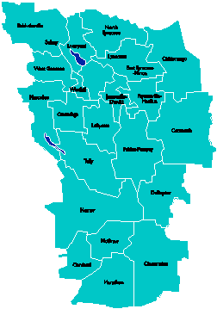
A Vision for Education in Central New York
College, Career & Citizenship Readiness
Notes:
Talk about where this vision came from. While it is Colleen and Jeff presenting, the Student Services committee and others have been visiting schools, talking about the future, and developing this vision. In the midst of all the compliance stuff like SLOs, and vested interest, and APPR, it’s been re-invigorating to think about the future and to think about our kids and their future.

Slide 2
What if…
… all students were motivated?
… all students were engaged?
… all students were ready for college and career?
… all students earned some college credit?
… all students could communicate? Collaborate? Think critically? Creatively solve problems?
Notes:
And so we went looking for schools that represented a vision…

Slide 3
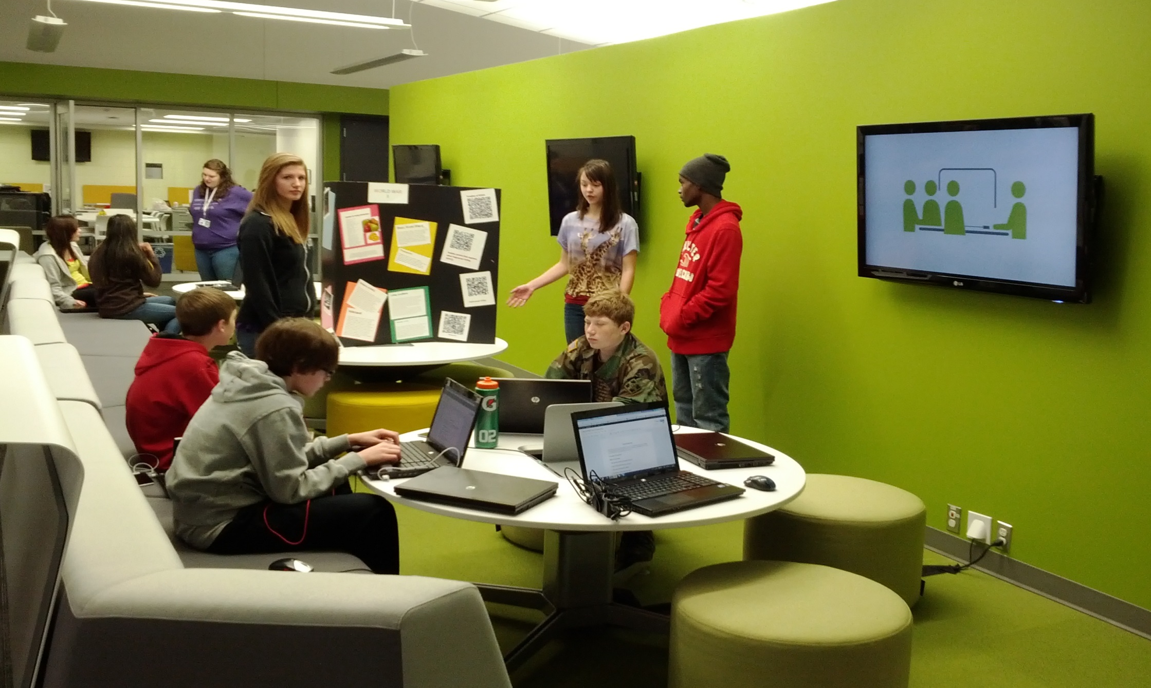
What Might that Look Like?

Slide 4
We Found “It” at New Tech
Started in 1996 in Napa, California
Businesses had concerns that high school graduates did not have essential skills
Funding from Bill and Melinda Gates Foundation
120 New Tech Schools
Across 18 States in the U.S. and in Australia

Slide 5
New Tech Students:
Grow 75% more in higher order thinking skills between freshmen and senior years than comparison group.
Graduate at a rate 6% greater than the national average.
Enroll in college at a rate 9% greater than the national average, regardless of locale.
Persist in 4-year colleges at a rate 14% higher than the national average and in 2-year colleges at a rate 43% higher than the national average.

Slide 6
A Vision for Education in CNY
Teaching that Engages
Culture that Empowers
Technology that Enables

Slide 7
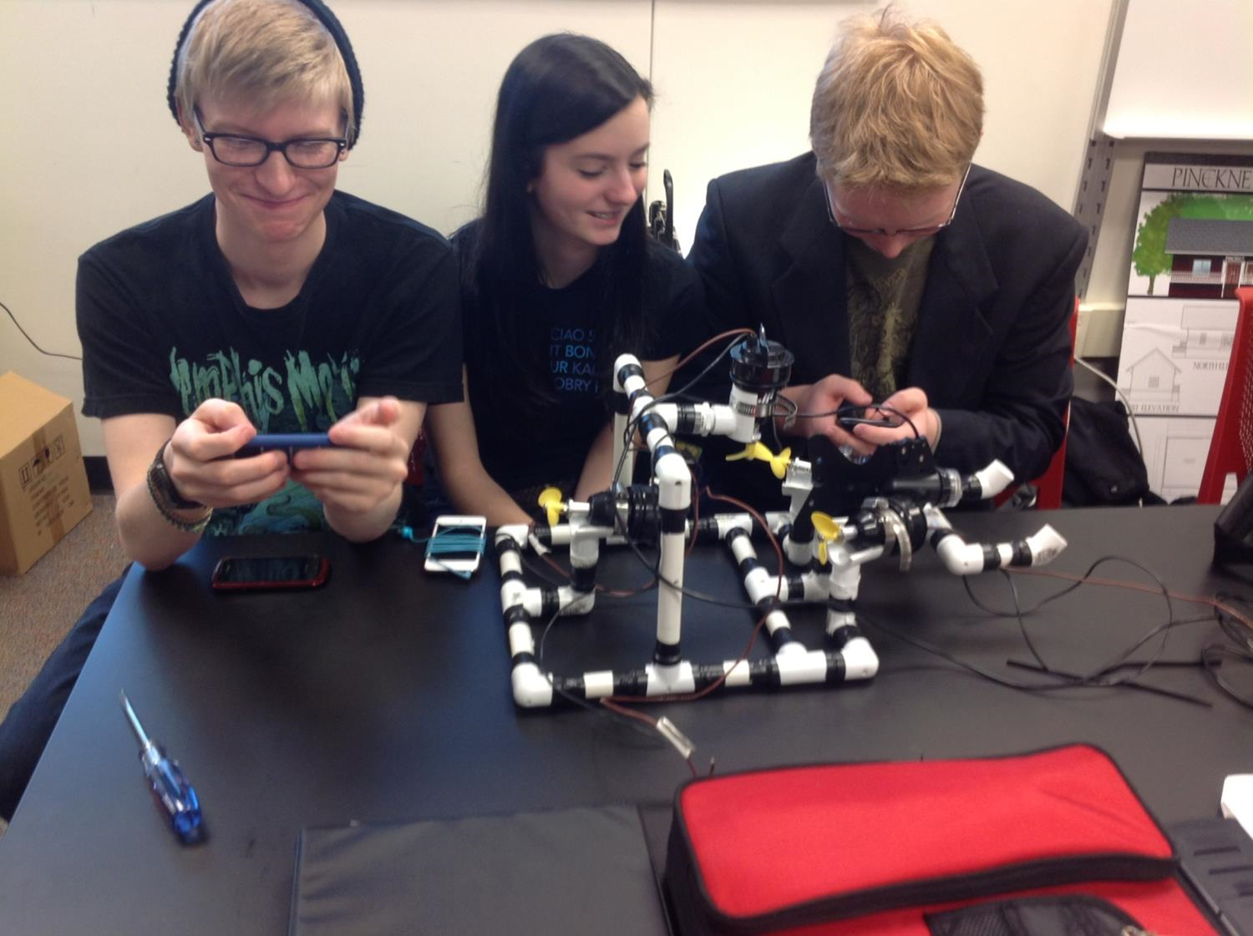
Teaching that Engages
Notes:
This is one way of thinking about the vision – all that this one picture expresses.

Slide 8
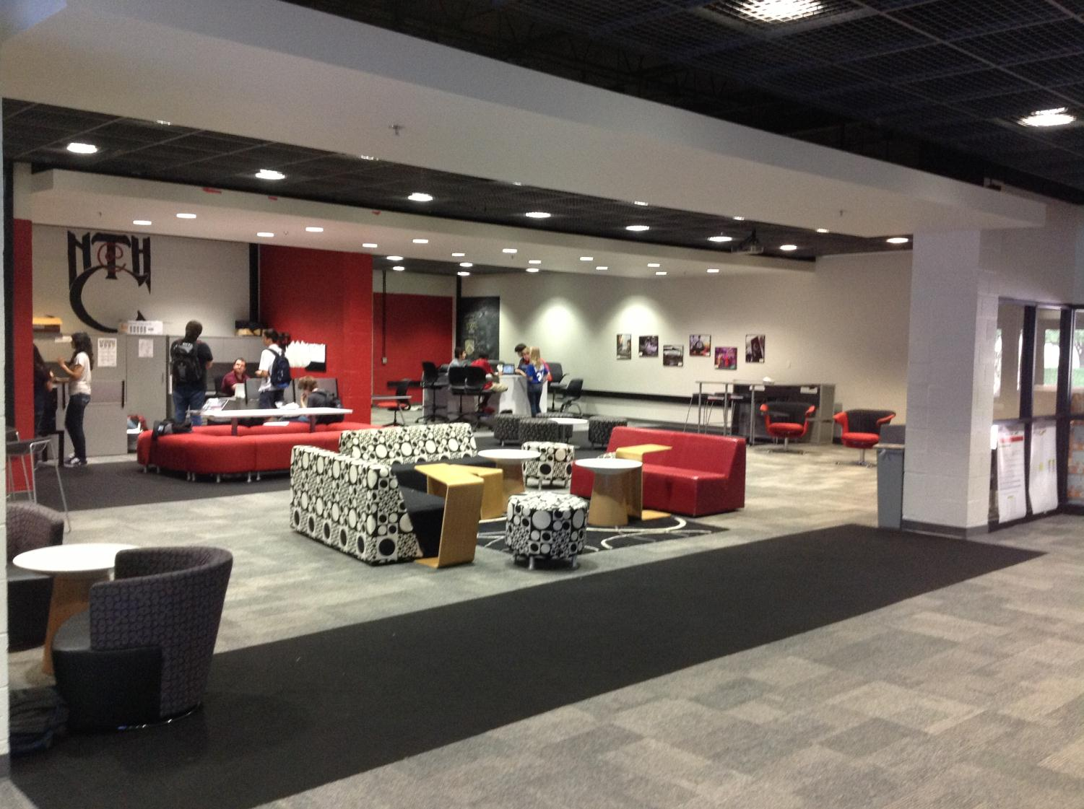
Culture that Empowers
Notes:
Facilities can enhance the learning environment, especially if it “looks” like college and career environments. We saw newer facilities and older facilities – both work as long as space is flexible and allows for larger, integrated classes and student collaboration spaces.

Slide 9
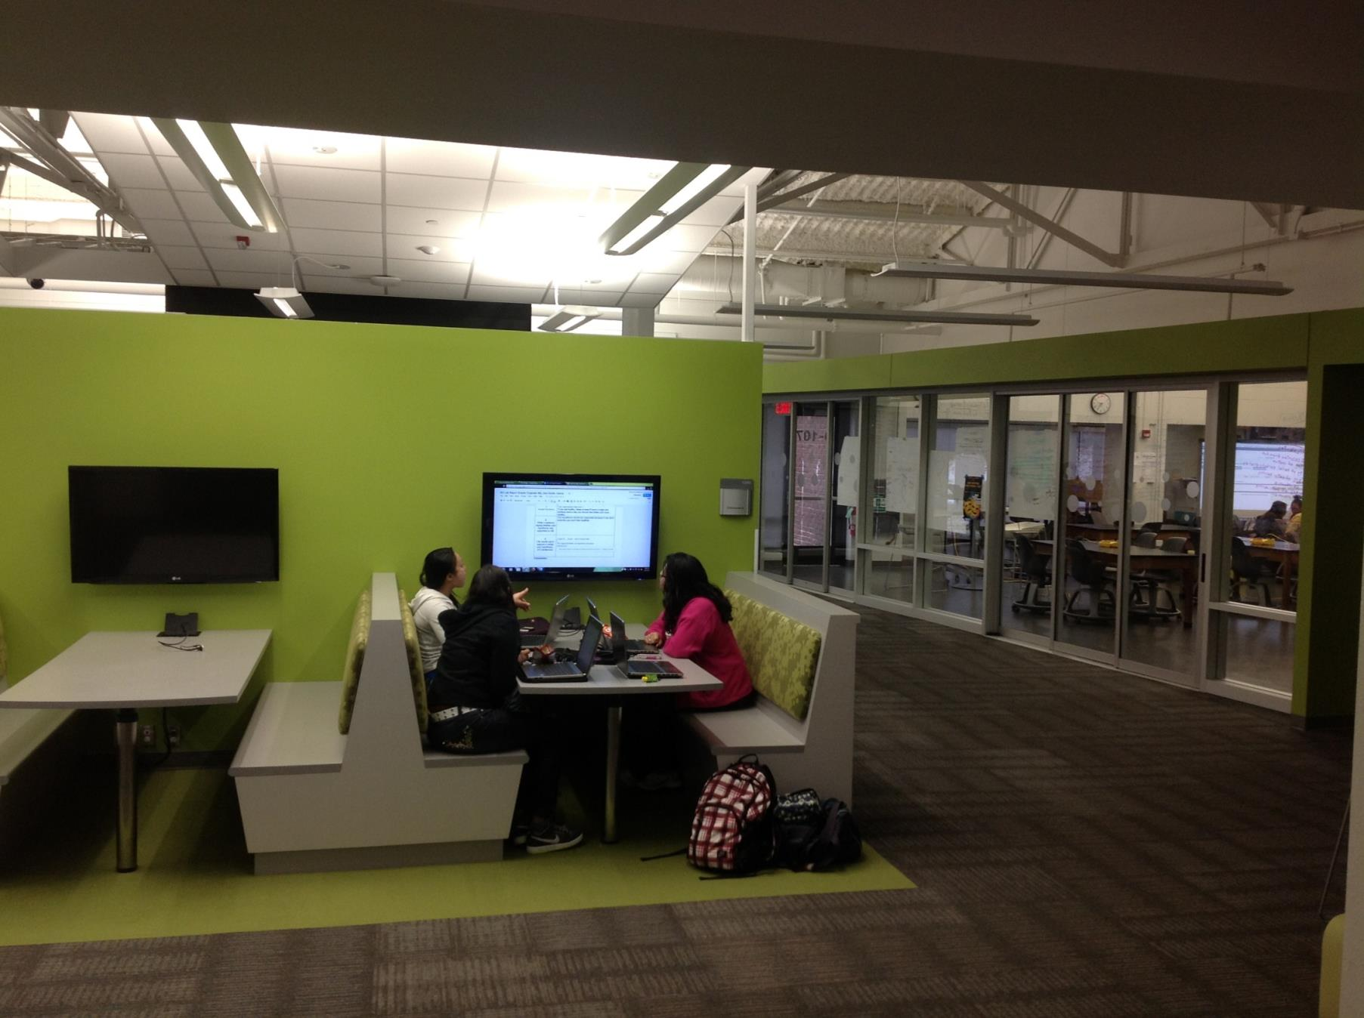
Technology that Enables
Notes:
Collaborative spaces that emulate how people collaborate and use technology in college and career settings

Slide 10
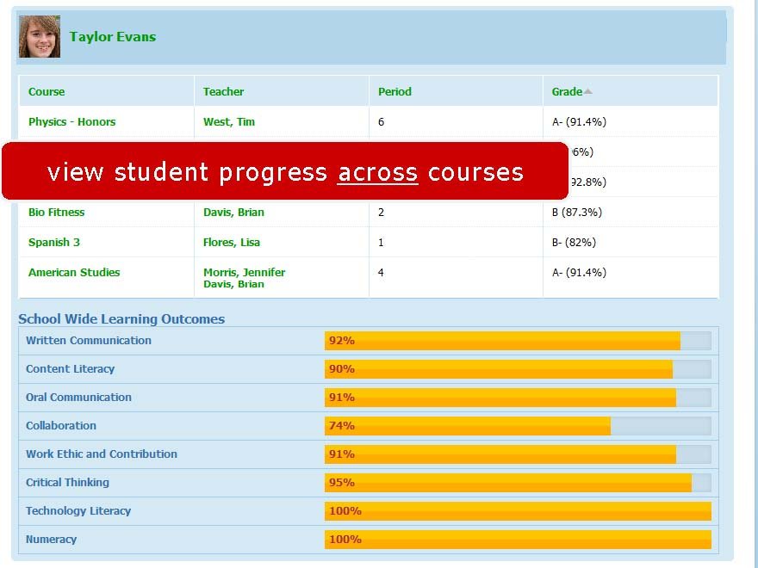
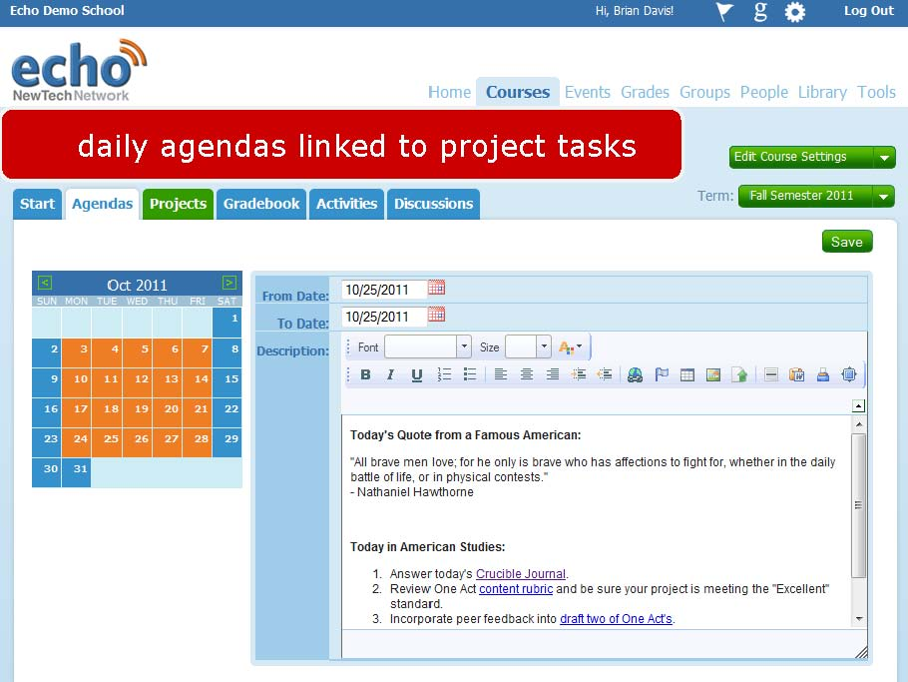

Slide 12
Perspectives about New Tech

Slide 13
What does it REALLY mean to be College, Career & Citizenship ready?
Notes:
It starts with this as the goal. We’ve all done the three question activity or thought about this. New Tech, by the way, has the “school success rubric” that does the best job of capturing this that I’ve seen…

Slide 14
College Readiness in NY:
75%
ELA test
80%
Math test
Notes:
Explain how this isn’t NYSED’s definition of readiness, but an actual idea about what it means to be ready for college, career, and citizenship. Elaborate.

Slide 15
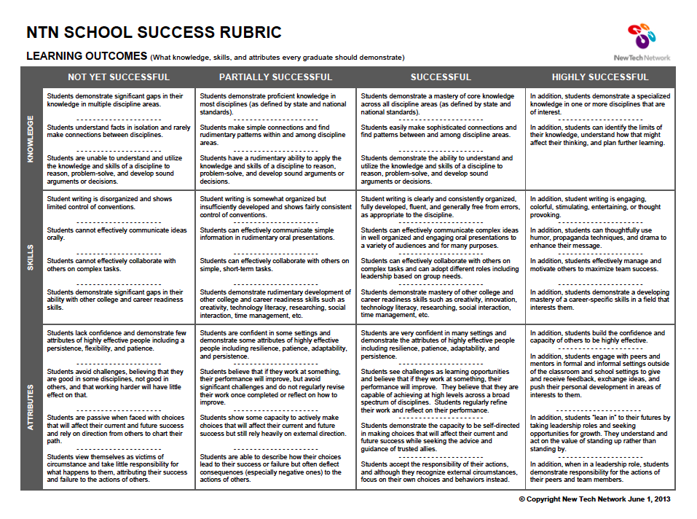

Slide 16
Pre-Service Teacher Training
Early College and Dual Enrollment
Professional Development
School:
Visitations
Observation
Training (Buck Institute and NTN)
Coaching
Co-teaching
New Tech Network Model
New Tech High School
New Tech
OCM BOCES Programs
Alternative Education
Special Education
District/School-Based
Integrated PBL Courses
School- within-a-School
Standards (CCLS, NGSS, SS Framework, NYS Teaching Standards, 4Cs, ISTE, etc.)
Business Partnerships
Notes:
Update on all three of these

Slide 17
Pre-Service Teacher Training
Early College and Dual Enrollment
Professional Development
School:
Visitations
Observation
Training (Buck Institute and NTN)
Coaching
Co-teaching
PBL^{NY}
New Tech Network Model
New Tech High School
CNY New Tech High School in Cortland County
(opening September 2015)
OCM BOCES Programs
Innovation Tech at the Career Academy (opening September 2014)
District/School-Based
Integrated PBL Courses
Baldwinsville School- within-a-School (opening September 2015)
Standards (CCLS, NGSS, SS Framework, NYS Teaching Standards, 4Cs, ISTE, etc.)
Business Partnerships
Notes:
Update on all three of these

Slide 18
Moving Ahead with the Regional Vision
Visit to Tech Valley in Albany with School District & BOCES Administrators
Visit to Kent and Pinckney, MI
Visit to Tech Valley with Legislators and TC3 & SUNY Cortland leadership

Slide 19
Moving Ahead with the Regional Vision
Summer Work Session with School District & BOCES Administrators
Presentation at TC3 to College Administrators (OCC soon)
Application to New Tech Network Submitted
Site Visit from New Tech Network to CNY

Slide 20
Central New York New Tech High School
Multiple districts
Cortland area location TBD
September 2015
Begin with grades 9 & 10
NTH@CNY

Slide 21
Transformation of the Career Academy
September 2014
Begin with grades 9 & 10
Students in grades 11 & 12 complete the Career Academy program, including CTE
Redesign space to support Innovation Tech model (Summer 2014)

Slide 22
Baldwinsville New Tech
School-within-a-School (shared campus)
September 2015
Begin with grade 10

Slide 23
Next Steps
Ongoing Visits to Tech Valley High School
Bus Trip to Fort Wayne, IN
Leadership Training
Teacher Training
BOCES Coaches and Trainers
Secure Cortland location
Convene Cortland Area New Tech Advisory Team

Slide 24
A Vision for Education in CNY
Teaching that Engages
Culture that Empowers
Technology that Enables

