Slide 1
What’s Special About Special Education
Janel Payette
Coordinator RSE TASC
Notes:
Introduce myself and the network.

Slide 2
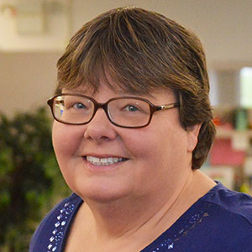
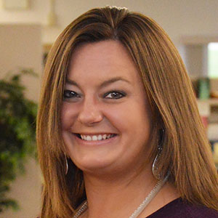
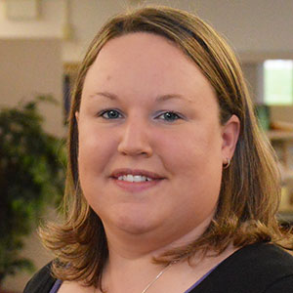
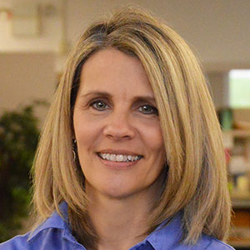
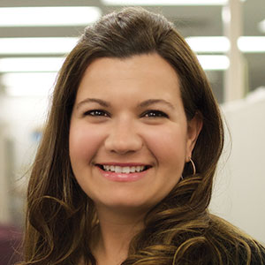
RSE TASC Trainer Team
Pamela Treat-Ulrich NonDistrict Specialist 315-431-8589 ptreat-ulrich@ocmboces.org
Colleen Crisell Transition Specialist 315-433-2639 ccrisell@ocmboces.org
Melissa Fenn Bilingual Special Education
315-431-8472 mfenn@ocmboces.org
Erica Morat Special Education Trainer 315-431-8575 emorat@ocmboces.org
Patty Ordway-Bennett Transition Specialist 315-431-8415 pordway-bennett@ocmboces.org
Tracy James PBIS Behavior Specialist 315-431-8586 tjames@ocmboces.org
Erin Simmons PBIS Behavior Specialist 315-431-8559 esimmons@ocmboces.org
Jackie Burrows Preschool Behavior Specialist 315-431-8475 jburrows@ocmboces.org
Notes:
I’m the coordinator of the Regional Special Education Technical Assistance and Support Center. We are NYSED grant funded and provide support to districts and schools in the Mid-State area on various topics in special education.
Explain each specialists role

Slide 3
Learning Targets
Gain an understanding of the distribution of Students with Disabilities (SWD) across 13 Disability Classifications that make up the SWD population in the OCM BOCES region
Identify new Office of Special Education Initiatives that Impact the Systems under which SWD are Served
State the importance of Specially Designed Instruction for SWD
Identify components of a compliant continuum of service and draw connections between hallmarks of effective practice and the NYS Teaching Standards
Notes:
I’d like everyone to take a moment of “I” time and read our intended targets for the day….
Today is intended to provide you with some general information that you need to effectively supervise the practice of special education teachers.

Slide 4
Notes:
To start we are going to frame our day around who it is we are exactly talking about in terms of the students with disabilities. This chart represents the distribution of students with disabilities across the 13 classification categories in the OCM region. The distribution of SWD in your schools are most likely similar to this.
Take a moment to review this data and then turn to a partner and share why this data is significant.
The data is significant because the majority of students with disabilities have the intellectual functioning required to meet the standards. It’s the unique learning characteristics that result from their disabilities that if not addressed appropriately can hinder their progress in the general education curriculum.
These unique needs need to be met with specially designed instruction and supplemental aids and support as identified on a students IEP. Which we’ll talk a little more about in a moment.
After looking at the make-up of students with disabilities with whom we work, lets take a look at some State initiatives that will impact these students.

Slide 5
What New State Initiatives Impact the Systems under which Students with Disabilities are Educated?
Blueprint for Improved Outcomes for Students with Disabilities
Underlying Beliefs
7 Core Principles
Next Steps for NYSED
Next Steps for Districts
Least Restrictive Environment (LRE)
New York State is 49th in providing services in the Least Restrictive Environment
Board of Regents has voted to continue to look at developing policy around LRE
Notes:
NYSED OSE in consultation with a variety of stakeholder groups across the state has issued a Blueprint for Improved Outcomes for Students with Disabilities. You have a copy of the blueprint in your resource guide. This blueprint was built upon several underlying beliefs. The most important of which is that all teachers are teachers of students with disabilities. While there are many core principals to effective special education programming the State chosen 7 research-based Core principles.
Self-Advocacy and Goal Setting
SDI
Research based teaching and learning strategies
Family and parent engagement
Career development and work-based learning
MTSS for academics and behavior
Inclusive programs and activities
When you look more closely at your blueprints you’ll not that each core principle has several look fors that should be in place if your program is effective in that particular area.
One of the components of special education we will be getting into in just a few minutes is the continuum of service. Its important for you to know that NYS ranked 49th in Least Restrictive Environment. The BOR has decided to look more deeply at developing policy around making sure that students are receiving the services that they need across the continuum with a lens on inclusion.

Slide 6
What does NYS Mean by Special Education?
Part 200.1(ww) Special education means specially designed individualized or group instruction or special services or programs, and special transportation, provided at no cost to the parent, to meet the unique needs of students with disabilities.
Notes:
So what NYS means by special education. If we look at regulatory language we see some key words.

Slide 7
What does NYS mean by Specially Designed Instruction? Part 200.1(vv)
Specially-designed instruction means adapting, as appropriate to the needs of an eligible student under this Part, the content, methodology, or delivery of instruction to address the unique needs that result from the student's disability; and to ensure access of the student to the general curriculum, so that he or she can meet the educational standards that apply to all students.
Notes:
The provision of specially designed instruction and supplementary aids and services are essential components of providing SWD with access to a free appropriate public education in the least restrictive environment. Please take a moment to read this slide. You’ll see some other important words in bold in this definition as well.
Adapting
Content
Methodology
Delivery of Instruction
Access
General Curriculum
Specially designed instruction is not differentiated instruction. Differentiated instruction is for all learners. Its adapting the content, process or product based on a students abilities or preferences. SDI is what a particular student needs above and beyond DI.
Here’s an example:
From the US Dept of Education
In your folders you will find examples of specially designed instruction and supplementary aides and services in the IEP and Lesson Plan Development handbook
You’ll notice that this guide is broken down into areas that a student with a disability may struggle.
Turn to a partner and share 1 way you may use this guide in your evaluation process of special education teachers

Slide 8
How is Specially Designed Instruction Insured?
The provision of specially designed instruction relies on classroom teachers to have intentionally and purposefully planned to match instruction to the needs of the students with disabilities in their classroom.
Specific instructional approaches should be selected and utilized by classroom teachers, in combination with supplemental supports identified in the IEP, such as accommodations, accessible materials, assistive technology, and/or adaptive equipment
In considering and explicitly planning to address the needs of students with disabilities, teachers should identify needed supports, services, accommodations, teaching strategies, learning strategies, etc., that the student may need in each of the following areas:
Content
Materials
Environment
How learning will be measured
How instruction should be provided
Notes:
Keep your IEP and Lesson Planning guide out. One barrier that I’ve observed in many schools and districts that I’ve been in to making sure that students are provided with SDI is that general and special education teachers are not engaging in collaborative planning or communication about the needs of SWD.
When planning for SWD teachers essentially need to look at all parts of a lesson and anticipate the barriers that SWD will come across based on the unique needs as identified in their IEP. Teachers must then insert the appropriate SDI and supplementary aides and services outlined in the IEP into the appropriate portion of the lesson
This template provides a basic format for teachers to share information about SWD to ensure that both general and special education teachers are planning with individual needs in mind.
If you turn to the next page you will see a completed example of this tool. Take a moment of “I” time to it over. Turn to a partner and complete this phrase: This makes sense to me because…

Slide 9
What about the Continuum of Services for Students with Disabilities?
Specially Designed Instruction 200.6(a)(1)
Students with disabilities shall be provided special education in the least restrictive environment, as defined in section 200.1(cc) of this Part. To enable students with disabilities to be educated with nondisabled students to the maximum extent appropriate, specially designed instruction and supplementary services may be provided in the regular class, including, as appropriate, providing related services, resource room programs and special class programs within the general education classroom.
Notes:
Now what about the continuum of service for SWD. Academic instruction for students with disabilities can be provided through a variety services.
Related Services
Consult teacher services
Coteaching services
Resource Room services
Special class services
We are going to take a look at each of these services more in depth by completing 2 activities

Slide 10
Activity 1
Text Coding
You will be assigned a continuum of service in which to focus
Read under the following headings using a text coding procedure:
Purpose
Frequency
Duration
Location
Grouping Class Size and Caseload
Text coding Procedure
Place an + after information that is new to you
Place a ! after information that you feel is important
Place a ? after information that is confusing or that you have a wondering about
Share your Most Important Points (MIP )with your table
Notes:
We are going to now take out Continuum of Service and hallmark of Effective Service Guide.

Slide 11
Activity 2
Crosswalk the Hallmarks of Effective Practice with the NYS Teachers Rubric-
As a small group, read each Hallmark of Effective Practice
Identify the NYS Teaching Standard and Elements that correspond with that practice and record it next to the practice
Share out as a whole group

Slide 12
Closing: Learning Targets MIP
Gain an understanding of the distribution of Students with Disabilities (SWD) across 13 Disability Classifications that make up the SWD population in the OCM BOCES region
Identify new Office of Special Education Initiatives that Impact the Systems under which SWD are Served
State the importance of Specially Designed Instruction for SWD
Identify components of a compliant continuum of service and draw connections between hallmarks of effective practice and the NYS Teaching Standards
Notes:
MIP

Slide 13
Thank You!

