Slide 1
ELL Considerations for Evaluators
December 14, 2015
Facilitator: Tanya Rosado-Barringer, Mid-State RBERN Coordinator

Slide 3
Mid-State RBERN
What is Mid-State RBERN? (Regional Bilingual Education Resource Network)
Technical assistance
Professional Development
Instructional Support
Monitoring and Reviews on behalf of OBE-WL
Resources

Slide 4
Pre-Assessment
Entering
Emerging
Transitioning
Expanding
Commanding
Place yourself in the stage that you feel best represents your
knowledge of English Language Learners

Slide 5
Today’s Objectives
Content:
Review basic ELL/MLL foundational knowledge and information
Identify key expectations about supporting ELLs in the classroom.
Identify ELL considerations in the classroom.
Language:
Orally share and discuss information and key takeaways.
Write down evidence collected from videotaped classroom.

Slide 6
Who are our ELLs?

Slide 7
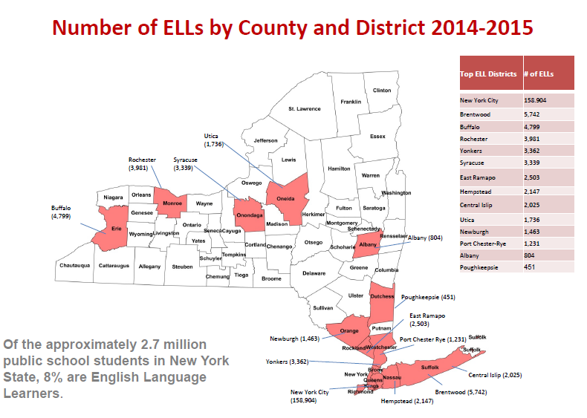
Data provided by the Office of Bilingual Education and World Languages

Slide 8
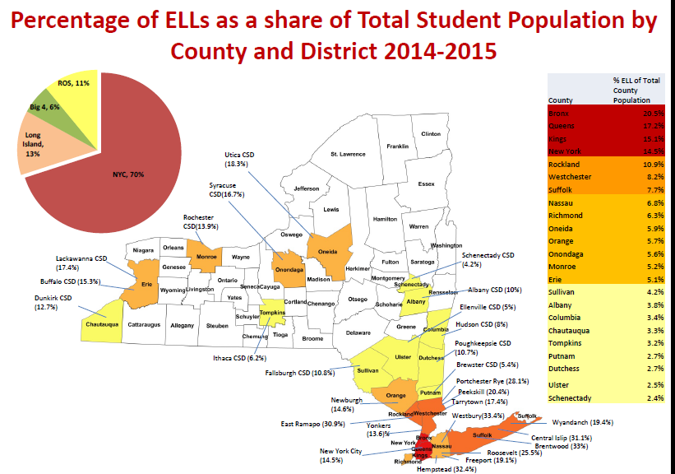
Data provided by the Office of Bilingual Education and World Languages

Slide 9
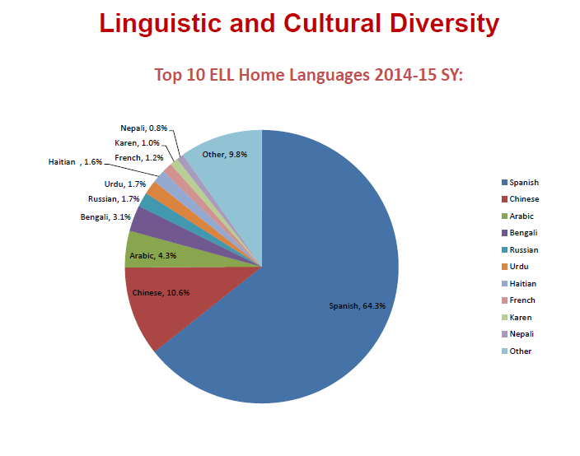
Data provided by the Office of Bilingual Education and World Languages

Slide 10
Data provided by the Office of Bilingual Education and World Languages

Slide 11
Data provided by the Office of Bilingual Education and World Languages

Slide 12
Data provided by the Office of Bilingual Education and World Languages

Slide 13
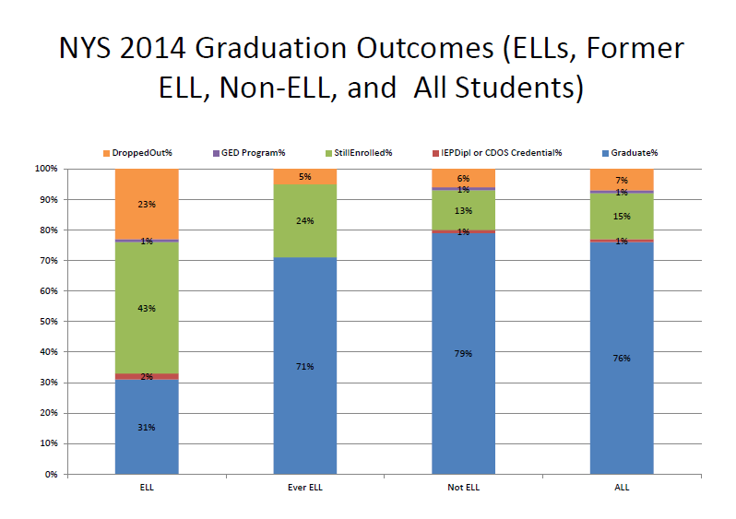
Data provided by the Office of Bilingual Education and World Languages

Slide 14
Key Takeaways
Turn and Talk –
One(1) Key Take Away
Time: 2 minutes

Slide 16
Who are our ELLs?
Motivation and Attitude
Skills in L1/Access to L2
Cultural Background
Peer & Role Models
ELLs
Personality & Learning Styles
Quality Instruction
Language Distance
Age

Slide 17
Expectations for Stakeholders
Clarify expectations for administrators, policy makers, and practitioners;
Provide a framework to prepare ELLs for success for college and career readiness;
Provide guidance, resources, and supports to districts, schools, and teachers
Promote a better understanding and appreciation of Bilingual Education, English as a Second Language, and World Languages/Foreign Language Studies.

Slide 18
Blueprint for ELL Success
The Blueprint is composed of the following 8 principles:
All teachers are teachers of English Language Learners (ELLs) and need to plan accordingly.
All schools boards and districts/school leaders are responsible for ensuring that the academic, linguistic, social, and emotional needs of ELLs are addressed.
Districts and schools engage all English Language Learners in instruction that is grade-appropriate, academically rigorous, and aligned with the New York State Prekindergarten Foundation for the Common Core and P- 12 Common Core Learning Standards.
Districts and schools recognize that bilingualism and biliteracy are assets and provide opportunities for all students to earn a Seal of Biliteracy upon obtaining a high school diploma.
Source: OBE-WL

Slide 19
Blueprint for ELL Success
8 Principles continued:
Districts and schools value all parents and families of ELLs as partners in education and effectively involve them in the education of their children.
District and school communities leverage the expertise of bilingual, ESL, and Language Other Than English (LOTE) teachers and support personnel while increasing their professional capacities.
Districts and school communities leverage ELLs’ home languages, cultural assets, and prior knowledge.
Districts and school use diagnostic tools and formative assessment practices in order to monitor ELLs’ content knowledge as well as new and home language development to inform instruction.

Slide 20
COMMISSIONER’S REGULATION PART 154
AMENDED AREAS OF CR PART 154
Commissioner's Regulation Part 154 establishes the legal requirements for the education of English Language Learners (ELLs) in New York State.
ELL Identification
Parent Notification and Information
Retention of Records
ELL Program Placement
Program Requirements
Provision of Programs
Grade Span
Program Continuity
Students with Disabilities
ELL Exit Criteria
Intervention Support for ELLs
Former ELL Services
Professional Development
School District Planning and Reporting Requirements
Notes:
AREAS OF CR PART 154 REGULATION
These are all areas that CR Part 154 covers.

Slide 21
IMPLICATIONS

Slide 22
Shift in roles for all teachers
Integration of content and language in new language development (Chamot, 2009; Coyle, Hood, & Marsh, 2010; Echevarria, Vogt, & Short, 2012).
The idea behind integrating content and language is that new language development happens most successfully when learners are engaged in authentic content-specific tasks from the very beginning of their exposure to the new language.
(Walqui & Heritage, 2012).

Slide 23
Instruction for ELLs
ELLs can start developing language for academic purposes at the same time that they are developing basic communication skills in their new language (Walqui & Heritage, 2012).
There is no single method or single combination of methods that can successfully support language development for all students.
Therefore, all teachers must have a strong knowledge of multiple methods for teaching ELLs(MLLs) and a strong knowledge of the children in their care so they can create the appropriate balance and methods needed for the children they teach.”

Slide 24
NYS Teaching
Standards
Standard 7
Professional Growth
Notes:
NOTES

Slide 25
NYS Teaching
Standards –
Group Activity – What should you as the lead evaluator be listening and looking for in the classroom that supports an ELL?
Standard 7
Professional Growth
Notes:
NOTES

Slide 26
Standard 1: Knowledge of Students & Student Learning
Knowledge of child development
Knowledge of research…
Knowledge of diverse learning needs
Knowledge of individual students
Knowledge of economic, social
Knowledge of technological literacy…
Ask about the student.
What are the student’s specific needs?
What sub-group of ELL/MLL is the student identified as?
LTE, SWD, Former ELL, Ever ELL, Migrant, Refugee, Newcomer, Ever ELL, SIFE
Language Proficiency in L1 and L2
Are they entering, emerging, transitioning, expanding or commanding?
Literacy Level in L1 & L2
Culture and Languages Spoken
Personal Experiences
Academic Experiences
Notes:
NOTES

Slide 27
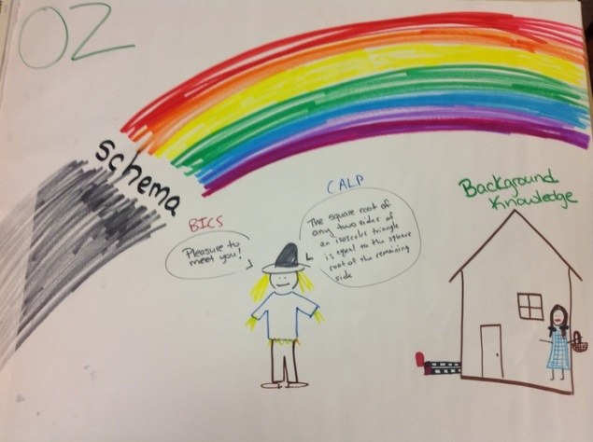
Standard 2: Knowledge of Content & Instructional Planning (1)
Knowledge of content…
Connect concepts across disciplines…
Uses a broad range of instructional strategies
Establishes goals & expectations
Designs instruction
Evaluate / utilize resources
Lesson Preparation
Content objectives clearly defined, displayed, and reviewed with students
Recognized by verbs related to knowledge of the content area: identify, analyze, rank, construct, graph,
divide, solve, visualize, design.
Language objectives clearly defined, displayed, and reviewed with students
Address the language needed to engage with the academic content, perform classroom tasks, and achieve the content objectives: read, write, listen, list, tell, discuss, journal, record, persuade, debate, draft
Also key vocabulary, language functions, and language learning strategies.
(SIOP) (Echevarria, Vogt, & Short, 2000; 2004; 2008)
Notes:
NOTES

Slide 28
Standard 2: Knowledge of Content & Instructional Planning (2)
Knowledge of content…
Connect concepts across disciplines…
Uses a broad range of instructional strategies
Establishes goals & expectations
Designs instruction
Evaluate / utilize resources
Content concepts appropriate for age and educational background level of student
Supplementary materials used to a high degree, making the lesson clear and meaningful (e.g., computer programs, graphs, models, visuals)
Adaptation of content (e.g., text, assignment) to all levels of student proficiency
Meaningful activities that integrate lesson concepts (e.g., surveys, letter writing, simulations, constructing models) with language practice opportunities for reading, writing, listening, and/or speaking
(SIOP) (Echevarria, Vogt, & Short, 2000; 2004; 2008)
Notes:
NOTES

Slide 29
Standard 2: Knowledge of Content & Instructional Planning (3)
Knowledge of content…
Connect concepts across disciplines…
Uses a broad range of instructional strategies
Establishes goals & expectations
Designs instruction
Evaluate / utilize resources
Common –Core based instruction
o Differentiated using instruction aligned with Bilingual Common Core Progressions
o Ensuring understanding and essential vocabulary and highlight them in instruction
Deliver meaning based instruction “Authentic”
o Use text to represent ideas and concepts that students understand and can say
Building Background
Concepts explicitly linked to students' background experiences
Links explicitly made between past learning and new concepts
Key vocabulary emphasized (e.g., introduced, written, repeated, and highlighted for students to see)
(SIOP) (Echevarria, Vogt, & Short, 2000; 2004; 2008)
Notes:
NOTES

Slide 30
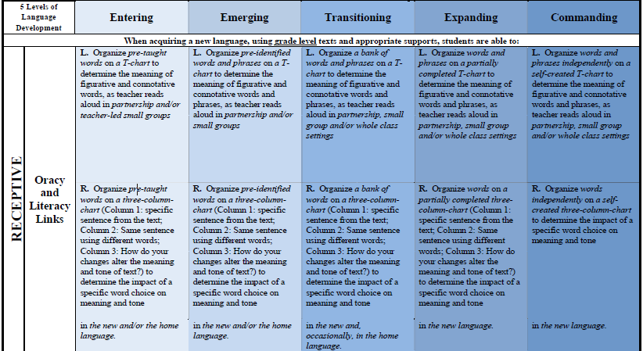
Example of Performance Indicators in New Language Arts Progressions
Source: https://www.engageny.org/resource/new-york-state-bilingual-common-core-initiative

Slide 31
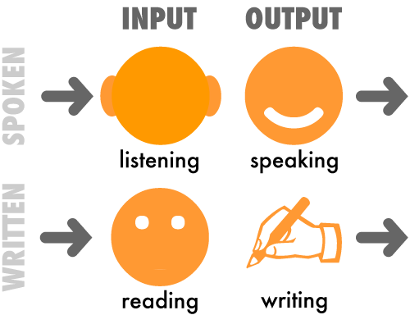
Standard 3: Instructional Practice
Research-based practices
Communicates clearly…
High expectations…
Variety of instructional… to engage student
Engage students in multi-disciplinary skills
Monitor and assess progress
Practice and Application
Hands-on materials and/or manipulatives provided for students to practice using new content knowledge
Activities provided for students to apply content and language knowledge in the classroom
Activities integrate all language skills (i.e., reading, writing, listening, and speaking)
(SIOP) (Echevarria, Vogt, & Short, 2000; 2004; 2008)
Notes:
NOTES

Slide 32
Standard 3: Instructional Practice
Research-based practices
Communicates clearly…
High expectations…
Variety of instructional… to engage student
Engage students in multi-disciplinary skills
Monitor and assess progress
Strategies
Ample opportunities provided for students to use learning strategies
Scaffolding techniques consistently used assisting and supporting student understanding (e.g., think-alouds)
A variety of questions or tasks that promote higher-order thinking skills (e.g., literal, analytical, and interpretive questions)
Interaction
Frequent opportunities for interaction and discussion between teacher/student and among students, which encourage elaborated responses about lesson concepts
Grouping configurations support language and content objectives of the lesson
Sufficient wait time for student responses consistently provided
Ample opportunities for students to clarify key concepts in L1 as needed with aide, peer, or L1 text
(SIOP) (Echevarria, Vogt, & Short, 2000; 2004; 2008)
Notes:
NOTES

Slide 33
Standard 3: Instructional Practice
Research-based practices
Communicates clearly…
High expectations…
Variety of instructional… to engage student
Engage students in multi-disciplinary skills
Monitor and assess progress
Strategies
Ample opportunities provided for students to use learning strategies
Scaffolding techniques consistently used assisting and supporting student understanding (e.g., think-alouds)
A variety of questions or tasks that promote higher-order thinking skills (e.g., literal, analytical, and interpretive questions)
Interaction
Frequent opportunities for interaction and discussion between teacher/student and among students, which encourage elaborated responses about lesson concepts
Grouping configurations support language and content objectives of the lesson
Sufficient wait time for student responses consistently provided
Ample opportunities for students to clarify key concepts in L1 as needed with aide, peer, or L1 text
(SIOP) (Echevarria, Vogt, & Short, 2000; 2004; 2008)
Notes:
NOTES

Slide 34
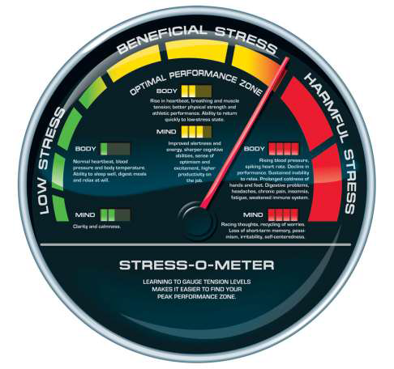
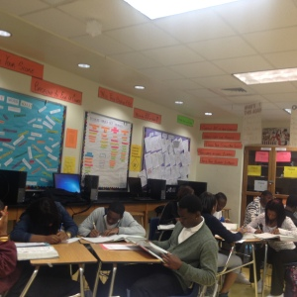
Standard 4: The Learning Environment
Creates a respectful, safe and supportive environment
Creates an intellectually stimulating environment
Manages the learning environment
Organize and utilize available resources (e.g. physical space, time, technology…)
Create a print-rich classroom environment which reflects the ELL’s cultures and languages.
Keep anxiety
low.
The physical room is used as a resource for students in their (independent) work.
(SIOP) (Echevarria, Vogt, & Short, 2000; 2004; 2008)
Notes:
NOTES

Slide 35
Standard 5: Assessment for Student Learning
Range of assessment tools
Understand, analyze, use data for differentiation*
Communicates assessment system*
Reflect upon assessment system and adjust*
Prepare students for assessments
* - assessed through “multiple measures”
Review and Assessment
Comprehensive review of key vocabulary
Comprehensive review of key content concepts
Regular feedback provided to students on their output (e.g., language, content, work)
Assessment of student comprehension and learning of all lesson objectives (e.g., spot checking, group response) throughout the lesson
NYSITELL
NYSESLAT
Regents Exams
Home Language & New Language Arts Assessments
Literacy & Math Assessments
(SIOP) (Echevarria, Vogt, & Short, 2000; 2004; 2008)
Notes:
NOTES

Slide 36
Standard 6: Professional Responsibilities
Upholds standards and policies
Collaborate with colleagues
Communicate & collaborate with families
Perform non-instructional duties
Complies with laws and polices
Language Development
Cultural Competency
ELL Specific Needs
CR PART 154
Bilingual Common Core Progression
Blueprint for ELL Success
Parent Outreach
Co-Teaching/PBL
Notes:
NOTES

Slide 37
Standard 7: Professional Growth
Language Development
Cultural Competency
ELL Specific Needs
Bilingual, ESOL & LOTE staff
Reflect on practice
Set goals for professional development
Communicate and collaborate to improve practice
Remain current in knowledge of content and pedagogy
Notes:
NOTES

Slide 38
BURNING QUESTIONS

Slide 39
Post Assessment
Entering
Emerging
Transitioning
Expanding
Commanding

Slide 40
Contact Information
Mid-State Regional Bilingual Education Resource Network (RBERN) at
OCM BOCES Rodax Bldg. #7 P.O. Box 4774 – 6075
East Molloy Road Syracuse, New York 13221 Tel: (315) 433-2664 or 2610 Fax: (315) 431-8449
Coordinator: Tanya Rosado-Barringer Email: tbarringer@ocmboces.org
Web page: http://rbern.ocmboces.org
Mid-State Regional Special Education Technical Assistance Support Centers (RSE TASC) at OCM BOCES 6075 East Molloy Road PO Box 4774 Syracuse, NY 13221 315-433-2645 Fax: 315-431-8495
Coordinator: Janel Payette
Email: jpayette@ocmboces.org
Melissa Fenn, Bilingual Special Education Specialist
Email: mfenn@ocmboces.org
Web page:
http://www.ocmboces.org/teacherpage.cfm?teacher=1438

Slide 41
RESOURCES
SED – Office of Bilingual Education Website
http://www.p12.nysed.gov/biling/
Mid-State RBERN
http://rbern.ocmboces.org/
New York State TESOL
www.nystesol.org
New York Association of Bilingual Education
www.nysasbe.net
EngageNY
http://engageny.org
www.Edchange.org
http://www.colorincolorado.org
http://EverythingESL.net
http://readwritethink.org
http://www.tolerance.org/
CUNY NYSIEB
http://www.nysieb.ws.gc.cuny.edu/
Center for Applied Linguistics
http://www.cal.org/
WIDA
www.wida.us

