Slide 1
BCIC Meeting
June 2014

Slide 2
Welcome
Introductions
Overview of Agenda

Slide 3
SED Update
June 2014

Slide 4
SED Updates

Slide 5
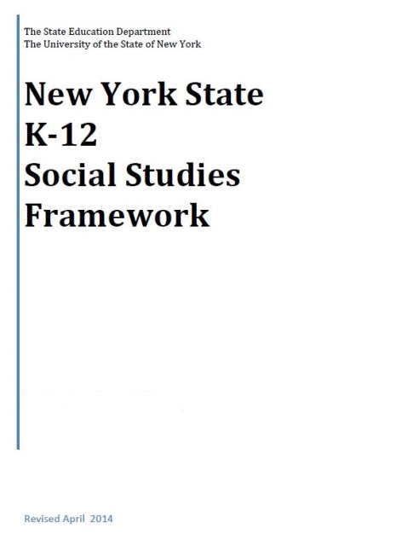
NYS K-12 Social Studies Framework
Adopted April 2014
Intended to serve as a guide for local districts to develop Social Studies curriculum

Slide 6

Science Standards
?
Some sort of study group or task force may be formed this summer to consider the issue. Other than that, no action.

Slide 7
Now What? Life After RTTT
Five recommendations made to SED:
Redefine College, Career & Citizenship Readiness
Sustained (non-competitive) funding for PD
Instructional technology not testing technology
Provision of a “Road Map”
DDI for instruction not accountability

Slide 8
Now What? Life After RTTT
Also, three things for next year, with or without SED’s coordinated leadership:
Social Studies
Literacy in the Content Areas/Technical Subjects
Support for principals as instructional leaders

Slide 9
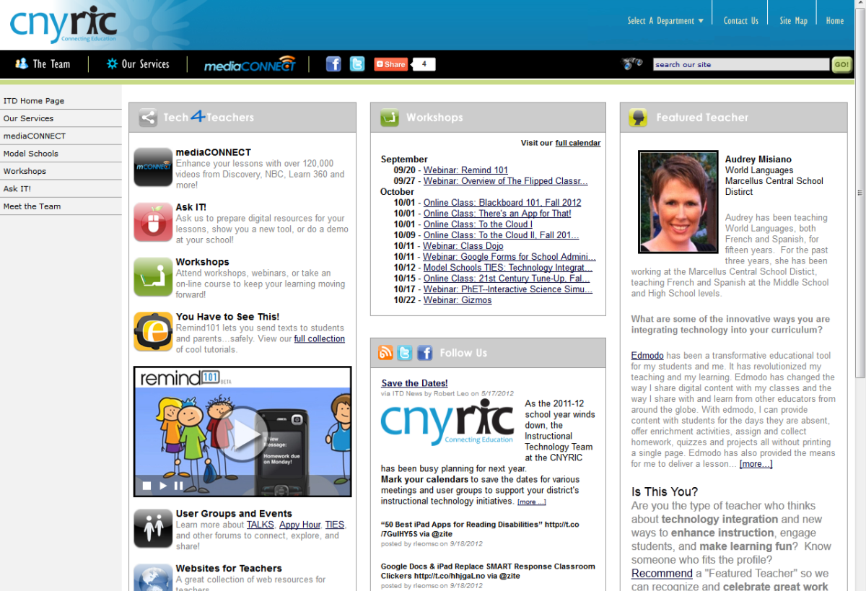
ITD

Slide 10
CI&A Summer 2014- registration remains active for these confirmed sessions
Standards and Teaching Practice
  Supporting All Students through Differentiation and Scaffolding- July 1
  PBL 102- Integrated Course- July 24 (ongoing for the year)
  Geometry: Analysis and Implementation- July 25
  Singapore Math Mash- August 18
Culture
  Revised Responsive Classroom- August 19-22
Data Inquiry
  Reenergizing your PLC- August 20-21

Slide 11
CI&A Looking to the
Regional sessions continue to be included
On-site days increase by .5 days for CI&A but decrease by 2 for Network Team
Individual district planning for 14-15 will be scheduled for late July- October.
Oct 24- Common Superintendent Day: will have limited capacity for district work (literacy and math). Please schedule by the end of August (after that we will register remaining staff to attend Turn Your RTI Upside Down).

Slide 12
Summer: CI&A and
Network Team
Please note that registration is reviewed June 13 to decide if enrollment is adequate

Slide 13
Building a Positive Learning Culture
Responsive Classroom has been updated and redesigned
August 19-22

Slide 14
Teaching and Learning
Supporting All Students through Differentiated Instruction and Scaffolding- July 1.
Research to Deepen Understanding- Designed especially for grades 6-12 ELA and library media specialists implementing instructional shifts for close reading and writing evidence based claims. July 15 at the North location or July 17 at the South location.

Slide 15
Teaching and Learning: Math
Geometry Analysis and Implementation: July 25 and Aug 15. Come once or both times!
Algebra 1 Reflection and Plan: July 18 or August 8.
Teachers of Grades 6-8: Reflection, Refining and Moving Forward is July 15 and 16.
Teachers of Grades 3-5: Reflection, Refining and Moving Forward is July 22-23.
Teachers of Grades K-2: Reflection, Refining and Moving Forward is July 29-30.
And for teachers of math K-8 wishing to extend or develop competency and proficiency with Singapore Math Strategies, join the Singapore Math Mash August 18.

Slide 16
Teacher Centers
New Teacher Welcome Project
September 11th
SUNY Oswego Phoenix Center
Joint Oswego/OCM/Oswego-CNY Teacher Center Project
No cost for participation

Slide 17
Higher Education

Slide 18
CNY NYS ASCD
2014-2015
Theme TBA
Dates TBA

Slide 19
ISS News
Instructional Support Services Updates
School Library System
Science Center
RSE TASC
SE SIS

Slide 20
District Sharing

Slide 21

FM Writes
District Curriculum Council
2012-present
BCIC June 2014

Slide 22
Why?
“…include all teachers in literacy development. Teachers in all content areas should expect high quality written work from students. This demands system-wide thinking and an uncompromised approach to implementation.”
Dr. Corliss Kaiser, Fayetteville-Manlius CSD
Opening Statement, August 2012
"Writers need this sense of fullness, of readiness to write, of responsiveness. It can come from storytelling, it can come from shared responses to literature. . . any type of literature. However it comes, writing is terribly important.“
Lucy Calkins, Columbia University
“ Your subject is so important it’s worth writing about.”
Dr. Douglas Reeves, Leadership and Learning Center
Common Core Anchor Standards for Writing

Slide 23
What currently exists (ed)?
Exemplary Writing Instruction
Curriculum Projects, Past and Present
Curriculum Maps
FM Writing Standard
K-12 Writing Folders
Digital Portfolios
Professional Contacts

Slide 24
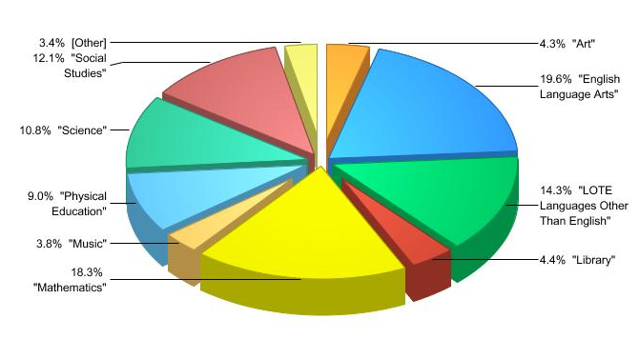
Maps with “writing”
By Department…

Slide 25
DCC Inventory:
Discuss at Departments…
How can DCC members gauge what currently exists in writing in all department/grade levels…?
What are teacher needs, i.e.- PD, Instructional materials?
Recommendations for DCC?

Slide 26
District Curriculum Council
FM WRITES: SYNTHESIS OF RECOMMENDATIONS
1. Writing Rubrics
Create short (2pt) and refine extended (4pt), Dissemination, Talking Points
2. Writing Anchors
Establish a library of anchors, organized by domain and grade level
Plan for the sharing and use of anchors
3. FM Writes In-services
4. FM Writes Parent Communication
5. FM Writes Informational Video
6. Rubicon Atlas Widget

Slide 27
FM Writes In-service Courses
LA 139 Measurement Through the Common Core: Writing Practices and Assessment
LA 140 New Ways to Incorporate Writing Into All Areas
LA 141 Take Off Running With Checklists
LA 142 Rethinking Research: Writing Ideas for All Classrooms
LA 143 Struggling Writers: Why Writing Makes Students Writhe
LA 164 What Goes Into Digital Portfolios

Slide 28
Rubicon Atlas Widget
Anchors

Slide 29
Questions?

Slide 30
Next Up: [this could be you]
September:
October:
November:
It could always be a surprise!

Slide 31
Race To The Top
(the Regents Reform Agenda)

Slide 32
Standards

Slide 33
CCLS Implementation
Continue to update the curriculum and assessment chart
In the fall, we will have ELA and math roundtable discussions (like we did this year)

Slide 34
Data-Driven Instruction

Slide 35
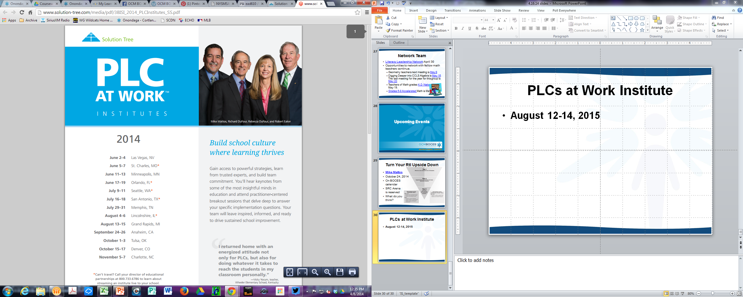
Reenergize your PLC
Two day event
August 20 and 21 to reenergize, refresh and refocus your PCL.
Sessions will build upon work from 2014 summer conference, highlight journeys from other teams and offer resources to continue to develop your team.
Preview: August 2015 Solution Tree returns! Will your team be ready?

Slide 36
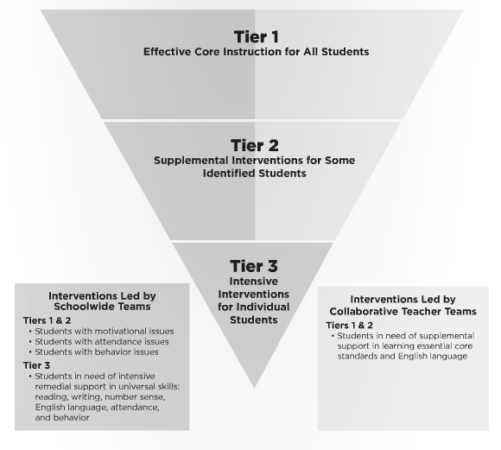
Turn Your RtI Upside Down
Mike Mattos
October 24, 2014
SRC Arena (lunch & materials)
$35 components
$65 non-components
Registration up
(group registration is available)

Slide 37
PLCs at Work Institute
August 12-14, 2015
OnCenter and Civic Center

Slide 38
PLC Coaching
Building CI&A Coaching Capacity
Solution Tree training our coaches
Working with Superintendent of Adlai Stevenson High School District

Slide 39
District Assessment Project
So far…
The importance of a good, widely-understood rationale for any initiatives
Four approaches to assessment audits:
  Equity
  Thematic
  Quantity Reduction
  High Stakes Focus

Slide 40
Assessment Academy (RFP)
RFP Being Submitted
Participating districts:
  Baldwinsville
  Cortland
  Liverpool
  North Syracuse
  West Genesee
CI&A Capacity for replication

Slide 41
Professional Practice

Slide 42
2014-15 Lead Evaluator Training
Three sessions is the right amount, complete in March
Four options (Cortland and Syracuse) is good
More people mentioned following one teacher was nice, but others did suggest watching multiple teachers (at multiple levels, and quality)
You can never do too much Growth Producing Feedback
Do more with crucial conversations
More work with different forms of evidence
Articles that can also be used with staff
Could there be some aspects of the training done on-line? Flip some
Watch videos of principals in action with teachers
Moving teachers from effective to Highly effective
District sharing
District team work (work done by district team – maybe flip this or HW)

Slide 43
2014-15 Principal Evaluator Training
Three sessions is the right amount
After the CSA meetings works
Keep up the research updates
Watching videos of principals doing their thing is helpful (with conversation)
Articles and discussion
Connect with principals – what are they thinking and needing?

Slide 44
2014-15 Principal Support
Themes Have Been identified:
PBL
Instructional leadership
Time management
Growth Producing Feedback
Crucial Conversations

Slide 45
Culture

Slide 46
Bill Daggett Returns
Thursday, September 25 Day Sessions Baker HS, Baldwinsville | Thursday, September 25 Evening BoE Session Homer Jr High School | Friday, September 26 Day Sessions AM: Cortland JrSr HS PM: Homer Jr HS
Baldwinsville Lyncourt Solvay | Homer Fayetteville-Manlius McGraw | Cortland (am) McGraw (am) Homer (pm) DeRuyter (pm) Cincinnatus (pm) Marathon (pm) LaFayette (pm)

Slide 47
Long-term Planning

Slide 48
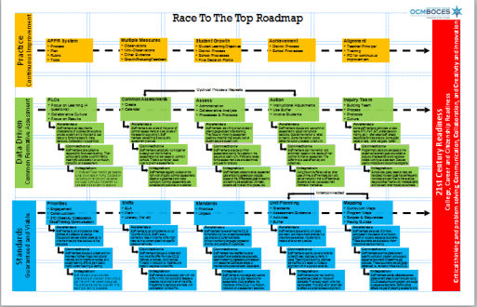
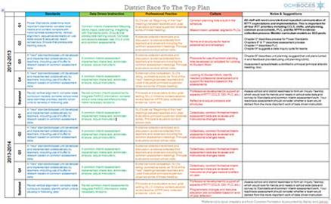
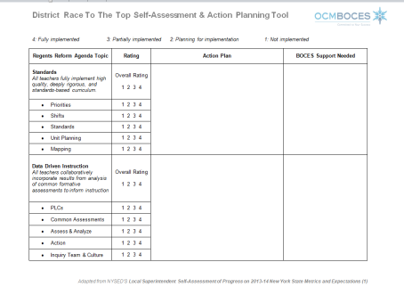
Long-term Planning Evaluation: A Protocol

Slide 49
Regional Vision

Slide 50
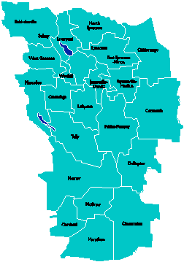
A Vision for Education in
Central New York
College, Career
& Citizenship Readiness
Notes:
Talk about where this vision came from. While it is Colleen and Jeff presenting, the Student Services committee and others have been visiting schools, talking about the future, and developing this vision. In the midst of all the compliance stuff like SLOs, and vested interest, and APPR, it’s been re-invigorating to think about the future and to think about our kids and their future.

Slide 51
Pre-Service Teacher Training
Early College and Dual Enrollment
Professional
Development
School:
Visitations
Observation
Training
(Buck Institute
and NTN)
Coaching
Co-teaching
PBL^{NY}
New Tech Network Model
New Tech High School
CNY New Tech High School in Cortland County
OCM BOCES Programs
Innovation Tech at the Career Academy
District/School-Based
Integrated PBL Courses
Baldwinsville School-
within-a-School
Standards (CCLS, NGSS, SS Framework, NYS Teaching Standards, 4Cs, ISTE, etc.)
Business Partnerships
Notes:
Update on all three of these

Slide 52

Transformation of the Career Academy
September 2014
Begin with grades 9 & 10
Students in grades 11 & 12 complete the Career Academy program, including CTE
Summer 2014-Redesign space to support Innovation Tech model
InnovationTech.us

Slide 53
Central New York New Tech High School
Multiple districts
Location: Hartnett Elementary in Truxton (Homer)
September 2016
Begin with grades 9 & 10
CNY NTH

Slide 54
A Vision for Education in CNY
Teaching that Engages
Culture that Empowers
Technology that Enables

Slide 55

Project Based Learning

Slide 56
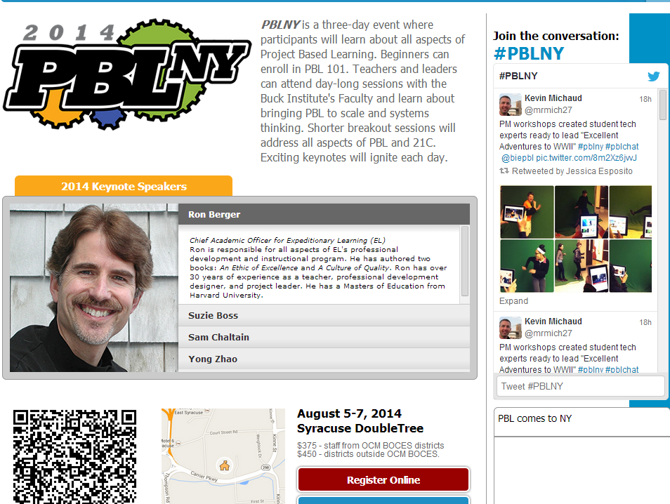

Slide 57
Project Based Learning
Training:
  PBL 101: Regional or on-site
  101s Scheduled for fall
Coaching:
  Full Implementation Model: 40 on-site days
  Can customize to 20-30 days on-site
  Scheduling NOW
Turnkey:
  Support for district facilitators to build capacity within districts. Teams of up to five ($8700 for component districts).

Slide 58
PBL 102:
Integrated Course
Preparation and support for transdisciplinary courses.
Will be offered for ELA/Humanities and ELA/Science.
Both sessions start July 24.

Slide 59
Business/Community Partnerships
Redefining the relationship
One of the biggest challenges to good PBL
October 17th “speed-dating” event at the Doubletree – hold the date

Slide 60
Assessment

Slide 61
Scoring Debriefing
How did things go?
Regional scoring?
Shipping the papers out?

Slide 62
CCLS Regents Exams
Early anecdotal feedback:
Algebra 1 no surprises
ELA 11 was hard
How about our districts?

Slide 63
Regents Scoring
Heads-up:
Culture issues continue to be problematic
Test security office doing surprise visits
Proctor training
Scoring
Papers near 65

Slide 64
BCIC Meeting
NEXT
September 11, 2014
Rodax 8 Large Conference Room

