Slide 1
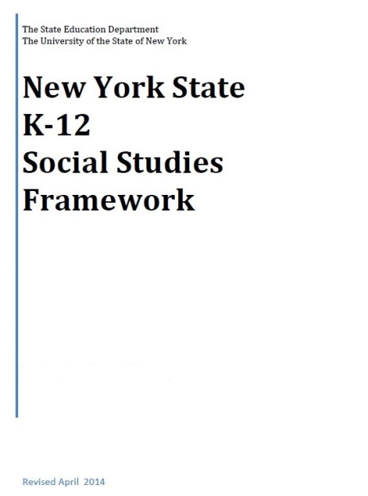
NYS K-12 Social Studies Framework
Adopted April 2014
Intended to serve as a guide for local districts to develop Social Studies curriculum

Slide 2
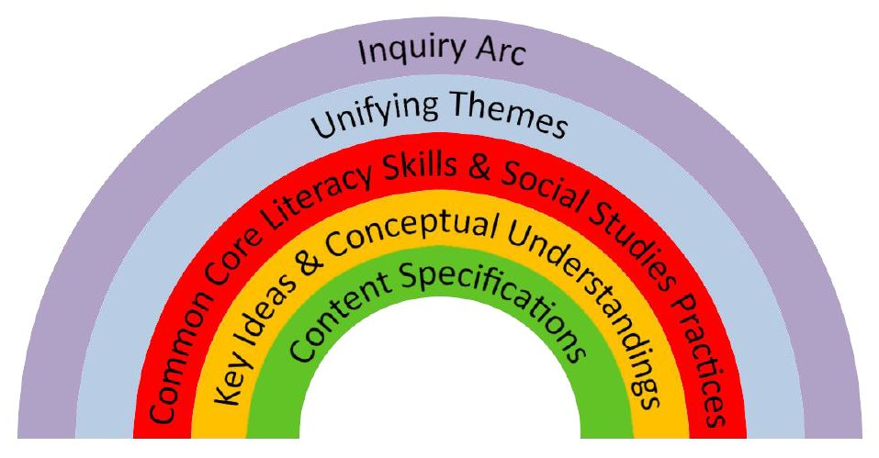
The Framework
Emphasis on:
Balance of content and skills
Civics and preparing students for citizenship and to take informed action

Slide 3
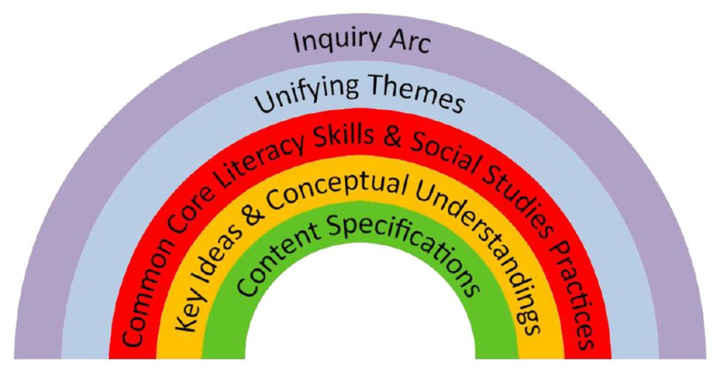
The Framework
Inquiry Arc (NCSS C3 Framework )
Developing questions and planning inquiries
Applying disciplinary concepts and tools
Evaluating sources and using evidence
Communicating conclusions and taking informed action
SKILLS
Notes:
NCSS – National Council for the Social Studies

Slide 4
The Framework
Unifying Themes (NCSS)
Individual Development and Cultural Identity
Development, Movement, and Interaction of Cultures
Time, Continuity, and Change
Geography, Humans, and the Environment
Development and Transformation of Social Structures
Power, Authority, and Governance
Civic Ideals and Practices
Creation, Expansion, and Interaction of Economic Systems
Science, Technology, and Innovation
Global Connections and Exchange
CONTENT

Slide 5
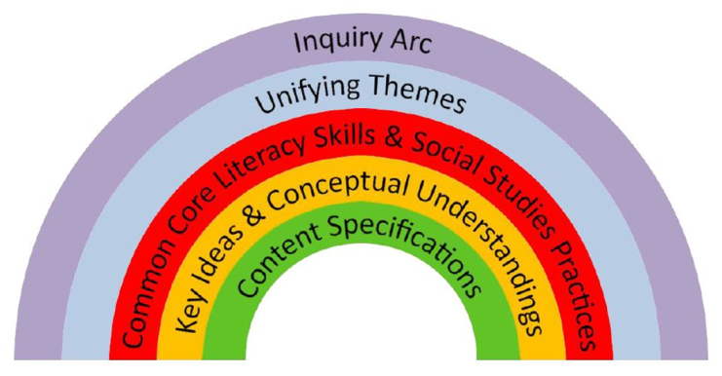
The Framework
New York State Common Core Learning Standards
Reading, Writing, Speaking and Listening
Literacy in History/Social Studies 6-12 (with addition of grade 5 to the 6-8 band)

Slide 6
The Framework
Social Studies Practices
Gathering, Using, and Interpreting Evidence
Chronological Reasoning and Causation
Comparison and Contextualization
Geographic Reasoning
Economics and Economics Systems
Civic Participation

Slide 7
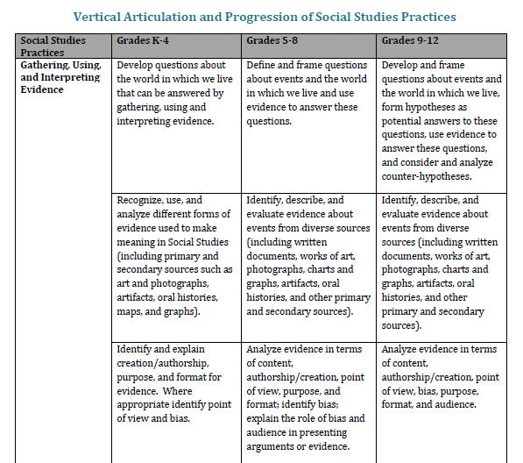
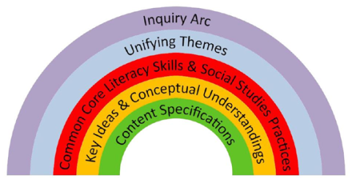
The Framework
Vertical Articulation of Social Studies Practices K-12

Slide 8
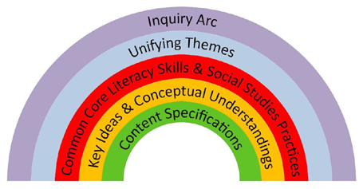
The Framework
Social Studies Learning Standards and Core Curriculum for Social Studies
History of the United States and New York
World History
Geography
Economics
Civics, Citizenship, and Government

Slide 9
Content Sequence
Kindergarten Self and Others
Grade 1 My Family and Other Families, Now and Long Ago
Grade 2 My Community and Other United States Communities
Grade 3 Communities around the World
Grade 4 Local History and Local Government
Grade 5 The Western Hemisphere
Grade 6 The Eastern Hemisphere
Grade 7 History of the United States and New York – I
Grade 8 History of the United States and New York – II
Grade 9 Global History and Geography – I
Grade 10 Global History and Geography – II
Grade 11 US History and Government
Grade 12 PIG/Econ

Slide 10
The Framework
Key Ideas
Aligned to standards
Conceptual Understandings
More specific
Content Specifications
“Students will…” statements
Larger perspectives, trends, and issues
8-12 per grade level
Enduring understandings
2-7 per Key Idea
Focus of teaching and learning
Specific content that can be taught

Slide 11
Field Guide
Released Summer of 2014
Guidance about how to integrate social studies content, practices, and CCLS in the context of rigorous, inquiry-driven instruction.

Slide 12
Regents Assessments
No precise timetable not changing until at least 2017
Don’t know what re-design will look like
Conversations are just beginning

Slide 13
Next Steps for Districts
Consider the Field Guide this summer
Begin to have conversations with Social Studies staff about implications
Consider implementing small pieces, especially the skills (Inquiry Arc and Social Studies Practices)
Aim for larger commitment of resources during Summer 2015 – assessments and resources will be clearer

