Slide 1
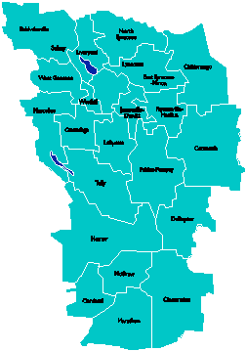
A Vision for Education in Central New York
College, Career & Citizenship Readiness

Slide 2
What if…
… all students were motivated?
… all students were engaged?
… all students were ready for college and career?
… all students earned some college credit?
… all students could communicate? Collaborate? Think critically? Creatively solve problems?

Slide 3
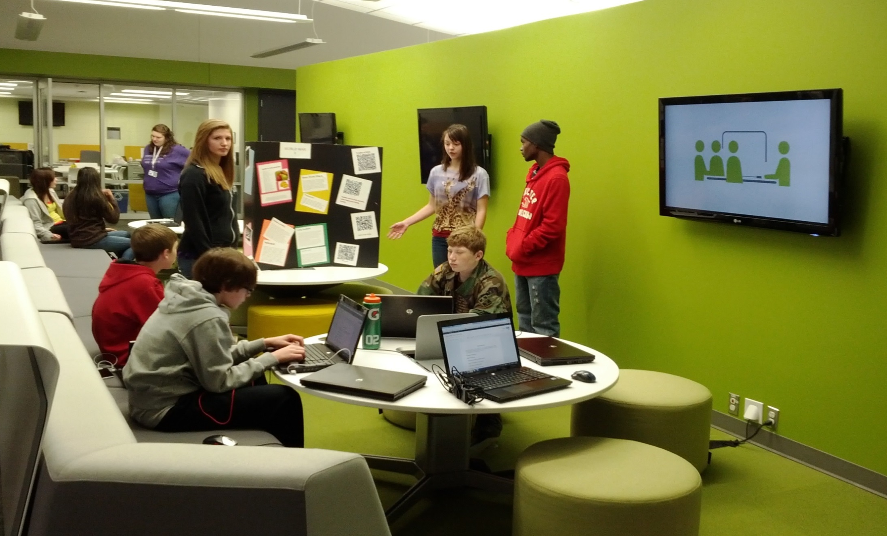
What Might that Look Like?

Slide 4
High School of the Past
Knowledge
History
Biology
Chemistry
Physics
Math
Literacy
Economics
Government
Culture
Current events

Slide 5
High School of the Future
Skills
Collaboration
Critical thinking
Communication
Creativity
Problem solving
Technology
Literacy
Numeracy
Researching
Time management
Knowledge
History
Biology
Chemistry
Physics
Math
Literacy
Economics
Government
Culture
Current events
Attributes
Persistence
Resilience
Patience
Self-worth
Confidence
Adaptability
Curiosity
Flexibility
Risk taking
Responsibility
Agency

Slide 6
A Vision for Education in CNY
Teaching that Engages
Culture that Empowers
Technology that Enables

Slide 7
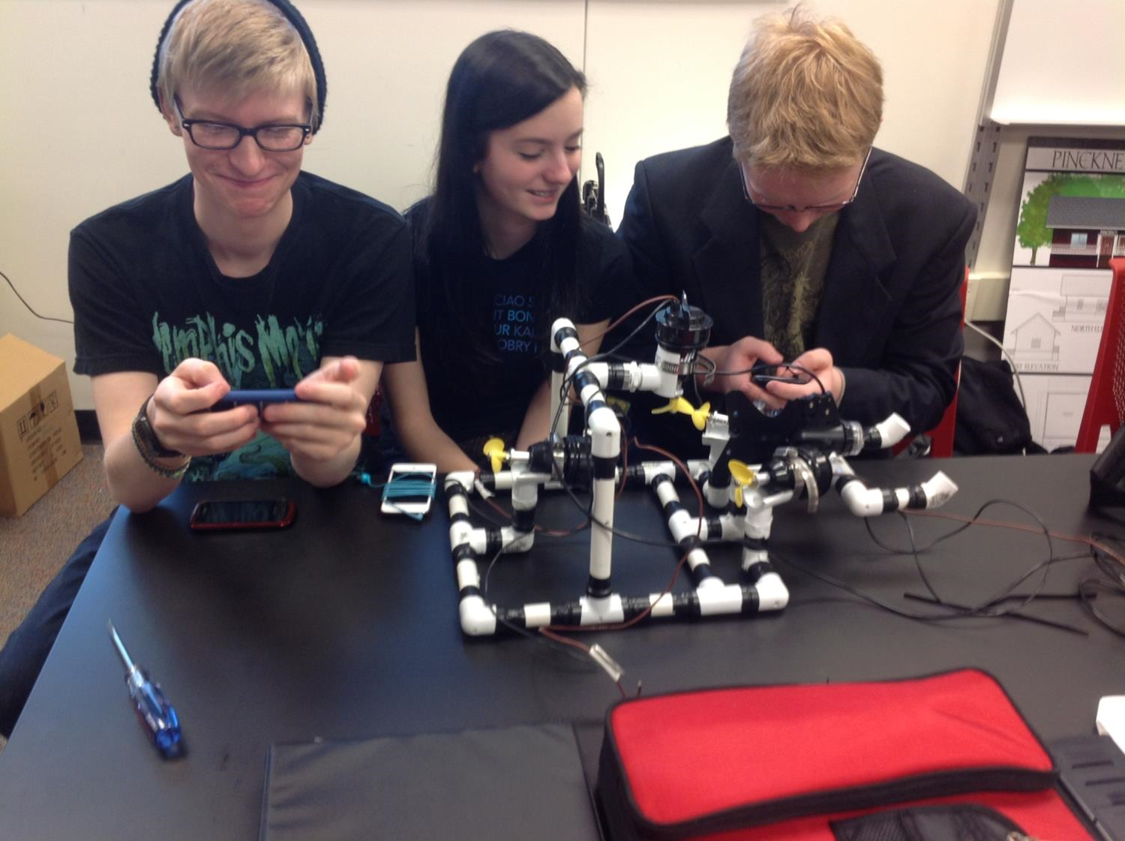
Teaching that Engages

Slide 8
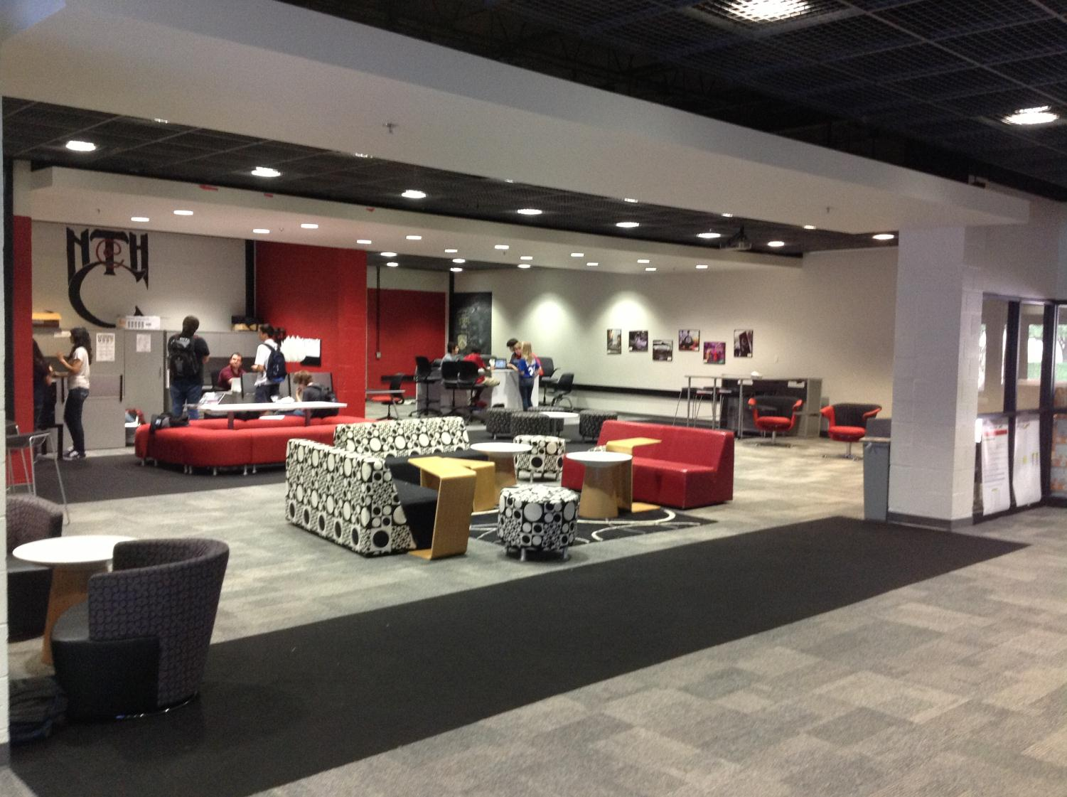
Culture that Empowers
Notes:
Facilities can enhance the learning environment, especially if it “looks” like college and career environments. We saw newer facilities and older facilities – both work as long as space is flexible and allows for larger, integrated classes and student collaboration spaces.

Slide 9
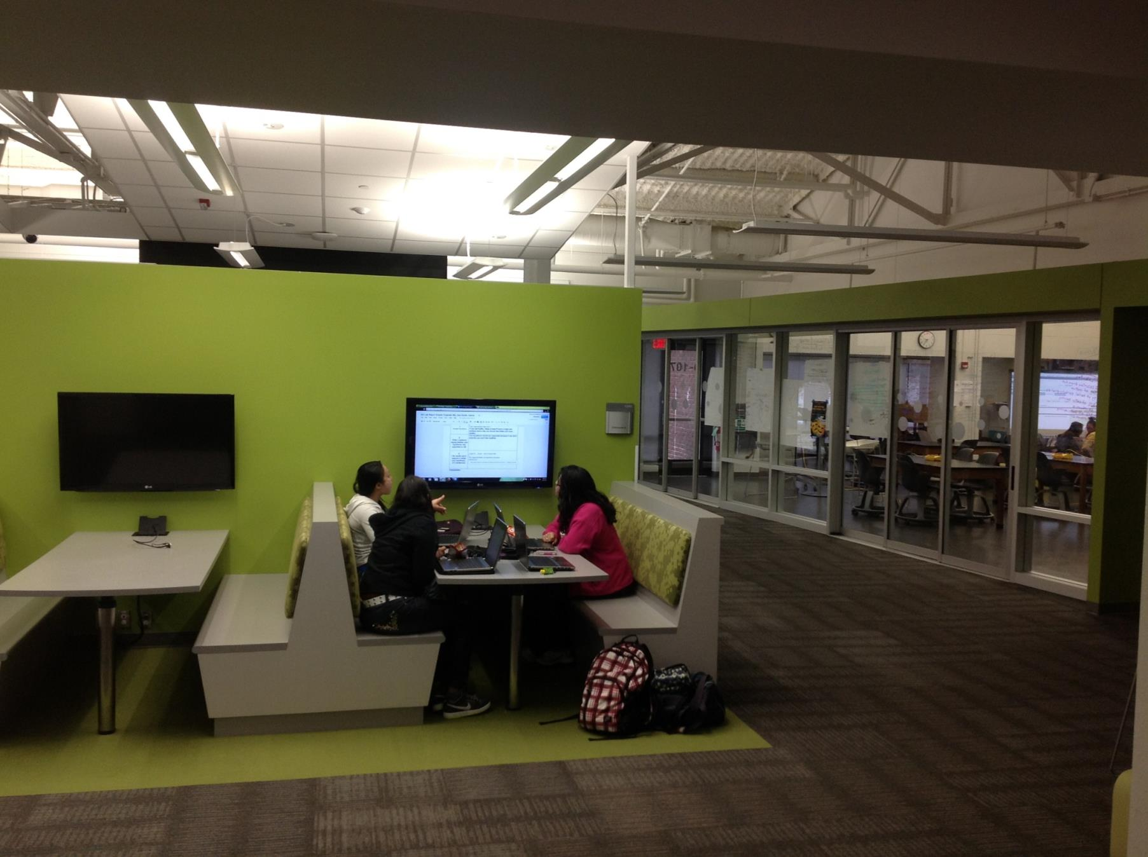
Technology that Enables
Notes:
Collaborative spaces that emulate how people collaborate and use technology in college and career settings

Slide 10
Pre-Service Teacher Training
Early College and Dual Enrollment
Professional Development
School:
Visitations
Observation
Training (Buck Institute and NTN)
Coaching
Co-teaching
PBL^{NY}
New Tech Network Model
New Tech High School
CNY New Tech High School in Cortland County
(opening September 2016)
OCM BOCES Programs
Innovation Tech at the Career Academy (opening September 2014)
District/School-Based
Integrated PBL Courses
Future School Adoption
Standards (CCLS, NGSS, SS Framework, NYS Teaching Standards, 4Cs, ISTE, etc.)
Business Partnerships
Notes:
Update on all three of these

Slide 11
What is Project-Based Learning?
Project-based learning hails from a tradition of pedagogy which asserts that students learn best by experiencing and solving real-world problems. According to researchers, project-based learning essentially involves the following:
students learning knowledge to tackle realistic problems as they would be solved in the real world
increased student control over his or her learning
teachers serving as coaches and facilitators of inquiry and reflection
students (usually, but not always) working in groups
Edutopia.org

Slide 12
What is Project-Based Learning?
These inquiry-based teaching methods engage students in creating, questioning, and revising knowledge, while developing their skills in critical thinking, collaboration, communication, reasoning, synthesis, and resilience.
Barron & Darling-Hammond, 2008

Slide 13
Research indicates that PBL…
has a positive effect on student content knowledge and the development of skills such as collaboration, critical thinking, and problem solving;
benefits students by increasing their motivation and engagement
is challenging for teachers to implement, leading to the conclusion that teachers need support in order to plan and enact PBL effectively while students need support including help setting up and directing initial inquiry, organizing their time to complete tasks, and integrating technology into projects in meaningful ways
Brush & Saye, 2008; Krajcik, et al., 1998

Slide 14
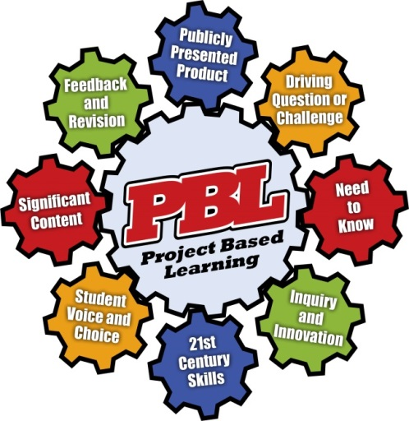
The Eight Essential Elements of PBL

Slide 15
What is PBL?
Notes:
15

Slide 16
Students are challenged to solve a relevant, real-world problem or issue within the context of a course
The Driving Question drives the curriculum and student inquiry
A good Driving Question makes a project intriguing, complex, and problematic
Driving
Question
or
Challenge
How can we as Urban Planners develop a plan to revitalize our downtown area?
Notes:
A great driving question:
is open-ended
stimulates more questions
is real world based
incorporates multiple standards
For the teacher:
A DQ helps to initiate and focus the inquiry--the teaching and learning.
It also captures and communicates the purpose of the project in a succinct question.
It helps to guide planning and reframe standards or big content and skills.
For the student:
Ultimately, the driving question is for the students.
It creates interest and a feeling of challenge so that even the most reluctant student thinks, "Hmmm, I guess that sounds cool."
It guides the project work. All work for the project, including the culminating project and daily lessons and activities, should be trying to help students answer the driving question.
It helps student answer the question: "Why are we doing this?" .
For Partners:
It connects learning to a field or discipline
It brings the curriculum to life with relevancy to the world of work
It allows for career exploration and the development of workplace skills and knowledge
It can solve a problem or issues
Based on the driving question—what other questions would you have that would drive your inquiry? How is it complex? How is relevant? Why might it be intriguing to students?

Slide 17
Students activate prior knowledge, determine the content to be mastered, and identify topics or issues of exploration
Need
to
Know
Know | Need to Know
Some businesses have closed | What business are located in the downtown area?
Not a lot of people visit downtown | Why did businesses leave the downtown area?
Parking is difficult to find | Why is it is important to revitalize downtown?
Notes:
This is a key concept in PBL -- the project creates a “need to know” for students.
In traditional education, typically, students are told they need to learn something “because it’s going to be on the test” or “it’s important for your grade” or “you’ll need it later in school or in life.” This may motivate some students, but not others.
But if they are exploring an interesting question or meeting a challenge, students will be more motivated.
The fact that students are going to make a public presentation also creates a need to know the material – so they won’t look bad in front of an audience.
For example, our DQ to revitalize downtown might generate a know/need to know list such as this. How can we as Urban Planner develop a plan to revitalize our downtown area?
Students might need to know what businesses are located in the downtown area, reasons why the downtown area is not thriving, why is it important to revitalize downtown, etc.

Slide 18
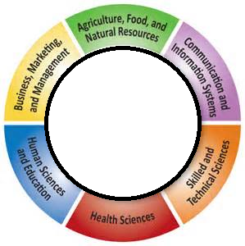
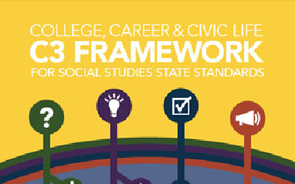
All learning experiences found in the project are aligned with Common Core Learning Standards and content area standards
Significant
Content
Content Standards
Notes:
The significant content drives the project—not the end product.
PBL focuses on the process of learning.
Knowledge and skills are scaffolded providing academic support.
This done through by modeling the expected outcome, guided practice, until the student can independently demonstrate learning or the skill.

Slide 19
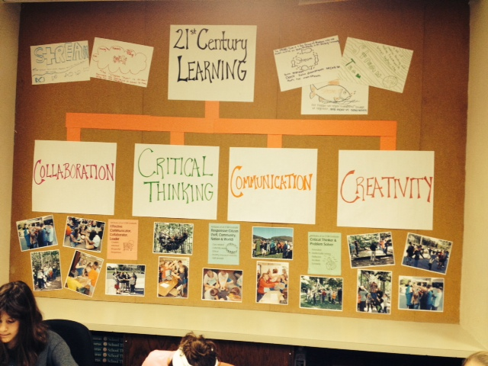
Competencies that should be taught and assessed
Life skills required for future success – in general and in the workplace
Students will get better at these skills if they see them modeled, have the opportunity to talk about them and practice them
21st
Century
Skills
Notes:
4 C’s of 21st Century Career and College Readiness—collaboration, communication, creativity, critical thinking—are seamlessly embedded in a project.
Moreover, we believe:
Schools (and PBL) can teach these
Students can get better at these skills if they see them modeled, talk about what they are, and practice them.
These skills should be assessed. And they will become even more important if they are explicitly factored into grades and reported to students, parents, and even employers and post-secondary institutions.

Slide 20
Inquiry is a process and way of thinking that involves:
Asking questions
Digging for answers
Asking new questions
Finding supporting evidence for your conclusions
Inquiry
&
Innovation
Notes:
A project requires students to engage in inquiry.
By “inquiry” we don’t just mean researching something.
We often think of inquiry in terms of science experiments or investigations, or research papers in a history class. But any project can be thought of as inquiry.
For example, designing a website informing citizens of the revitalization project for downtown: Who do we want to visit the site? Why do we want people to visit our site? What information do we want to reveal about the project? What images do we use? What is the best way to present this information on the website so the website is functional and achieves our goals?
A project also requires innovation:
Students create something new in PBL. They aren’t just reproducing an answer to a question or solution to a problem that’s been provided by the teacher. They’re not building something from a kit. They’re not just following directions to re-create a product someone else designed.

Slide 21
Students make choices, independently and collectively, to express their learning
Students can make choices within the project based on their interests, values, or beliefs
5 Ways Student Choice Impacts Learning (according to A.J. Juliani)
1. Improves student buy-in
2. Puts responsibility back in student’s hands
3. Allows for flexibility
4. Embraces current and new passions
5. Leads to growth
Student
Voice &
Choice
Driving Question, Inquiry Questions, Products, Team Roles and Tasks, Project Timelines, Resources
Notes:
Students should have some degree of voice and choice in a project, to increase engagement and encourage independent thinking.
To learn something deeply, students need to internalize it and make it their own.
To be able to use that learning and influence issues that matter to them.
Therefore, student voice activities revolve around the development and application of individual students’ skills, ideas, and connections to others, which make the learning student centered.
Students can help create a Driving Question, or sub-questions for inquiry; decide what products they will create to answer the Question; decide who will do what on a team, what resources to gather, how to organize time and tasks.

Slide 22
Student Voice: PBL is about student learning and engagement in the 21st century.
Notes:
22

Slide 23
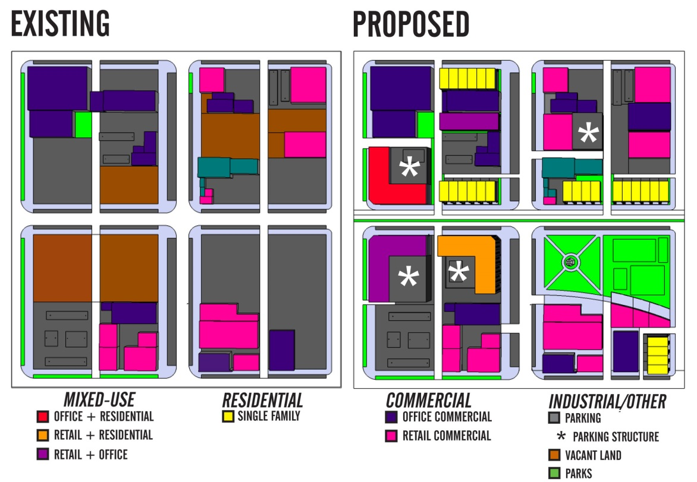
During a project, there should be frequent opportunities for students to get feedback from peers and the teacher (or other adults) on the quality of their work, so they can improve it.
Feedback
&
Revision
Notes:
During a project, there should be frequent opportunities for students to get feedback from peers and the teacher (or other adults) on the quality of their work, so they can improve it.
For example, with our downtown revitalization project students, teachers, and partners would review research notes; analyze time and tasks logs; critique rough drafts and prototypes; and provide feedback on practice presentations.
This process of critique and revision, leading to high-quality products, becomes part of the culture of the classroom.
Students also get feedback on how they’re working.
For example, how well their team is collaborating and communicating; how well they are using critical thinking and problem solving skills.

Slide 24
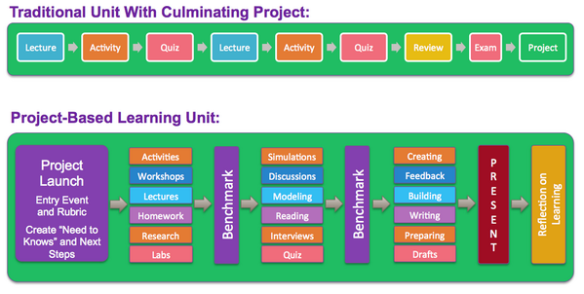
Notes:
PBL is different from the traditional project.
A traditional unit is linear and teacher-driven with little opportunity to for student voice and choice, revision, collaboration and relevancy.
A PBL unit, incorporates the eight essential elements so that student learning is personalized, meaningful, and deep.

Slide 25
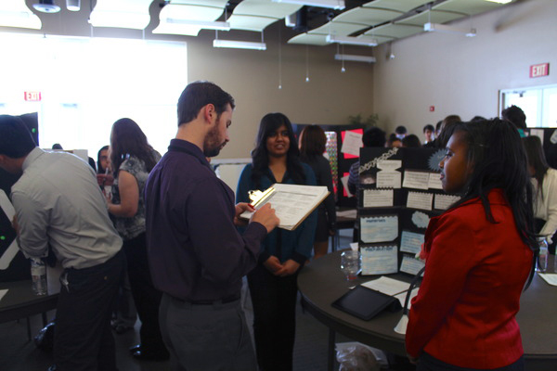
Requires students to think of their audience
Gives students the chance to demonstrate their learning
Culminates the project with a bang
Motivates students to do high- quality work
Allows for assessment of 21st century skills
Publicly
Presented
Product
Notes:
There are several reasons why a project should include a presentation to some sort of audience.
It requires students to think of their audience: who are we creating products for, who are we speaking to, and what does this audience need?
It gives students the chance to demonstrate that they have built skills and gained knowledge, and are offering up their work as proof.
It culminates the project with a bang. A big project should have a big finish after all the work.
It motivates students to do high-quality work if they know they have to stand in front of an audience.
It allows for assessment of 21st century skills such as communication and use of media.
It shows the world -- other students, parents, administrators, business and community members -- what your students can do (and how they can dress up!). It impresses people and includes them in a celebration of work well done.
A presentation might be a formal oral presentation, or it could be a showing of student work, or a performance like a debate, a speech, a play, or a piece of music.
In the case of our downtown revitalization project, student may present their ideas to members of the Chamber of Commerce and the City Council.

Slide 26
Save The Beach
Use the Check-list to see the 8 essential features of PBL?
Notes:
26

Slide 27
The Flow of a Project
Launch Project:
Entry Event & Driving Question
Build Knowledge
And Skills to Answer DQ
Feedback
Develop and Revise
Product that Answers DQ
Present Product
That Answers DQ

Slide 28
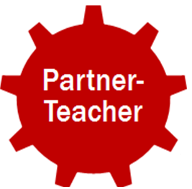
Partnerships of Yesterday
Present to students
Donate supplies
Provide job shadow opportunities
Offer student internships
Host field trips
Notes:
Generally speaking, business partnerships of yesterday were mostly teacher driven requesting partners to be guest speakers or to request a tour of the facility. It was also involved partners working with school districts to host job shadow opportunities for students and internships. This is the old school-to-work model, which proved successful in most partnerships.

Slide 29
Partnerships for Today
Notes:
Today, the partnership model has expanded to include students as a partner and the function of the roles each partner assumes is far more involved in student learning.

Slide 30
Types of Partnerships
Contributory partnerships are formed to benefit an organization or the community.
Consultative partnerships are for the purpose of acting as consultant with curriculum, projects, and other areas where an outside perspective would be useful in making decisions.
Operational partnerships are work-sharing arrangements in which the components of a given task are delegated to specific parties.
Collaborative partnerships are set up to share resources, ideas, and decision-making.
Notes:
We have defined four types of partnerships, however, they are not necessarily stand alone. In other words, a partnership with a teacher or school district may take on all four types.
Contributory is beneficial to one party or both in some way.
Consultative is a partner consulting with a teacher, groups of teachers, or with an administrator bringing their expertise to the table when designing curriculum and/or projects.
Operational is when partners are given a task to complete, which can be the business, the teacher, the administrator, or the student.
Collaborative is when partners are collaborating on a project or sharing resources.
Let’s look at the activities that might be included in each type of partnership.

Slide 31
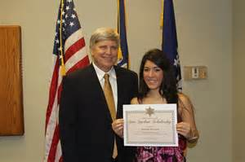
Contributory
Offer scholarships and grants
Share or donate supplies and resources
Provide job shadow opportunities
Offer student internships during the school year or in the summer
Provide teacher externships during the summer
Invite a student or a teacher to attend a trade conference or audit a college course
Invite students to physically or virtually tour the facility or work site
Use project ideas or display projects on site
Notes:
Scholarships and grants
Donations of supplies and resources
Job shadowing opportunities, internships, and externships
Trade conferences
Auditing college courses
Facility or worksite tours
Use or display student projects
It is not just business and community partners contributing, but students and teachers can contribute to business and community partners.

Slide 32
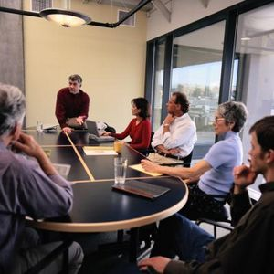
Consultative
Train teachers and students in industry standards and business functions
Assist students during the project with skills and knowledge
Assist teachers with project management
Provide feedback to students for improvement as they work on a project
Evaluate project design and provide feedback to teacher(s) for improvement
Evaluate integrated curriculum for inclusion of industry-based skills and knowledge or post-secondary expectations
Help students with college and career planning
Notes:
Partners acting as consultants in a variety of ways help to bring a realistic perspective to education
Training in industry standards and business functions
Consult with students on a project design
Assist with project management and feedback with improvement
Evaluate project design with the teacher before launching the project
Evaluate curriculum for inclusion of relevant skills, knowledge, and expectations
Help with college and career exploration

Slide 33
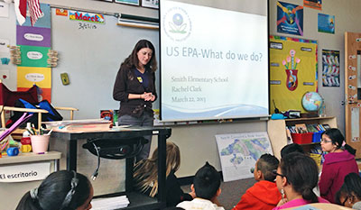
Operational
Challenge students to solve an industry-specific or community-based problem
Participate in an entry event to kick-off a project
Serve as a judge on a panel
Join an Advisory Council
Visit classes on campus or virtually as a guest speaker
Participate in teacher employment interviews
Host an exhibition or presentation event
Generate articulation agreements and develop dual-enrollment opportunities
Notes:
Partner complete specific tasks to ensure student learning, growth and development
Challenge students to solve an industry-specific or community-based problem
Participate in an entry event to kick-off a project
Serve as a judge on a panel
Join an Advisory Council
Visit classes on campus or virtually as a guest speaker
Participate in teacher employment interviews
Host an exhibition or presentation event
Generate articulation agreements and develop dual-enrollment opportunities

Slide 34
Collaborative
Plan projects with teachers
Design an integrated course to reflect industry-based and/or college expectations
Develop evaluation criteria for a project
Mentor at-risk students
Tutor struggling students
Visit classes on campus or virtually as a guest speaker
Act as a thought partner to a principal providing an outside perspective when making decisions
Work with school district to develop a college preparation course
Notes:
Partners collaborate in a number of way to make student learning rigorous and relevant
Plan projects with teachers
Design an integrated course to reflect industry-based and/or college expectations
Develop evaluation criteria for a project
Mentor at-risk students
Tutor struggling students
Visit classes on campus or virtually as a guest speaker
Act as a thought partner to a principal providing an outside perspective when making decisions
Work with school district to develop a college preparation course

Slide 35
Aviation High School
Notes:
35

Slide 36
Collaborative Partnerships
Higher Education
Administrators
Community Agencies
Businesses
Students
Teachers
Notes:
Collaborative partnerships with businesses, community agencies, and post-secondary institutions are essential to develop the knowledge and skills students need to face with success rigorous higher education coursework, career challenges, and a globally competitive workforce.

Slide 37
Benefits of Partnerships
Improve the quality of the workplace
Provide employees with learning experiences and a new understanding of the educational system
Provide opportunities for students’ career exploration
Bring resources to enrich the curriculum
Ensure that school teaching is relevant to the skills required of industry
Integrate young people into the labor market by involving them in cooperative education experiences

Slide 38
Benefits of Partnerships
Connect schools with local businesses
Assist with curriculum development, new learning opportunities and skill development
Meet the labor market needs of business and industry
Promote easier student transitions from high school to college to the workplace due to curriculum alignment
Reduce the need for remedial course work when students enter college

Slide 39
A Vision for Education in CNY
Teaching that Engages
Culture that Empowers
Technology that Enables

