Slide 1
BCIC Meeting
May 2014

Slide 2
Welcome
Introductions
Overview of Agenda

Slide 3
SED Update
May 2014

Slide 4
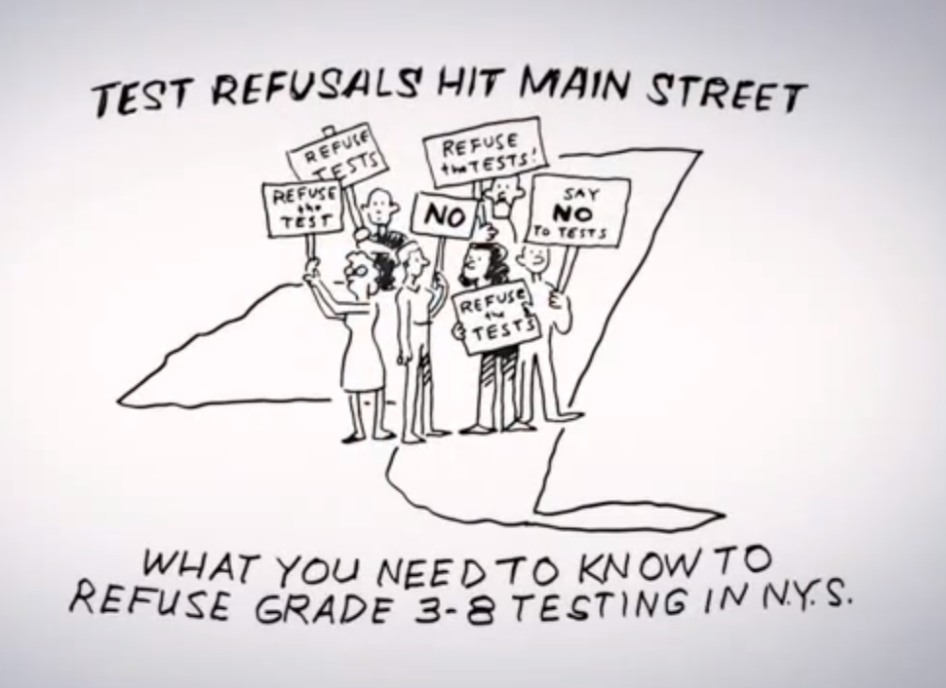
SED Updates

Slide 5
Accountability
NCLB waiver request was submitted to USDOE on February 28
Adjust AMOs
Focus school removed from the list would not have to be replaced by other focus schools

Slide 6
Accountability
Weighted Average for Groups That Fail Participation Criterion: If the participation rate of an accountability group falls below the required percentage, a “weighted average” of the group’s participation rates over the current and the previous year is calculated. If the result meets the participation criterion for the measure, the group is considered to have met the participation criterion.
Sample Weighted Average Calculation:
Year | Enrollment | Tested | Rate
Current | 60 | 56 | 93%
Previous | 75 | 73 | 97%
Calculation of Weighted Average | 135 | 129 | 96%
SIRS manual page 212 version 9.10

Slide 7
Accountability
Schools and districts that fail to meet the 95% participation rate requirement will fail to make AYP.
Failure to meet participation rate requirements will not result in Priority or Focus School designation. However, failure to meet the participation rate requirement will preclude a Priority or Focus School from being removed from accountability status. In addition, in combination with other metrics, a school that fails to meet the participation rate requirement could be identified as a Local Assistance Plan School and cannot be designated a Reward School.

Slide 8
District | Refusals THIS year | ≈ participation rate | Refusals LAST year
Baldwinsville | 110 | 98% | 7
Cazenovia CSD | 70 | 75% | 5
Chittenango | 22 | 98% | 5
Cincinnatus | 47 | 82% | 2
Cortland | 79 | 93% | 8
DeRuyter | 13 | 93% | 0
ESM
Fabius Pompey | 4 | 99% | 0
Fayetteville-Manlius | 68 | 96% | 10
Homer | 45
Jamesville-DeWitt | 41 | 97% | 10
LaFayette | 96 | 74% | 0
Liverpool | 180 | 94% | 27
Lyncourt | 11 | 94% | 1
Marathon | 15 | 95% | 2
Marcellus | 38 | 94% | 0
McGraw | 16 | 96% | ?
North Syracuse | 234 | 94% | 10
Onondaga
Solvay
Tully | 8 | 98% | 0
West Genesee | 129 | 94% | 25
Westhill | 94 | 89% | 5

Slide 9
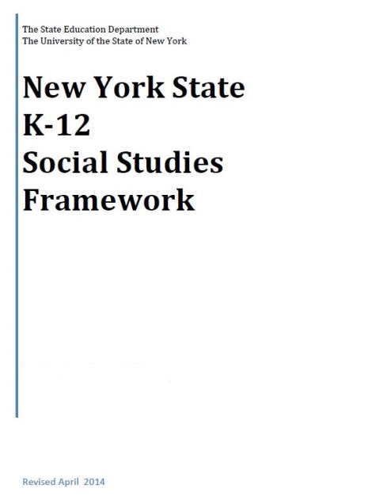
NYS K-12 Social Studies Framework
Adopted April 2014
Intended to serve as a guide for local districts to develop Social Studies curriculum

Slide 10
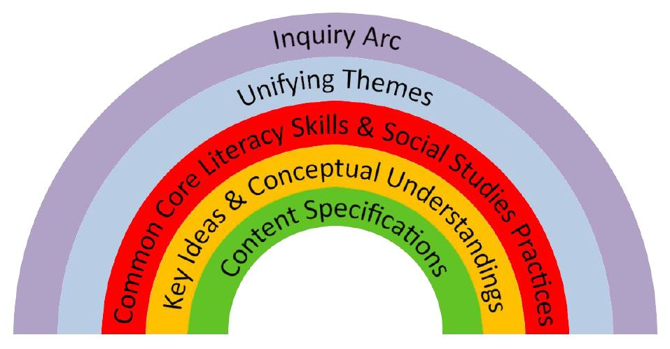
The Framework
Emphasis on:
Balance of content and skills
Civics and preparing students for citizenship and to take informed action

Slide 11
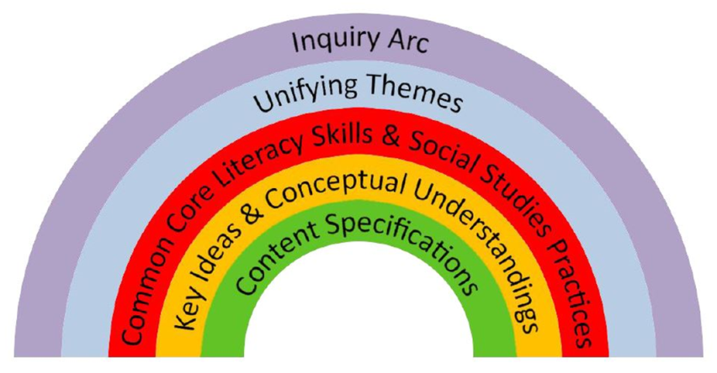
The Framework
Inquiry Arc (NCSS C3 Framework )
Developing questions and planning inquiries
Applying disciplinary concepts and tools
Evaluating sources and using evidence
Communicating conclusions and taking informed action
SKILLS
Notes:
NCSS – National Council for the Social Studies

Slide 12

The Framework
Unifying Themes (NCSS)
  Individual Development and Cultural Identity
  Development, Movement, and Interaction of Cultures
  Time, Continuity, and Change
  Geography, Humans, and the Environment
  Development and Transformation of Social Structures
  Power, Authority, and Governance
  Civic Ideals and Practices
  Creation, Expansion, and Interaction of Economic Systems
  Science, Technology, and Innovation
  Global Connections and Exchange
CONTENT

Slide 13

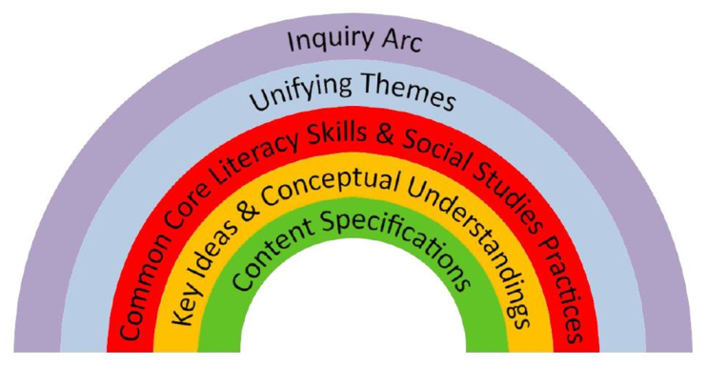
The Framework
New York State Common Core Learning Standards
Reading, Writing, Speaking and Listening
Literacy in History/Social Studies 6-12 (with addition of grade 5 to the 6-8 band)

Slide 14
The Framework
Social Studies Practices
  Gathering, Using, and Interpreting Evidence
  Chronological Reasoning and Causation
  Comparison and Contextualization
  Geographic Reasoning
  Economics and Economics Systems
  Civic Participation

Slide 15
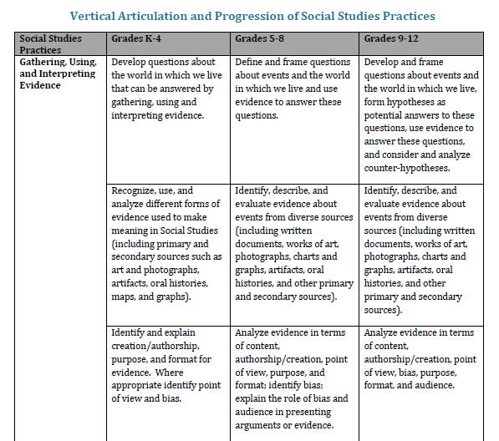

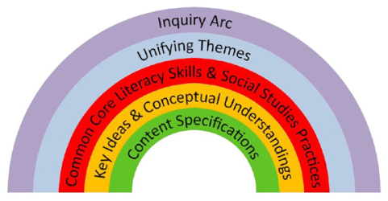
The Framework
Vertical Articulation of Social Studies Practices K-12

Slide 16
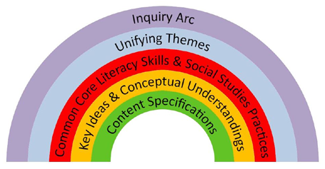

The Framework
Social Studies Learning Standards and Core Curriculum for Social Studies
  History of the United States and New York
  World History
  Geography
  Economics
  Civics, Citizenship, and Government

Slide 17
Content Sequence
Kindergarten Self and Others
Grade 1 My Family and Other Families, Now and Long Ago
Grade 2 My Community and Other United States Communities
Grade 3 Communities around the World
Grade 4 Local History and Local Government
Grade 5 The Western Hemisphere
Grade 6 The Eastern Hemisphere
Grade 7 History of the United States and New York – I
Grade 8 History of the United States and New York – II
Grade 9 Global History and Geography – I
Grade 10 Global History and Geography – II
Grade 11 US History and Government
Grade 12 PIG/Econ

Slide 18
The Framework
Key Ideas
Aligned to standards
Conceptual Understandings
More specific
Content Specifications
“Students will…” statements
Larger perspectives, trends, and issues
8-12 per grade level
Enduring understandings
2-7 per Key Idea
Focus of teaching and learning
Specific content that can be taught

Slide 19
Field Guide
Released Summer of 2014
Guidance about how to integrate social studies content, practices, and CCLS in the context of rigorous, inquiry-driven instruction.

Slide 20
Regents Assessments
No precise timetable not changing until at least 2017
Don’t know what re-design will look like
Conversations are just beginning

Slide 21
Next Steps for Districts
Consider the Field Guide this summer
Begin to have conversations with Social Studies staff about implications
Consider implementing small pieces, especially the skills (Inquiry Arc and Social Studies Practices)
Aim for larger commitment of resources during Summer 2015 – assessments and resources will be clearer

Slide 22
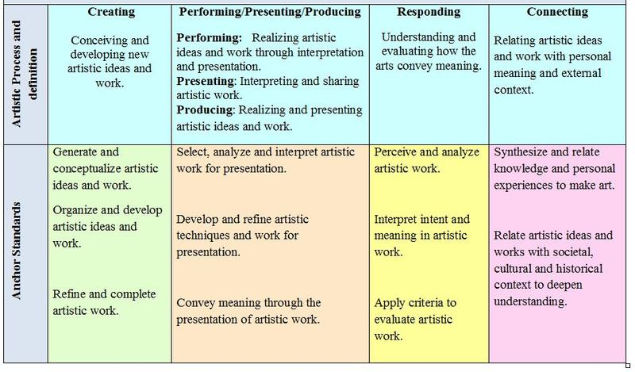
Arts Standards

Slide 23
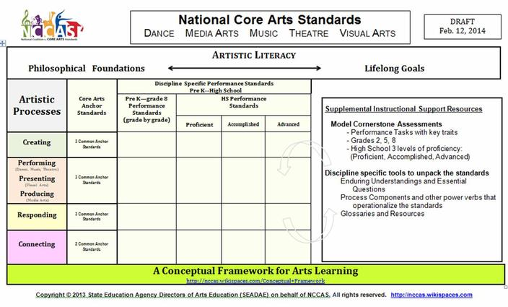
Arts Standards

Slide 24
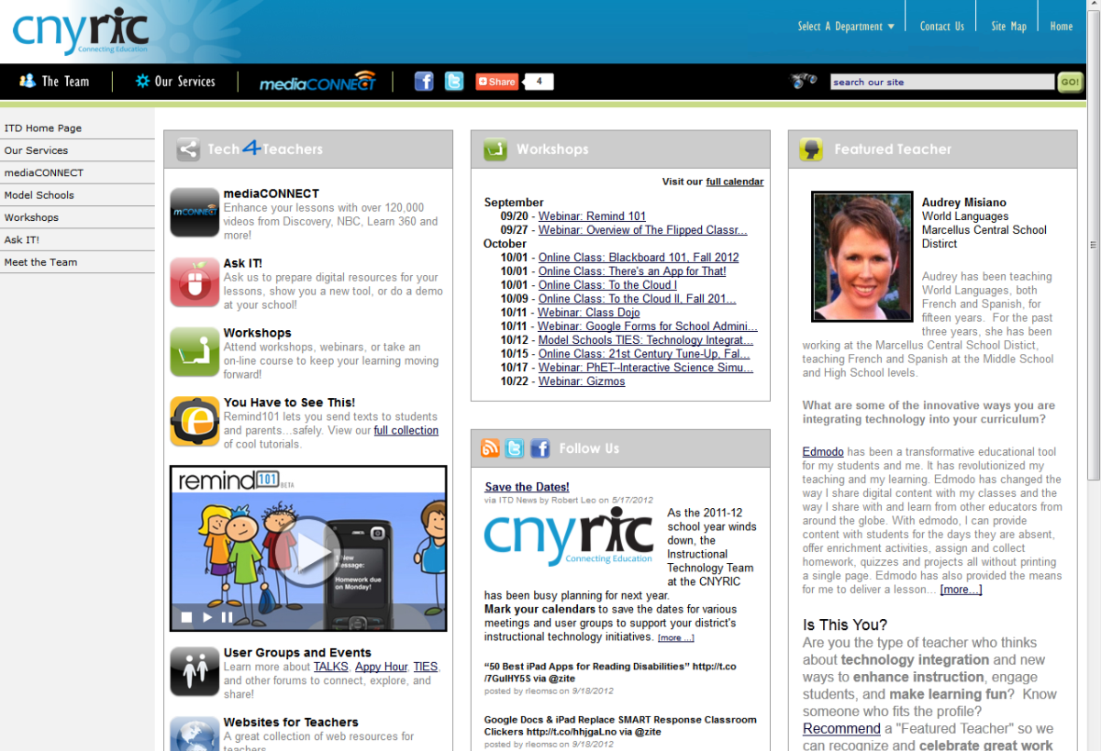
ITD

Slide 25
2014-15 CI&A Survey
Thank you…
Please complete by Monday, May 19

Slide 26
Summer: CI&A and
Network Team
Please note that registration is reviewed June 13 to decide if enrollment is adequate

Slide 27
Building a Positive Learning Culture
Responsive Classroom has been updated and redesigned
August 19-22

Slide 28
Teaching and Learning
Supporting All Students through Differentiated Instruction and Scaffolding- July 1.
Research to Deepen Understanding- Designed especially for grades 6-12 ELA and library media specialists implementing instructional shifts for close reading and writing evidence based claims. July 15 at the North location or July 17 at the South location.

Slide 29
Teaching and Learning: Math
Geometry Analysis and Implementation: July 25 and Aug 15. Come once or both times!
Algebra 1 Reflection and Plan: July 18 or August 8.
Teachers of Grades 6-8: Reflection, Refining and Moving Forward is July 15 and 16.
Teachers of Grades 3-5: Reflection, Refining and Moving Forward is July 22-23.
Teachers of Grades K-2: Reflection, Refining and Moving Forward is July 29-30.
And for teachers of math K-8 wishing to extend or develop competency and proficiency with Singapore Math Strategies, join the Singapore Math Mash August 18.

Slide 30
Teacher Centers
New Teacher Welcome Project
September 11th
SUNY Oswego Phoenix Center
Joint Oswego/OCM/Oswego-CNY Teacher Center Project
No cost for participation

Slide 31
Higher Education

Slide 32
CNY NYS ASCD
Data-Driven Instruction theme
October 9: What’s a PLC, Really?
December 10, 2013 – How To Talk (About Common Formative Assessments)
February 27, 2014 – Now What? (Tier 1 Strategies)
March 19, 2014 – How Do I Teach Every Kid? (Meeting the Needs of Diverse Learners)
May 15, 2014 – Annual Meeting at Dinosaur

Slide 33
District Sharing

Slide 34

West Genesee
BYOD Pilot

Slide 35
Next Up: Fayetteville-Manlius
FM Writes

Slide 36
Race To The Top
(the Regents Reform Agenda)

Slide 37
CCLS Curriculum Conversation
Continue to update the curriculum and assessment chart

Slide 38
District Assessment Project
Last chance (starts May 23)
Teacher Center/Regional Collaboration (OCM BOCES, CNY/Oswego Teacher Center, Oswego BOCES)
With LCI doing the training and providing the feedback to teams
Participate as district teams

Slide 39
District Assessment Project
The product of the first part of the work would be an “action plan” for assessments.
In order to do this, districts first conduct an “assessment audit.”

Slide 40
District Assessment Project
Project leadership teams:
1 District instructional leader
1 principal
1-2 teacher leaders
1 SWD teacher
1 ELL teacher (if appropriate)
1 union representative

Slide 41
District Assessment Project
Segment 1:
1-day program (May 23) at which time a work plan is sketched out (in addition to training)
1 60-90 minute team phone call with LCI for the provision of district-specific feedback

Slide 42
District Assessment Project
Segment 2:
1-day program (June 27 OR July 28) at which time the team brings collected assessment artifacts and uses these to inform audit
Audit work submitted to LCI for district-specific feedback

Slide 43
District Assessment Project
Segment 3:
1-day program (July 29 OR Aug 25?) at which time the team brings completed audits and uses them to create action plans
Work submitted to LCI for district-specific feedback

Slide 44
Assessment Academy (RFP)
Assessment Academy
In each semester, separate cohorts of teachers:
  who work on assessments
  try them out
  look at student work
  Improve assessments

Slide 45
Network Team
Upcoming Opportunities

Slide 46
Network Team
Literacy Leadership Network-April 30
Opportunities to network with fellow math teachers continue.
  Geometry teachers next meeting is May 8
  Digging Deeper into CCLS Algebra is May 16. The last meeting for the year for this group is May 22.
  Teachers of Math grades K-2- Networking May 19.
  Grades 6-8 Accelerated Math is May 21.

Slide 47
Data-Driven Instruction

Slide 48
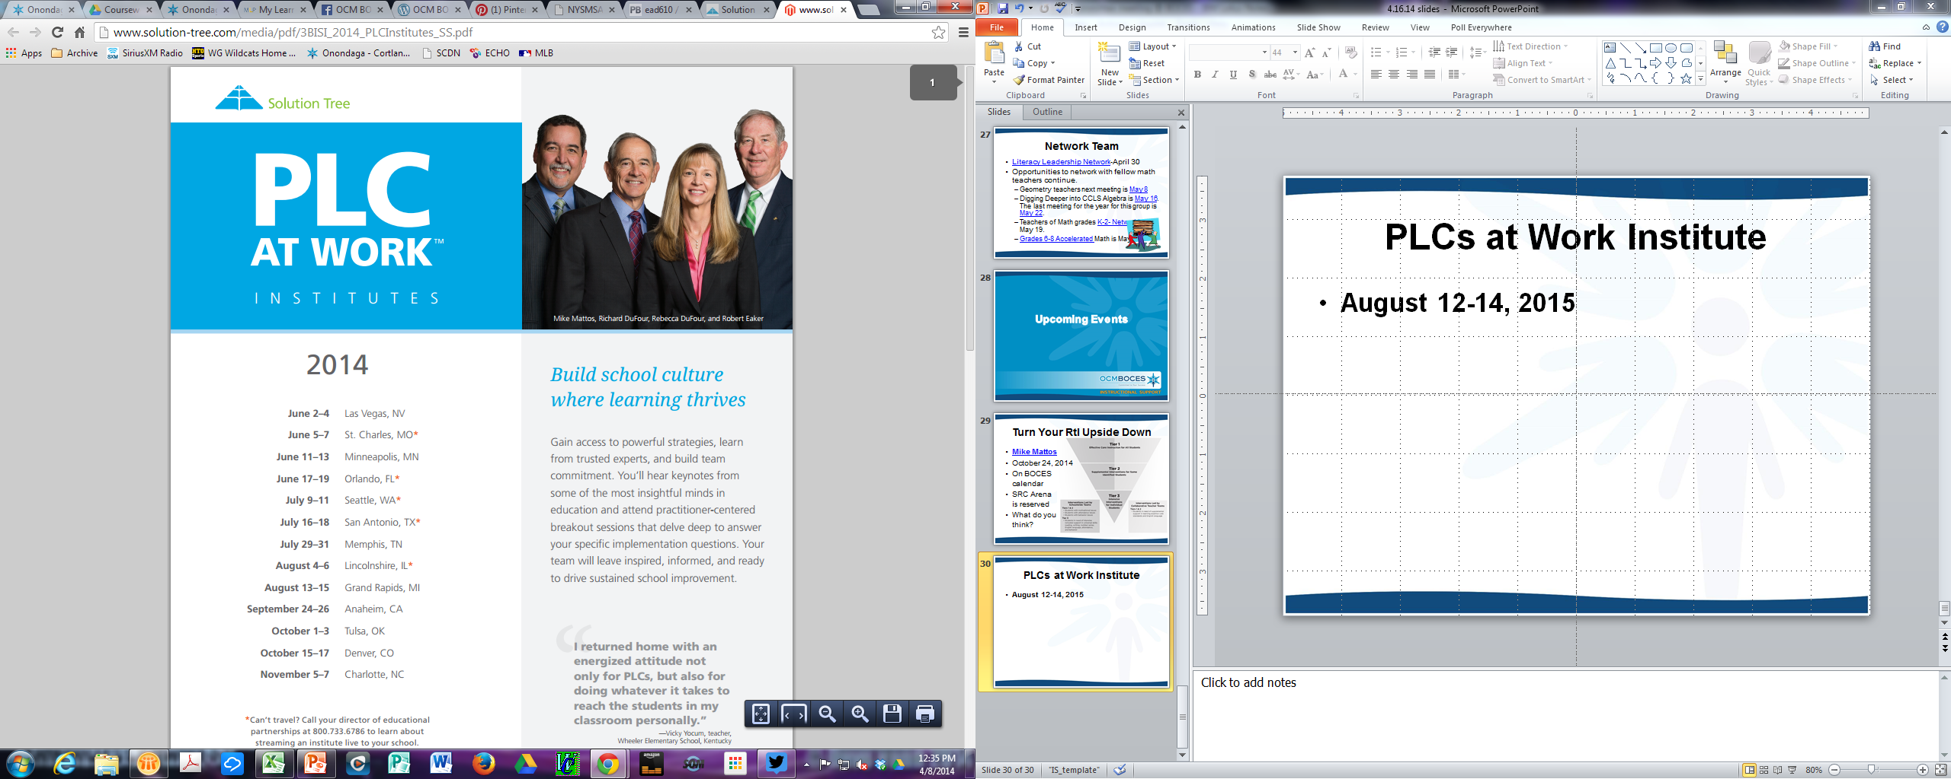
Reenergize your PLC
Two day event
August 20 and 21 to reenergize, refresh and refocus your PCL.
Sessions will build upon work from 2014 summer conference, highlight journeys from other teams and offer resources to continue to develop your team.
Preview: August 2015 Solution Tree returns! Will your team be ready?

Slide 49
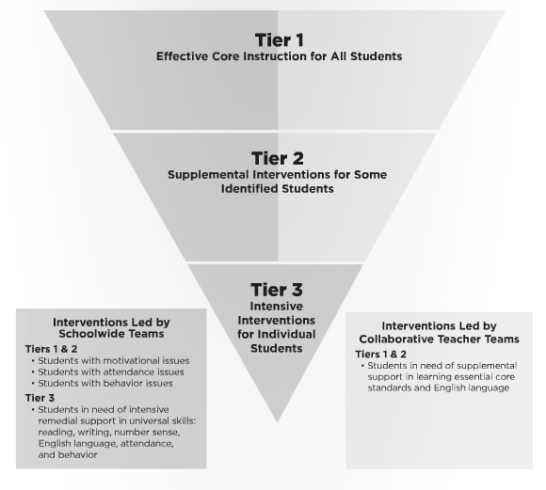
Turn Your RtI Upside Down
Mike Mattos
October 24, 2014
SRC Arena (lunch & materials)
$35 components
$65 non-components
Best way to register?

Slide 50
PLCs at Work Institute
August 12-14, 2015
OnCenter and Civic Center

Slide 51
Professional Practice

Slide 52
2014-15 Lead Evaluator Training
Three sessions is the right amount, complete in March
Four options (Cortland and Syracuse) is good
More people mentioned following one teacher was nice, but others did suggest watching multiple teachers (at multiple levels, and quality)
You can never do too much Growth Producing Feedback
Do more with crucial conversations
More work with different forms of evidence
Articles that can also be used with staff
Could there be some aspects of the training done on-line? Flip some
Watch videos of principals in action with teachers
Moving teachers from effective to Highly effective
District sharing
District team work (work done by district team – maybe flip this or HW)

Slide 53
2014-15 Principal Evaluator Training
Three sessions is the right amount
After the CSA meetings works
Keep up the research updates
Watching videos of principals doing their thing is helpful (with conversation)
Articles and discussion
Connect with principals – what are they thinking and needing?

Slide 54
2014-15 Principal Support
What should we do next year to help our principals be instructional leaders?
Discussion

Slide 55
Culture

Slide 56
Bill Daggett Returns
Thursday, September 25 Day Sessions Baker HS, Baldwinsville | Thursday, September 25 Evening BoE Session Homer Jr High School | Friday, September 26 Day Sessions AM: Cortland JrSr HS PM: Homer Jr HS
Baldwinsville Lyncourt Solvay | Homer Fayetteville-Manlius McGraw | Cortland (am) McGraw (am) Homer (pm) DeRuyter (pm) Cincinnatus (pm) Marathon (pm) LaFayette (pm)

Slide 57
Regional Vision

Slide 58
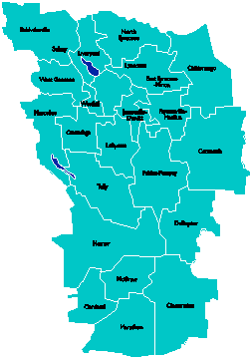
A Vision for Education in
Central New York
College, Career
& Citizenship Readiness
Notes:
Talk about where this vision came from. While it is Colleen and Jeff presenting, the Student Services committee and others have been visiting schools, talking about the future, and developing this vision. In the midst of all the compliance stuff like SLOs, and vested interest, and APPR, it’s been re-invigorating to think about the future and to think about our kids and their future.

Slide 59
Pre-Service Teacher Training
Early College and Dual Enrollment
Professional
Development
School:
Visitations
Observation
Training
(Buck Institute
and NTN)
Coaching
Co-teaching
PBL^{NY}
New Tech Network Model
New Tech High School
CNY New Tech High School in Cortland County
OCM BOCES Programs
Innovation Tech at the Career Academy
District/School-Based
Integrated PBL Courses
Baldwinsville School-
within-a-School
Standards (CCLS, NGSS, SS Framework, NYS Teaching Standards, 4Cs, ISTE, etc.)
Business Partnerships
Notes:
Update on all three of these

Slide 60
Central New York New Tech High School
Multiple districts
Location: Hartnett Elementary in Truxton (Homer)
September 2016
Begin with grades 9 & 10
CNY NTH

Slide 61

Transformation of the Career Academy
September 2014
Begin with grades 9 & 10
Students in grades 11 & 12 complete the Career Academy program, including CTE
Summer 2014-Redesign space to support Innovation Tech model
InnovationTech.us

Slide 62
A Vision for Education in CNY
Teaching that Engages
Culture that Empowers
Technology that Enables

Slide 63

Project Based Learning

Slide 64
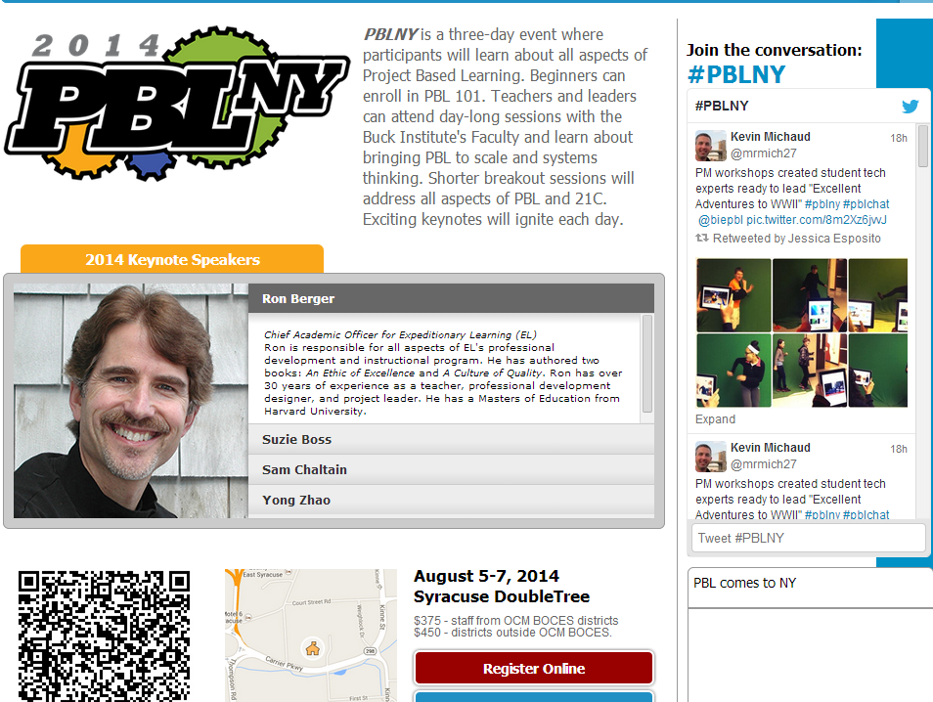

Slide 65
Project Based Learning
Training:
  PBL 101: Regional or on-site
  Summer PBL- July 15,17,18
Coaching:
  Full Implementation Model: 40 on-site days
  Can customize to 20-30 days on-site
  Scheduling NOW
Turnkey:
  Support for district facilitators to build capacity within districts. Teams of up to five ($8700 for component districts).

Slide 66
PBL 102:
Integrated Course
Preparation and support for transdisciplinary courses.
Will be offered for ELA/Humanities and ELA/Science.
Both sessions start July 24.

Slide 67
PBL Roundtable
So Far | Future Plans
What have you been doing or thinking about PBL? | What are you planning or thinking about in the future?

Slide 68
Assessment

Slide 69
11th Grade ELA -CCLS
Overview of scoring for new HS ELA-CCLS regents will be May 22-afternoon.
Open for all schools

Slide 70
CCLS Regents Scoring Deadlines
If chosen for standard setting you have been notified by SED (school needs to complete the scoring by 11:00 a.m. on Friday June 6 for UPS pick up that afternoon)
Schools that have not been selected for a score collection project will want to complete the scoring in advance of the Department's posting of the conversion charts for these exams on the Rating Day, June 26, 2014. They should also check with their RIC for any deadline they have for submission of the answer sheets that were provided by their scanning center.

Slide 71
June Regents Regional Scoring
  Materials and direction memo sent April 21
  Thank you for providing scorer names
  Need Geometry scoring leader- please!
  Scoring Leader Training May 20 in Cortland 2:00-3:00. The intent is to provide overview of process and role.

Slide 72
Grant Writing Basics

Slide 73
BCIC Meeting
NEXT
June 19, 2014
Henry Large Conference Room

