Slide 1
BCIC Meeting
April 2014

Slide 2
Welcome
Introductions
Overview of Agenda

Slide 3
SED Update
April 2014

Slide 4
SED Updates

Slide 5
Accountability
Weighted Average for Groups That Fail Participation Criterion: If the participation rate of an accountability group falls below the required percentage, a “weighted average” of the group’s participation rates over the current and the previous year is calculated. If the result meets the participation criterion for the measure, the group is considered to have met the participation criterion.
Sample Weighted Average Calculation:
Year | Enrollment | Tested | Rate
Current | 60 | 56 | 93%
Previous | 75 | 73 | 97%
Calculation of Weighted Average | 135 | 129 | 96%
SIRS manual page 212 version 9.10

Slide 6
 | refusals | Last yr | ≈ participation rate
Baldwinsville CSD | 86 | 7 | 93-99%
Cazenovia CSD | 44 | 1 | 88-90%
Chittenango | 15 | 5 | 98%
Cincinnatus | 19 | 2 | 93%
Cortland | 48 | 5 | 96%
DeRuyter | 12 | 0 | 93%
East Syracuse Minoa
Fabius Pompey | 4 | 0 | over 95%
Fayetteville-Manlius | 52 | 10 | 97%
Homer | 14 | 7 | 99%
Jamesville-DeWitt | 31 | 10 | 98%
LaFayette Central School | 76 | 0 | 80%
Liverpool | 89 | 17 | 97%
Lyncourt | 6 | 1 | 97%
Marathon | 12 | 2 | 96%
Marcellus | 23 | 0 | 96%
McGraw | 7 | 0 | 99%
McGraw | 6 | 0 | 97%
North Syracuse
Onondaga | 15 | 0 | 96%
Solvay UFSD | 56 | 0 | 91%
Tully | 4 | 0
West Genesee | 100 | 6 | 96%
Westhill | 84 | 5 | 90%
SCSD | 80 | 0 | 99%

Slide 7
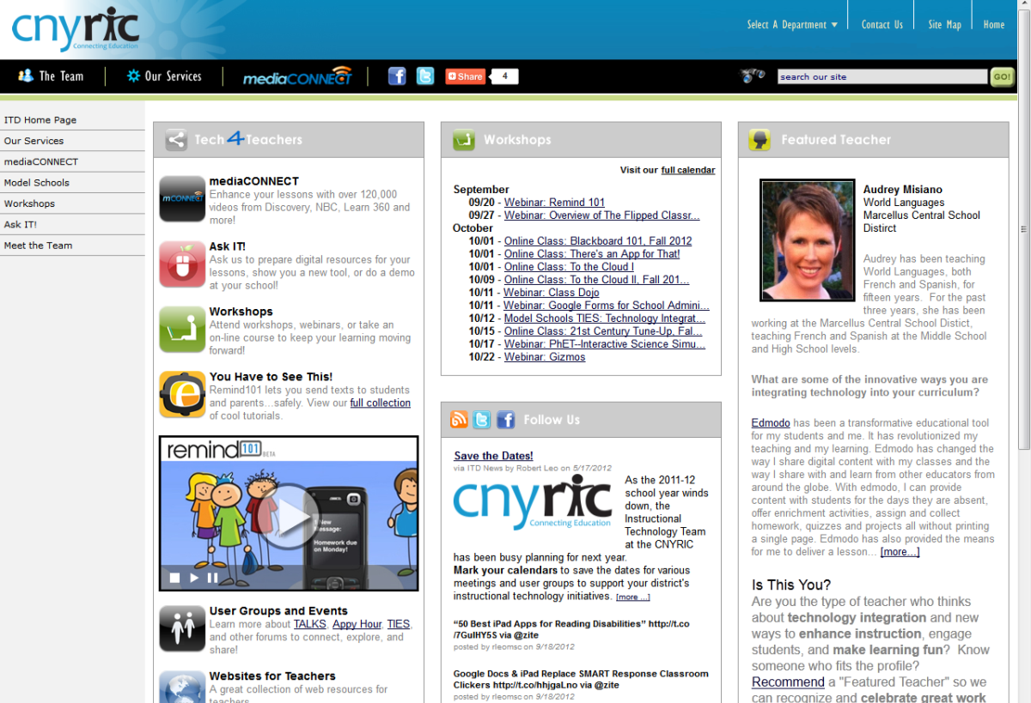
ITD

Slide 8
CI&A
Project Based Learning 101
May 15, 20, and 29 (last one during year)
July 15, 17, 18 summer cohort
Responsive Classroom-Level One:
May 21,22 and June 4,5,6

Slide 9
Summer Preview 2014
Registration will be open by April break.
Registration requested by June 13.

Slide 10
Some Highlights
Support for PBL and CCLS
Developing Critical Thinking
Collaborative Inquiry
Developing Student Voice and Choice
Professional Learning Communities
Re-energizing Your PLC- Aug 20 and 21

Slide 11
Additional Previews.. For Math
For teachers of math- continue to analyze and refine practices with CCLS and modules for Algebra, Geometry, K-2, 3-5, 6-8
Singapore Strategies

Slide 12
Also….
Research to Deepen Understanding
DI and Scaffolding

Slide 13
Teacher Centers

Slide 14
Higher Education

Slide 15
CNY NYS ASCD
Data-Driven Instruction theme
October 9: What’s a PLC, Really?
December 10, 2013 – How To Talk (About Common Formative Assessments)
February 27, 2014 – Now What? (Tier 1 Strategies)
March 19, 2014 – How Do I Teach Every Kid? (Meeting the Needs of Diverse Learners)
May 15, 2014 – Annual Meeting at Dinosaur

Slide 16
District Sharing

Slide 17
Homer
The Chromebook classroom

Slide 18
Race To The Top
(the Regents Reform Agenda)

Slide 19
CCLS Curriculum Conversation
Continue to update the curriculum and assessment chart

Slide 20
District Assessment Project
Still no RFP; still coming?
Teacher Center/Regional Collaboration (OCM BOCES, CNY/Oswego Teacher Center, Oswego BOCES)
With LCI doing the training and providing the feedback to teams
Participate as district Teams

Slide 21
District Assessment Project
The product of the first part of the work would be an “action plan” for assessments.
In order to do this, districts first conduct an “assessment audit.”

Slide 22
District Assessment Project
Project leadership teams:
1 District instructional leader
1 principal
1-2 teacher leaders
1 SWD teacher
1 ELL teacher (if appropriate)
1 union representative

Slide 23
District Assessment Project
Segment 1:
1-day program (May 23) at which time a work plan is sketched out (in addition to training)
1 60-90 minutes team phone call with LCI for the provision of district-specific feedback

Slide 24
District Assessment Project
Segment 2:
1-day program (June 27 OR July 28) at which time the team brings collected assessment artifacts and uses these to inform audit
Audit work submitted to LCI for district-specific feedback

Slide 25
District Assessment Project
Segment 3:
1-day program (July 29 OR Aug 25?) at which time the team brings completed audits and uses them to create action plans
Work submitted to LCI for district-specific feedback

Slide 26
District Assessment Project
Assessment Academy
In each semester, separate cohorts of teachers:
who work on assessments
try them out
look at student work
Improve assessments

Slide 27
Network Team
Upcoming Opportunities

Slide 28
Network Team
Literacy Leadership Network-April 30
Opportunities to network with fellow math teachers continue.
Geometry teachers next meeting is May 8
Digging Deeper into CCLS Algebra is May 16. The last meeting for the year for this group is May 22.
Teachers of Math grades K-2- Networking May 19.
Grades 6-8 Accelerated Math is May 21.

Slide 29
Data-Driven Instruction

Slide 30
PLCs at Work Refresher
August 20-21, 2014

Slide 31
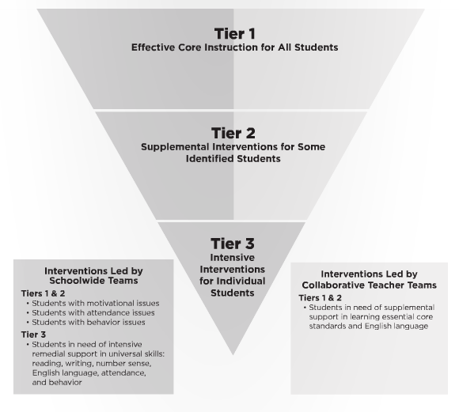
Turn Your RtI Upside Down
Mike Mattos
October 24, 2014
SRC Arena

Slide 32
PLCs at Work Institute
August 12-14, 2015
OnCenter and Civic Center

Slide 33
Professional Practice

Slide 34
Lead Evaluator Training
Lead Evaluators Year One will begin in August
Lead Evaluators Ongoing will be three (half) days in 2014-2015
Principal Evaluator Ongoing will be three (half) days in 2014-2015
Attendance going out next week so you can do your certification

Slide 35
Culture

Slide 36
Bill Daggett Returns
Thursday, September 25 Day Sessions Baker HS, Baldwinsville | Thursday, September 25 Evening BoE Session Homer Jr High School | Friday, September 26 Day Sessions AM: Cortland JrSr HS PM: Homer Jr HS
Baldwinsville Lyncourt Solvay | Homer Fayetteville-Manlius McGraw | Cortland (am) McGraw (am) Homer (pm) DeRuyter (pm) Cincinnatus (pm) Marathon (pm) LaFayette (pm)

Slide 37
Regional Vision

Slide 38
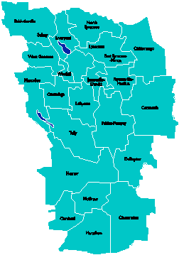
A Vision for Education in Central New York
College, Career & Citizenship Readiness
Notes:
Talk about where this vision came from. While it is Colleen and Jeff presenting, the Student Services committee and others have been visiting schools, talking about the future, and developing this vision. In the midst of all the compliance stuff like SLOs, and vested interest, and APPR, it’s been re-invigorating to think about the future and to think about our kids and their future.

Slide 39
Pre-Service Teacher Training
Early College and Dual Enrollment
Professional Development
School:
Visitations
Observation
Training (Buck Institute and NTN)
Coaching
Co-teaching
PBL^{NY}
New Tech Network Model
New Tech High School
CNY New Tech High School in Cortland County
OCM BOCES Programs
Innovation Tech at the Career Academy
District/School-Based
Integrated PBL Courses
Baldwinsville School- within-a-School
Standards (CCLS, NGSS, SS Framework, NYS Teaching Standards, 4Cs, ISTE, etc.)
Business Partnerships
Notes:
Update on all three of these

Slide 40
Central New York New Tech High School
Multiple districts
Location: Hartnett Elementary in Truxton (Homer)
September 2016
Begin with grades 9 & 10
CNY NTH

Slide 41
Transformation of the Career Academy
September 2014
Begin with grades 9 & 10
Students in grades 11 & 12 complete the Career Academy program, including CTE
Summer 2014-Redesign space to support Innovation Tech model
InnovationTech.us

Slide 42
A Vision for Education in CNY
Teaching that Engages
Culture that Empowers
Technology that Enables

Slide 43
Project Based Learning

Slide 45
Project Based Learning
Training:
PBL 101: Regional or on-site
Coaching:
Full Implementation Model: 40 on-site days
Can customize to 20-30 days on-site
Turnkey:
Support for district facilitators to build capacity within districts. Teams of up to five ($8700 for component districts).

Slide 46
PBL 102: Integrated Humanities Course
Training
Coaching
Networking
Integrated project
PBL102 Training | PBL Regional Network Meetings | PBL In-District Coaching
September 18, 25, 30 October 2 | November 13, January 15, March 12, May 14 | October, December, February, April and June

Slide 47
PBL Roundtable
So Far | Future Plans
What have you been doing or thinking about PBL? | What are you planning or thinking about in the future?

Slide 48
Assessment

Slide 49
11th Grade ELA -CCLS
We anticipate having a turn-key training for use of rubric and processes for scoring the ELA-CCLS Regents.
May 22 or 27

Slide 50
June Regents Regional Scoring
Fewer schools participating, so there are some different models for scoring some exams (not straight Teams A, B, C)
Location: Tully
Scoring Leader Training May 20 or 21
Will soon be requesting names of scorers

Slide 51
BCIC Meeting
NEXT
Post-BCIC, 10:30-11:00a
Grant Writing Basics

Slide 52
BCIC Meeting
NEXT
May 15, 2014
Henry Large Conference Room

