Slide 1
BCIC Meeting
March 2014

Slide 2
Welcome
Introductions
Overview of Agenda

Slide 3
SED Update
March 2014

Slide 4

SED Updates

Slide 5
Curriculum and Standards
Social Studies Frameworks draft
  April adoption likely
  Exam change 2018? 2019?
  Field Guide will be developed
  Some tinkering and some 4th grade flexibility
Next Generation Science Standards
  Some change, eventually
  Either adopt or MA model

Slide 6
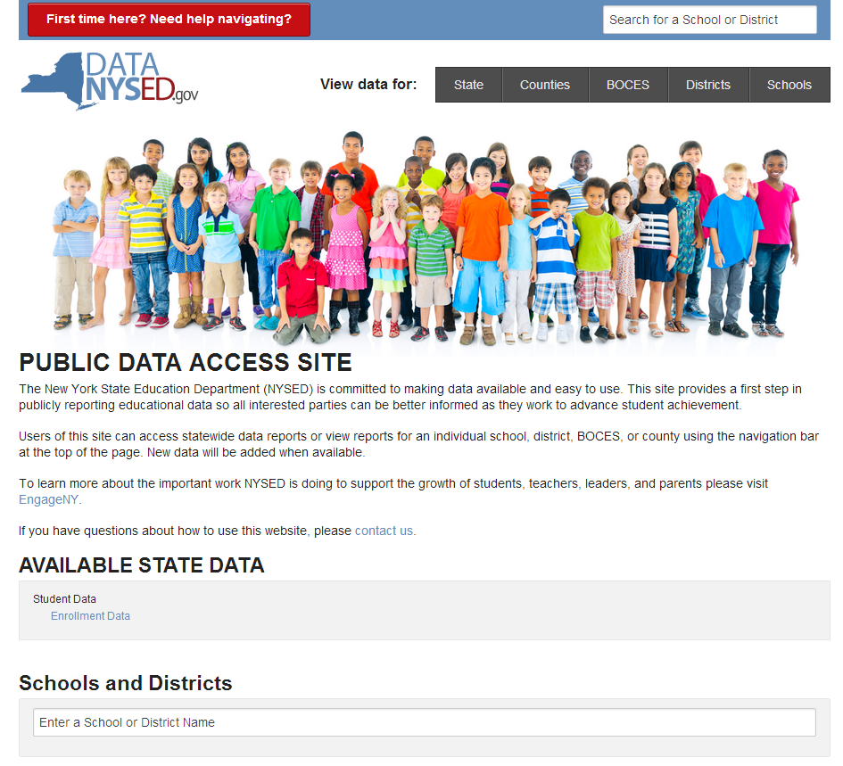
Accountability
School Report Cards have changed
Data.nysed.gov
Data will be updated
as it becomes
available

Slide 7
Assessment
Here are SED’s slides about the Regents scales

Slide 8
Political Updates
Regents Committee = Governor’s Committee
Both single-house budgets disappointing
Getting closer to crunchtime

Slide 9
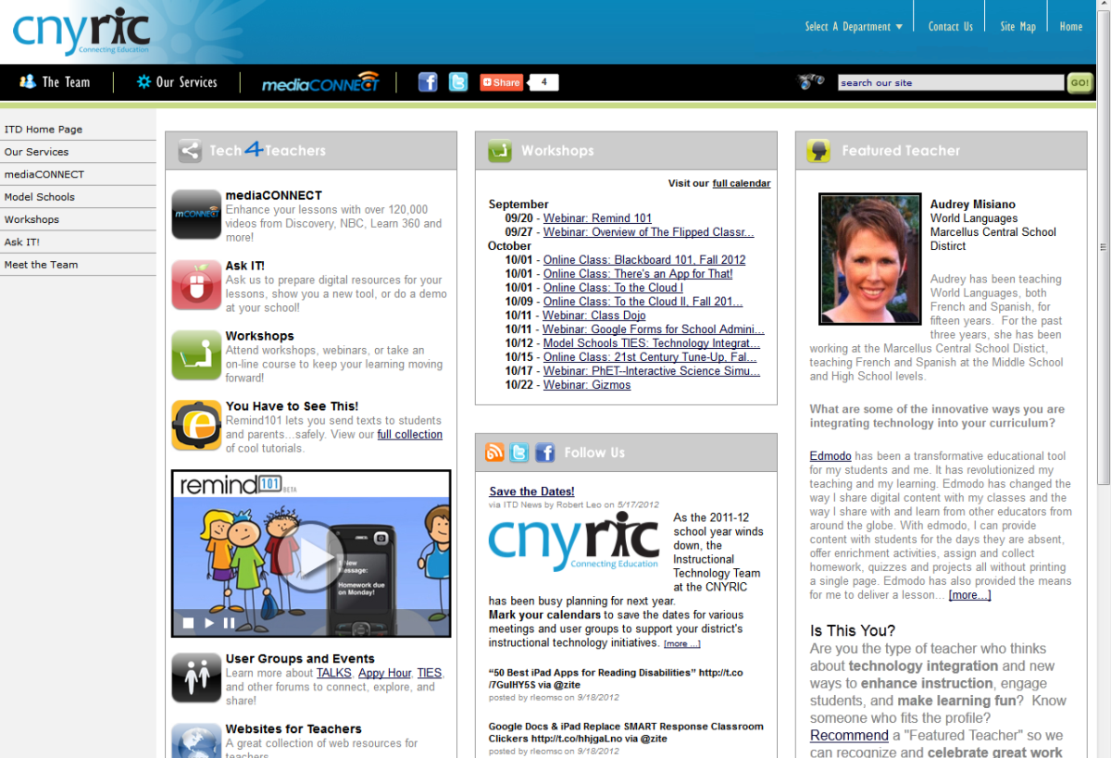
ITD

Slide 10

CI&A
Project Based Learning 101
  May 15, 20, and 29 (last one during year)
  July 15, 17, 18 summer cohort
Responsive Classroom-Level One:
  May 21,22 and June 4,5,6

Slide 11
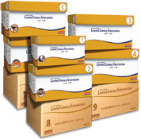
Literacy Programs
Reading Recovery: Initial training through an I3 grant. This is final year to have costs covered by grant. Application due to OCM April 15th.
Leveled Literacy Intervention: NEW for 14-15 is purple level!

Slide 12

Upcoming
Summer- on MLP by mid-April (registration closes mid-June)
2014-15- Surveys in March

Slide 13
Teacher Centers

Slide 14
Higher Education

Slide 15
CNY NYS ASCD
Data-Driven Instruction theme
October 9: What’s a PLC, Really?
December 10, 2013 – How To Talk (About Common Formative Assessments)
February 27, 2014 – Now What? (Tier 1 Strategies)
March 19, 2014 – How Do I Teach Every Kid? (Meeting the Needs of Diverse Learners)
May 15, 2014 – Annual Meeting at Dinosaur

Slide 16

Regional Summer School
Common Core-aligned
curriculum transition,
using Odell materials
Supporting SWDs
and ELLS better

Slide 17
District Sharing

Slide 18

Next month: Homer
The Chromebook classroom

Slide 19
Race To The Top
(the Regents Reform Agenda)

Slide 20
CCLS Curriculum Conversation
Continue to update the curriculum and assessment chart

Slide 21
Formative Assessment
"The Bridge Between Today's Lesson and Tomorrow's" article
Grading video clip
Formative Assessment video
Formative Assessment research summary activity

Slide 22
Balanced Assessment Project
Still no RFP; still coming?
Teacher Center/Regional Collaboration
With LCI doing the training and providing the feedback to teams
District Teams
Interest and process

Slide 23
Balanced Assessment Project
The product of the first part of the work would be an “action plan” for assessments.
In order to do this, districts first conduct an “assessment audit.”

Slide 24
Balanced Assessment Project
Project leadership teams:
1 District instructional leader
1 principal
1-2 teacher leaders
1 SWD teacher
1 ELL teacher (if appropriate)
1 union representative

Slide 25
Balanced Assessment Project
Segment 1:
1-day program (May 23?) at which time a work plan is sketched out (in addition to training)
1 60-90 minutes team phone call with LCI for the provision of district-specific feedback

Slide 26
Balanced Assessment Project
Segment 2:
1-day program (June 27 OR July 28?) at which time the team brings collected assessment artifacts and uses these to inform audit
Audit work submitted to LCI for district-specific feedback

Slide 27
Balanced Assessment Project
Segment 3:
1-day program (July 29 OR Aug 25?) at which time the team brings completed audits and uses them to create action plans
Work submitted to LCI for district-specific feedback

Slide 28
Balanced Assessment Project
Assessment Academy
In each semester, separate cohorts of teachers:
  who work on assessments
  try them out
  look at student work
  Improve assessments

Slide 29
Network Team
Upcoming Opportunities

Slide 30
Network Team
Networking for Teachers of 6-8 Accelerated Math-April 2
Common Core Geometry- Digging into Modules- April 3
CCLS-Algebra 1:Modules- April 10
Literacy Leadership Network-April 30

Slide 31
Data-Driven Instruction

Slide 32
PLCs at Work
Follow-up sessions
Coaching available
CNY NYS ASCD Focus
Still working out August 12-14, 2015, to host the real thing in Syracuse. What kind of interest do we have (we have to make a big commitment)?

Slide 33
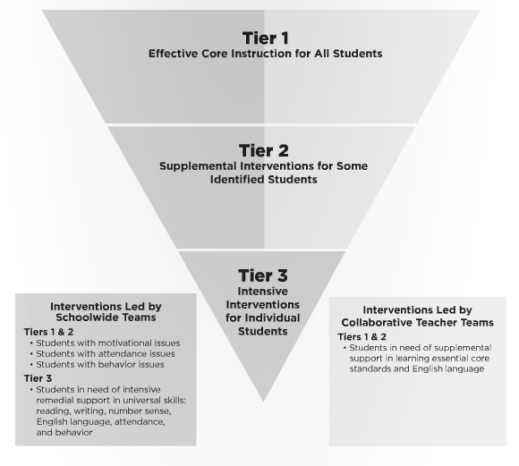
Turn Your RtI Upside Down
Mike Mattos
October 24, 2014
On BOCES
calendar
SRC Arena
is reserved
What do you
think?

Slide 34
Professional Practice

Slide 35
Lead Evaluator Training
Lead Evaluators Year One will begin in August
Lead Evaluators Ongoing will be three (half) days in 2014-2015
Principal Evaluator Ongoing will be three (half) days in 2014-2015
Will we need Principals Year One?

Slide 36
RTTT Reporting

Slide 37
RTTT and Network Teams
No cost extension
Bills and letters went out

Slide 38
Regional Vision

Slide 39
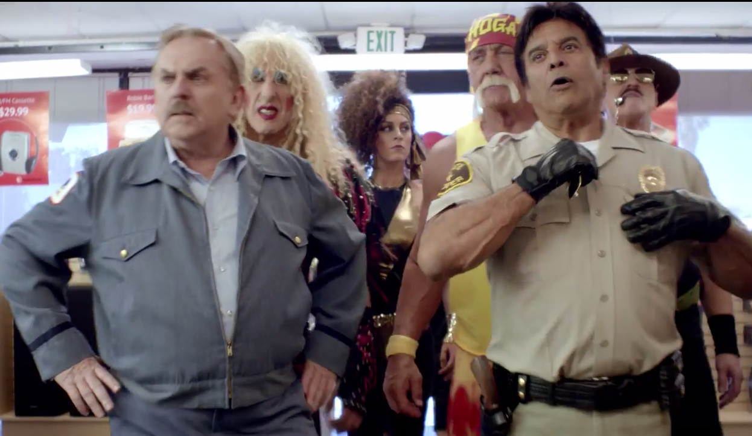

Slide 40
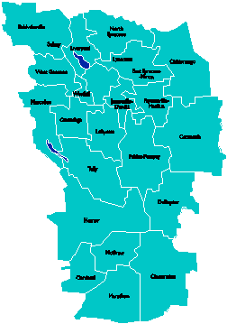
A Vision for Education in
Central New York
College, Career
& Citizenship Readiness
Notes:
Talk about where this vision came from. While it is Colleen and Jeff presenting, the Student Services committee and others have been visiting schools, talking about the future, and developing this vision. In the midst of all the compliance stuff like SLOs, and vested interest, and APPR, it’s been re-invigorating to think about the future and to think about our kids and their future.

Slide 41
Pre-Service Teacher Training
Early College and Dual Enrollment
Professional
Development
School:
Visitations
Observation
Training
(Buck Institute
and NTN)
Coaching
Co-teaching
PBL^{NY}
New Tech Network Model
New Tech High School
CNY New Tech High School in Cortland County
OCM BOCES Programs
Innovation Tech at the Career Academy
District/School-Based
Integrated PBL Courses
Baldwinsville School-
within-a-School
Standards (CCLS, NGSS, SS Framework, NYS Teaching Standards, 4Cs, ISTE, etc.)
Business Partnerships
Notes:
Update on all three of these

Slide 42
Central New York New Tech High School
Multiple districts
Location TBD
September 2015
Begin with grades 9 & 10
NTH@CNY

Slide 43
Baldwinsville New Tech
School-within-a-School (shared campus)
September 2015
Begin with grade 10

Slide 44

Transformation of the Career Academy
September 2014
Begin with grades 9 & 10
Students in grades 11 & 12 complete the Career Academy program, including CTE
Summer 2014-Redesign space to support Innovation Tech model
InnovationTech.us

Slide 45
A Vision for Education in CNY
Teaching that Engages
Culture that Empowers
Technology that Enables

Slide 46
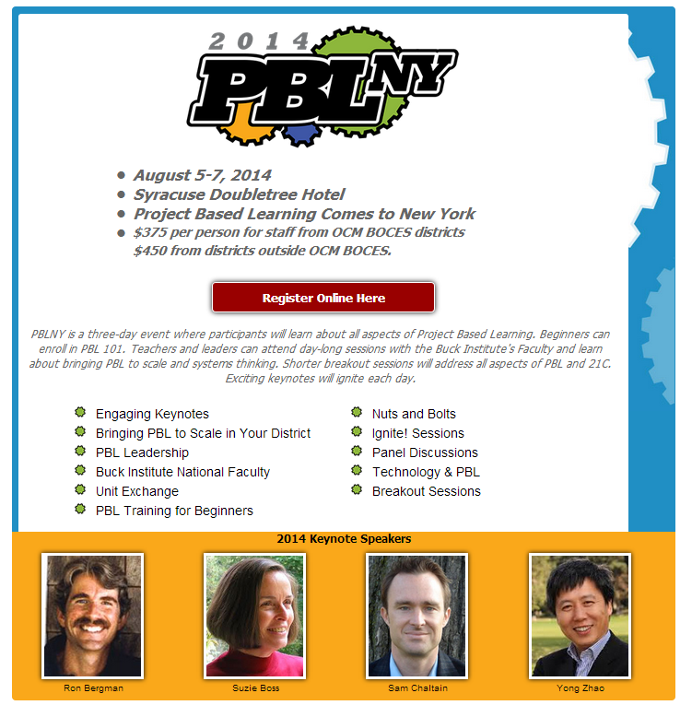

Slide 47

Project Based Learning

Slide 48

Project Based Learning:
Multiple ways to engage
Training:
  PBL 101: Regional or on-site
Coaching:
  Full Implementation Model: 40 on-site days
  Can customize to 20-30 days on-site
Turnkey: Support for district facilitators to build capacity within districts. Teams of up to five $8700 (for component districts).

Slide 49
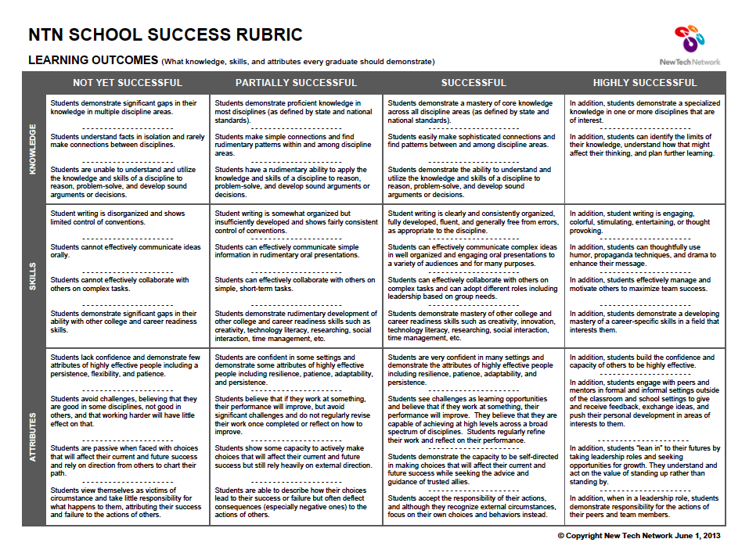
Where in Your Program?

Slide 50
Assessment

Slide 51
3-8 & BOCES Papers
ELA papers from all BOCES students will be returned to districts by 4:00pm on April 7th.
Any individual make-up papers will be delivered by the specific BOCES program administrator by 4:00pm on April 9th.

Slide 52
3-8 & BOCES Papers
Math papers from all BOCES students will be returned to districts by 4:00pm on May 6th.
Any individual make-up papers will be delivered by the specific BOCES program administrator by 4:00pm on May 8th.

Slide 53
“Opting Out”
“All students are expected to participate in State tests as part of the core academic program. Absences from all or part of the required academic program should be managed in accordance with the attendance policies of the district. For accountability and other statewide reporting purposes, students who do not participate in an assessment are reported to the State as “not tested.” Schools do not have any obligation to provide an alternative location or activities for individual students while the tests are being administered.”

Slide 54
“Opting Out”
What’s coming you way?
What is your district’s response?
Suggestions: Family by family interaction by principal. Written responses are OK, but alone might not de-escalate.

Slide 55
June Regents Scoring
Anticipate training for scoring CCLS ELA in late May
Regional Scoring:
  Gathering participating group input for US History and Global Studies scheduling
  Location: Tully
  Scoring Leader Training in late May

Slide 56
BCIC Meeting
NEXT
April 10, 2014
Henry Large Conference Room

