Slide 1
BCIC Meeting
February, 2014

Slide 2
Welcome
Introductions
Overview of Agenda

Slide 3
SED Update
February, 2014

Slide 4

SED Updates

Slide 5
Assessment
Middle-Level double testing issue
A1 and Integrated Algebra doubling-up
Allow for Geometry doubling-up (through June 2016)
Some PARCC piloting going on (samples)
K-2 standardized testing prohibited
Time limit on assessments for APPR

Slide 6
CCLS Regents 5 Levels
NYS Level 5
Analogous to current Mastery Level
Students exceed Common Core grade-level expectations
NYS Level 4
Analogous to current 75/80
Aspirational Performance Measure
Students meet Common Core grade-level expectations
NYS Level 3
Analogous to current 65
Graduation and Credit Proficiency
Students partially meet Common Core grade-level expectations
NYS Level 2
Analogous to current 55
Safety Net for students with disabilities
Not proficient on Common Core grade-level expectations
NYS Level 1
Does not demonstrate knowledge and skills sufficient for Level 2

Slide 7
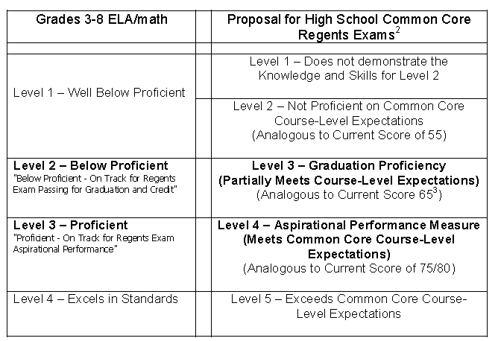
4 to 5 Performance Levels

Slide 8
Curriculum and Standards
Research paper requirement on hold
Next Generation Science Standards on hold
Social Studies Frameworks draft

Slide 9
Data
Data portal on hold

Slide 10
Placement Decisions
Special AIS cut points will again be provided
SED neither requires nor encourages districts to make promotion or placement decisions using student performance on state assessments in grades 3-8
Make adjustments to ensure students are not negatively impacted by the Common Core transition and use multiple measures - not grades 3-8 state assessment results alone for AIS

Slide 11

Accountability
12-year road map that requires student proficiency on the Common Core Learning Standards (CCLS) for graduation purposes beginning with the class of 2022?
Exactly what this means is unclear. Until 2022 it means there will be a conversion from Common Core to the old levels. After that?

Slide 12
ON HOLD: Accountability
If a school district seeks to terminate an educator based on an ineffective rating resulting from student performance on Common Core assessments administered in the 2012-13 and/or 2013-14 school years, he or she may raise as a defense an alleged failure by the board of education to timely implement the Common Core by providing adequate professional development, guidance on curriculum, or other necessary supports to the educator during those school years

Slide 13
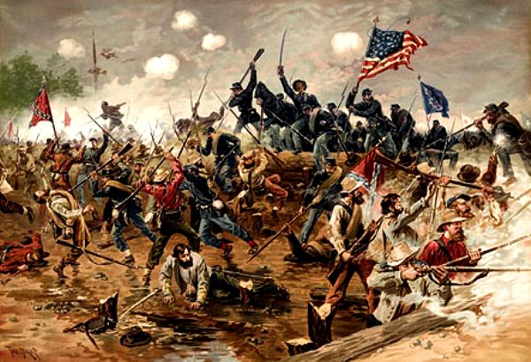
Political Updates

Slide 14
Political Updates
Regents committee
Governor’s Committee
Governor's budget lower than expected
Legislators urging more aid
NYSUT civil war

Slide 15
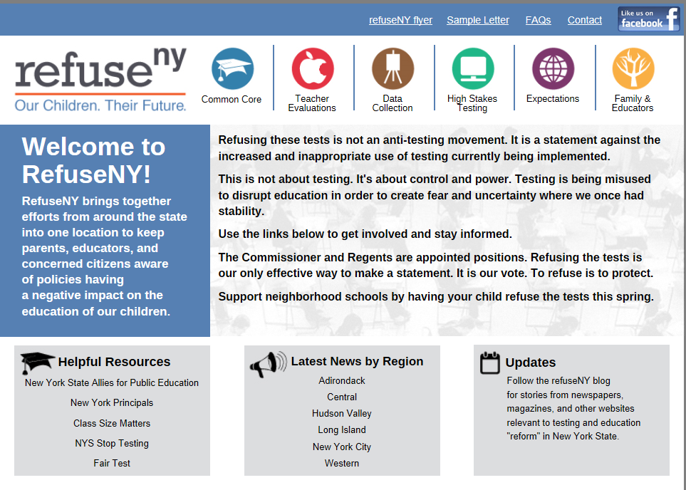

Slide 16
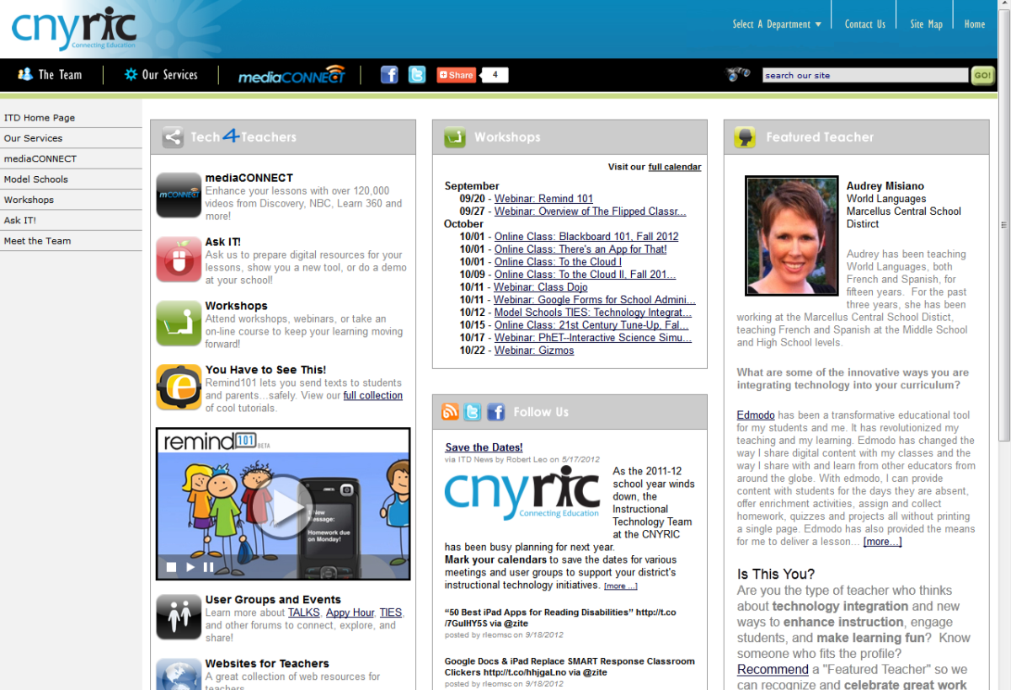
ITD

Slide 17
CI&A
Feb 25 is the Participation in Government- F.O.C.U.S Interest Group.
Going Deeper into Literacy Shifts: Informational Text- Feb 27
Standards Based Planning for the 21st Century: Instruction for All- starts Feb 27
Project Based Learning- Next regional opportunity May- June and then July
and August sessions.

Slide 18

Upcoming
Summer- on MLP by mid-April (registration closes mid-June)
2014-15- Surveys in March

Slide 19
RBERN Conference
March 10: Key Principles for ELL Instruction:
What We All Need to Know & Do
March 11: Building Coteachers'Identities of Competence

Slide 20
Teacher Centers

Slide 21
Higher Education

Slide 22
CNY NYS ASCD
Data-Driven Instruction theme
October 9: What’s a PLC, Really?
December 10, 2013 – How To Talk (About Common Formative Assessments)
February 27, 2014 – Now What? (Tier 1 Strategies)
March 19, 2014 – How Do I Teach Every Kid? (Meeting the Needs of Diverse Learners)
May 15, 2014 – Annual Meeting at Dinosaur

Slide 23

Regional Summer School
Common Core-aligned
curriculum transition
Grade Policy Change
Supporting SWDs
and ELLS better
This is a short summer!

Slide 24
District Sharing
Marcellus Central School District

Slide 25
Marcellus
Using Bill Daggett’s message across the district.

Slide 26

Next month: Homer
The Chromebook classroom

Slide 27
Race To The Top
(the Regents Reform Agenda)

Slide 28
CCLS Curriculum Conversation
At the mid-point of the year
How’s it going?
Modules?
Other approaches?
Textbook decisions?
Updating the curriculum and assessment chart

Slide 30
Math Module Updates
Adopt, Adapt, Refer

Slide 31
Module Updates
Kindergarten Modules 1-6
1st Grade Modules 1-6
2nd Grade Modules 1-8
3rd Grade Modules 1-7
4th Grade Modules 1-7
5th Grade Modules 1-6
All modules are released at this time!

Slide 32
Module Updates
Grade 6 Modules 1-6
Grade 7 Modules 1-6
Grade 8 Modules 1-7
Algebra I Modules 1-5
All modules are released at this time!
Geometry Module 1 ONLY

Slide 33
Module Checklists
PK-5 “A Story of Units” 7/6/13
6-8 “A Story of Ratios” 1/30/14
A1 “A Story of Functions” 1/30/14

Slide 34
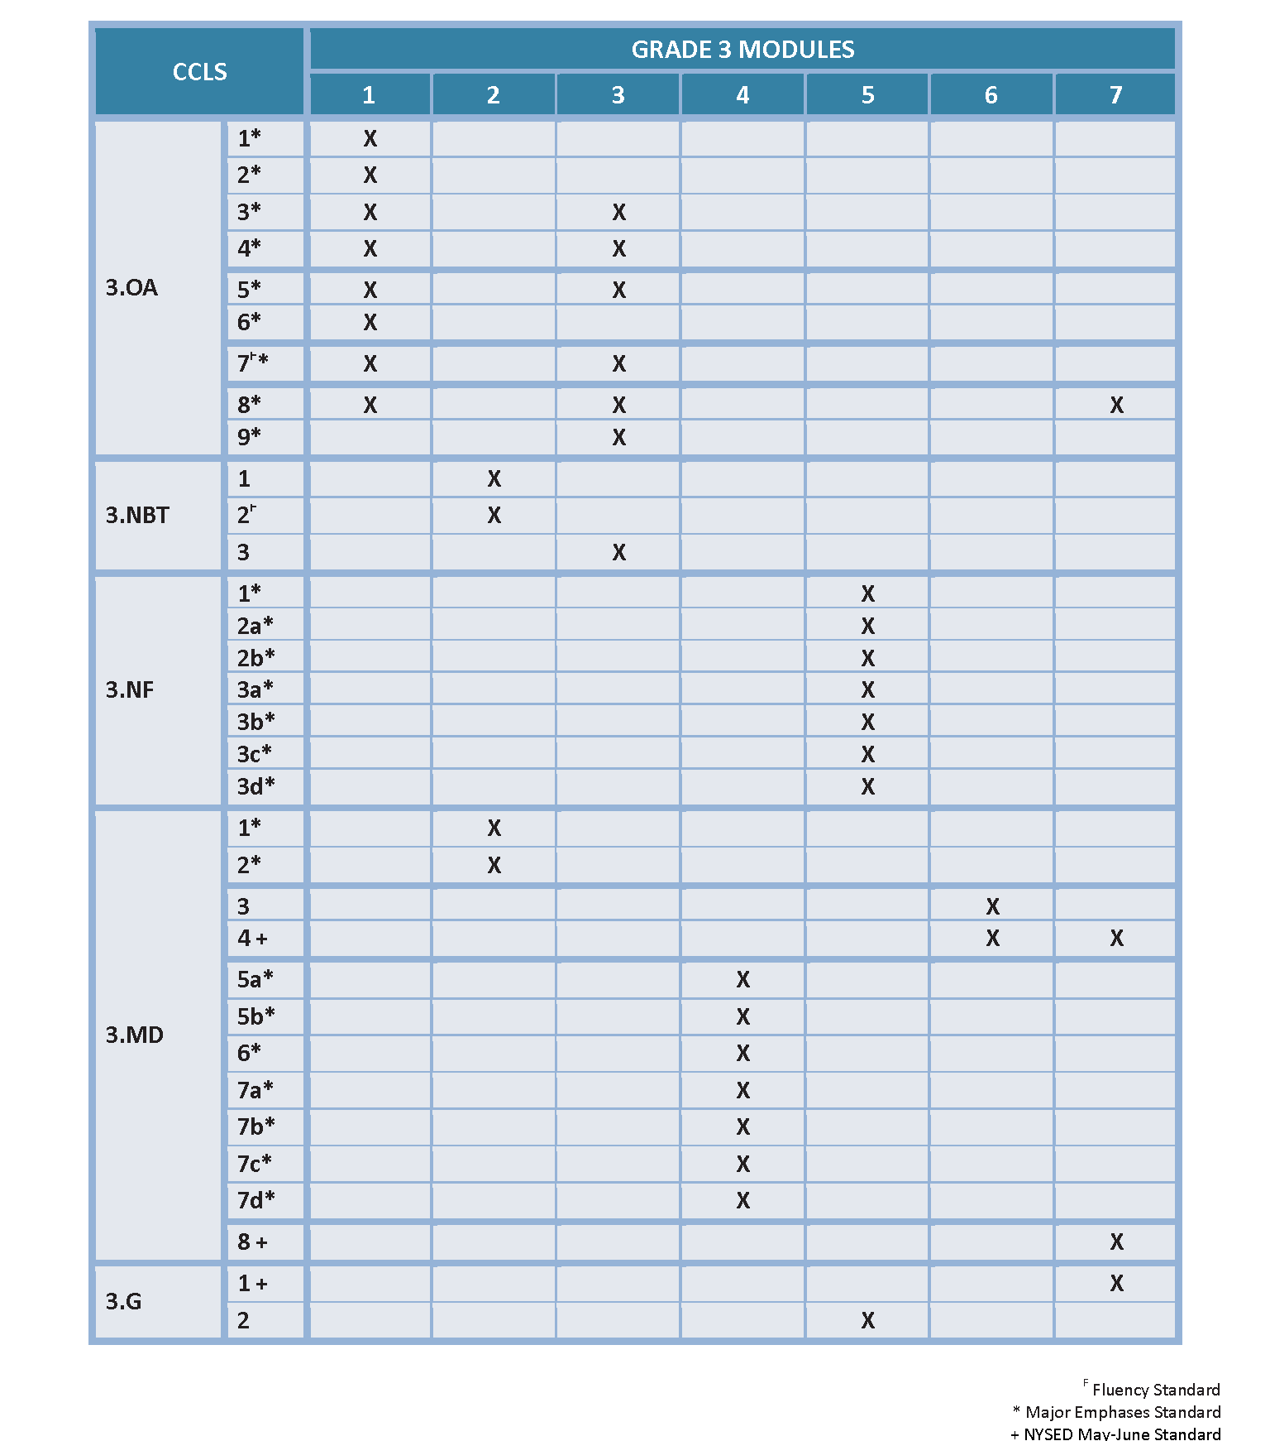
CCLS Checklist for A Story of Units
Notes:
Either play the video provided or use the sequence of animations and accompanying script on the next four “hidden” slides.
TIME ALLOTTED FOR THIS SLIDE:
6 minutes
MATERIALS NEEDED:
CCSS Checklist for A Story of Units

Slide 35
Practice a Planning Protocol
Repeat this process for each lesson.
    Read lesson.
    Study exit ticket. Identify critical portions of concept development and problem set.
    Consider needs of specific students.
    Refer to subsequent exit ticket. Revise implementation plan as needed.
    Make adjustments to the student debrief as needed.
    Consider the other lesson components, ensuring a balance of rigor.
Notes:
Review the planning protocol. If time allows, have participants go through the cycle again for the second lesson of the topic.
TIME ALLOTTED FOR THIS SLIDE:
5 minutes
MATERIALS NEEDED:
The preselected topic

Slide 36
ELA Module Updates
Adopt, Adapt, Refer

Slide 37
Module 9.3 at a Glance
Texts:
  Unit 1: Seed Text as Springboard to Research
    Animals in Translation: Using the Mysteries of Autism to Decode Animal Behavior, Temple Grandin and Catherine Johnson
  Unit 2: The Research Process
    Selected informational texts/articles (National Geographic, New York Times, Wall St. Journal, Science Daily)
  Unit 3: The Writing Process
    N/A
Number of Lessons in Module:
  35 (including Module Performance Assessment)

Slide 38
Module 10.1 at a Glance
Texts:
  Unit 1:
    “The Passionate Shepherd to His Love,” Christopher Marlowe
    “The Nymph’s Reply to the Shepherd,” Sir Walter Raleigh
    “Raleigh was Right,” William Carlos Williams
  Unit 2:
    “The Palace Thief” from The Palace Thief, Ethan Canin
  Unit 3:
    “Rules of the Game” and “Two Kinds” from The Joy Luck Club, Amy Tan
    “Dreaming of Heroes” from Friday Night Lights, H.G. Bissinger
Number of Lessons in Module:
  39 (including Module Performance Assessment)

Slide 39
Module 11.1 at a Glance
Texts:
  Unit 1: “My Last Duchess,” Robert Browning
  Unit 2: Excerpts from Hamlet, William Shakespeare
  Unit 3: Excerpt from A Room of One’s Own, Virginia Woolf
Number of Lessons in Module:
  41 (including Module Performance Assessment)

Slide 40
Writing Instruction in Different Curriculum Modules
Module 10.1
  Explanatory writing
  Identifying and using evidence
Module 9.3
  Writing to analyze sources
  Writing as a product of research

Slide 41
Research Module Overview
Unit 1:
Close Reading
Unit 2:
The Research Process
Unit 3:
The Writing Process
Using seed texts as springboards for exploring topics
Using inquiry to refine and deepen understanding around a topic
Communicating research effectively through writing

Slide 42
Modules’ Approach to Research
Research: NY Curriculum Modules
CCSS Writing
CCSS Reading
Odell Education Research Unit

Slide 43
Assessment Design
http://www.engageny.org/resource/new-york-state-passage-selection-resources-for-grade-3-8-assessments
http://www.engageny.org/resource/selection-of-authentic-texts-for-common-core-instruction-guidance-and-a-list-of-resources
http://www.engageny.org/resource/new-york-state-item-review-criteria-for-grade-3-8-english-language-arts-tests
http://www.engageny.org/resource/new-york-state-common-core-sample-questions

Slide 44
Resources
The module writers are encouraging teachers to send corrections, comments, and suggestions to them at:
nyteacher@commoncore.org
Districts and schools can order Student Handbooks and Teacher Manuals from the writers of the modules at:
www.CommonCore.org
They are also working on Parent Newsletters for every module.

Slide 45
Network Team- Regional
Math
  CCLS- Math Digging Deeper into Geometry-Feb 27, March 20, April 3, May 8
  CCLS-Math Digging Deeper into Algebra Modules- Feb 13, April 10, May 16, May 22
  CCLS Math: Digging Deeper into K-5 Modules- March 5 (north) and March 6 (south) and for grades 6-8 -March 13 (south) and March 18(north)
  Math Networking for K-2 – March 17 and May 19
  CCLS in Math: Working with Fractions, Ratio, Proportions, and Scale March 24

Slide 46
Network Team- Regional
New Math Addition (ha-ha):
  Networking for 6-8 Accelerated Math teachers: 3.14.14, 4.2.14, 5.21.14
  This came from the last middle-level principals meeting.

Slide 47
Network Team- Regional
ELA
  Feb 24 and March 19--- Literacy Leadership Network
  Making Evidence Based Claims- Feb 28
  Researching to Deepen Understanding- March 17

Slide 48
Data-Driven Instruction

Slide 49
PLCs at Work
Follow-up sessions
Coaching available
CNY NYS ASCD Focus
Still working out August 12-14, 2015, to host the real thing in Syracuse. What kind of interest do we have (we have to make a big commitment)?

Slide 50
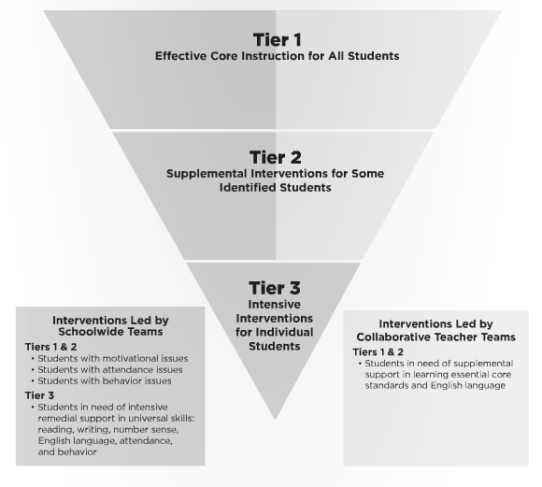
Turn Your RtI Upside Down
Mike Mattos
October 24, 2014
On BOCES
calendar
SRC Arena
is reserved
What do you
think?

Slide 51
Professional Practice

Slide 52
Lead Evaluator Training
From the Review Room: “Describe the process by which evaluators will be trained and the process for how the district will certify and re-certify lead evaluators. Describe the process for ensuring inter-rater reliability. Describe the duration and nature of such training.”
Make sure all of your Lead Evaluators
are getting their required training to be
re-certified

Slide 53
Culture

Slide 54
Assessment & Systems Thinking
 | Classroom Assessments |  | Common Formative Assessments | Common Interim Assessments | Student Learning Objectives | External Assessments
Examples | Worksheets, classroom response, whiteboards, exit tickets, conferences, student self-assessment | Chapter/unit tests, final projects | Common tasks and prompts assessed with rubric, quizzes | Performances, tests, or writing prompts given every 6-8 weeks | Growth measures designed for use with the APPR growth and local achievement | 3-8 tests, Regents exams, SAT, AP
Format | Very formative; can be diagnostic if used prior to instruction | Mostly summative | Formative | Formative and summative | Summative | Very summative
Responsibility | Classroom teachers | Classroom teachers | Grade level/discipline teams of teachers working together. District teams of representative teachers may also look at the data |  | Teachers and lead evaluators/principals | An external group of “experts”
Purpose | Provides immediate feedback and guides instructional decisions | Provision of grades | To assess student learning in order to make instructional decisions. Also serves to assess curriculum, instruction, and pacing. |  | Conversion to scores for use in teacher and principal evaluation | Accountability and placement

Slide 55
Assessment & Systems Thinking
Possible regional RFP
Districts audit their assessments
Create action plan
Work on assessments
Giselle Martin-Kneip is on board, waiting for SED…

Slide 56
Long Term Planning

Slide 57
RTTT Reporting

Slide 58
RTTT and Network Teams
No cost extension
Billing to start up again soon (explanation will come)
Beyond next year?

Slide 59
Regional Vision

Slide 60
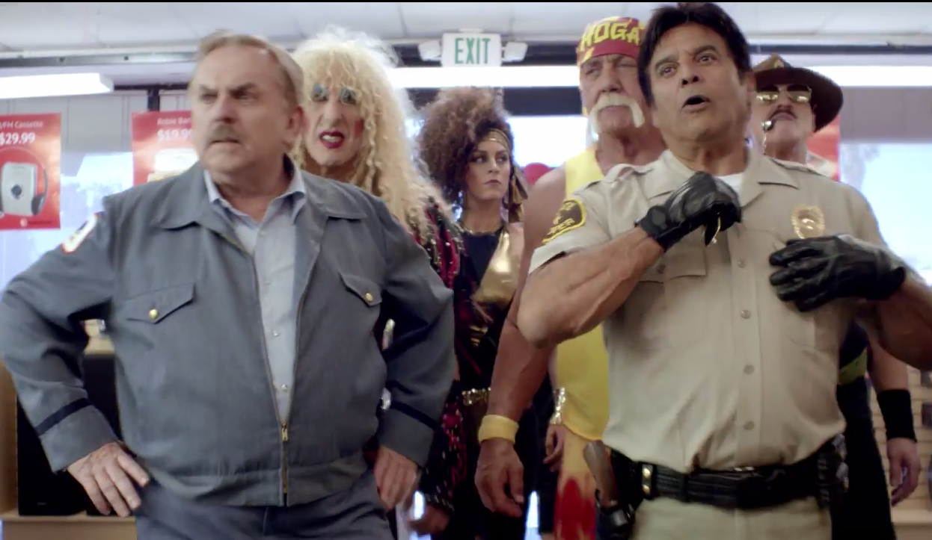

Slide 61
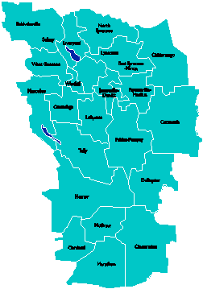
A Vision for Education in
Central New York
College, Career
& Citizenship Readiness
Notes:
Talk about where this vision came from. While it is Colleen and Jeff presenting, the Student Services committee and others have been visiting schools, talking about the future, and developing this vision. In the midst of all the compliance stuff like SLOs, and vested interest, and APPR, it’s been re-invigorating to think about the future and to think about our kids and their future.

Slide 62
Pre-Service Teacher Training
Early College and Dual Enrollment
Professional
Development
School:
Visitations
Observation
Training
(Buck Institute
and NTN)
Coaching
Co-teaching
PBL^{NY}
New Tech Network Model
New Tech High School
CNY New Tech High School in Cortland County
OCM BOCES Programs
Innovation Tech at the Career Academy
District/School-Based
Integrated PBL Courses
Baldwinsville School-
within-a-School
Standards (CCLS, NGSS, SS Framework, NYS Teaching Standards, 4Cs, ISTE, etc.)
Business Partnerships
Notes:
Update on all three of these

Slide 63
Central New York New Tech High School
Multiple districts
Location TBD
September 2015
Begin with grades 9 & 10
NTH@CNY

Slide 64
Baldwinsville New Tech
School-within-a-School (shared campus)
September 2015
Begin with grade 10

Slide 65

Transformation of the Career Academy
September 2014
Begin with grades 9 & 10
Students in grades 11 & 12 complete the Career Academy program, including CTE
Summer 2014-Redesign space to support Innovation Tech model
InnovationTech.us

Slide 66
A Vision for Education in CNY
Teaching that Engages
Culture that Empowers
Technology that Enables

Slide 67


Slide 68

Project Based Learning

Slide 69
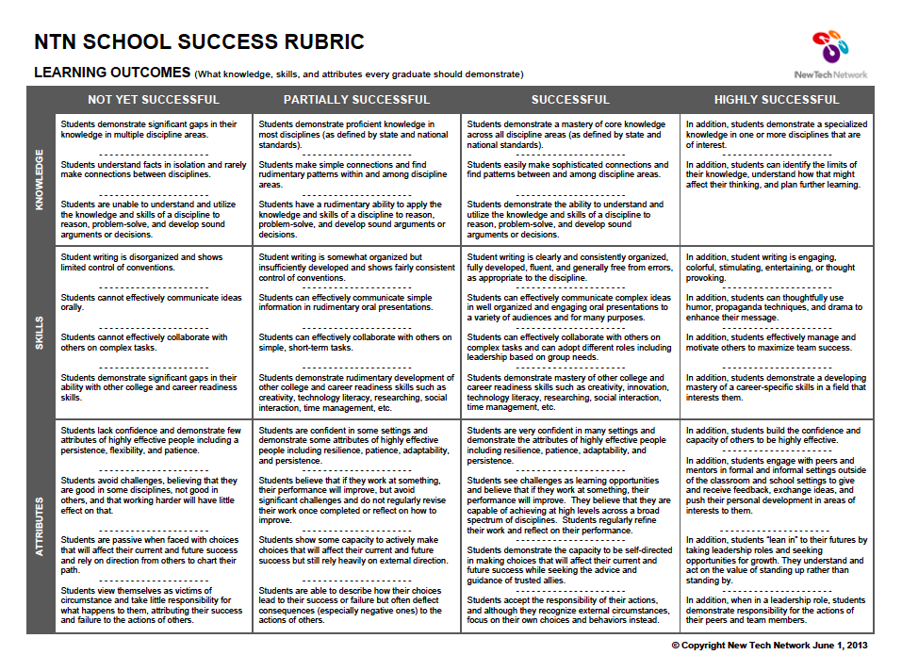
Where in Your Program?

Slide 70
Assessment

Slide 71
3-8 Scoring
Eastside
  ESM
  FM
  JD
  Cazenovia
  Chittenango
  OCM
South
  LaFayette
  McGraw
  Potential site: McEvoy

Slide 72
June Regional Regents Scoring
May meeting for scoring leaders
Anticipate advance training for ELA-Common Core scoring leaders
Commitment to regional scoring and information sent Jan 28.
Please respond by March 3.
Here is the link to the form: https://docs.google.com/forms/d/13NkUPbSgWXWNh7gMbMhCuiidFYpqf5A88AD4FFfX39Q/viewform

Slide 73
Double-Testing Discussion

Slide 74


Slide 75


Slide 76


Slide 77
BCIC Meeting
NEXT
March 20, 2014
Henry Large Conference Room

