Slide 1
BCIC Meeting
December, 2013

Slide 2
Welcome
Introductions
Overview of Agenda

Slide 3

SED Updates

Slide 4
SED Update
January 2014

Slide 5
Graduation
Seal of Biliteracy is coming
Pilot in 2014-2015
Full implementation later

Slide 6
Curriculum and Standards
Research paper on hold
NGSS on hold
SS Frameworks proceeding

Slide 7
NCLB Waiver Request #2
Waiver application being prepared:
Mostly like present waiver
Some accountability adjustments
Some SWD adjustments
Use NYSESLAT before ELLS take ELA

Slide 8
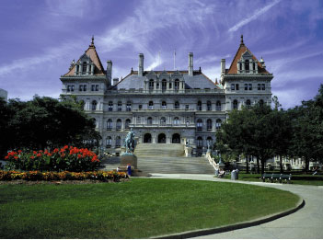
Legislative Updates

Slide 9
Executive Updates
Cuomo says more $, maybe 5%, but…
Pay but not pay for UPK
Education Reform Commission:
  1. Expand early education
  2. Expand the use of technology
  3. Merit pay
  4. Replicate programs to connect high school and college for students
  5. Invest in higher education
  6. Increase efficiencies

Slide 10
Legislative Updates
Flanagan’s report
  More $ for PD
  Delay assessments and data portal
  Testing and privacy laws
Silver’s threat
More $

Slide 11
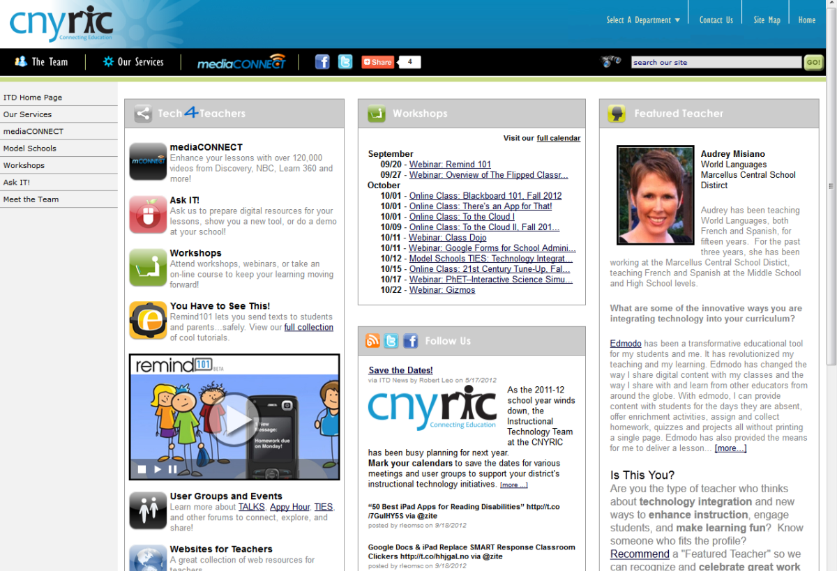
ITD

Slide 12
CI&A
PBL 101- Feb 3
Developing Collaborative Groups: Adaptive Schools- Feb 4
Feb 4- Differentiated Instruction
Students from Poverty- Feb 11
Instructional Strategies for Students from Poverty-Feb 12
Going Deeper into Literacy Shifts: Informational Text- Feb 27
Standards Based Planning for the 21st Century: Instruction for All- starts Feb 27

Slide 13
RBERN Conference
March 10: Key Principles for ELL Instruction:
What We All Need to Know & Do
March 11: Building Coteachers'Identities of Competence

Slide 14
Teacher Centers

Slide 15
Higher Education

Slide 16
CNY NYS ASCD
Data-Driven Instruction theme
October 9: What’s a PLC, Really?
December 10, 2013 – How To Talk (About Common Formative Assessments)
February 27, 2014 – Now What? (Tier 1 Strategies)
March 19, 2014 – How Do I Teach Every Kid? (Meeting the Needs of Diverse Learners)
May 15, 2014 – Annual Meeting at Dinosaur

Slide 17

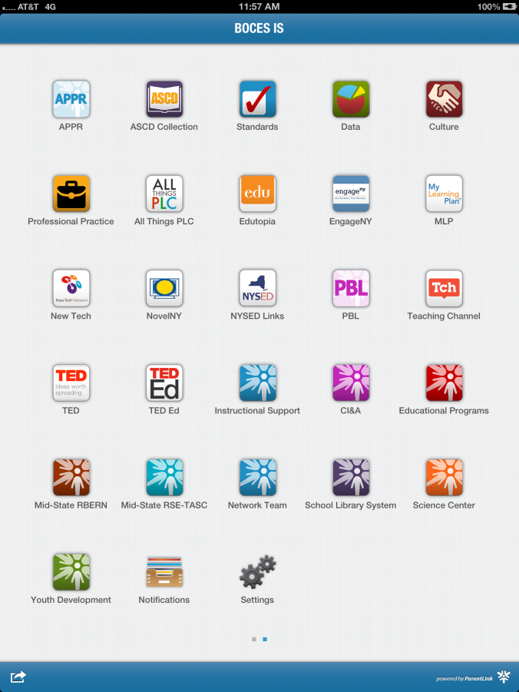
BOCES IS app

Slide 18
OCM BOCES Facilities
Responsible Planning
for the Future

Slide 19
Summary
Improved facilities for our students
Purchase an existing facility and convert it to our use
Discontinue some leases, moving those programs to the purchased facility
Reallocate funds, net cost ≈ $0
Notes:
Highlighted points

Slide 20
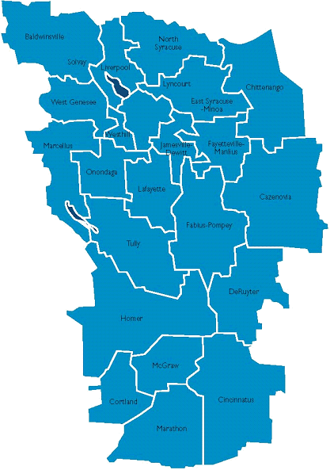
Referendum Details
Thursday, January 23, 2014
10am – 8pm
Three BOCES locations:
  CTC, Liverpool (Main Entrance)
  Henry Campus, Thompson Rd
  (Administration Building)
  McEvoy Center, Cortland
  (Adult Education Entrance)
Notes:
These are the details of the referendum

Slide 21
District Sharing
Onondaga Central School District

Slide 23
Race To The Top
(the Regents Reform Agenda)

Slide 24
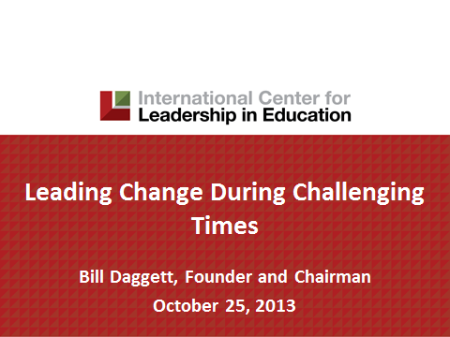
The Need for Change
Bill Daggett
January 9
Summary?
Feedback?
Next Steps?

Slide 25
Network Team- Regional
CCLS- Math Digging Deeper into Geometry-Jan 23 and Feb 7 and Feb 27
Math Networking for K-2 – Jan 27
CCLS-Math Digging Deeper into Algebra Modules- Feb 13
Reading Closely for Textual Details- Jan 27
Core Research: Elementary teams- Jan 31 and Middle and High School- Feb 3
Core Research: Overview for Administrators-Feb 12
Making Evidence Based Claims- Feb 28

Slide 26
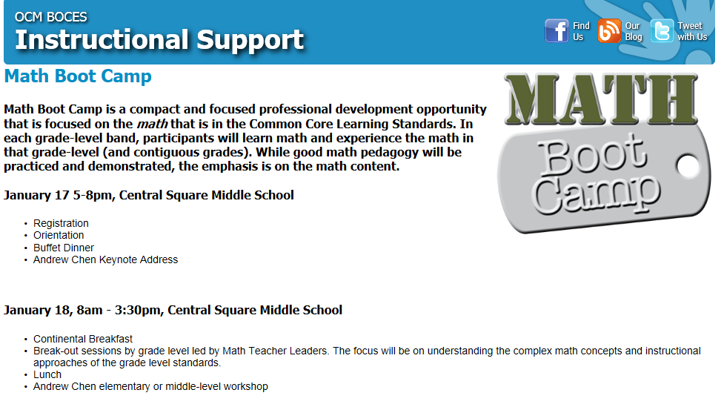

Slide 27
Core Research
Research and the
Common Core Learning Standards (CCLS)

Slide 28
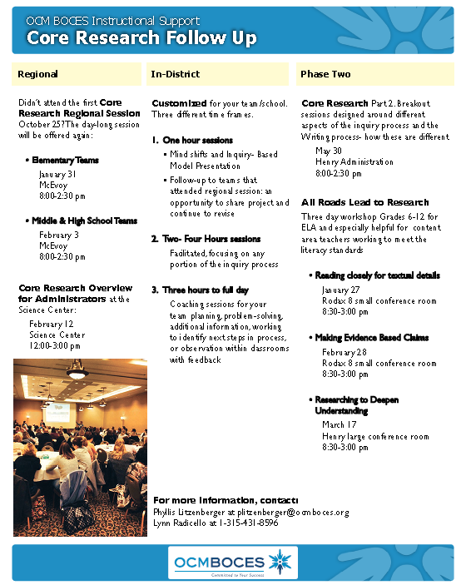
Core Research:
January 31st for Elementary
February 3rd for Middle
and Secondary Levels
At McEvoy

Slide 29
Data-Driven Instruction

Slide 30
PLCs at Work
Follow-up sessions
Coaching available
CNY NYS ASCD Focus
Still working out August 12-14, 2015, to host the real thing in Syracuse. What kind of interest do we have (we have to make a big commitment)?

Slide 31
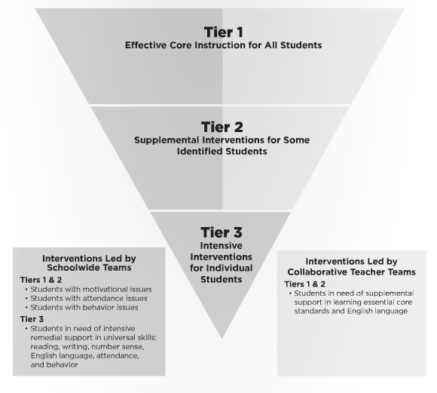
Turn Your RtI Upside Down
Mike Mattos
October 24, 2014
On BOCES
calendar
SRC Arena
is reserved
What do you
think?

Slide 32
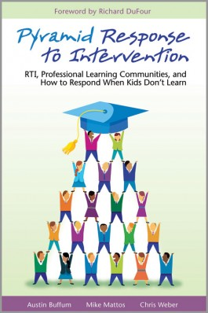
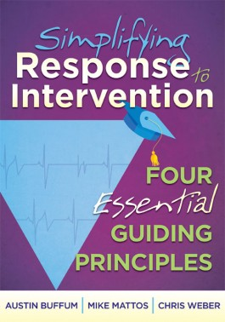
RtI Presents from RSE TASC

Slide 33
Professional Practice

Slide 34
Lead Evaluator Training
From the Review Room: “Describe the process by which evaluators will be trained and the process for how the district will certify and re-certify lead evaluators. Describe the process for ensuring inter-rater reliability. Describe the duration and nature of such training.”
Make sure all of your Lead Evaluators
are getting their required training to be
re-certified

Slide 35
Culture

Slide 36
Assessment & Systems Thinking
 | Classroom Assessments |  | Common Formative Assessments | Common Interim Assessments | Student Learning Objectives | External Assessments
Examples | Worksheets, classroom response, whiteboards, exit tickets, conferences, student self-assessment | Chapter/unit tests, final projects | Common tasks and prompts assessed with rubric, quizzes | Performances, tests, or writing prompts given every 6-8 weeks | Growth measures designed for use with the APPR growth and local achievement | 3-8 tests, Regents exams, SAT, AP
Format | Very formative; can be diagnostic if used prior to instruction | Mostly summative | Formative | Formative and summative | Summative | Very summative
Responsibility | Classroom teachers | Classroom teachers | Grade level/discipline teams of teachers working together. District teams of representative teachers may also look at the data |  | Teachers and lead evaluators/principals | An external group of “experts”
Purpose | Provides immediate feedback and guides instructional decisions | Provision of grades | To assess student learning in order to make instructional decisions. Also serves to assess curriculum, instruction, and pacing. |  | Conversion to scores for use in teacher and principal evaluation | Accountability and placement

Slide 37
Long Term Planning

Slide 38
RTTT Reporting

Slide 39
Other Business

Slide 40
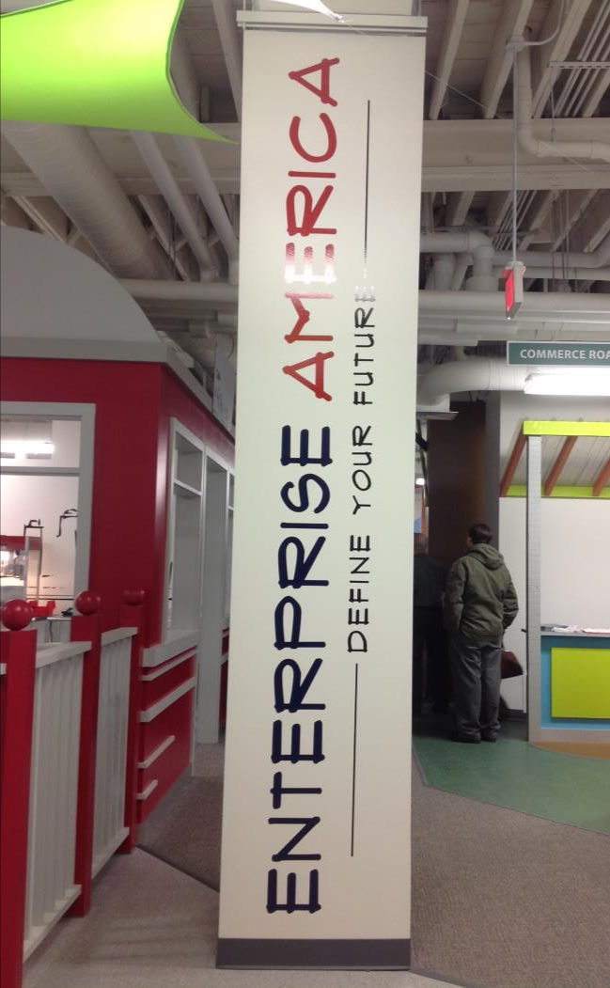
Ready to book
$1175 per class
Like a science kit/system
Aidable

Slide 41

Join us at OCM BOCES January 28th at 3:00p for a demonstration and explanation and receive a copy of SkillsWin! signed by the author, Bill Coplin. Space is limited. Sign up in MLP.

Slide 42

August 5-7, 2014

Slide 43
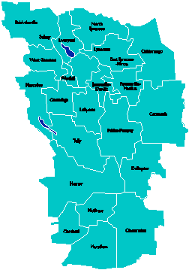
A Vision for Education in
Central New York
College, Career
& Citizenship Readiness
Notes:
Talk about where this vision came from. While it is Colleen and Jeff presenting, the Student Services committee and others have been visiting schools, talking about the future, and developing this vision. In the midst of all the compliance stuff like SLOs, and vested interest, and APPR, it’s been re-invigorating to think about the future and to think about our kids and their future.

Slide 44
Pre-Service Teacher Training
Early College and Dual Enrollment
Professional
Development
School:
Visitations
Observation
Training
(Buck Institute
and NTN)
Coaching
Co-teaching
PBL^{NY}
New Tech Network Model
New Tech High School
CNY New Tech High School in Cortland County
OCM BOCES Programs
Innovation Tech at the Career Academy
District/School-Based
Integrated PBL Courses
Baldwinsville School-
within-a-School
Standards (CCLS, NGSS, SS Framework, NYS Teaching Standards, 4Cs, ISTE, etc.)
Business Partnerships
Notes:
Update on all three of these

Slide 45
Central New York New Tech High School
Multiple districts
Location TBD
September 2015
Begin with grades 9 & 10
NTH@CNY

Slide 46
Baldwinsville New Tech
School-within-a-School (shared campus)
September 2015
Begin with grade 10

Slide 47

Transformation of the Career Academy
September 2014
Begin with grades 9 & 10
Students in grades 11 & 12 complete the Career Academy program, including CTE
Summer 2014-Redesign space to support Innovation Tech model
InnovationTech.us

Slide 48
A Vision for Education in CNY
Teaching that Engages
Culture that Empowers
Technology that Enables

Slide 49
Assessment

Slide 50
LOTE June 2014
Latin –Version A
Italian-
German-
French-
Spanish-

Slide 51
3-8 Scoring
Eastside
  ESM
  FM
  JD
  Cazenovia
  Chittenango
  OCM
South
  Cincinnatus
  LaFayette
  Onondaga
  Fabius-Pompey
  McGraw
  Potential site: McEvoy

Slide 52
Double-Testing Discussion

Slide 53
Double-Testing
If a district opts to have accelerated students take the NYS Grade 7 or 8 Common Core Mathematics Test in addition to one or both Regents Examinations in Algebra, the results from the NYS Grade 7 or 8 Common Core Mathematics Test will be used for institutional accountability purposes rather than the results from a Regents Examination in mathematics.

Slide 54
Double-Testing
Students who take the Regents Examination in Algebra I (Common Core) in grade 7 or 8 will be counted as participants when determining the participation rate in mathematics for the school they attend in grade 7 or 8.

Slide 55
Double-Testing
The result on the Regents Examination in Algebra I (Common Core) taken in grade 7 or 8 will not count towards the participation rate in mathematics for the high school in which they later enroll.

Slide 56
Double-Testing
The same rule would apply for any students who take the Regents Examination in Geometry in grade 7 or 8.

Slide 57
Double-Testing
Results for students who take only the Regents Examination in Algebra I (Common Core) in grade 7 or 8 will be incorporated into the Performance Index for the school in which the student is enrolled. Grade 7 or 8 students who accelerate and obtain, at a minimum, the score on the Regents Examination in Algebra I (Common Core) necessary to meet Regents Diploma requirements will, for the purposes of calculating a school’s or a district’s Performance Index, be counted at the “full credit” level.

Slide 58
Double-Testing
Grade 7 or 8 students who do not obtain scores on the Regents Examination in Algebra I (Common Core) necessary to meet Regents Diploma requirements will earn the school or district ”no credit” for the student’s performance. The same rule will apply to seventh and eighth grade students who take another Regents Examination in mathematics (e.g., Geometry).

Slide 59
Double-Testing
The waiver and proposed regulatory amendments pertain to institutional accountability requirements, not to the requirements that individual students must meet in order to graduate from high school. The waiver does not change (i.e., the waiver neither increases nor decreases) the requirements students must currently meet in order to obtain a diploma.

Slide 60
Double-Testing
However, for institutional accountability, high schools will only get credit in the Performance Index for Regents exams or their equivalents that are taken after a student first enters ninth grade, even if students have taken Regents exams in math or their equivalents in grade 7 or 8.

Slide 61
Double-Testing
Those districts that wish to have seventh or eighth grade students take only the Regents Examination in mathematics will need to make a material change to their approved APPR plan in the State-provided Growth and Other Comparable Measures subcomponent (Task 2), as well as the Locally-Selected Measures subcomponent (Task 3), as applicable.

Slide 62
Double-Testing
If any material changes are made to an approved APPR plan, the school district or BOCES must submit the material changes on a form prescribed by the Commissioner, to the Commissioner for approval. The Commissioner has the authority to reject the plan if any of the changes do not rigorously adhere to the law and regulations.

Slide 63

Double-Testing
Consider Public Perception
Pressure on district
More media
coverage?
Messaging
(remember Bill
Daggett)

Slide 64
BCIC Meeting
NEXT
February 13, 2014
Distance Learning Room

