Slide 1
OCM BOCES Facilities
Responsible Planning for the Future

Slide 2
Facilities Planning
Current Condition
Challenges
Desired State
Proposed Solutions

Slide 3
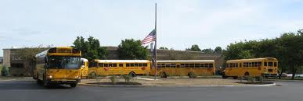
Current Condition
Owned Facilities
Leased Facilities
McEvoy (acquired 1969)
Henry (acquired 1975)
Career Training Center
Rodax 1-3 (CNYRIC)
Rodax 7/8
Science Center
Kasson Road School
St. Cecilia’s School*
Liverpool Community Church*
Cortland Alternative School
* = currently for sale
Henry Campus, Syracuse, NY
McEvoy Campus, Cortland, NY
Notes:
OCM BOCES owns two campuses; our other sites are leased from school districts or other community entities

Slide 4
Challenges
Increasing enrollment in special education
Limited ability to grow in adult education
Adult education students and K-12 students in same building
Meeting district needs
Responsiveness to business community
Quality of leased buildings
Lack of adequate space for instructional programs
Containing the rental budget
Segregated setting at Kasson Road School
Notes:
Because of the nature of the varied services a BOCES provides, facilities can be a challenge. Some of our services are provided centrally, others are provided in our component school districts. While leasing provides flexibility, it is not necessarily the most cost-effective approach.

Slide 5
Desired State
Adult Education in its own facility
Adequate space for programs
Modest amount of room for expansion
Minimize (but not eliminate) leasing
Control growth of capital/rental costs
Notes:
Presently, we have adult education students sharing facilities with K-12 students. The educational needs of these two groups are different. Separate facilities provide better opportunities for each group. If we could relocate our adult education programs to a separate location, space for other cramped programs could be realized. OCM BOCES is growing and that is another reason why additional space is important. If we can accomplish these goals through the consolidation of multiple leased spaces into a BOCES-owned location, programs can be better served and our lease costs can be contained.

Slide 6
Possible Solutions
Status quo
Lease additional space
Do a capital project
Reallocate leasing expenses

Slide 7
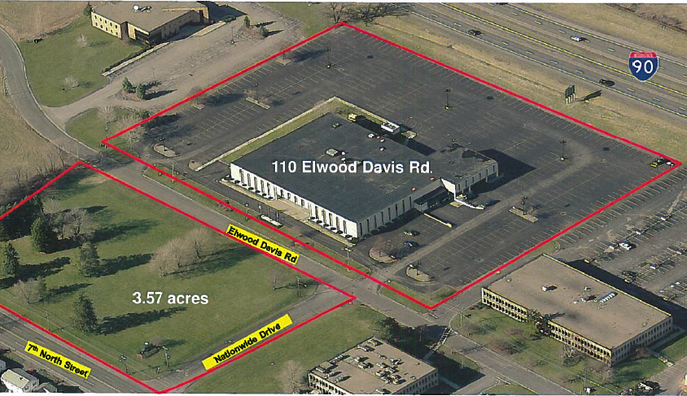
Proposed Solution
Purchase an existing facility and convert it to our use: “Nationwide Building”
Notes:
A facility exists in our community that can meet some of the challenges. There is a now vacant building, located between 7th North Street and the Thruway in the Town of Salina, that is the right size to meet BOCES’ needs. This facility would be home to the adult education programs in Onondaga County. Additionally, it is large enough to allow us to relocate administration, the Science Center, and other departments, allowing us to eliminate several of our leases.

Slide 8
Proposed Solution
Discontinue some leases, moving those programs to the newly purchased facility
Adult Education (from CTC)
Instructional Support (from Rodax 7 & 8)
Administration (from Henry)
Conference Spaces (from Henry & Rodax)
Science Center (from Corporate Drive)
Notes:
This slide lists the programs and departments that would relocate to the new location.

Slide 9
Proposed Solution
Discontinue other leases, moving those programs to the newly vacated facilities
Kasson Road special education program to CTC
STARS alternative high school from St. Cecilia’s in Solvay to Henry
Notes:
This slide lists programs that would move as a result of the changes listed on the previous slide.

Slide 10
Proposed Solution
Present Scenario
CTC $927,000
CAS $245,000
Alt Hmb $ 66,000
Rodax 1-3 $490,000
Rodax 7/8 $138,000
Sci Ctr $ 86,000
St. Cecilia’s $ 51,000
Kasson Rd $135,000
Summer $ 63,000
Site-based $165,000
$2,366,000
Adult Ed-Rental Budget ($410,000)
CNYRIC ($203,000)
$1,753,000
New Debt Srv $ 0
Adult Ed-Debt Paymt $ 0
Net Total $1,753,000
Proposed
CTC $927,000
CAS $245,000
Alt Hmb $ 66,000
Rodax 1-3 $490,000
Rodax 7/8 $ 0
Sci Ctr $ 0
St. Cecilia’s $ 0
Kasson Rd $ 0 Summer $ 63,000
Site-based $165,000
$1,956,000
Adult Ed-Rental Budget ($ 0)
CNYRIC ($203,000)
$1,753,000
New Debt Srv $410,000
Adult Ed-Debt Paymt ($410,000)
Net Total $1,753,000
Notes:
This slide summarizes our leases and debt services. In the scenario we are proposing, the amount of expense saved from the elimination of several leases will directly offset the debt service on the purchase of the building.

Slide 11
To Acquire a Facility
Requires referendum of the “qualified voters of the BOCES district” (popular vote)
Citizen of the US
Age 18
Resident within BOCES for 30 days prior to the referendum
Notes:
A referendum is required to approve the purchase of the building.

Slide 12
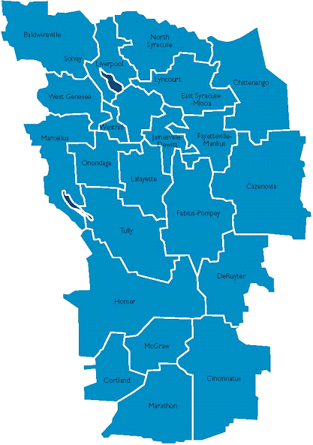
Referendum Details
Thursday, January 23, 2014
10am – 8pm
Three BOCES locations:
CTC, Liverpool (Main Entrance)
Henry Campus, Thompson Rd
(Administration Building)
McEvoy Center, Cortland
(Adult Education Entrance)
Notes:
These are the details of the referendum

Slide 13
Summary
Improved facilities for our students
Purchase an existing facility and convert it to our use
Discontinue some leases, moving those programs to the purchased facility
Reallocate funds, net cost ≈ $0
Notes:
Highlighted points

