Slide 1
BCIC Meeting
October, 2013

Slide 2
Welcome
Introductions
Overview of Agenda

Slide 3
SED Updates

Slide 4
PARCC Timeline
Board of Regents October Agenda
Not sure when decision will be made (but needs to be soon)
Prepare for Computer Based Testing (no matter what)

Slide 5
Common Core Regents Exams
Timeline of the new Regents Examinations:
The Common Core ELA Regents Exam (Grade 11) is required for those students first entering grade 9 in 2013-14 or later
The Common Core Algebra I Regents Exam is required for those students first beginning commencement-level math in 2013-14 or later
For the first year, students enrolled in Common Core classes may take the old ELA or math exam in addition to the new exam and have the higher score count

Slide 7
Common Core Regents Exams
Resources have just been posted:
ELA 11 resources
A1 resources
The transition memo (the September update)

Slide 8
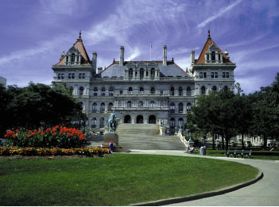
Legislative Updates

Slide 9
ITD

Slide 10
CI&A: Upcoming
NEW-ADDED SESSIONS: PBL Oct 29
Co-Teaching: What to do with two teachers? Nov 13
Responsive Classroom Level 2: Dec 11
Going Deeper into the Literacy Shifts: Text Complexity- Dec 12
Scaffolding for Student Outcomes: Meeting Needs of Diverse Learners- Dec 17

Slide 11
CI&A and Literacy– In the Mix
PBL- Sessions, On-site presentations, Coaching
Responsive Classroom Level One
Standards Based Planning
LLI groups- Initial K-2, Ongoing and Initial Intermediate (10/29)
Curriculum Development
Support for data gathering for school planning
Research-Oct 25--- Full with wait list.

Slide 12
Teacher Centers

Slide 13
Higher Education

Slide 14
CNY NYS ASCD
Data-Driven Instruction theme
October 9: What’s a PLC, Really?
December 10, 2013 – How To Talk (About Common Formative Assessments)
February 27, 2014 – Now What? (Tier 1 Strategies)
March 19, 2014 – How Do I Teach Every Kid? (Meeting the Needs of Diverse Learners)
May 15, 2014 – Annual Meeting at Dinosaur

Slide 15
Home School Service
Some Interest Expressed
Forms
Process and procedures
“Accountability”
CSA Committee says “go”

Slide 17
Race To The Top
(the Regents Reform Agenda)

Slide 18
Modules
What the are we doing?
The chart is available
What have we learned so far?
ELA support is scheduled
Math support is scheduled
Flexibility and recovery

Slide 19
Math Boot Camp
Friday night keynote address and warm-up activity
Saturday grade level groups doing the math in their grade level

Slide 20
Math Boot Camp
Probable location: Central Square Middle School
Probable date: January, TBA
Oswego/OCM BOCES/TC Joint Project

Slide 21
Core Research Research and the Common Core Learning Standards (CCLS)

Slide 22
Core Research Update
October 25th status
Post-October 25th
engageNY samples
research.ocmboces.org

Slide 23
Data-Driven Instruction

Slide 24
PLCs at Work
Follow-up sessions
Coaching available
CNY NYS ASCD Focus

Slide 25
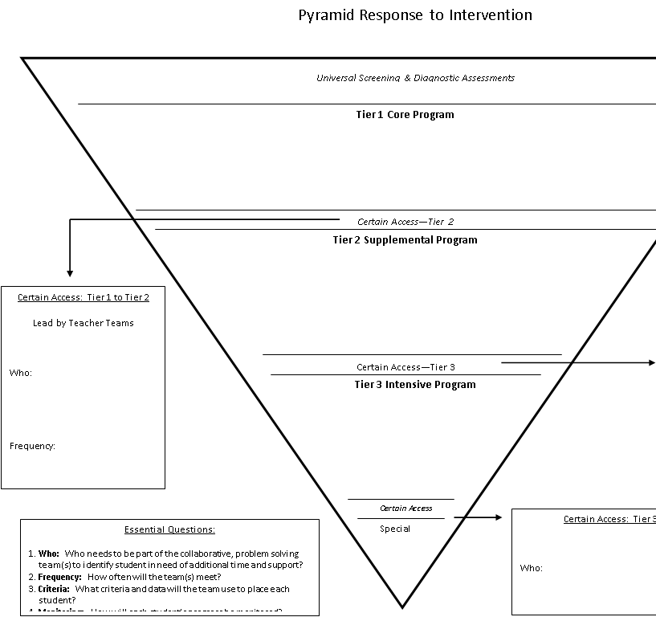
Turn Your RtI Upside Down
It is possible that Mike Mattos might be here on October 24, 2014
CSA Calendar Committee knows
SRC Arena is reserved

Slide 26
Opportunity: State DDI project for grades 3-8
To address question of are students reaching standards ?
Larger n; common quick assessment
To examine if there is difference between adopting, adapting, referring to modules?

Slide 27
Broome Tioga BOCES convened group to write short common periodic assessments for 3-8 ELA and Math
Designed to be administered within windows within module schedule
Data shared (region by region) to gather information on student progress towards achievement of standards

Slide 28
ELA
Grade | Length | Format | Modules
3 | 40 minutes 1 source | 4 Multiple Choice 1 Extended Written Response | Module 1 : Becoming a Close Reader and Writing to Learn: The Power of Reading Module 2A : Researching to Build Knowledge and Teaching Others: Adaptations and the Wide World of Frogs Module 3A: Considering Perspectives and Supporting Opinions: Staging Stories
4 | 40 minutes 2 sources | 4 Multiple Choice 1 Extended Written Response | Module 1: Becoming a Close Reader and Writing to Learn: Native Americans in New York Module 2A: Researching to Build Knowledge and Teaching Others: Interdependent Roles in Colonial Times Module 3A: Considering Perspectives and Supporting Opinions: Simple Machines
5 | 40 minutes 2 sources | 4 Multiple Choice 1 Extended Written Response | Module 1: Becoming a Close Reader and Writing to Learn: Stories of Human Rights Module 2A : Researching to Build Knowledge and Teaching Others: Biodiversity in Rainforests of the Western Hemisphere Module 3A: Considering Perspectives and Supporting Opinions: Sports and Athletes’ Impact on Culture
6 | 40 minutes 2 sources | 6 Multiple Choice 1 Extended Written Response | Module 1: Close Reading and Writing to Learn: Myths: Not Just Long Ago Module 2A: Working with Evidence: Rules to Live By Module 3A:Understanding Perspectives: The Land of the Golden Mountain
7 | 40 minutes 2 sources | 6 Multiple Choice 1 Extended Written Response | Module 1: Close Reading and Writing to Learn: Journeys and Survival Module 2A: Working with Evidence: Working Conditions Module 3A: Understanding Perspectives: Slavery: The People Could Fly
8 | 40 minutes 2 sources | 6 Multiple Choice 1 Extended Written Response | Module 1: Close Reading and Writing to Learn: Finding Home: Refugees Module 2A: Working with Evidence: Taking a Stand Module 3A: Understanding Perspectives: Japanese American Relations in WWII

Slide 29
MATH (highlighted modules not available as of 9/25/13
Grade | Length | Format | Modules
3 | 40 minutes | 10 Multiple Choice 2 Constructed Response | Module 1: Properties of Multiplication and Division and Solving Problems with Units of 2–5 and 10 Module 3: Multiplication and Division with Units of 0, 1, 6–9, and Multiples of 10 Module 4: Multiplication and Area
4 | 40 minutes | 10 Multiple Choice 2 Constructed Response | Module 1: Place Value, Rounding, and Algorithms for Addition and Subtraction Module 3: Multi-Digit Multiplication and Division Module 4: Angle Measure and Plane Figures
5 | 40 minutes | 10 Multiple Choice 2 Constructed Response | Module 1: Place Value and Decimal Fractions Module 3: Addition and Subtraction of Fractions Module 4: Multiplication and Division of Fractions and Decimal Fractions
6 | 40 minutes | 10 Multiple Choice 2 Constructed Response | Module 1: Ratios and Unit Rates Module 3: Rational Numbers Module 4: Expressions and Equations
7 | 40 minutes | 10 Multiple Choice 2 Constructed Response | Module 1: Ratios and Proportional Relationships Module 2: Rational Numbers Module 4: Percent and Proportional Relationships
8 | 40 minutes | 10 Multiple Choice 2 Constructed Response | Module 1: Integer Exponents and Scientific Notation Module 3: Similarity Module 5: Examples of Functions from Geometry

Slide 30
Any OCM District may participate:
Please notify Lynn if interested by Nov 1
District will have access to assessments and schedule
Report district data and participate in larger data analysis

Slide 31
Professional Practice

Slide 32
Parent APPR Reporting
Regional approach
67% writing/writing
30% writing/verbal
Resources prepared
Requests to date, very low

Slide 33
Training (APPR)
Lead Evaluator Training
Year one cohort
Ongoing (3 days)
October 28 or 29
Please make sure people know and are signed up
Principal Evaluator Training
Ongoing (3 days)

Slide 34
SLO Season
Lessons Learned (APPR 2.0 session)
It is about setting a target for the students and then determining the percent of student who meet the target (avoid confounding double-target)
Our assessments aren’t all that great
More testing means less learning

Slide 35
Culture

Slide 36
Assessment & Systems Thinking
 | Classroom Assessments |  | Common Formative Assessments | Common Interim Assessments | Student Learning Objectives | External Assessments
Examples | Worksheets, classroom response, whiteboards, exit tickets, conferences, student self-assessment | Chapter/unit tests, final projects | Common tasks and prompts assessed with rubric, quizzes | Performances, tests, or writing prompts given every 6-8 weeks | Growth measures designed for use with the APPR growth and local achievement | 3-8 tests, Regents exams, SAT, AP
Format | Very formative; can be diagnostic if used prior to instruction | Mostly summative | Formative | Formative and summative | Summative | Very summative
Responsibility | Classroom teachers | Classroom teachers | Grade level/discipline teams of teachers working together. District teams of representative teachers may also look at the data |  | Teachers and lead evaluators/principals | An external group of “experts”
Purpose | Provides immediate feedback and guides instructional decisions | Provision of grades | To assess student learning in order to make instructional decisions. Also serves to assess curriculum, instruction, and pacing. |  | Conversion to scores for use in teacher and principal evaluation | Accountability and placement

Slide 37
Common Formative Interim Assessment
Common Formative Interim Assessment
Common Formative Interim Assessment
September
June
UNIT
UNIT
UNIT
UNIT
UNIT
UNIT
SLO Baseline
Common Formative Interim Assessment
Common Formative Interim Assessment
SLO Summative

Slide 38
Assessment
What is the current “story” of assessment?

Slide 39
Assessment
What do we want to assess?
What do we assess?
Coherence & systems thinking
Are we missing an opportunity?

Slide 40
Long Term Planning

Slide 41
RTTT Reporting

Slide 42
Other Business

Slide 43
Enterprise America
WCNY October 30th 2:00p
Education Center 3:30p

Slide 44
Odds & Ends
Enterprise America status?
Regional Summer School Report out
Regional Vision/New Tech
PBLNY
Yong Zhao, Sam Chaltain, Suzie Boss, Ron Berger
PBL 101
PBL Leadership, PBL Systems

Slide 45
BCIC Meetings This Year
Share a practice
10 minute slot per meeting
Volunteers?
Set up a schedule?

Slide 46
BCIC Meetings Next Year
3rd Thursday of the Month
Do you care for next year?
Rodax 8 Large for next year?

Slide 47
Assessment

Slide 48
January 2014 Regional Regents Scoring
Please respond to quick link --- deadline is November 15th.
Scoring leaders are important so please consider nominating capable teacher leaders

Slide 49
3-8 Cluster Scoring
3-8 Presentation today from one vendor
3-8 Tentative participation due by Dec
Reconfigure sites and finalize schedule as needed

Slide 50
BCIC Meeting
NEXT
November 14, 2013
Rodax 8 Small Conference Room

