Slide 1
BCIC Meeting
September, 2013

Slide 2
Welcome
Introductions
Overview of Agenda

Slide 3
SED Updates

Slide 4
SED Updates

Slide 5
SED Updates
Assessment
PARCC Filed testing
To PARCC or not to PARCC

Slide 6
SED Updates
APPR
Growth Scores to 4-8 math & ELA teachers
Reporting scores to Level 0 right now
Parent notification
Public release to teacher and principal scores

Slide 7
SED Updates
Curriculum
Modules are not science (instruction
Module schedule
More A1 just added
Research requirement

Slide 8
SED Updates
McKinney-Vento
Go to workshop or watch webinar

Slide 9
Legislative Updates

Slide 10
ITD

Slide 11
CI&A Upcoming
Standards Based Planning for the 21st Century-Instruction for All: Oct 2,3, Nov 4,5, Dec 10
Project Based Learning 101: Oct. 7,11, Nov 8
Responsive Classroom Level One: Oct 16,17,18, Nov 14,15
Formative Assessment: Strategies to Improve Instruction and Student Learning: Oct 21

Slide 12
Teacher Centers
New Teacher Welcome Project
24 teachers
Oswego & OCM
OCM DISTRICTS: Cazenovia, FM, Fabius-Pompey, Homer, McGraw, Solvay
“You guys organized a great seminar! Lots of learning took place and you made us feel exited about the profession. Thanks again and best wishes!”

Slide 13
Teacher Centers
New Teacher Welcome Project
24 teachers
Oswego & OCM
OCM DISTRICTS: Cazenovia, FM, Fabius-Pompey, Homer, McGraw, Solvay

Slide 14
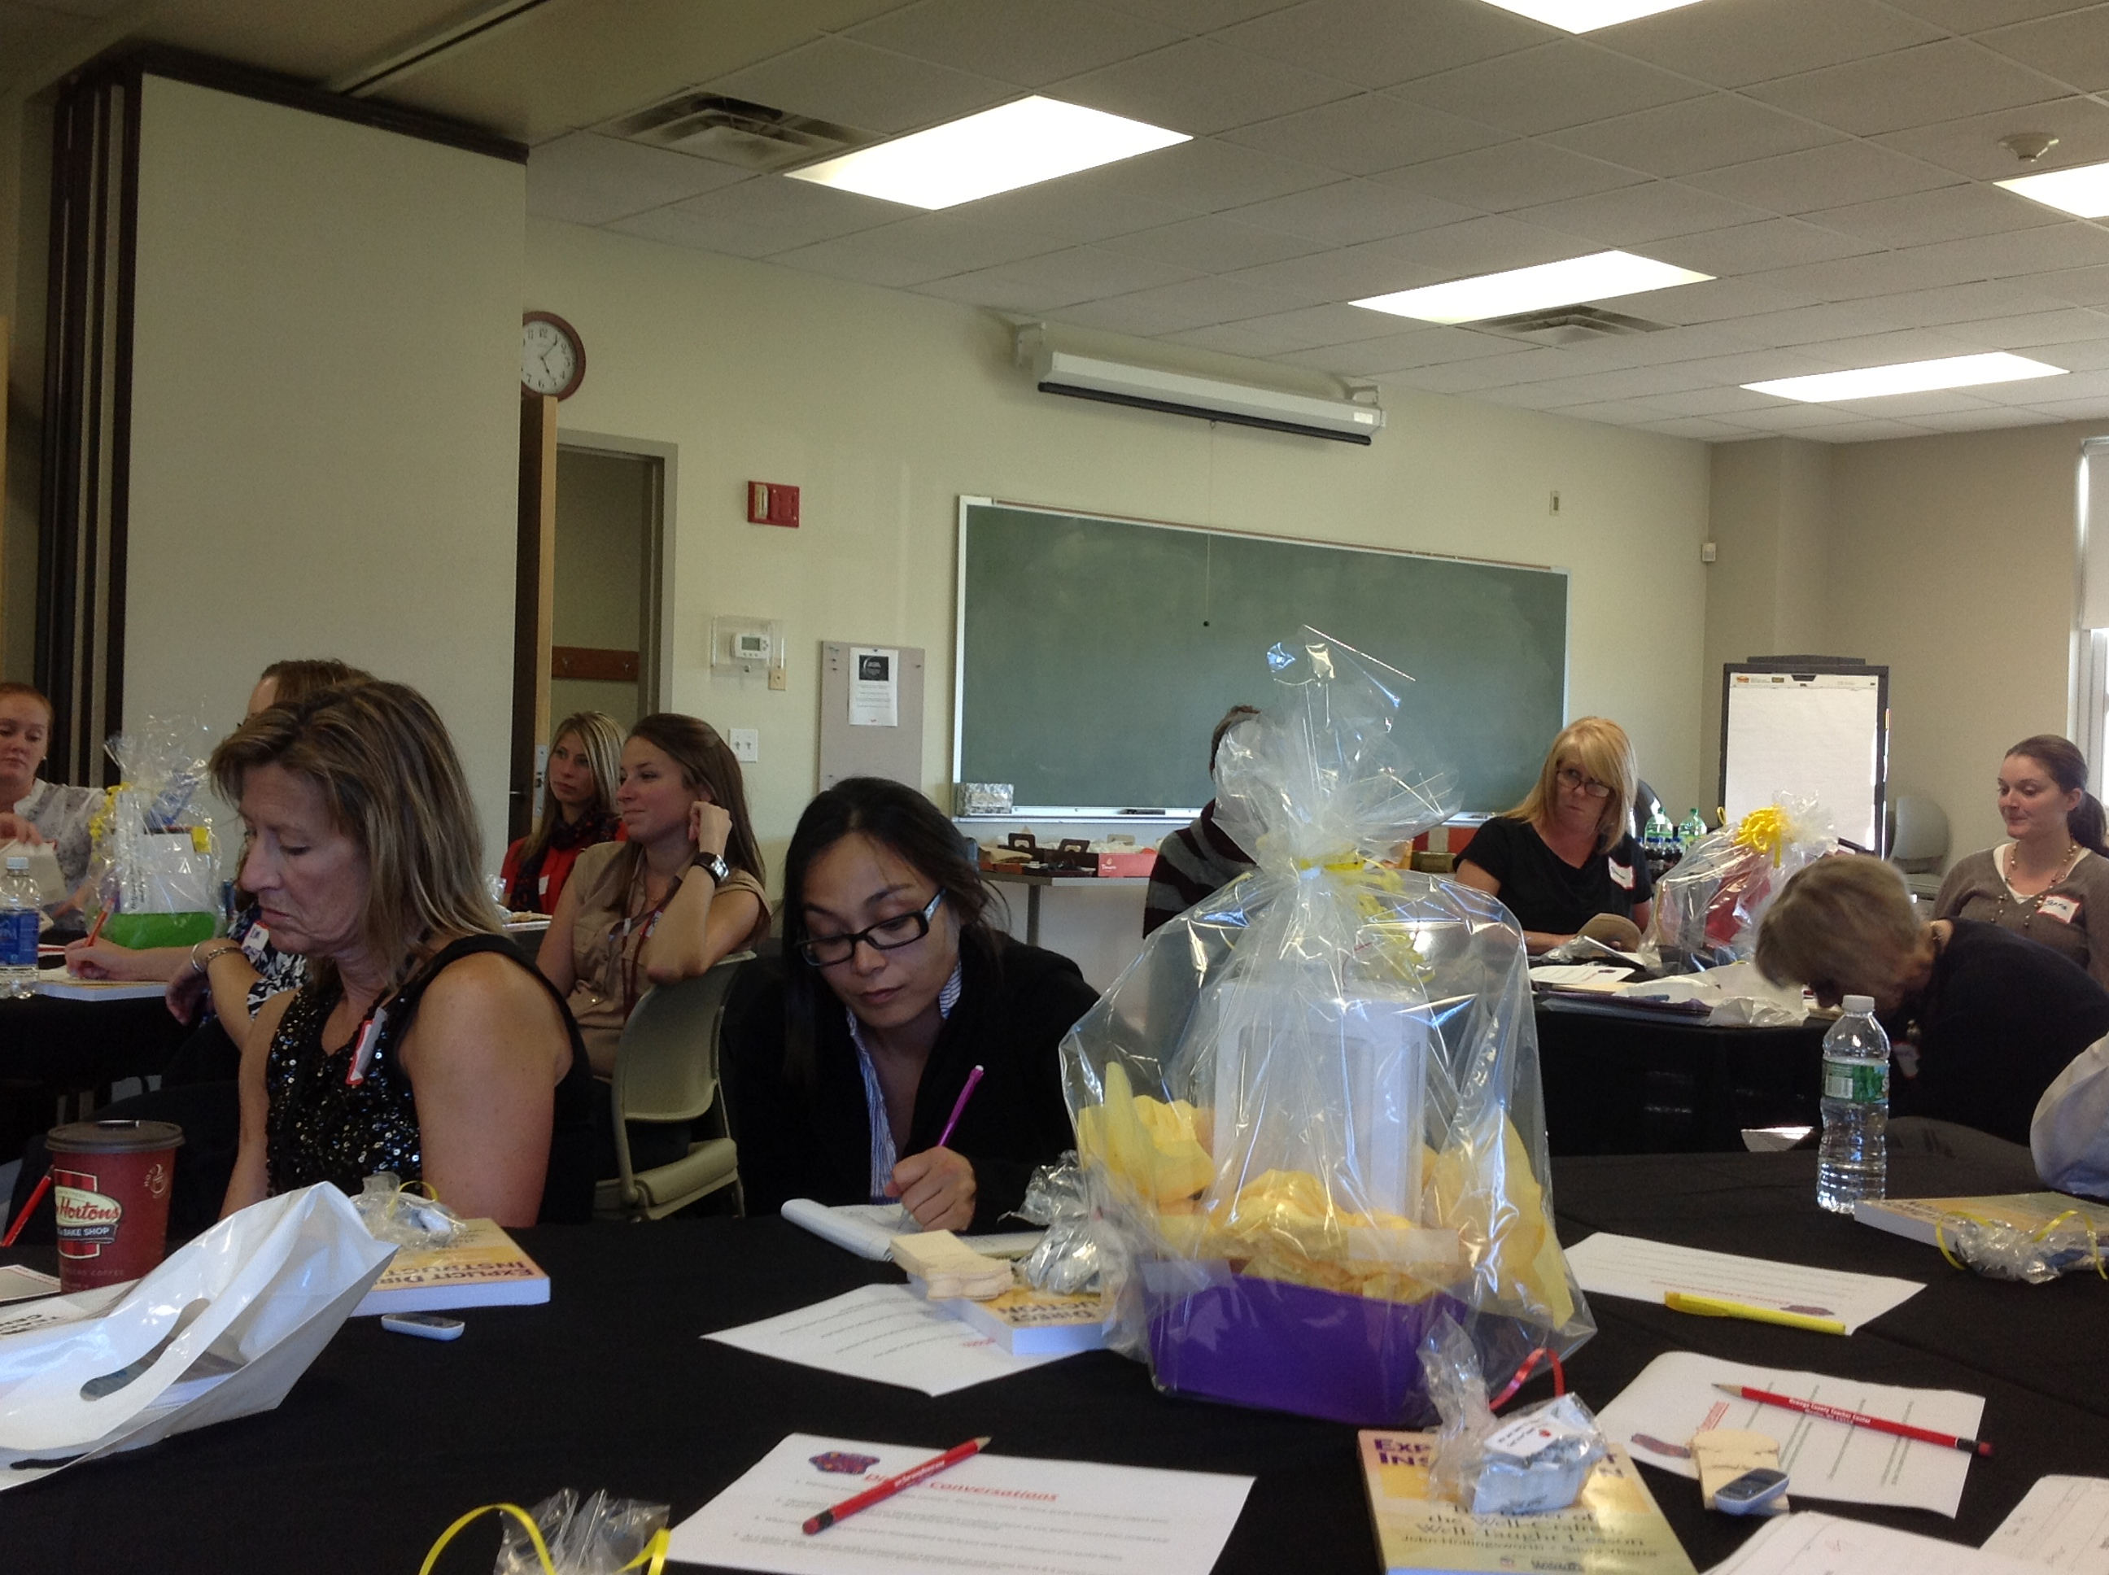
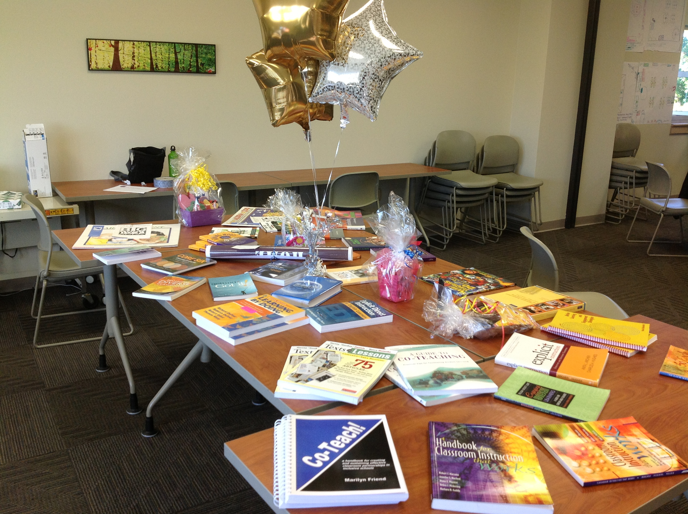
Teacher Centers
New Teacher Welcome Project
“You guys organized a great seminar! Lots of learning took place and you made us feel exited about the profession. Thanks again and best wishes!”

Slide 15
Higher Education

Slide 16
ISS NEWS
Some new staff:
Tanya Rosada-Barringer (RBERN)
Catie Reeve (NT/CIA)

Slide 17
CNY NYS ASCD
Data-Driven Instruction theme
October 9: What’s a PLC, Really?
December 10, 2013 – How To Talk (About Common Formative Assessments)
February 27, 2014 – Now What? (Tier 1 Strategies)
March 19, 2014 – How Do I Teach Every Kid? (Meeting the Needs of Diverse Learners)
May 15, 2014 – Annual Meeting at Dinosaur

Slide 18
Grant Writing
Grant Writing Service is re-activated (link)
Four levels
Aidable

Slide 19
Home School Service
Some Interest Expressed
Forms
Process and procedures
“accountability”
Any other interest? Explore further?

Slide 20
CNY LDP
New Year One Cohort
North Syracuse, FM, Liverpool
Year Two cohort, too
North Syracuse, FM

Slide 21
Race To The Top
(the Regents Reform Agenda)

Slide 22
Metrics and Expectations
SED for 2013-2014
At implementation?

Slide 23
Materials Selection

Slide 24
Modules
What the $#@& are we doing?
Go around and fill in the chart
What have we learned so far?
If printing, do we want coordination?
ELA support is scheduled
Math support is scheduled
Flexibility and recovery

Slide 25
Kit (1st Grade 8.4)
Kit's mom gets up at six.
Kit's mom gets dad up.
Kit's mom gets Kit up.
Kit's mom gets dad fed.
Kit's mom gets Kit fed.
Kit's mom gets Kit's pets fed.

Slide 29
Science
Next Generation Science Standards
Comment still open
Decision ???

Slide 30
Core Research Research and the Common Core Learning Standards (CCLS)

Slide 31
What is it?
Core Research is an inquiry-based research process for use in grades K – 12. Research is the process we use to find the right information when we need it, and to effectively present the results of that research in writing and other ways.
All roads lead to research.

Slide 32
How is this different?
The focus is on inquiry-based research and how that’s related to the Common Core. It’s not about searching for information to support conclusions we’ve already made. Instead, it’s about research to deepen understanding and the accompanying expression of that understanding.

Slide 33
Why?
Our students need to be able to find, evaluate, and apply information now. More importantly, the ability to research and to express an understanding of it are authentic college and career ready skills.

Slide 34
Useful/important links to engageny
The five subshifts: http://www.engageny.org/sites/default/files/resource/attachments/sub_shifts.final_.doc
The Research and Writing Process: http://www.engageny.org/sites/default/files/resource/attachments/writing_standards_graphic2a.docx
Writing Standards K – 5: http://www.engageny.org/sites/default/files/resource/attachments/writing_standards_research_table_k-5.final_.doc
Writing Standards 6 – 8: http://www.engageny.org/sites/default/files/resource/attachments/writing_standards_research_table_6-8.final_.doc
Writing Standards 9 – 12: http://www.engageny.org/sites/default/files/resource/attachments/writing_standards_research_table_9-12.final_.doc

Slide 35
BOCES Instructional Support Team (IS) can help.
Instructional Support Services has created a web page of materials to support Core Research. It can found in the following locations:
C I & A Professional Development
http://cia.ocmboces.org/
Network Team
http://networkteam.ocmboces.org
School Library System
http://sls.ocmboces.org/

Slide 36
Regional Training Opportunity for Teacher/Librarian Teams – October 25, 2013, 8a – 3p
Expected outcomes:
Identify the components of a Common Core-aligned inquiry and research process.
Explain how a Common Core-aligned research project emphasizes questioning, inquiry, and deepening and explaining understand rather than defending a position.
Understand that inquiry and research are iterative, cyclical processes.
Have the opportunity to develop a new research plan or refine an existing research plan to align with the CCLS.

Slide 37
After the Regional Training Opportunity…
There will be additional/follow-up training for Teacher/Librarian teams offered through School Library System, Network Team and C I & A. Training can be individualized, at your school, at BOCES, and other locations.

Slide 38
October 25 is not the end – it’s just the beginning.

Slide 39
Data-Driven Instruction

Slide 40
PLCs at Work
Follow-up sessions
Coaching available
CNY NYS ASCD Focus
Note: It is possible that Mike Mattos might be here on October 24, 2014, for Turn Your RtI Upside-Down

Slide 41
Professional Practice

Slide 42
Parent APPR Reporting
Regional approach
67% writing/writing
30% writing/verbal
Resources prepared
Requests to date, very low

Slide 43
Training (APPR)
Lead Evaluator Training
Year one cohort
Ongoing (3 days)
Principal Evaluator Training
Ongoing (3 days)

Slide 44
SLO Season
Lessons Learned (APPR 2.0 session)
It is about a setting a target for the students and then determining the percent of student who meet the target (avoid confounding double-target)
Our assessments aren’t all that great
More testing means less learning

Slide 45
Culture

Slide 46
Long Term Planning

Slide 47
RTTT Finances

Slide 48
Other Business

Slide 49
Odds & Ends
Enterprise America
Regional Summer School Report
Regional Vision/New Tech
PBLNY
Yong Zhao, Sam Chaltain, Suzie Boss, Ron Berger
PBL 101
PBL Leadership, PBL Systems

Slide 50
Assessment

Slide 51
June 2013 Regional Regents Scoring
Accomplished
All exams and scorers were at designated places and times
Tully hosting and facilities were outstanding
First take at “mixing cultures”
Networking and sharing across districts with some future plans made

Slide 52
Test | # Papers | # Scorers | Time Taken | Notes
ELA | 276 | 8 | 1.5 days
Living Environment | 264 | 6 | 1 day and 1.5 hours | One more team needed to finish in one day
US History | 283 | 10 | 1.5 days | One team took 1.5 hours longer
Algebra | 249 | 9 | 1 day
Global | 289 | 10 | 1 day and 2 hours
Physics | 158 | 6 | 1 day
Earth Science | 349 | 8 | 2 days | Have teams of 3-4 Clear directions on lab portion
Algebra 2 | 171 | 6 | Not quite full day
Chemistry | 236 | 8 | 1 day
Geometry | 184 | 6 | Just over ½ day

Slide 53
Notes for next time
Scoring leaders – need teacher leaders for consistency- perhaps then not have them score
Have more OCM BOCES staff on site –especially in mornings
Explicit directions for packing and shipping student papers
Updated rosters
Keep teams and papers by district (thus all papers from single district were scored by same scoring team)

Slide 54
Notices:
This is a cultural shift: teachers struggled with not knowing final scorers for individual students
This is a cultural shift: some teacher teams struggled to trust colleagues
This is a cultural shift: some reluctance to be teacher leader- trainer to review scoring expectations and rubrics
When the technology works, life is good

Slide 55
3-8 Cluster Scoring
Commitment from districts
Same clusters? Locations?
Calendaring
One grade per day
Regional schedule/coordinate with RIC
Interested in a presentation from a vendor?

Slide 56
BCIC Meeting
NEXT
October 17, 2013

