Slide 1
Math 7-12 Committee
October 29, 2015

Slide 2

Agenda
Welcome & Introductions
Math Task
Background on Committee Work
Overview of Committee Goals
Exploring Problem-Based Learning
Collaborating in Teams to Design Problem-Based Learning Project
Next Steps

Slide 3
Welcome & Introductions

Slide 4
Math Task

Slide 5
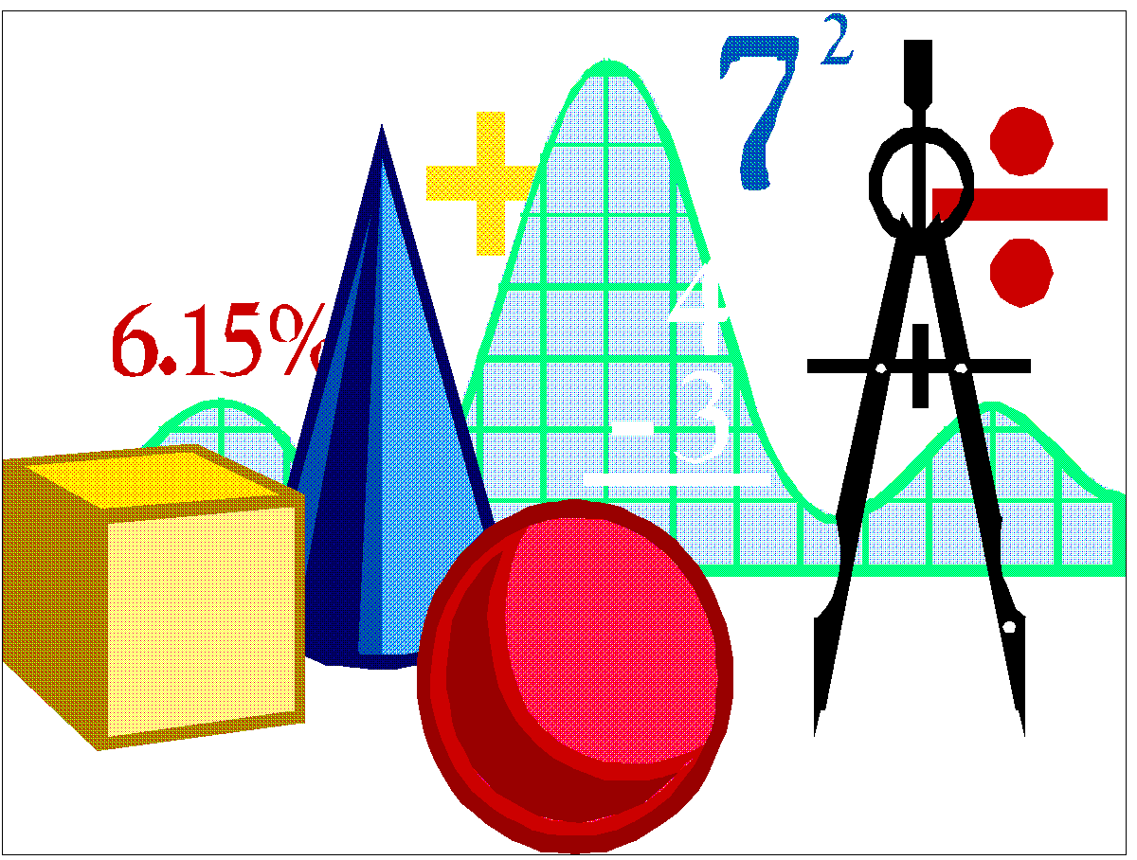
History of the 7 – 12 Math Committee

Slide 6
January – June 2013
Goals of the Committee
Use data to analyze students’ math skills.
Research and recommend Math Intervention Programs for 7th,8th and 9th grades.
Research and recommend what resources/textbooks should be purchased to support instruction aligned with the Common Core at the 7th and 8th grade level.

Slide 7
2013 – 2014
Goals of the Committee
Develop a common understanding of Common Core Shifts, Mathematical Practices and Standards as a Committee.
Develop meaningful ways to improve students’ writing skills in math.
Gain a common understanding of literacy in the math class.
Use data to analyze students’ math skills
Analyze the effectiveness of Math Interventions.

Slide 8
2014- 2015
Goals of the Committee
Develop a common understanding of Common Core Shifts, Mathematical Practices and Standards.
Use data to analyze students’ math skills.
Research and recommend what resources/textbooks should be purchased to support instruction aligned to the Common Core High School (9 and 10).
Analyze the effectiveness of Math Intervention Programs.
Develop meaningful ways to improve students’ writing skills in math.
Create a focus on mathematical practices through Instructional Rounds.

Slide 9
Overview of
Committee Goals

Slide 10
2015-2016
Goals of the Committee
Develop meaningful ways to incorporate more literacy in math
Develop teacher-created resources for math courses; Design problem-based learning projects
Use data and student work to analyze students’ math skills
Research and recommend resources that should be purchased to support instruction (9-12)

Slide 11
Exploring Problem-Based Learning

Slide 12
Collaborating in Teams to Design Problem-Based Learning Project

Slide 13
Next Steps

