Slide 1
Literacy in the Math Class
Math Committee 3/10/16

Slide 2
What does it mean to be literate?

Slide 3
Some definitions:
Acquisition and learning and how the combination of the two allows one to communicate
Socially recognized ways of generating, communicating, and negotiating meaningful content through the medium of encoded text
Code breaker, text participant, text user and text analyst
Use and critically examine the text

Slide 4
What does it mean to mathematically literate?

Slide 5
Mathematical Literacy:
Recognizing the language of mathematics and its symbols, understanding what is being represented, and being able to explain (through solving or words) how to solve the scenario presented.
Steinhilber, pg. 4

Slide 6
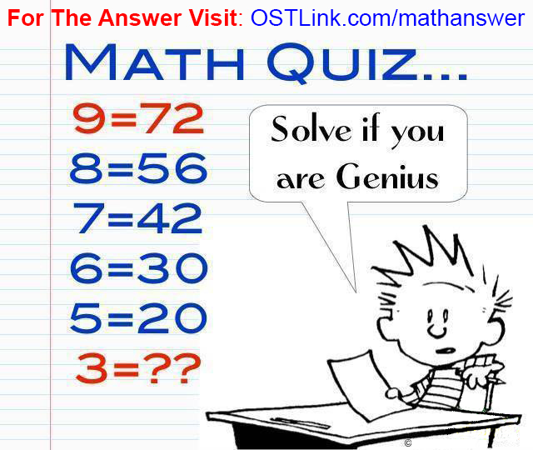
Can we consider a student who missed zero questions on a worksheet literate if they cannot explain why they follow those steps or what happens if they mix them up?

Slide 7
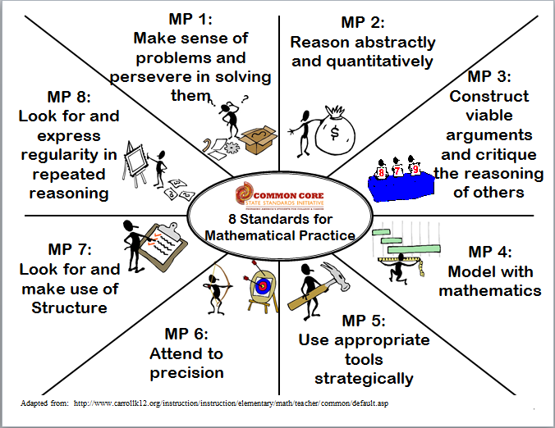
Mathematical Practices

Slide 8
Mathematical Practices
The Standards for Mathematical Practice describe ways in which developing student practitioners …ought to engage with the subject matter as they grow in mathematical maturity and expertise.

Slide 9

Find literacy in the mathematical practices.
Mathematical Literacy: Recognizing the language of mathematics and its symbols, understanding what is being represented, and being able to explain (through solving or words) how to solve the scenario presented.

Slide 10

To learn math students must construct it for themselves
They can only do that by exploring, justifying, representing, discussing, using, describing, investigating, predicting, in short by being active in the world.
Countryman, pg. 2

Slide 11
Writing in the Math Class
“Writing mathematics can free students of the assumption that math is just a collection of right answers to questions posed by someone else”
Countryman, pg. 11

Slide 12
Writing in the Math Class:
Helps students become aware of what they know and do not know
Connect to prior knowledge
Summarize their knowledge
Raise questions about new ideas
Reflect on what they know
Construct math for themselves
Countryman, pg 4-7

Slide 13
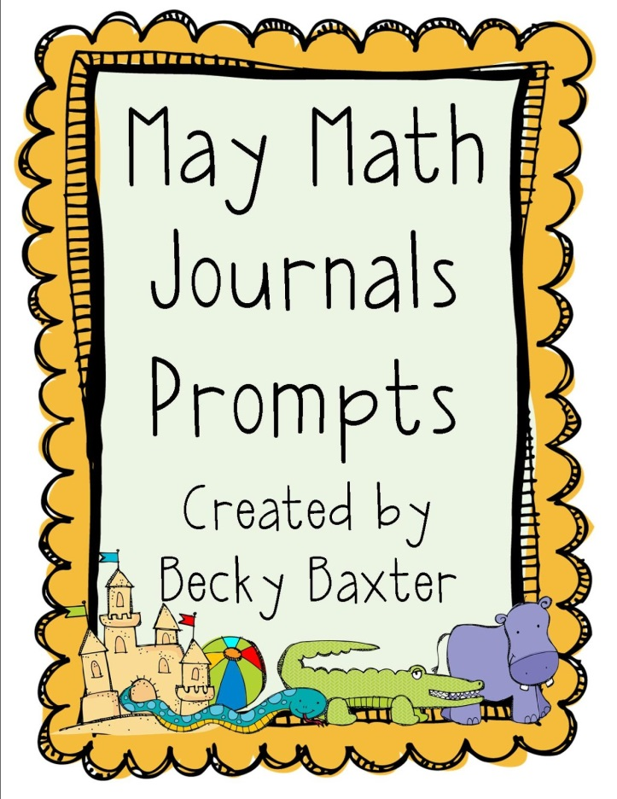
Ideas for Writing to Learn
Journals
Freewrite
Learning logs
Math autobiographies
About math problems
Formal papers
Test questions

Slide 14
Writing to Learn
“Writing to learn is different from writing to show that you have learned what the teacher or the text has set for you to learn. As you write, ideas come to you. Writing can be a way to find out what they know and what they don’t know. “
Countryman, pg. 88

Slide 15
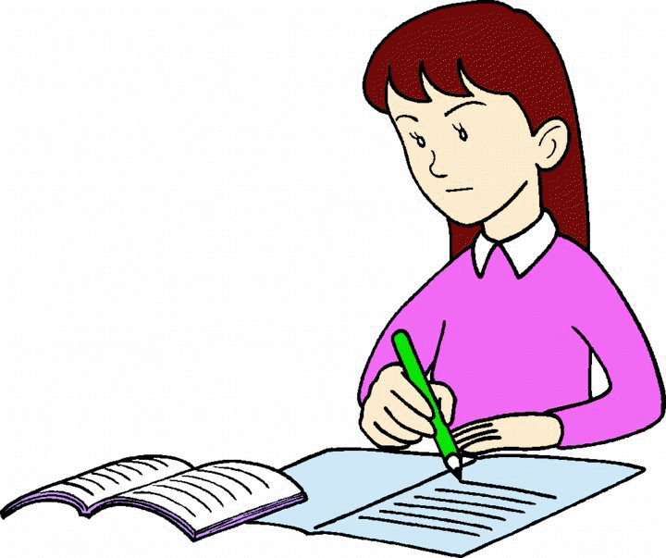
Planning
Think about what you are teaching next week. How will you have your students write to learn?

Slide 16
Toward a Discourse Community
“To support discourse effectively, teachers must build a community in which students will feel free to express their ideas.”
Thompson, pg. 44

Slide 17
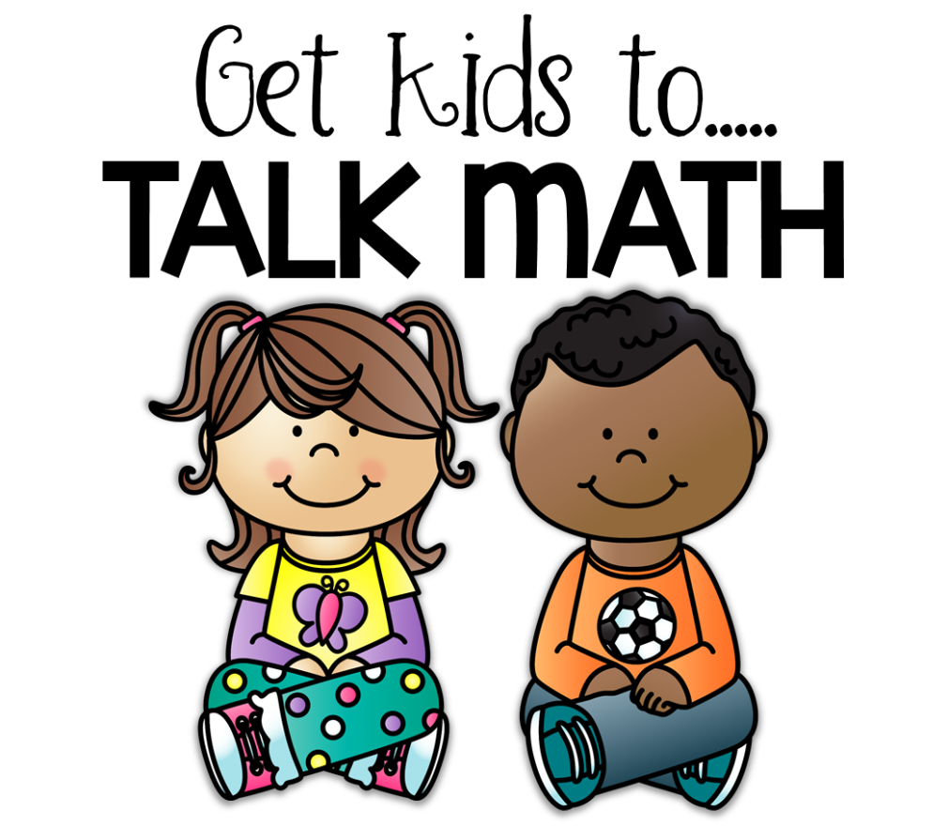
What are some ways that you encourage math-talk in your classroom?

Slide 18
Learning from students’ work with discourse
Ideally, we would like students to present their thinking about problems they are trying to solve and have other students question, challenge, and debate what is offered.
Thompson, pg. 48

Slide 19
Classroom Environment:
Using a thinking-based curriculum
The furniture arrangement is conducive to student talk
Frequently use think-pair-share
Ask questions
Build on student responses
Focus students on building meaning
Make sharing your thinking part of the routine

Slide 20
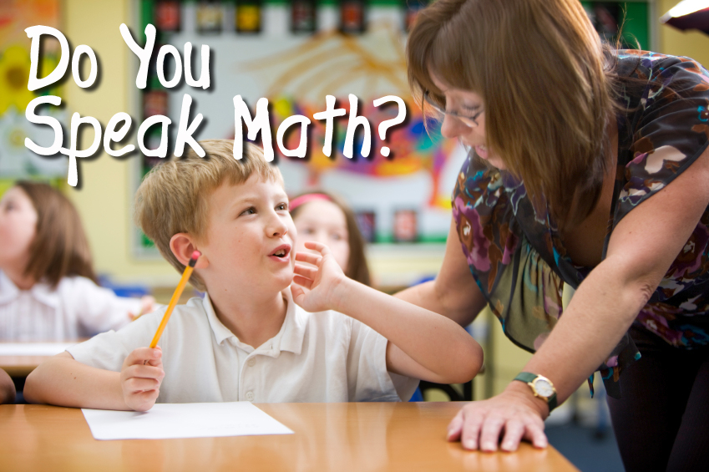
Planning
Think about your learning environment. What can you change to encourage more math talk?

Slide 21
Zoom-In-Zoom-Out
Word problems are an important part of mathematic instruction. They help students see how math might be used in the real world. However, many students struggle making sense of the problems they read.
Thompson, pg. 53

Slide 22

Zoom-In-Zoom-Out
Supports students independent meaning-making
Offers opportunities to communicate in small groups
Clarify understanding with whole group discussions
Informally assess students’ understanding

Slide 23
Zoom-In-Zoom-Out
1) Think-Pair-Share

Slide 24
1) Think-pair-share
Give students an opportunity to read independently
Students take turns sharing what they understand
Partners discuss similarities and differences to arrive at a consensus of what they think the problem mean

Slide 25
Zoom-In-Zoom-Out
Think-Pair-Share
Zoom In

Slide 26
Zoom In
Guide the class as the students analyze the information in the problem
Help students determine important and extraneous information
Students should identify and clarify meaning of vocabulary

Slide 27
Zoom-In-Zoom-Out
Think-Pair-Share
Zoom In
Zoom Out

Slide 28
Zoom Out
Ask partners:
What does the problem say
What math is needed to solve
What approaches might be useful
If necessary lead class in a discussion on the process described for partners – let all possibilities arise

Slide 29
Zoom-In-Zoom-Out
Think-Pair-Share
Zoom In
Zoom Out
Solve

Slide 30
Solve
Students should solve the task with peers
Construct a written explanation of the process used

Slide 31
Zoom-In-Zoom-Out
Think-Pair-Share
Zoom In
Zoom Out
Solve
Group Share

Slide 32
Group Share
Provide opportunities for students to illustrate different approaches in a whole-class setting
The purpose is to
Have students recognize the value of different methods
Analyze the effectiveness and efficiency of different approaches

Slide 33
Zoom-In-Zoom-Out
Think-Pair-Share
Zoom In
Zoom Out
Solve
Group Share

Slide 34
Planning
What parts of the Zoom-In-Zoom-Out might be the most challenging?
How might you modify this comprehension strategy for use in your class?

Slide 35
Mathematical Literacy:
Recognizing the language of mathematics and its symbols, understanding what is being represented, and being able to explain (through solving or words) how to solve the scenario presented.
Steinhilber, pg. 4

Slide 36


