Slide 1
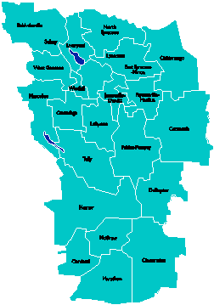
A Vision for Education in Central New York
College, Career & Citizenship Readiness
Notes:
Talk about where this vision came from. While it is Colleen and Jeff presenting, the Student Services committee and others have been visiting schools, talking about the future, and developing this vision. In the midst of all the compliance stuff like SLOs, and vested interest, and APPR, it’s been re-invigorating to think about the future and to think about our kids and their future.

Slide 2
Why a Regional Vision?
Student Services Superintendents’ Committee
Business Advisory Committee
Data indicate that not all students succeeding and finding meaning in school
Common Core and 21C Readiness
Notes:
And so we went looking for schools that represented a vision…

Slide 3
New Tech Came Closest
Started in 1996 in Napa, California
Businesses had concerns that high school graduates did not have essential skills
Funding from Bill and Melinda Gates Foundation
120 New Tech Schools
Across 18 States in the U.S. and in Australia

Slide 4
What Did We See?
Different Models of New Tech High Schools
Regional Schools where students from multiple districts attended together
Schools within schools
Professional Development Schools wrapped around the High School

Slide 5
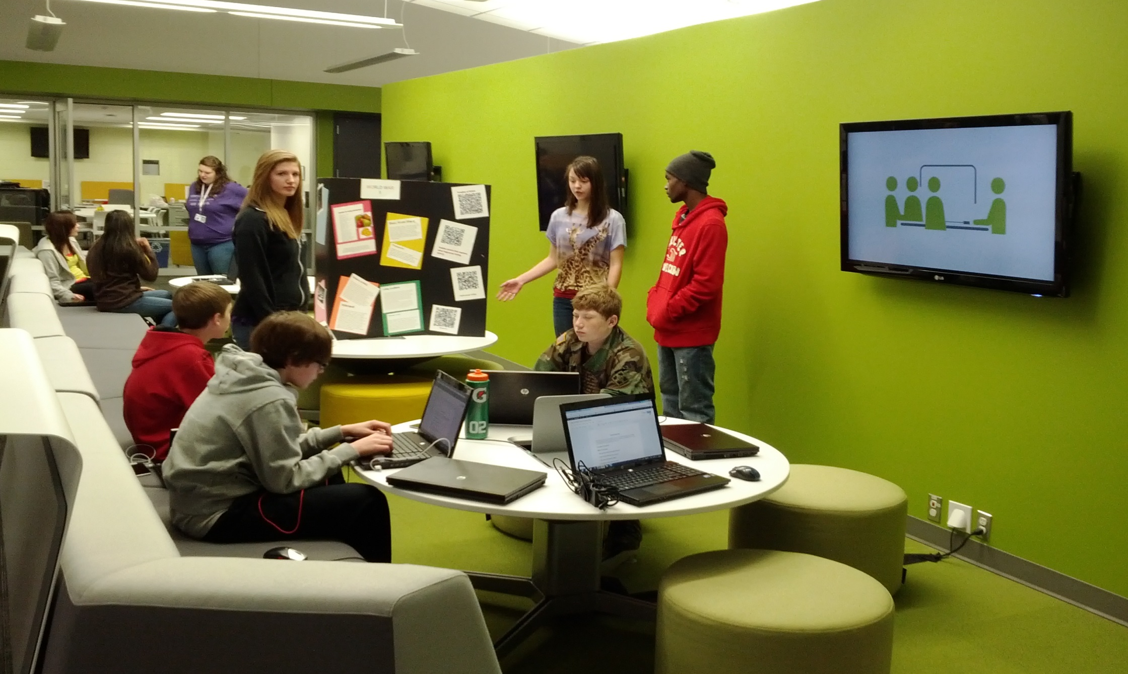
What Did We See in Visits?

Slide 6
New Tech Students:
Grow 75% more in higher order thinking skills between freshmen and senior years than comparison group.
Graduate at a rate 6% greater than the national average.
Enroll in college at a rate 9% greater than the national average, regardless of locale.
Persist in 4-year colleges at a rate 14% higher than the national average and in 2-year colleges at a rate 43% higher than the national average.

Slide 7
Perspectives about New Tech

Slide 8
A Vision for Education in CNY
Teaching that Engages
Culture that Empowers
Technology that Enables

Slide 9
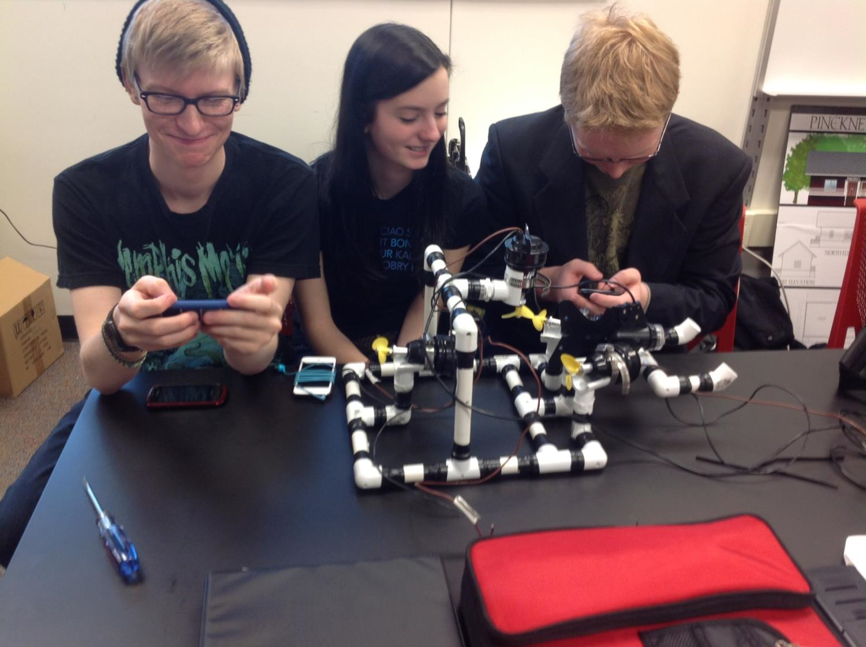
Teaching that Engages
Notes:
This is one way of thinking about the vision – all that this one picture expresses.

Slide 10
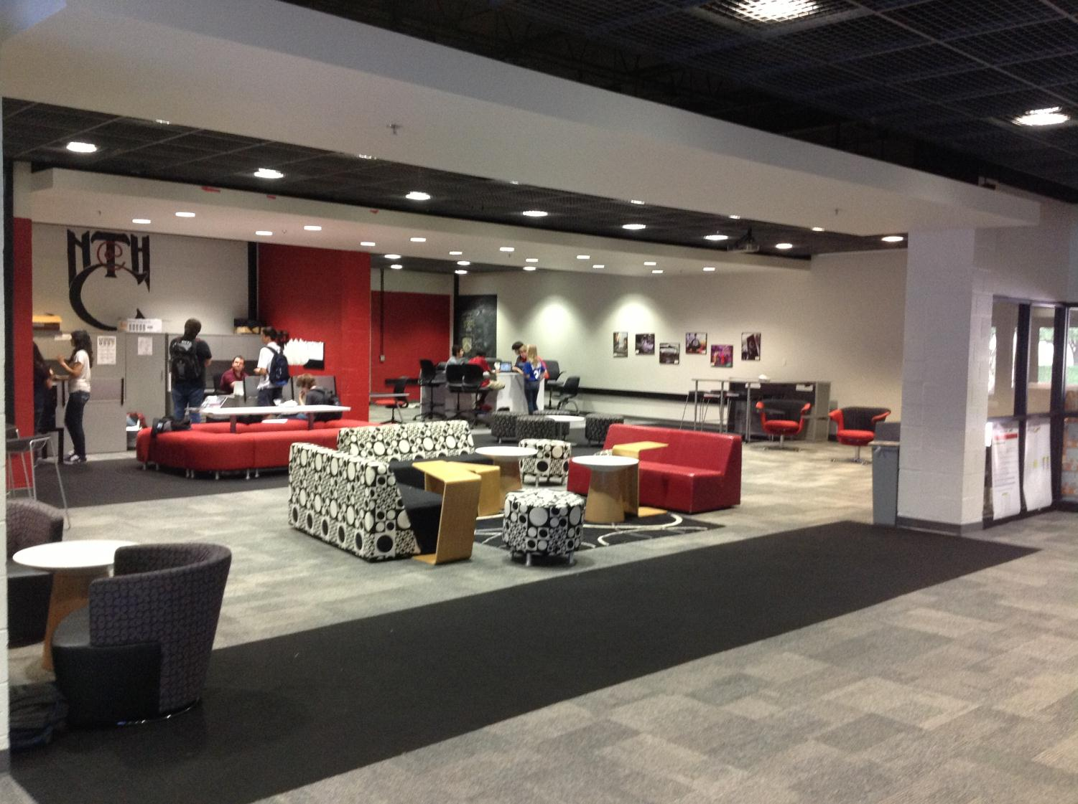
Culture that Empowers
Notes:
Facilities can enhance the learning environment, especially if it “looks” like college and career environments. We saw newer facilities and older facilities – both work as long as space is flexible and allows for larger, integrated classes and student collaboration spaces.

Slide 11
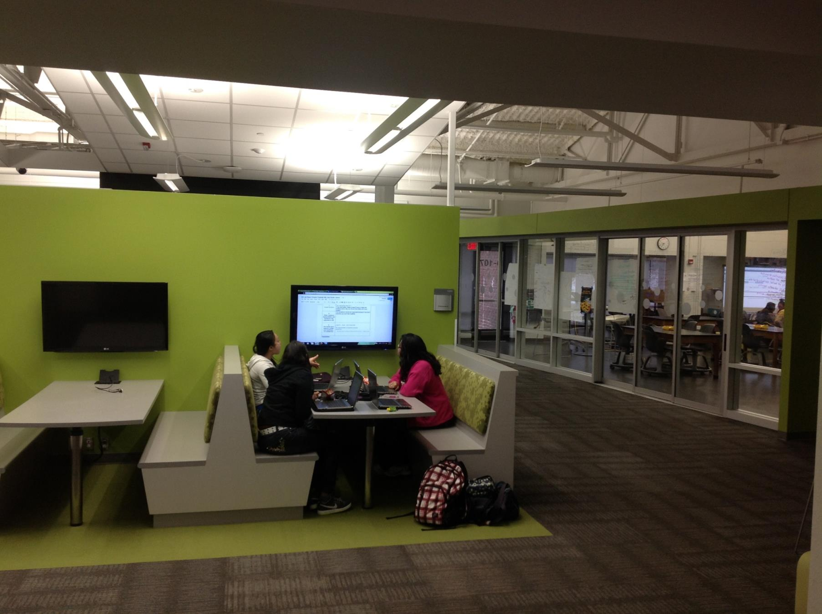
Technology that Enables
Notes:
Collaborative spaces that emulate how people collaborate and use technology in college and career settings

Slide 12
College, Career & Citizenship Readiness
Pre-Service Teacher Training
Early College and Dual Enrollment
Professional Development
School:
Visitations
Observation
Training (Buck Institute and NTN)
Coaching
Co-teaching
New Tech Network Model
New Tech High School
Regional
OCM BOCES Programs
Alternative Education
Special Education
District/School-Based
Integrated PBL Courses
School- within-a-School
Standards (CCLS, NGSS, SS Framework, NYS Teaching Standards, 4Cs, ISTE, etc.)
Business Partnerships
Notes:
This is another way to express the vision, in this case connecting the important parts and showing how it might work. We’re going to talk you through these different pieces and layers.

Slide 13
College, Career & Citizenship Readiness
What does it REALLY mean to be College, Career & Citizenship ready?
Notes:
It starts with this as the goal. Explain how this isn’t SED’s definition of readiness, but an actual idea about what it means to be ready for college, career, and citizenship. Elaborate.

Slide 14
College, Career & Citizenship Readiness
Reading/viewing
Writing
Speaking/presenting
Research
Math
Science
Technology
Engineering
Citizenship
Communication
Creativity & Problem Solving
Collaboration
Critical Thinking
Standards (CCLS, NGSS, SS Framework, NYS Teaching Standards, 4Cs, ISTE, etc.)

Slide 15
College, Career & Citizenship Readiness
Interviewing
Internships
Authenticity
Audience
Guidance
Entrepreneurship
Career Interests
Workforce Development
Business Partnerships

Slide 16
College, Career & Citizenship Readiness
Early College and Dual Enrollment
Earn credits
Experience coursework
Avoid remediation
Build capacity & persistence
Sense of Efficacy
Develop a future story

Slide 17
College, Career & Citizenship Readiness
Pre-Service Teacher Training
Influence future workforce
Scout the talent

Slide 18
College, Career & Citizenship Readiness
Pre-Service Teacher Training
Early College and Dual Enrollment
Standards (CCLS, NGSS, SS Framework, NYS Teaching Standards, 4Cs, ISTE, etc.)
Business Partnerships

Slide 19
College, Career & Citizenship Readiness
Pre-Service Teacher Training
Early College and Dual Enrollment
Professional Development
School:
Visitations
Observation
Training (Buck Institute and NTN)
Coaching
Co-teaching
Standards (CCLS, NGSS, SS Framework, NYS Teaching Standards, 4Cs, ISTE, etc.)
Business Partnerships
Notes:
Invitation to all to join us… the potential to impact many in the region. Want to be innovative but also know that one size doesn’t fit all. It depends on what you want in your district and where you are on your readiness journey. The Professional Development School is a place where educators form all over come to learn how see it in action and learn how to make changes in their practice.

Slide 20
A Vision for Education in CNY
Teaching that Engages
Culture that Empowers
Technology that Enables

Slide 21
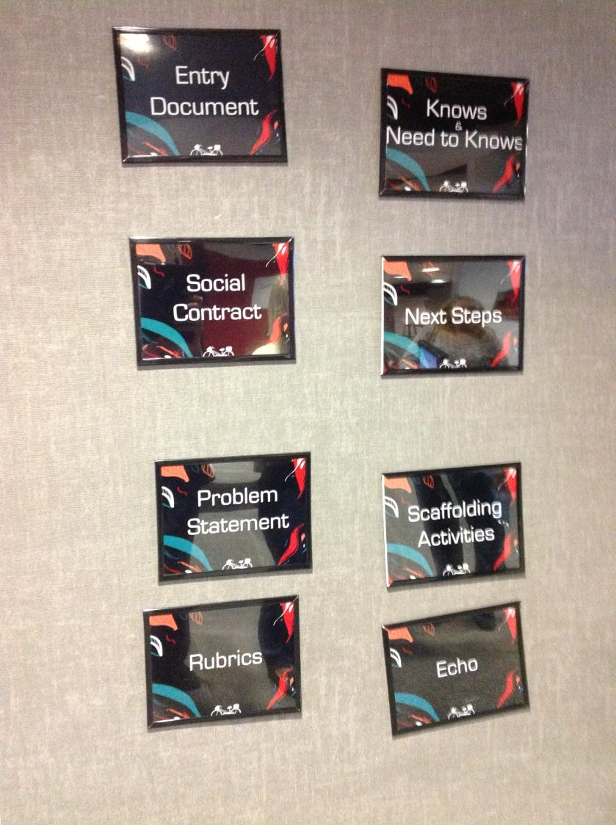

Slide 22
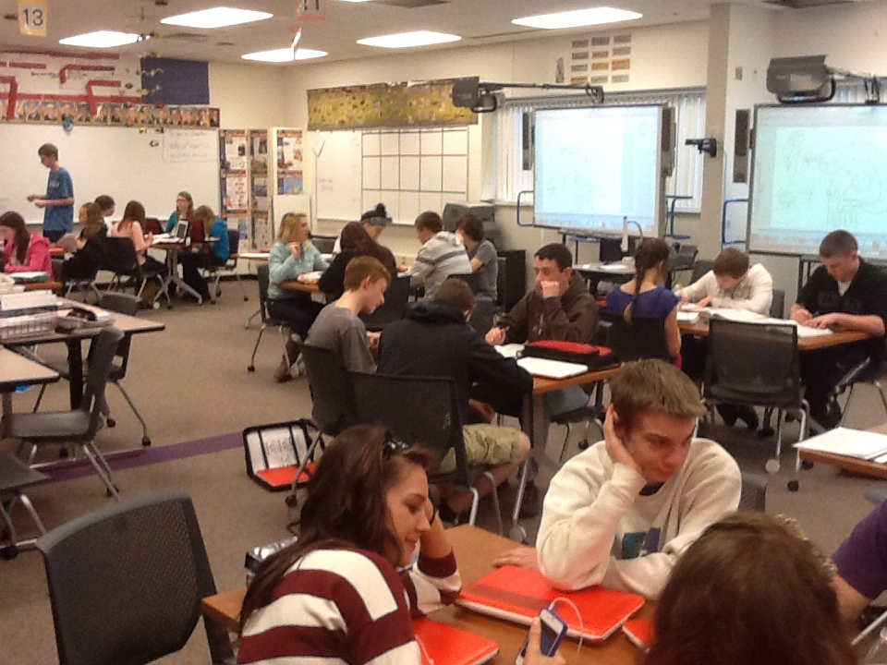

Slide 23
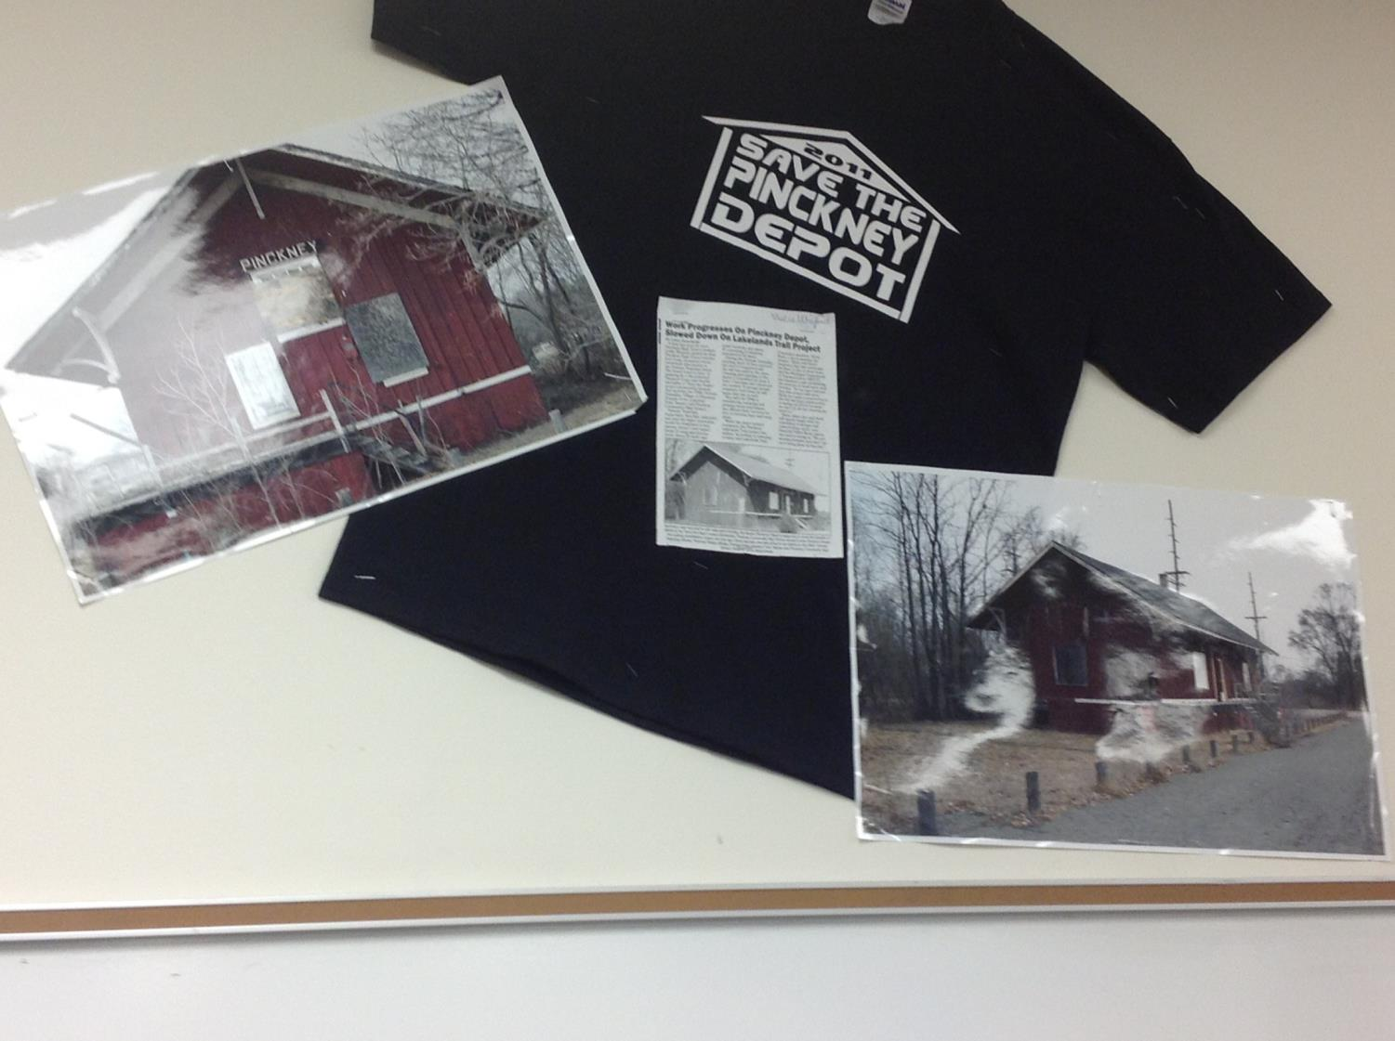

Slide 24
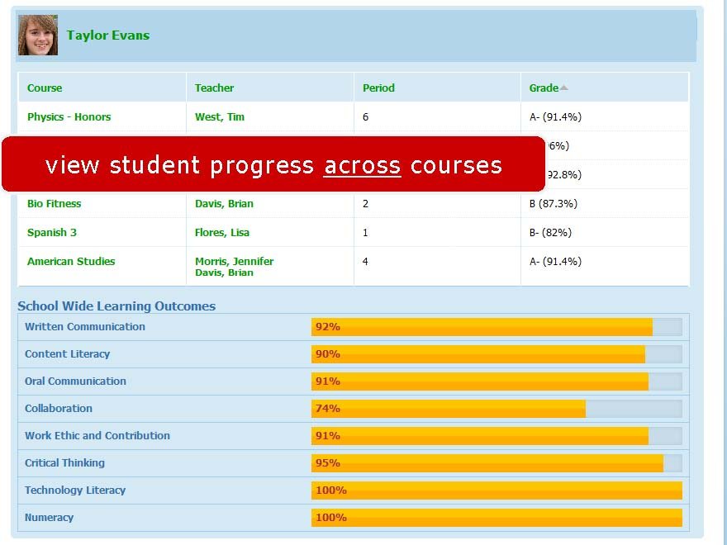
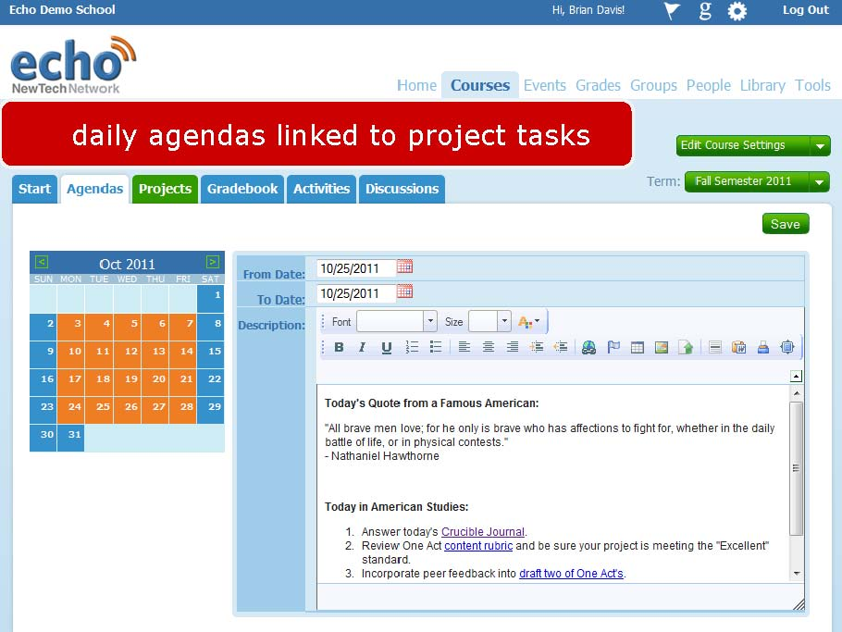

Slide 26
College, Career & Citizenship Readiness
Pre-Service Teacher Training
Early College and Dual Enrollment
Professional Development
School:
Visitations
Observation
Training (Buck Institute and NTN)
Coaching
Co-teaching
New Tech Network Model
New Tech High School
Regional
OCM BOCES Programs
Alternative Education
Special Education
District/School-Based
Integrated PBL Courses
School- within-a-School
Standards (CCLS, NGSS, SS Framework, NYS Teaching Standards, 4Cs, ISTE, etc.)
Business Partnerships
Notes:
So now that you’ve had the chance to se it, here’s what it might look like here. There can be a variety of levels of involvement. A regional model can change the lives of the students who attend, and it can serve as the model for variations of implementation. For OCM BOCES, it can mean… In districts, it could take the form of a school-with-a-school, selected integrated PBL courses, and an evolving pedagogy in all classrooms.

Slide 27
Next Steps:
New Tech-like OCM BOCES programs in September 2014
Districts who want to explore a regional approach or school-within-a-school move ahead
July 1 (pm) and 23 (all day)
Another visit opportunity in the fall
PBL training and coaching continues
PBL^{NY} here in summer of 2014

Slide 28
The Last Word: Students

