Slide 1
Rocket Engine Ignition
In order for a rocket to launch the fuel must “burn” to release the energy stored in the chemicals that are in the rocket engine.
When these chemicals burn they give off gases that flow out of the engine with such force as to push the rocket upwards.
OCM BOCES Science Center

Slide 2
Rocket Engine
The ignitor is inserted into the opening in the engine. An electrical current heats the ignitor and the high heat starts the chemical in the engine burning.
The burning chemicals release gases that expand as they leave the engine pushing the engine in the opposite direction. The burning finally reaches the ejection charge (chemicals with a quick explosive action) which pushes upwards to force the nosecone off releasing the parachute.
Animated Graphics: http://www.launchpad2000.com/abmodroc.html

Slide 3
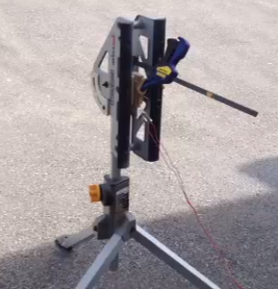
Engine Ignition Set Up
Engine clamped in place.
Wires from ignitor in engine to launcher.

Slide 4
Watch Ignition, Burn and Ejection
Identify the three phases (thrust, coast (delay), eject)
video
Think about any ways that this open air ignition might be different than a rocket launch ignition.

