Slide 1
PARCC Update
August 2012

Slide 2
PARCC’s Fundamental Advance
PARCC is designed to reward quality instruction aligned to the Standards, so the assessment is worthy of preparation rather than a distraction from good work.

Slide 3
Advances in the PARCC ELA/Literacy Assessment
August 2012

Slide 4
PARCC’s Core Commitments to ELA/Literacy Assessment Quality
Texts Worth Reading: The assessments will use authentic texts worthy of study instead of artificially produced or commissioned passages.
Questions Worth Answering: Sequences of questions that draw students into deeper encounters with texts will be the norm (as in an excellent classroom), rather than sets of random questions of varying quality.
Better Standards Demand Better Questions: Instead of reusing existing items, PARCC will develop custom items to the Standards.
Fidelity to the Standards (now in Teachers’ hands): PARCC evidences are rooted in the language of the Standards so that expectations remain the same in both instructional and assessment settings.

Slide 5
What Are the Shifts at the Heart of PARCC Design (and the Standards)?
Complexity: Regular practice with complex text and its academic language.
Evidence: Reading and writing grounded in evidence from text, literary and informational.
Knowledge: Building knowledge through content rich nonfiction.

Slide 6
Shift 1: Regular practice with complex text and its academic language
PARCC builds a staircase of text complexity to ensure students are on track each year for college and career reading.
PARCC rewards careful, close reading rather than racing through passages.
PARCC systematically focuses on the words that matter most—not obscure vocabulary, but the academic language that pervades complex texts.

Slide 7
Shift 2: Reading and writing grounded in evidence from text, literary and informational
PARCC focuses on students rigorously citing evidence from texts throughout the assessment (including selected-response items).
PARCC includes questions with more than one right answer to allow students to generate a range of rich insights that are substantiated by evidence from text(s).
PARCC requires writing to sources rather than writing to de-contextualized expository prompts.
PARCC also includes rigorous expectations for narrative writing, including accuracy and precision in writing in later grades.

Slide 8
Shift 3: Building knowledge through content rich nonfiction
PARCC assesses not just ELA but a full range of reading and writing across the disciplines of science and social studies.
PARCC simulates research on the assessment, including the comparison and synthesis of ideas across a range of informational sources.

Slide 9
Sample Items Illustrating Some of the Advances

Slide 10
Three Innovative Item Types That Showcase Students’ Command of Evidence with Complex Texts
Evidence-Based Selected Response (EBSR)—Combines a traditional selected-response question with a second selected-response question that asks students to show evidence from the text that supports the answer they provided to the first question. Underscores the importance of Reading Anchor Standard 1 for implementation of the CCSS.
Technology-Enhanced Constructed Response (TECR)—Uses technology to capture student comprehension of texts in authentic ways that have been difficult to score by machine for large scale assessments (e.g., drag and drop, cut and paste, shade text, move items to show relationships).
Range of Prose Constructed Responses (PCR)—Elicits evidence that students have understood a text or texts they have read and can communicate that understanding well both in terms of written expression and knowledge of language and conventions. There are four of these items of varying types on each annual performance-based assessment.

Slide 11
Literary Analysis Task (Grade 10): Ovid’s “Daedalus and Icarus” and Sexton’s “To a Friend Whose Work Has Come to Triumph”

Slide 12
Understanding the Literary Analysis Task
Students carefully consider two literary texts worthy of close study.
They are asked to answer a few EBSR and TECR questions about each text to demonstrate their ability to do close analytic reading and to compare and synthesize ideas.
Students write a literary analysis about the two texts.

Slide 13
Grade 10 Prose Constructed-Response Item
Use what you have learned from reading “Daedalus and Icarus” by Ovid and “To a Friend Whose Work Has Come to Triumph” by Anne Sexton to write an essay that provides an analysis of how Sexton transforms Daedalus and Icarus.
As a starting point, you may want to consider what is emphasized, absent, or different in the two texts, but feel free to develop your own focus for analysis.
Develop your essay by providing textual evidence from both texts. Be sure to follow the conventions of standard English.

Slide 14
Grade 10 Evidence-Based Selected-Response Item
Part A
Which of the following sentences best states an important theme about human behavior as described in Ovid’s “Daedalus and Icarus”?
Striving to achieve one’s dreams is a worthwhile endeavor.
The thoughtlessness of youth can have tragic results.*
Imagination and creativity bring their own rewards.
Everyone should learn from his or her mistakes.
Part B
Select three pieces of evidence from Ovid’s “Daedalus and Icarus” that support the answer to Part A.
“and by his playfulness retard the work/his anxious father planned” (lines 310-311)*
“But when at last/the father finished it, he poised himself” (lines 312-313)
“he fitted on his son the plumed wings/ with trembling hands, while down his withered cheeks/the tears were falling” (lines 327-329)
“Proud of his success/the foolish Icarus forsook his guide” (lines 348-349)*
“and, bold in vanity, began to soar/rising above his wings to touch the skies” (lines 350-351)*
“and as the years went by the gifted youth/began to rival his instructor’s art” (lines 376-377)
“Wherefore Daedalus/enraged and envious, sought to slay the youth” (lines 384-385)
“The Partridge hides/in shaded places by the leafy trees…for it is mindful of its former fall” (lines 395-396, 399)

Slide 15
Grade 10 Evidence-Based Selected-Response Item
Part A
What does the word vanity mean in these lines from the text “Daedalus and Icarus”?
“Proud of his success, the foolish Icarus forsook his guide, and, bold in vanity, began to soar” (lines 345-349)
arrogance*
fear
heroism
enthusiasm
Part B
Which word from the lines from the text in Part A best helps the reader understand the meaning of vanity?
proud*
success
foolish
soar

Slide 16
Understanding the Research Simulation Task
Session 1:
Students begin by reading an anchor text that introduces the topic. EBSR and TECR items ask students to gather key details about the passage to support their understanding.
Then, they write a summary or short analysis of the piece.
Session 2:
Students read two additional sources (may include a multimedia text) and answer a few questions about each text to learn more about the topic so they are ready to write the final essay and to show their reading comprehension.
Finally, students mirror the research process by synthesizing their understandings into an analytic essay using textual evidence from several of the sources.

Slide 17
Grade 7 Analytical Prose Constructed-Response Item #1
Based on the information in the text “Biography of Amelia Earhart,” write an essay that summarizes and explains the challenges Earhart faced throughout her life. Remember to use textual evidence to support your ideas.

Slide 18
Final Grade 7 Prose Constructed-Response Item #2
You have read three texts describing Amelia Earhart. All three include the claim that Earhart was a brave, courageous person. The three texts are:
“Biography of Amelia Earhart”
“Earhart's Final Resting Place Believed Found”
“Amelia Earhart’s Life and Disappearance”
Consider the argument each author uses to demonstrate Earhart’s bravery.
Write an essay that analyzes the strength of the arguments about Earhart’s bravery in at least two of the texts. Remember to use textual evidence to support your ideas.

Slide 19
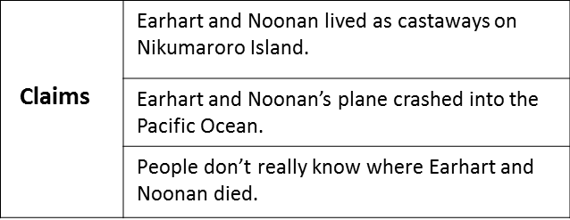
Grade 7 Technology-Enhanced Constructed-Response Item
Below are three claims that one could make based on the article “Earhart’s Final Resting Place Believed Found.”
Part A
Highlight the claim that is supported by the most relevant and sufficient facts within “Earhart’s Final Resting Place Believed Found.”
Part B
Click on two facts within the article that best provide evidence to support the claim selected in Part A.

Slide 20
Grade 6 Technology-Enhanced Selected-Response Item
Part A
Choose one word that describes Miyax based on evidence from the text. There is more than one correct choice listed below.
reckless
lively
imaginative*
observant*
impatient
confident
Part B
Find a sentence in the passage with details that support your response to Part A. Click on that sentence and drag and drop it into the box below.
Part C
Find a second sentence in the passage with details that support your response to Part A. Click on that sentence and drag and drop it into the box below.

Slide 21
Grade 3 Evidence-Based Selected-Response Item #1
Part A
What is one main idea of “How Animals Live?”
There are many types of animals on the planet.
Animals need water to live.
There are many ways to sort different animals.*
Animals begin their life cycles in different forms.
Part B
Which sentence from the article best supports the answer to Part A?
“Animals get oxygen from air or water.”
"Animals can be grouped by their traits.”*
"Worms are invertebrates.”
"All animals grow and change over time.”
"Almost all animals need water, food, oxygen, and shelter to live."

Slide 22
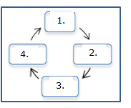
Grade 3 Technology-Enhanced Constructed-Response Item
Drag the words from the word box into the correct locations on the graphic to show the life cycle of a butterfly as described in “How Animals Live.”
Words:
Pupa
Adult
Egg
Larva

Slide 23
Advances in the PARCC Mathematics Assessment
August 2012

Slide 24
PARCC’s Core Commitments to Mathematics Assessment Quality
Focus: PARCC assessments will focus strongly on where the Standards focus. Students will have more time to master concepts at a deeper level.
Problems worth doing: Multi-step problems, conceptual questions, applications, and substantial procedures will be common, as in an excellent classroom.
Better Standards Demand Better Questions: Instead of reusing existing items, PARCC will develop custom items to the Standards.
Fidelity to the Standards (now in Teacher’s hands): PARCC evidences are rooted in the language of the Standards so that expectations remain the same in both instructional and assessment settings.

Slide 25
What Are the Shifts in the Math Standards at the Heart of PARCC Design?
Focus: The PARCC Assessment will focus strongly where the Standards focus
Coherence: Think across grades and link to major topics within grades
Rigor: In major topics, pursue conceptual understanding, procedural skill and fluency, and application.

Slide 26
Advances in Assessment Demanded by the Shifts
Shift #1 – Focus: The PARCC assessments will focus strongly where the Standards focus
Advance: PARCC assessments will focus strongly where the Standards focus (70% or more on the major work in grades 3-8).
Focus allows for a variety of problem types to get at concept in multiple ways.
Students will have more time to master concepts at a deeper level.

Slide 27
Advances in Assessment Demanded by the Shifts
Shift #2 - Coherence: Think across grades, and link to major topics within grades
Advance: The assessment design is informed by multi-grade progressions in the Standards and the Model Content Frameworks.
Key beginnings are stressed (e.g., ratio concepts in grade 6), as are key endpoints and takeaway skills (e.g., fluency with the multiplication table in grade 3).

Slide 28
Advances in Assessment Demanded by the Shifts
Shift #2 - Coherence: Think across grades, and link to major topics within grades
Advance: Integrative tasks draw on multiple standards to ensure students are making important connections.
The Standards are not treated as a checklist.

Slide 29
Advances in assessment demanded by the shifts
Shift #3 - Rigor: In major topics, pursue conceptual understanding, procedural skill and fluency, and application
Advance: PARCC assessments will reach the rigor in the Standards through innovations in technology and item design…

Slide 30
Overview of Mathematics Task Types
PARCC mathematics assessments will include three types of tasks.
Task Type | Description of Task Type
I. Tasks assessing concepts, skills and procedures | Balance of conceptual understanding, fluency, and application Can involve any or all mathematical practice standards Machine scorable including innovative, computer-based formats Will appear on the End of Year and Performance Based Assessment components
II. Tasks assessing expressing mathematical reasoning | Each task calls for written arguments / justifications, critique of reasoning, or precision in mathematical statements (MP.3, 6). Can involve other mathematical practice standards May include a mix of machine scored and hand scored responses Included on the Performance Based Assessment component
III. Tasks assessing modeling / applications | Each task calls for modeling/application in a real-world context or scenario (MP.4) Can involve other mathematical practice standards. May include a mix of machine scored and hand scored responses Included on the Performance Based Assessment component
For more information see PARCC Item Development ITN Appendix D.

Slide 31
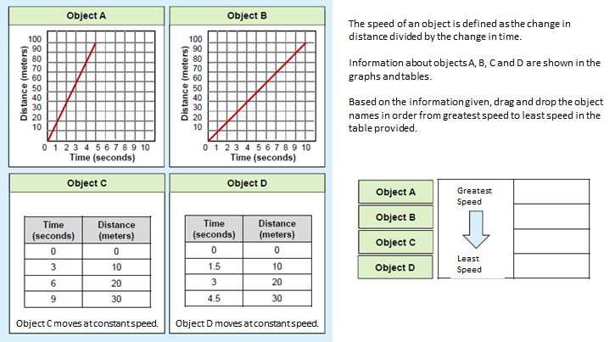
Grade 7 Illustrative Sample Item

Slide 32
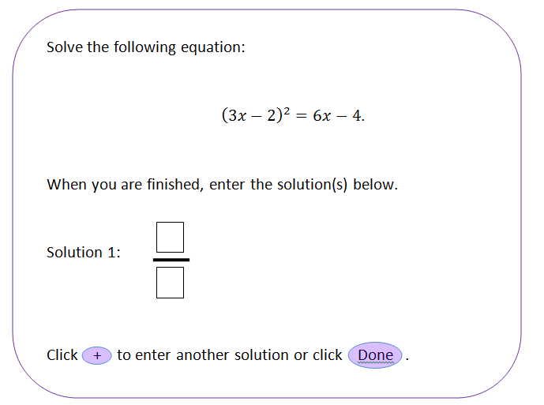
High School Illustrative Sample Item
Seeing Structure in a Quadratic Equation

